Slide 1
SOME PRINCIPLES OF PROPHECY
Lesson 1 for April 5, 2025

Slide 2
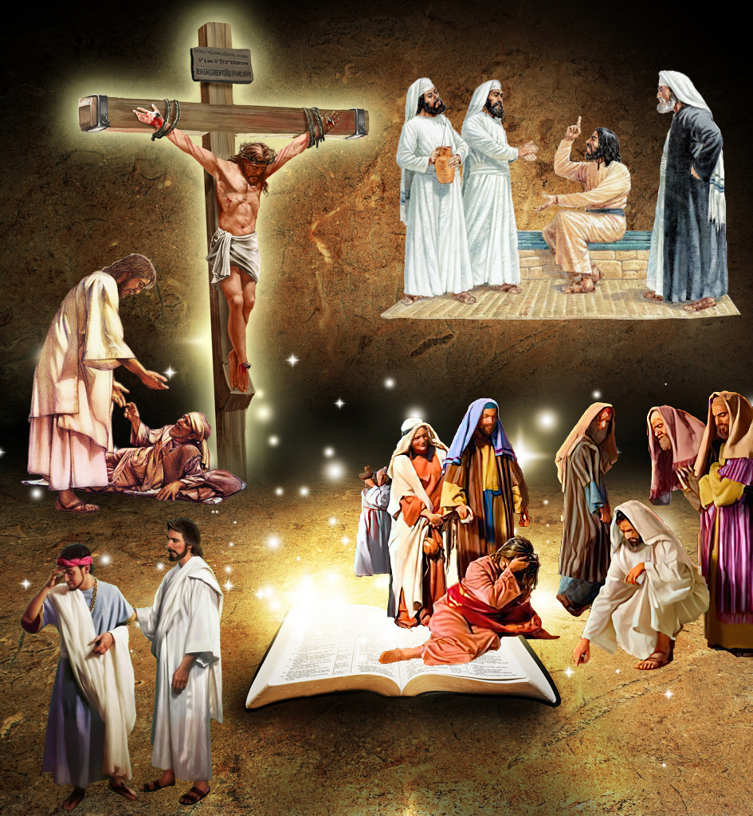
“ ‘But let him who glories glory in this, that he understands and knows Me, that I am the Lord, exercising lovingkindness, judgment, and righteousness in the earth. For in these I delight,’ says the Lord”
Jeremiah 9:24, NKJV

Slide 3
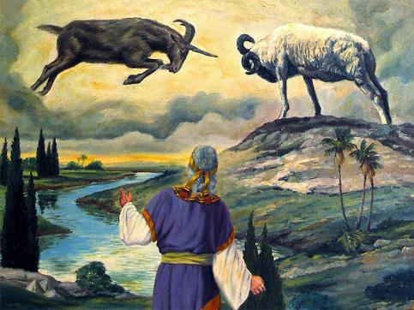
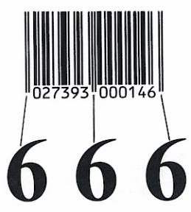
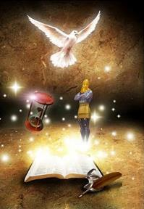
Symbols, ambiguous phrases, comparisons, strange actions on the part of the prophet… That's what biblical prophecy is like.
Some don't dare try to understand its meaning, and are content with what someone else tells them. Others take one or two sentences and create a fantastic interpretation without any basis.
But those who read and understand it correctly grow in their knowledge of God and receive abundant blessings. What principles can help us correctly study and understand biblical prophecy?
Principle 1: Read with the right attitude.
Principle 2: Discover the main theme.
Principle 3: Leverage science.
Principle 4: Holistic and contextual.
Principle 5: Meaning of symbols.

Slide 4
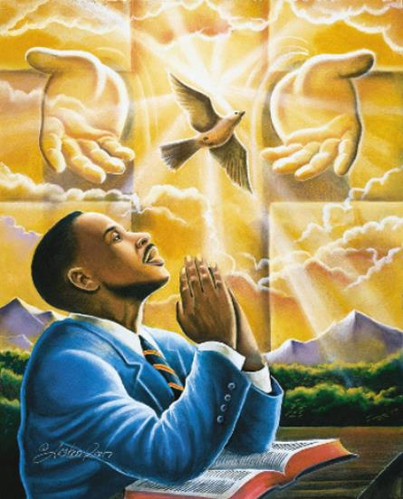
PRINCIPLE 1: READ WITH THE RIGHT ATTITUDE
“Blessed is the one who reads aloud the words of this prophecy, and blessed are those who hear it and take to heart what is written in it, because the time is near. (Revelation 1:3 NIV)
There is a blessing for those who read prophecy (Rev. 1:3a.) However, very few feel blessed by reading the prophecies contained in Revelation, Daniel, Isaiah, Zechariah, etc.
Why does this happen? Because they don't read them with the right attitude. When Jesus said, "Let the reader understand" (Matthew 24:15,) he was telling us that we are capable of understanding them, but under certain conditions:
Be willing to heed what prophecy teaches us (Rev. 1:3 NIV)
Recognize that we do not have the knowledge necessary to understand them, but rather we depend on divine wisdom to do so (Mt. 11:25; Jer. 9:23)
Reading prophecy to explain my perspective on how certain events will unfold, or without perceiving God's voice in it, is not a correct approach.

Slide 5
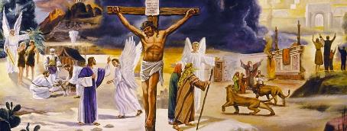
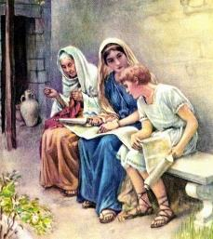
PRINCIPLE 2: DISCOVER THE MAIN THEME
“and how from infancy you have known the Holy Scriptures, which are able to make you wise for salvation through faith in Christ Jesus” (2 Timothy 3:15 NIV)
The psalmist acknowledged that he could not comprehend God’s knowledge, for His knowledge is infinite (Ps. 139:6; 147:5.) Paul tells us that God’s actions are “unsearchable,” that is, impossible to study and understand (Rom. 11:33.)
It is as impossible for us to understand the thought of God as it is for us to touch the moon with our hand (Is. 55:9.)
Fortunately, God has made an effort to come down to our level and help us understand something of His thoughts. In the Bible, the Word of God, even the simplest mind can perceive God's love and the salvation He offers us (2 Tim. 3:15.)
The Plan of Salvation is the main theme of the Bible and, of course, of the prophecies contained therein.

Slide 6
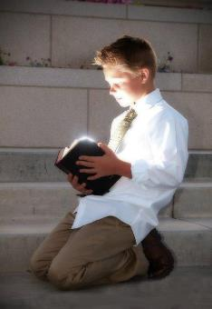
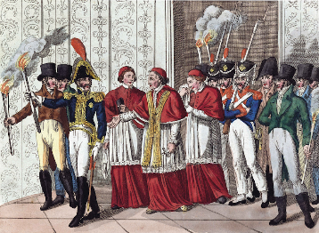
PRINCIPLE 3: USE SCIENCE
“But you, Daniel, roll up and seal the words of the scroll until the time of the end. Many will go here and there to increase knowledge” (Daniel 12:4 NIV)
Along with the command to seal the book – to hide its contents – until the time of the end, Daniel was told of an increase in the search for science – the knowledge necessary – to understand it (Dan. 12:4.)
When Jesus became incarnate, this seal began to be broken. Some of Daniel's prophecies could now be understood (Mat. 24:15.) Later, they were supplemented by other prophecies written in an "unsealed" book: Revelation (Rev. 22:10.)
In 1798, when Napoleon ended the papal hegemony that had maintained its iron grip for centuries, many saw this as the fulfillment of Daniel's prophecies. God had completely opened the book of Daniel, offering the knowledge necessary to understand it.
538
1,260
1798
Not only were the prophecies better understood since then, but other topics (the Sabbath, or the state of the dead, for example) were also correctly understood again.
Daniel 7:25
Let us ask the Author of prophecy to give us the necessary science to understand it.

Slide 7
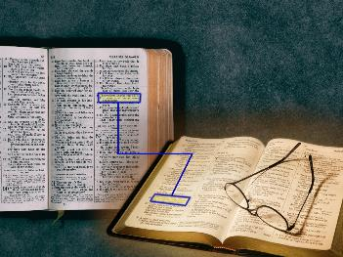
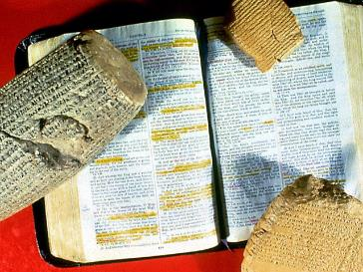
PRINCIPLE 4: HOLISTIC AND CONTEXT
“And beginning with Moses and all the Prophets, he explained to them what was said in all the Scriptures concerning himself” (Luke 24:27)
Reading prophecies in isolation will only lead to fantastic interpretations, far removed from their true meaning.
Jesus taught us to study the Bible holistically, that is, seen as a whole (Luke 24:27.)
Taking only one part (for example, a prophecy) and drawing conclusions based solely on that part is a flawed way to study God's Word. The correct approach is to compare these texts with others that address the same topic in various parts of the Bible.
Another point to consider is the context, that is, the context surrounding the text being studied. What do the texts before and after it say? Who wrote it, when, and why?
Taking a passage out of context can make it say whatever you want, but not the truth it wants to teach us.

Slide 8
PRINCIPLE 5: MEANING OF SYMBOLS
“The mystery of the seven stars that you saw in my right hand and of the seven golden lampstands is this: The seven stars are the angels of the seven churches, and the seven lampstands are the seven churches” (Revelation 1:20)
Biblical prophecies are replete with symbols and images. In a few cases, the prophecy itself tells us its meaning (Dan. 8:20; Rev. 1:20.) However, in most cases, its meaning is not explained.
What do the horns of the dread beast in Daniel 7:7-8 mean?
They are kings, and the kingdoms they represent (Dan. 7:24; 8:21)
What does the sword coming out of Jesus' mouth in Revelation 1:16 mean?
The Bible (Eph. 6:17; Heb. 4:12)
Who is the woman in Revelation 12:1?
God's Faithful People (Eph. 5:31-32; 2 Cor. 11:2)
Trying to take these images literally is absurd. Jesus does not have a sharp, two-edged sword coming out of his mouth (Rev. 1:16.)
To understand these symbols, we must turn to other parts of the Bible where similar ideas or symbols are used. Let's look at some examples:
God has made sure that whoever searches the prophecies is able to understand them.

Slide 9
“Whatever may be man's intellectual advancement, let him not for a moment think that there is no need of thorough and continuous searching of the Scriptures for greater light. As a people we are called individually to be students of prophecy. We must watch with earnestness that we may discern any ray of light which God shall present to us. We are to catch the first gleamings of truth; and through prayerful study clearer light may be obtained, which can be brought before others.”
EGW (Testimonies for the Church, volume 5, page 708)

