Slide 1

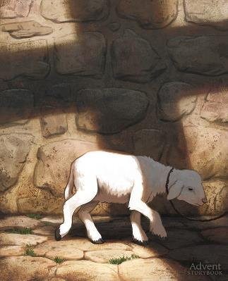
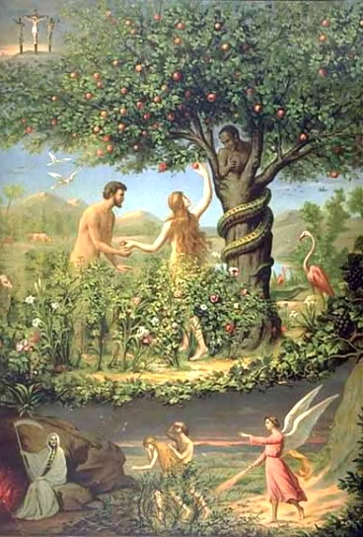
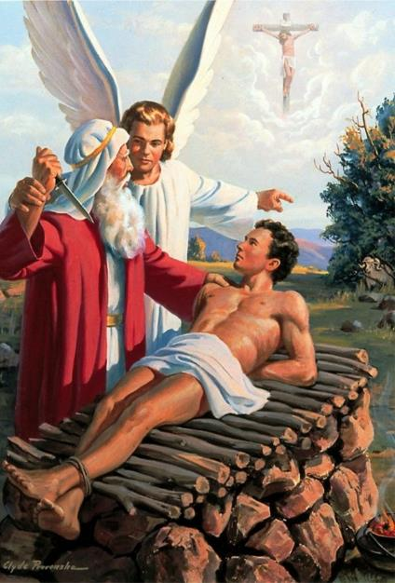
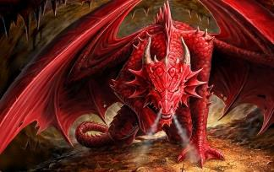
THE GENESIS FOUNDATION
Lesson 2 for April 12, 2025

Slide 2
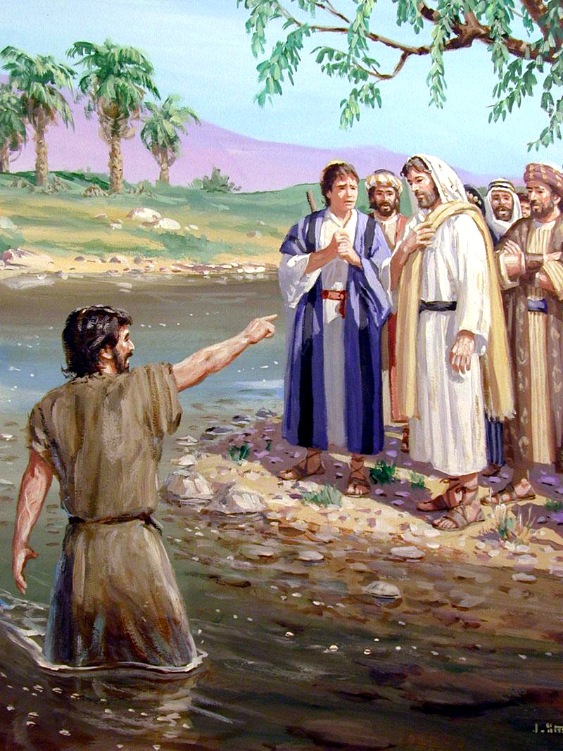
“The next day John saw Jesus coming toward him, and said, ‘Behold! The Lamb of God who takes away the sin of the world!’ ”
John 1:29, NKJV

Slide 3

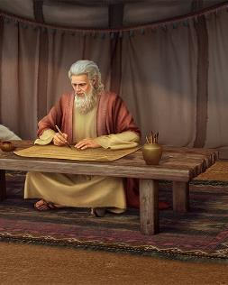
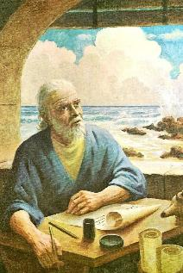
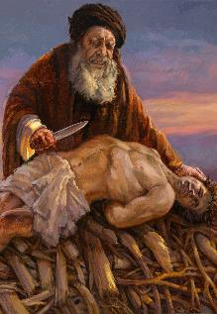
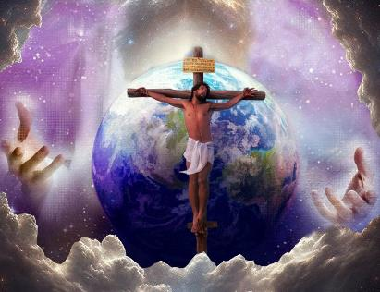







The Bible is made up of 66 books of different genres, and was written by more than 40 people over a period of 1,500 years.
We might expect there to be divergences and contradictions among the various authors. However, what we observe when studying it is unanimity. Moreover, there are parts of the Bible that cannot be understood without consulting other parts of it.
We are going to study a principle of interpretation that will help us discover the meaning of a symbol, or parallelism, by traveling through the entire Bible.
The principle of first mention.
Genesis 22: Love and the Lamb.
  “whom you LOVE”
  “where is the LAMB?”
Genesis 2-3: Death and the Serpent.
  “you will certainly DIE”
  “The SERPENT was more crafty”

Slide 4

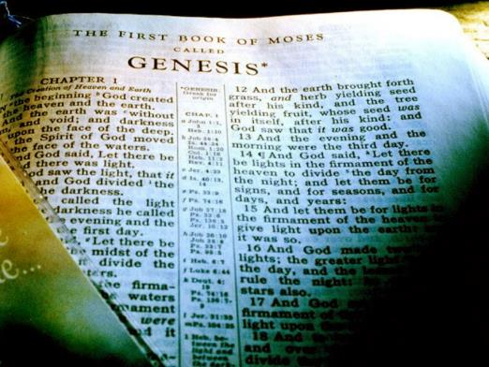




THE PRINCIPLE OF FIRST MENTION
“Jesus Christ is the same yesterday and today and forever” (Hebrews 13:8)
Every learning course begins with a first lesson. It typically outlines the principles that will underpin the subject matter.
In the Bible, we find this "first lesson" in Genesis. There, many key words appear for the first time, helping us understand the Plan of Salvation throughout the rest of the Bible.
God does not change (Mal. 3:6a; Heb. 13:8.) His Word does not change (Isa. 40:8.) Therefore, there are no contradictions in the Bible. The plan of salvation is explained in it little by little, until it is fully understood—or at least, to the understanding we need of it now (2 Pet. 1:19.)
We can better understand Jesus, and what he has done for us, through the first mention, in Genesis, of some key words: LOVE, LAMB, DEATH, and SERPENT.

Slide 5


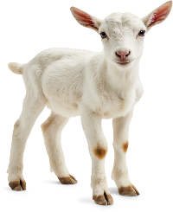
GENESIS 22:
LOVE AND THE LAMB

Slide 6

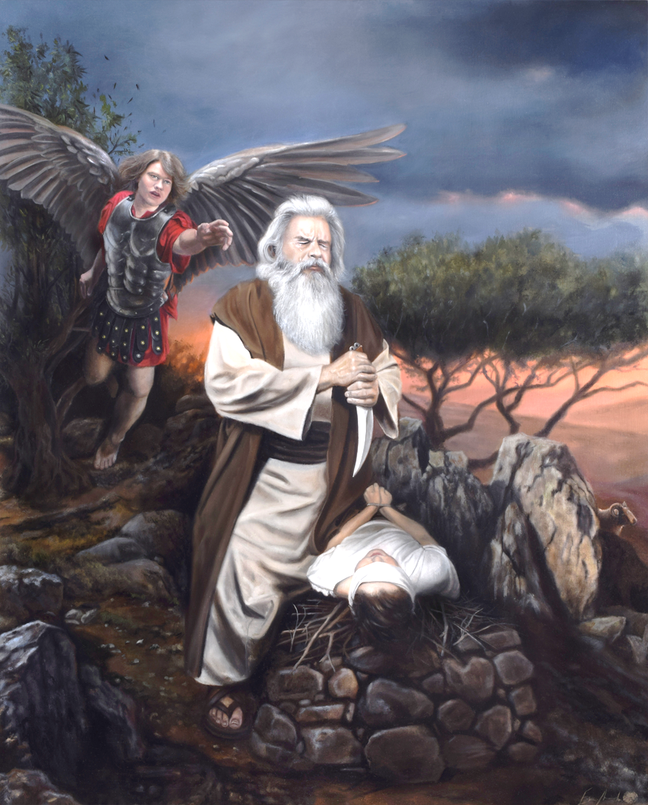
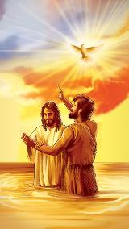
“whom you LOVE”
“Then God said, ‘Take your son, your only son, whom you love—Isaac—and go to the region of Moriah. Sacrifice him there as a burnt offering on a mountain I will show you” (Genesis 22:2)
Love! How do we define love? Our concept of it is clearly distorted by sin. How, then, can we understand the love of God, which is pure and holy?
The first biblical mention of love refers to the relationship between a father and his son: Abraham and Isaac (Gen. 22:2.) At first glance, the context seems daunting: Abraham was supposed to sacrifice his beloved son! (Don't worry, he didn't end up doing it.)
Compare this mention with the first mention of love we find in the synoptic gospels: “This [Jesus] is my beloved Son”
(Mt. 3:17; Mk. 1:11; Lk. 3:22.)
And don't miss the first mention in John's gospel (Jn. 3:16.) Abraham's act of sacrificing his son illustrates how God loved us to the point of sacrificing his own Son so that we might live eternally.

Slide 7

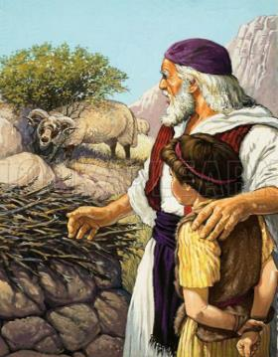
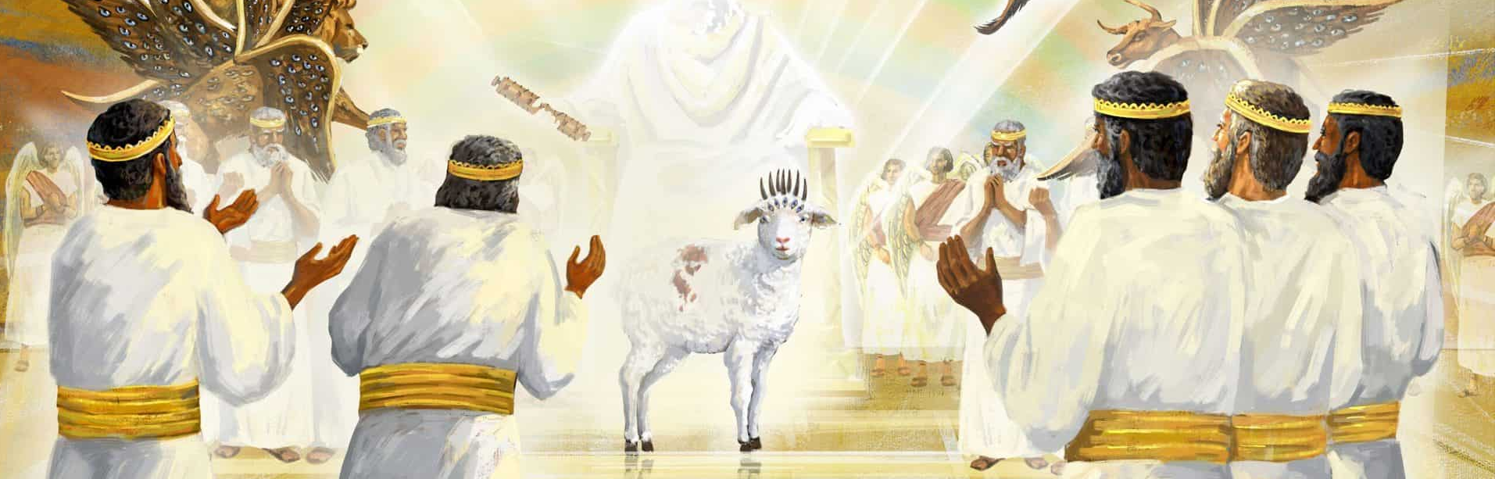
“where is the LAMB?”
“Isaac spoke up and said to his father Abraham, “Father?” “Yes, my son?” Abraham replied. “The fire and wood are here,” Isaac said, “but where is the lamb for the burnt offering?” (Genesis 22:7)
The first mention of the word LAMB is not accidental (Gen. 22:7.) It is the basis for understanding the repeated mention of the Lamb in Revelation (Rev. 5:6.)
He prevented the death of the firstborn (Ex. 12:13)
It was an offering that God always had in mind (Ex. 29:38-41)
I had to die for my sins
(Is. 53:6-8)
John the Baptist identified the Lamb (Jn. 1:29)
Note that the lamb God provided was actually a ram (Gen. 22:8, 13.) At Passover, a lamb was sacrificed, although it could be either a lamb or a ram (Ex. 12:3, 5.) That is, the word “lamb” came to mean the ultimate sacrifice. Gradually, the Bible expands the symbolic meaning of the lamb:
It's no wonder Revelation doesn't explain the identity of the Lamb. The Lamb is Jesus, who was sacrificed for my sins and who always intercedes for me with the Father (Heb. 7:25.)

Slide 8

“It had been difficult even for the angels to grasp the mystery of redemption—to comprehend that the Commander of heaven, the Son of God, must die for guilty man. When the command was given to Abraham to offer up his son, the interest of all heavenly beings was enlisted. With intense earnestness they watched each step in the fulfillment of this command. When to Isaac's question, “Where is the lamb for a burnt offering?” Abraham made answer, “God will provide Himself a lamb;” and when the father's hand was stayed as he was about to slay his son, and the ram which God had provided was offered in the place of Isaac—then light was shed upon the mystery of redemption, and even the angels understood more clearly the wonderful provision that God had made for man's salvation.”
EGW (Patriarchs and Prophets, pg. 155)

Slide 9
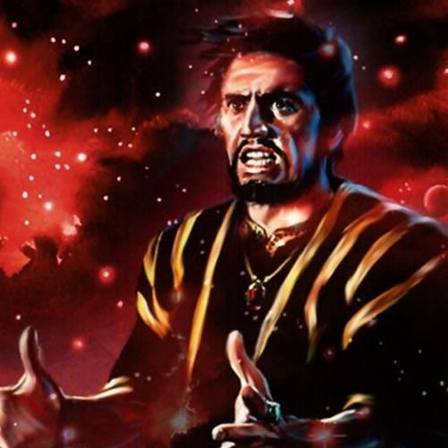

GENESIS 2-3:
DEATH AND THE SERPENT

Slide 10

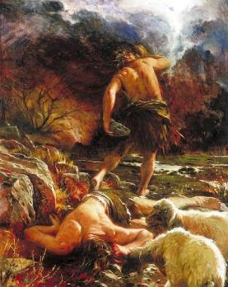
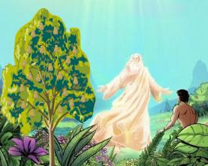

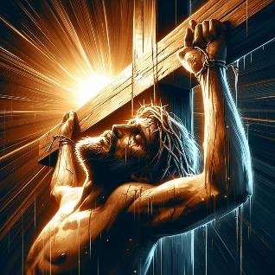
“you will certainly DIE”
“but you must not eat from the tree of the knowledge of good and evil, for when you eat from it you will certainly die” (Genesis 2:17)
God was the first to mention death (Gen. 2:17.) But death could only exist as a consequence of sin
(Rom. 5:12.)
Death is often associated with old age. But the first recorded death was that of a young man: Abel
(Gen. 4:8.) He, though a righteous man, died at the hands of an unrighteous man (Heb. 11:4; 1 Jn. 3:12.)
History was repeated centuries later, when the Righteous One died at the hands of the unrighteous (Mark 15:14.) Unlike Abel, Jesus—who could have prevented his death—allowed himself to be killed (Eph. 5:2.)
Jesus did what Abel could not: he conquered death (Rom. 6:9.) And, as Revelation 1:18 shows, he received “the keys of death,” with which he could open the tombs (“hell” or “Hades”.)

Slide 11


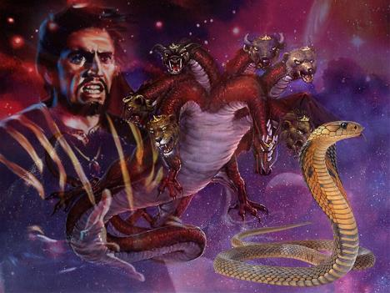
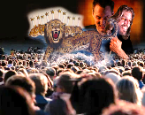
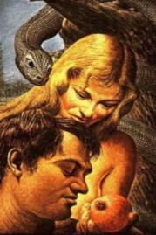
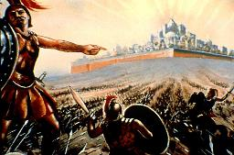
“the SERPENT was more crafty”
“Now the serpent was more crafty than any of the wild animals the Lord God had made” (Genesis 3:1a)
Revelation presents a dragon (Rev. 12:3-4.) It also tells us that this dragon is a symbol of Satan (Rev. 12:9.)
In identifying the symbol of the dragon, he adds a new symbol: Satan is “the ancient serpent.” Which serpent is he referring to?
Of course, the first serpent mentioned in the Bible
(Gen. 3:1.) In Eden, Satan (the serpent) deceived the whole world (i.e., Adam and Eve.)
In Revelation, we are reminded that this has been his purpose throughout history, and that it will be his special target at the end of time (Rev. 13:14.) He will even attempt to deceive everyone in the very presence of God (Rev. 20:8.)
How can we defend ourselves against his tricks? One way is to study how he first did it. His basic tactics haven't changed over the centuries.

Slide 12

EGW (Manuscript) Releases, vol. 10, pg. 156)
“The gospel is revealed in all the prophecies of the first advent of Christ as the Savior of men. Every act of the old dispensation to turn men away from sin or to bring them forgiveness was done with reference to the Savior who was to come. He was the stepping stone by which man was to be exalted.”

