Slide 1
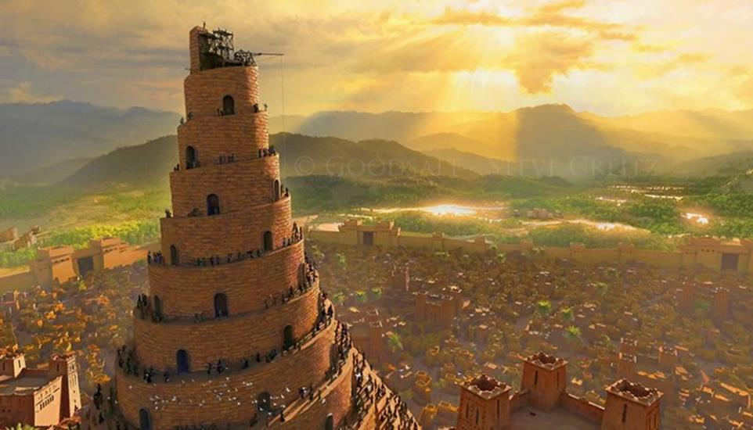
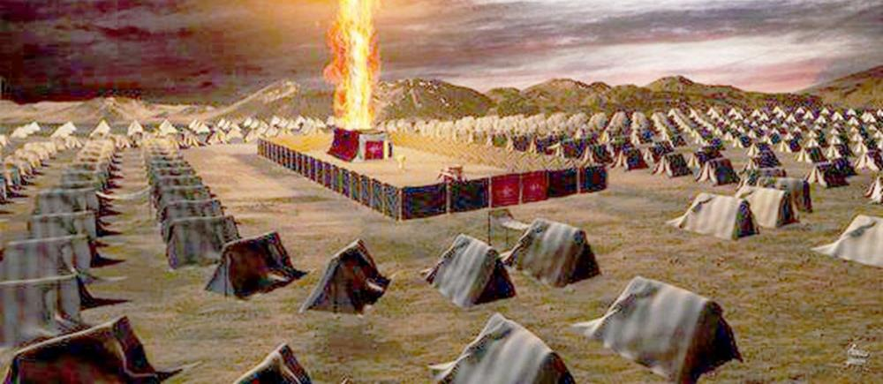
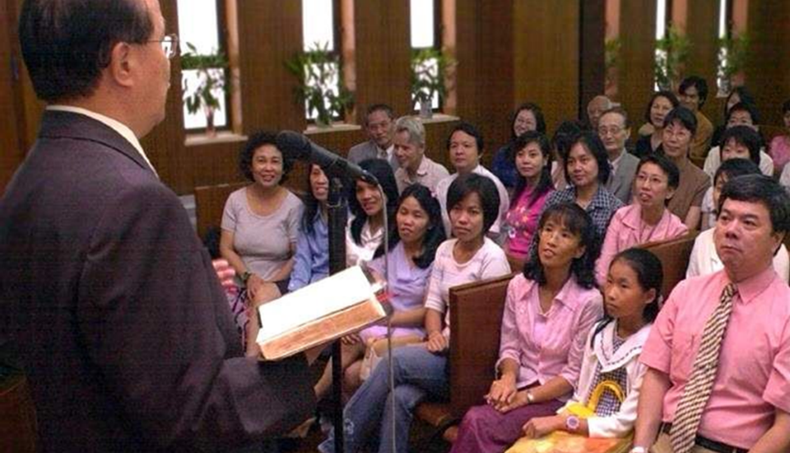
THE NATIONS PART 1
Lesson 4 for April 26, 2025

Slide 2
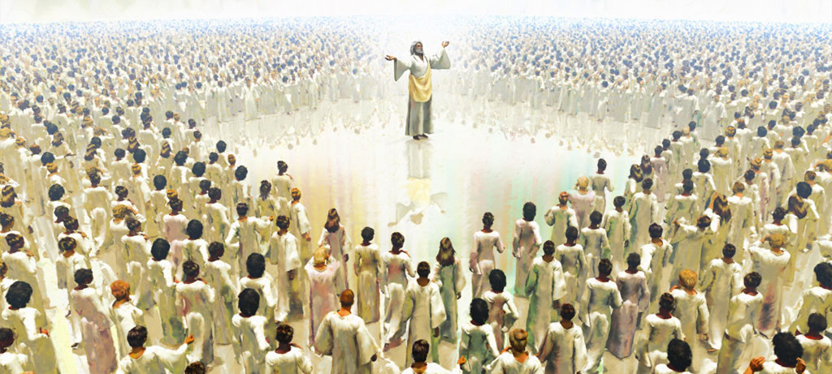
“ ‘Then to Him was given dominion and glory and a kingdom, that all peoples, nations, and languages should serve Him. His dominion is an everlasting dominion, which shall not pass away, and His kingdom the one which shall not be destroyed’ ” Daniel 7:14, NKJV

Slide 3
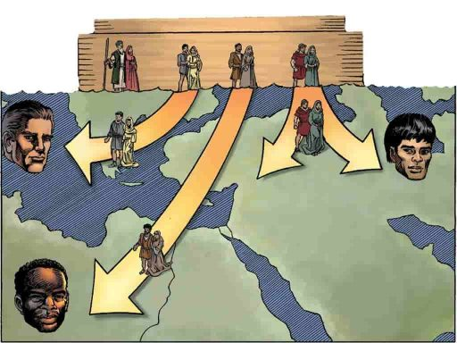
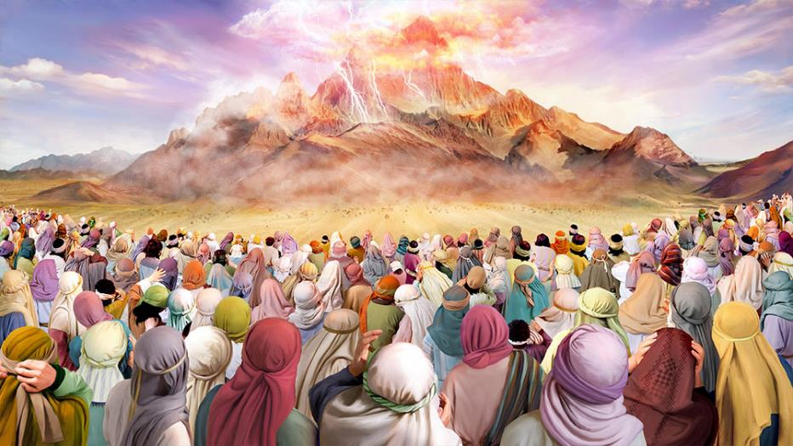
From the sons of Noah arose the nations that populated the world after the flood.
Most of them were hostile to God, worshipping other gods, and living according to their own laws.
But God brought forth a new nation, and gave it the laws that would make it the most powerful nation in the world, in whose light all the nations of the Earth would walk.
The Origin of Nations:
The first nations.
A nation begotten by God.
The Chosen People:
The history of Israel.
The history of the Church.
The role of the chosen people.

Slide 4
THE ORIGIN OF NATIONS

Slide 5
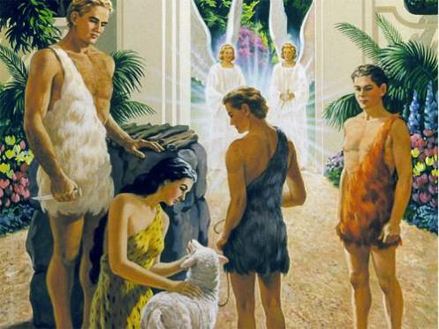
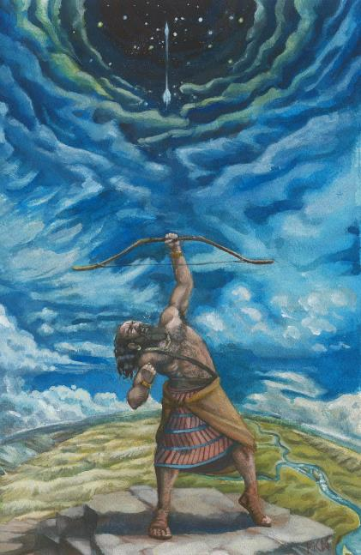
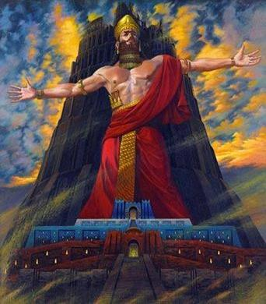
THE FIRST NATIONS
“These are the clans of Noah’s sons, according to their lines of descent, within their nations. From these the nations spread out over the earth after the flood” (Genesis 10:32)
Because of their sin, Adam and Eve were expelled from Eden and forbidden to enter it. They and their descendants continued to come to the entrance to Eden, guarded by the cherubims, to offer sacrifices to God.
In this way, humanity, for a time, continued to recognize God as its supreme ruler.
When, due to the prevailing evil, God decided to destroy the Earth with the flood, he also removed the Garden of Eden. After the flood, men like Nimrod decided to create their own states outside of God, governed by themselves (Gen. 10:6-12.)
Nimrod is said to have been “a giant hunter before the Lord God” (Gen. 10:9 LXX .) Among the cities he built were Babel and Nineveh, from which nations sprang that were declared enemies of God’s people.

Slide 6
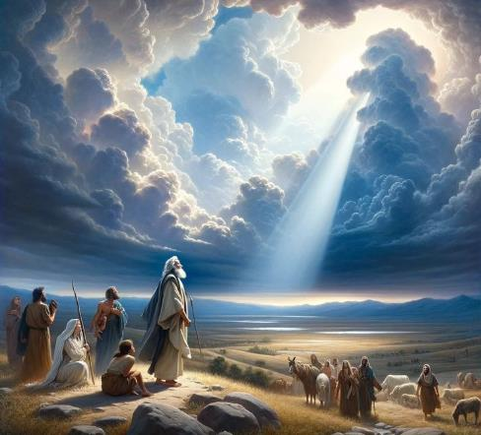
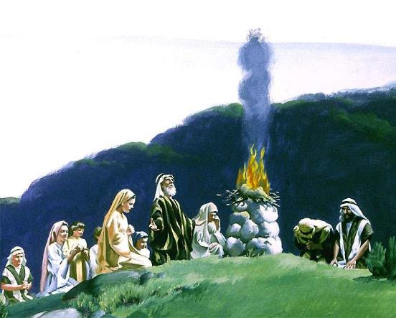
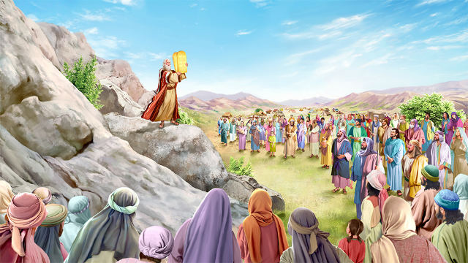
A NATION BEGOTTEN BY GOD
“I will make you into a great nation, and I will bless you; I will make your name great,
and you will be a blessing” (Genesis 12:2)
Genesis 10 uses the Hebrew word goyim to refer to the nations. This same word is used to refer to the Gentiles, that is, those who are far from God.
In order to recover those nations, God decided to bring forth a new nation, Israel, through the descendants of Abram/Abraham (Gen. 2:1-3.)
Why choose Abraham? “For I have chosen him, so that he will direct his children and his household after him to keep the way of the Lord” (Gen. 18:19.) In this way, God could show the world what happens when we allow ourselves to be led by Him.
He gave them just standards that would astonish the nations, causing them to desire to come into contact with Israel to imitate it, and thus receive the blessing that God desired to impart to them (Deut . 4:5-8.)

Slide 7
THE CHOSEN PEOPLE

Slide 8
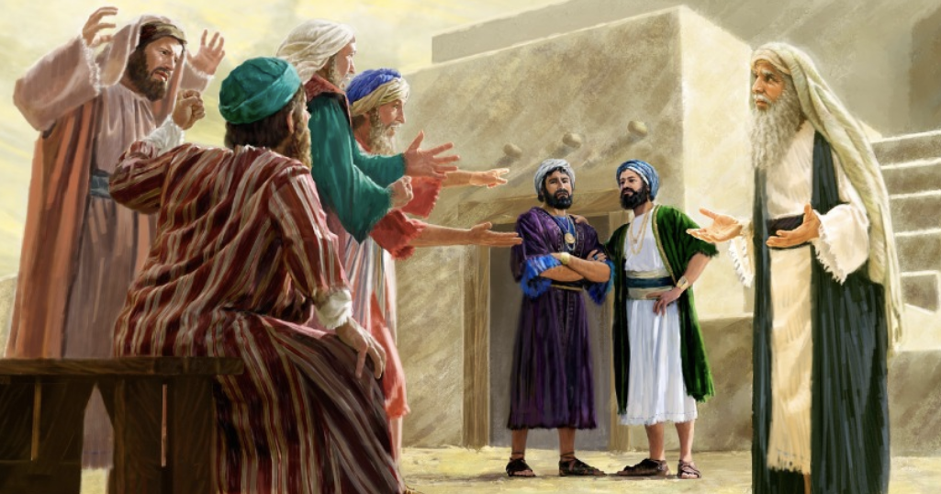
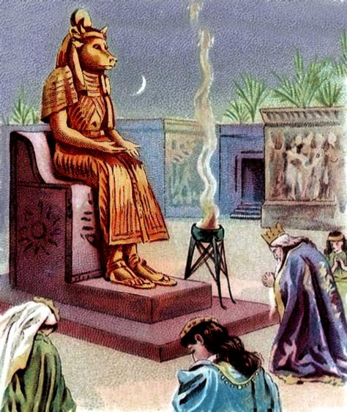
THE HISTORY OF ISRAEL
“Behold, you have grown old, and your sons do not walk in your ways; therefore, now appoint us a king to judge us, such as all the nations have” (1 Samuel 8:5)
Unfortunately, instead of wanting to be an exemplary nation, led directly by God, Israel wanted to be like the other nations (1 Sam. 8:5.)
By asking for a king, they rejected God (1 Sam. 8:7.) Even when warned of the consequences of having a king, they persisted in their rebellion (1 Sam. 8:9, 19.)
Knowing in advance this reaction of Israel, God had dictated laws that, if obeyed, would ensure that the requested king would remain as close as possible to God's ideal (Deut. 17:14-20.)
Despite this, even the best kings had great flaws. Most of them are said to have done evil (1 Kings 11:6.)
After all, they were sinners ruling over sinners. For that reason, there is no righteous government except the one to come, The Kingdom of God (Dan. 2:44.)

Slide 9
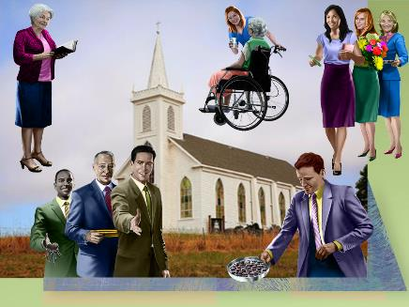
THE HISTORY OF THE CHURCH
“Not so with you. Instead, whoever wants to become great among you must be your servant”. (Matthew 20:26)
After Israel's apostasy, Jesus instituted a new people: The Church. But this people was not to have a king or a specific nationality. Those who governed it were to do so by serving others (Mt. 20:25-28.)
During a 300-year persecution, the Church remained more or less faithful
But freedom arrived. Constantine (4th century) legalized Christianity. And he became its "unofficial" ruler! He presided over congresses and issued laws governing the Church
In the 5th and 6th centuries, the Church relied increasingly on the state, and the Bishop of Rome gained greater authority. Service was no longer the norm of government
Throughout the Middle Ages, anyone who did not obey the authority of the Church had to pay for their rebellion with death, torture, or imprisonment
The Church thus made the same mistakes as the people of Israel.

Slide 10
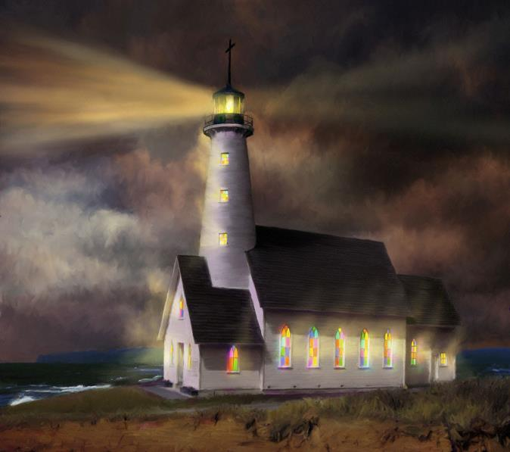
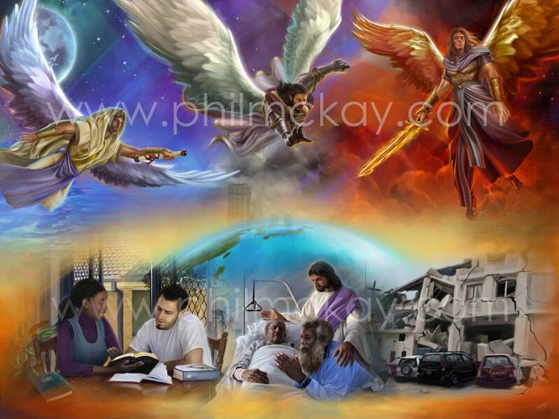
THE ROLE OF THE CHOSEN PEOPLE
“I, the Lord, have called you in righteousness; I will take hold of your hand. I will keep you and will make you to be a covenant for the people and a light for the Gentiles” (Isaiah 42:6)
How could Israel have been “a light to the nations” (Isa . 42:6)? How can the Church be “the light of the world” (Matt. 5:14)?
Through his obedience (Deut. 4:6; Matt. 5:16)
Showing the solution to sin (Lev. 4:27-29; Jn. 3:16)
Announcing the Second Coming of Jesus (Is. 40:9-10; Rev. 14:6-11)
The historical reality of the people of God has been that of a people who have failed to accomplish the work that God had designated for them.
Still, the world has been blessed, through Israel and the Church, with the blessed message of Salvation.
We are living in the final stretch of history. The last opportunity to fulfill our purpose of being the light of the world, of proclaiming God's salvation (Isa . 52:7.)

Slide 11
EGW (Letter 108, 1902)
“O what a power for good a converted man—transformed daily—can exert to bring blessing and gladness to the world. When the church is imbued with the spirit of obedience and love, the members will exert in the world a saving influence, and God will withhold from them nothing that will crown that influence with success and victory. Men and women are His agencies for the salvation of souls. Those who are filled with an earnest desire to draw sinners to Christ have the sympathy and co-operation of the heavenly universe.”

