Slide 1
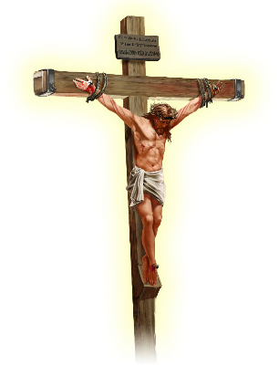
UNDERSTANDING SACRIFICE
Lesson 6 for May 10, 2025

Slide 2
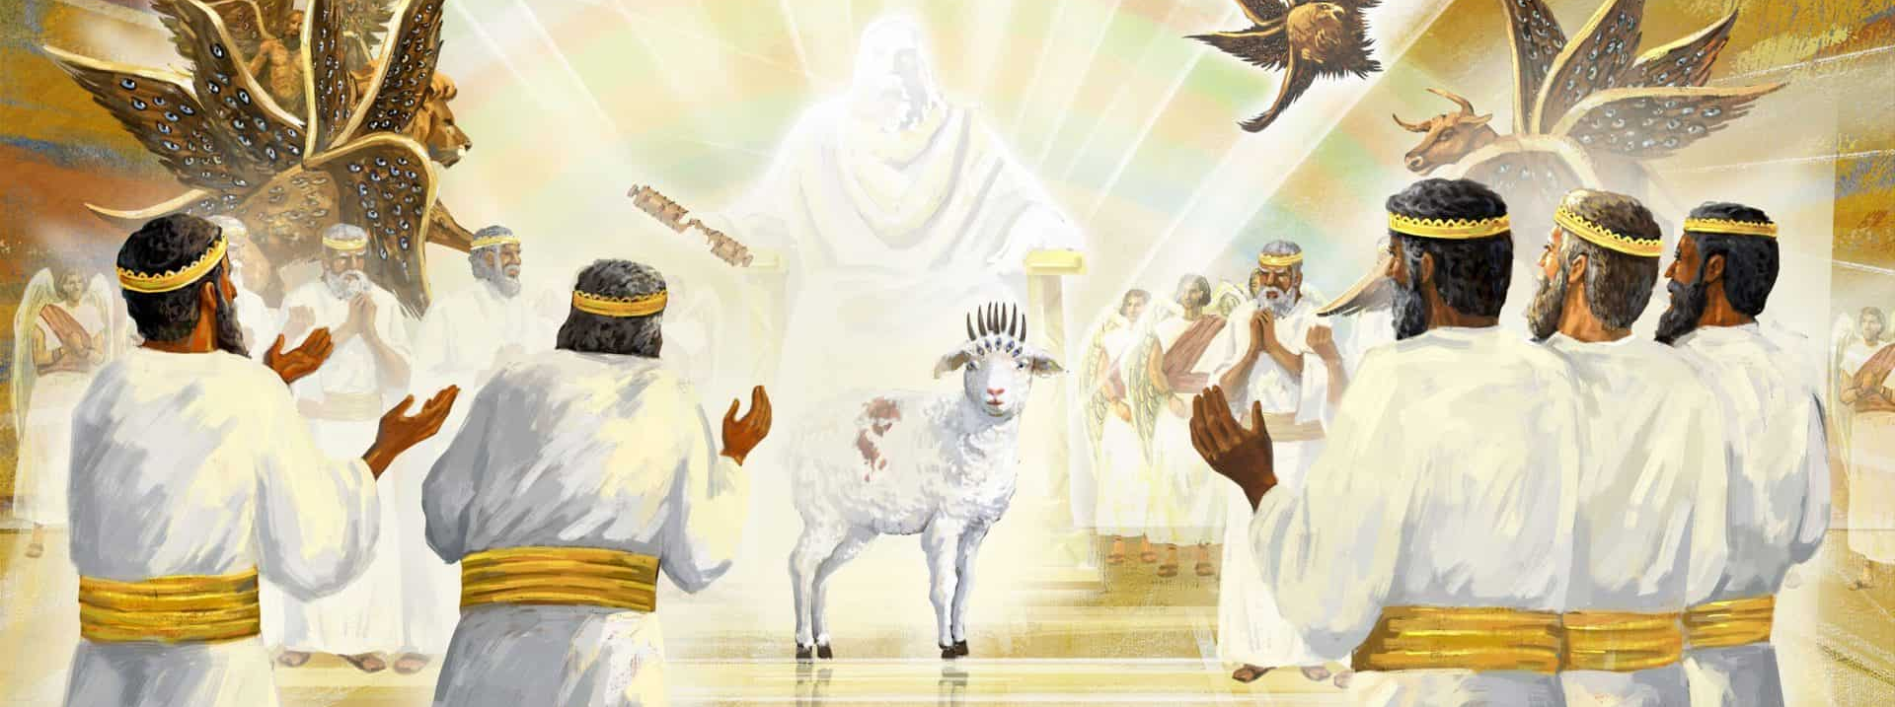
“And they sang a new song, saying: ‘You are worthy to take the scroll, and to open its seals; for You were slain, and have redeemed us to God by Your blood out of every tribe and tongue and people and nation’ ” Revelation 5:9, NKJV

Slide 3
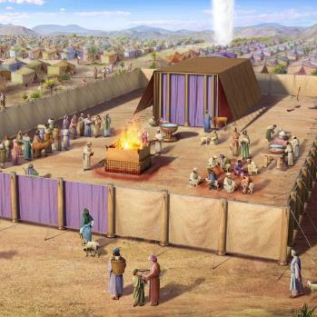
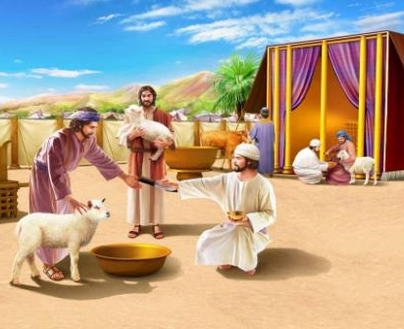
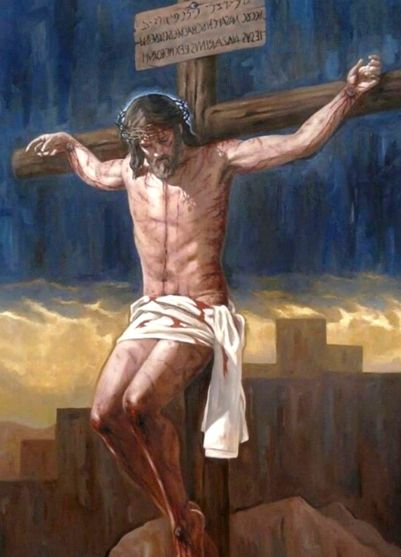
Hundreds of animals die every day. A river of blood gushing from the place where they're slaughtered. We're not talking about an animal slaughterhouse, nor a pandemic that forces animals to be slaughtered.
We're talking about the Sanctuary and the Temple of the people of Israel. They are sacrifices ordained by God himself. Why so much cruelty? Why so much death of innocent animals?
They all pointed to a single Savior. Each of the slaughtered animals represented the deserved death of the sinner who sacrificed it. Each cruel sacrifice spoke of the love of the One who cruelly died for my sake: Jesus, the Lamb of God.
The meaning of sacrifices:
Pleasant and unpleasant sacrifices.
The sacrifices of the Sanctuary.
The Passover lamb.
Jesus, the Lamb of God:
The Lamb in the Temple.
The Lamb in Heaven.

Slide 4
THE MEANING OF SACRIFICES

Slide 5
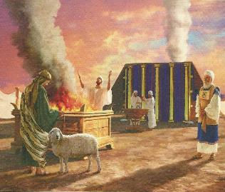
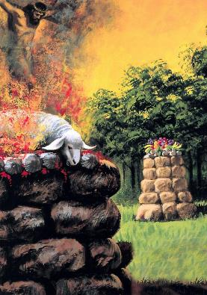
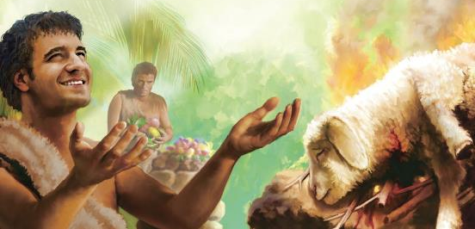
GRATEFUL AND UNGRATEFUL SACRIFICES
“The multitude of your sacrifices— what are they to me?” says the Lord. “I have more than enough of burnt offerings, of rams and the fat of fattened animals; I have no pleasure in the blood of bulls and lambs and goats.” (Isaiah 1:11)
God instituted animal sacrifice as a form of worship. However, He went so far as to say that He was “enough” with such sacrifices (Isaiah 1:11). But soon after, He will say, “Their burnt offerings and sacrifices will be accepted on my altar” (Isaiah 56:7 ). Were the sacrifices pleasing to God, or did they displease Him?
We can answer this question with the example of Cain and Abel. Abel's sacrifice was pleasing to him, but Cain's was ungrateful (Gen. 4:3-5).
The problem wasn't just the type of sacrifice. The attitude with which it was offered determined the quality of the offering.
Cain, like the Israelites of Isaiah's time, did not wish to harmonize his life with God, nor did he see any salvific significance in his sacrifice. Abel, on the other hand, recognized himself as a sinner and acknowledged the Lamb as his substitute.

Slide 6
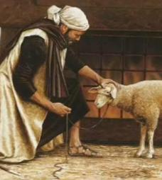
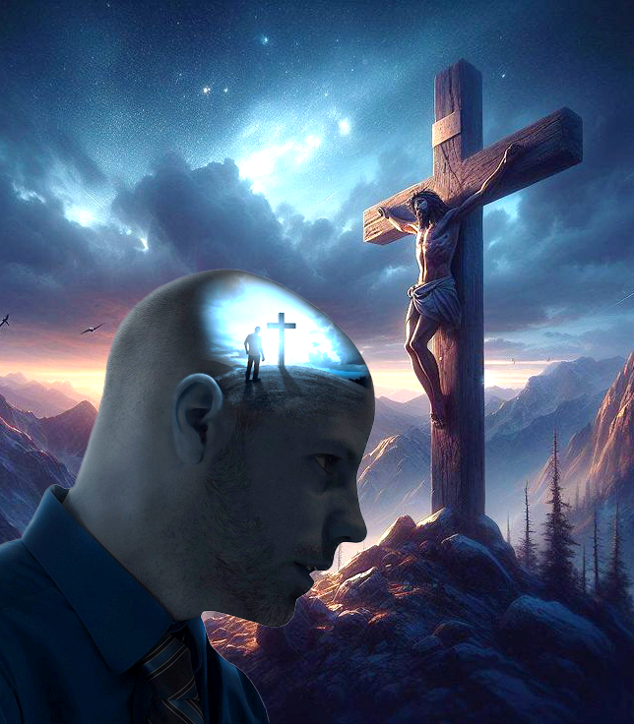
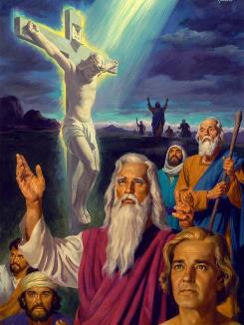
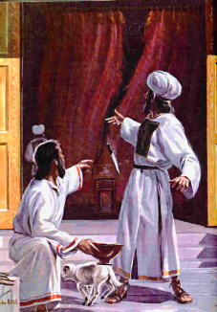
THE SACRIFICES OF THE SANCTUARY
“But those sacrifices are an annual reminder of sins. It is impossible for the blood of bulls and goats to take away sins” (Hebrews 10:3-4)
The punishment for sin is death (Rom. 6:23a). But is the death of an animal the punishment for my sin? No! The punishment for MY sin is MY death.
So why sacrifice animals that cannot take away our sin (Heb . 10:3-4)?
These animals were symbols (types) of Jesus's redemptive death (antitype). Until Jesus died cruelly and unjustly for the sins of the world, every animal sacrificed symbolized that substitutionary death. Jesus died in MY place as punishment for MY sin.
Until the cross, these sacrifices were necessary as "mini-prophecies”. Sins were forgiven by faith in the Lamb of God who was about to die.
When the veil was rent after Jesus' death, those sacrifices became meaningless. Now, our sins are forgiven by faith in the Lamb of God who died for them.

Slide 7
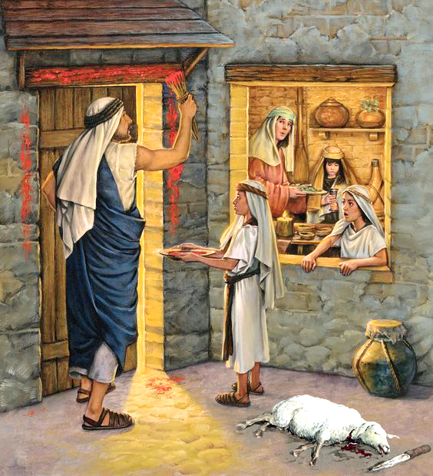
THE PASSOVER LAMB
“Get rid of the old yeast, so that you may be a new unleavened batch—as you really are. For Christ, our Passover lamb, has been sacrificed” (1 Corinthians 5:7)
At the first Passover, the doors were painted with the sacrificed blood of the lamb, and the angel of death passed by. The firstborn in that house were spared.
That blood symbolized the blood of Jesus (1 Pet. 1:18-19). The Passover ritual celebrated each year was, therefore, a symbol of Jesus' death (1 Cor. 5:7b).
Passover
From the 10th to the 14th of Abib, the lamb was kept (Ex. 12:3)
The lamb was sacrificed on the 14th day between the two evenings (Ex. 12:6)
Jesus
Those days Jesus preached exclusively in the Temple (Jn. 18:20)
Jesus died that day between the two evenings (Luke 23:44-46 NIV)
Jesus was the only human being whose life was acceptable to a holy God. He died without sin so that death might pass by when I cleanse my life with his blood (Rev. 7:14).

Slide 8
JESUS, THE LAMB OF GOD

Slide 9
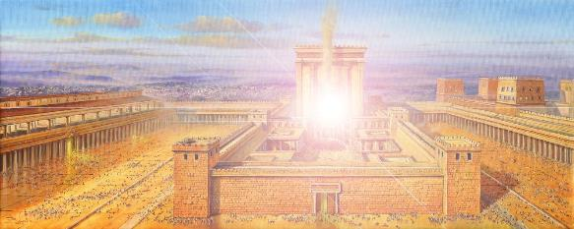
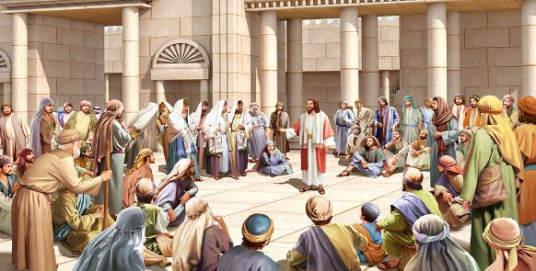
THE LAMB IN THE TEMPLE
“I will shake all nations, and what is desired by all nations will come, and I will fill this house with glory,’ says the Lord Almighty” (Haggai 2:7)
During the dedication of the first Temple, when the ark was brought into it, the glory of God filled the Temple (1 Kings 8:5-10).
After the return from the Babylonian exodus, a second temple was built. But there was no ark in it, and no glory filled the Temple at its dedication. Many mourned this fact (Hag 2:3).
But God promised that his glory would fill that Temple, and he would do so through one person: the Desired One (Hag . 2:7). Who was this “Desired One”?
Jesus was called “God with us” (Matthew 1:21-23). As he walked, taught, and healed in the Temple, the glory of God’s very presence filled the Temple. Every act performed in it depended on that glory. The Creator himself was willing to live among us… and to die for us.

Slide 10
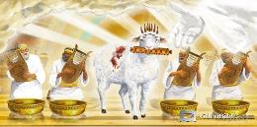
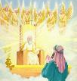
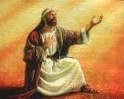
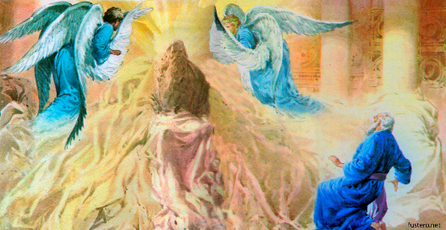
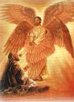
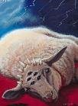
THE LAMB IN HEAVEN
“In a loud voice they were saying: “Worthy is the Lamb, who was slain, to receive power and wealth and wisdom and strength and honor and glory and praise!’” (Revelation 5:12)
Three prophets—Ezekiel, Isaiah, and John—were able to contemplate God's throne in vision. While Ezekiel was a mere observer, Isaiah and John interacted on the scene:
They saw angels praising him: “Holy, holy, holy” (Is . 6:1-3; Rev. 4:8)
Isaiah felt unworthy; and John wept because there was no one worthy (Isa . 6:5; Rev. 5:4)
Isaiah's sin was taken away; and John beheld the Lamb slain for his sin (Isa . 6:6-7; Rev. 5:6)
Our unworthiness enhances the dignity of the Lamb. By being slain, Jesus demonstrated two things:
That God loves us to the point of sacrificing himself for us.
It Should show us how sinful and fallen we are that only trhrough the cross could we be saved.

Slide 11
“Jesus is our surety. “Behold the Lamb of God, which taketh away the sin of the world.” Christ, our Passover, has been sacrificed for us. Every drop of blood shed by the Jewish sacrifices pointed to the Lamb of God. All the typical offerings were fulfilled in him. Type met antitype when he died on the cross. He came to make it possible, by the sacrifice of himself, to put away sin. He paid the ransom for our redemption. We are bought with a price; and Christ calls upon us to let him take our sins, and impute to us his righteousness.”
EGW (The Review and Herald, July 19, 1898)

