Slide 1
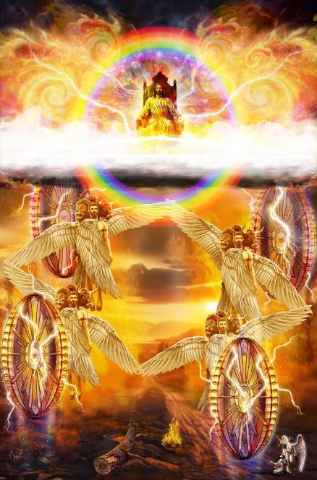
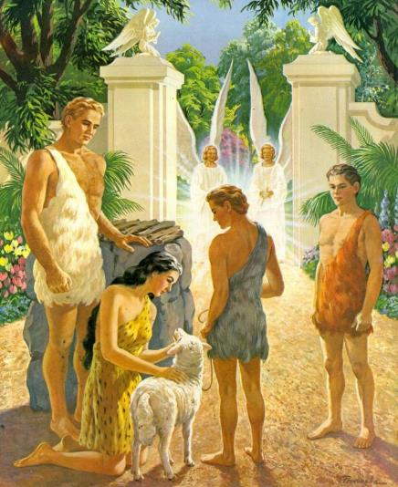
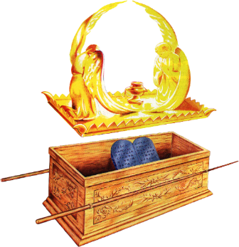
FOUNDATIONS FOR PROPHECY
Lesson 7 for May 17, 2025

Slide 2
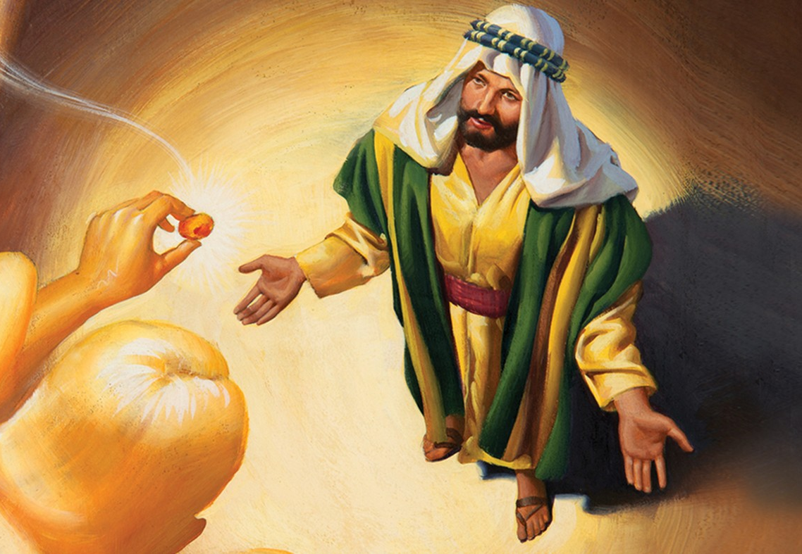
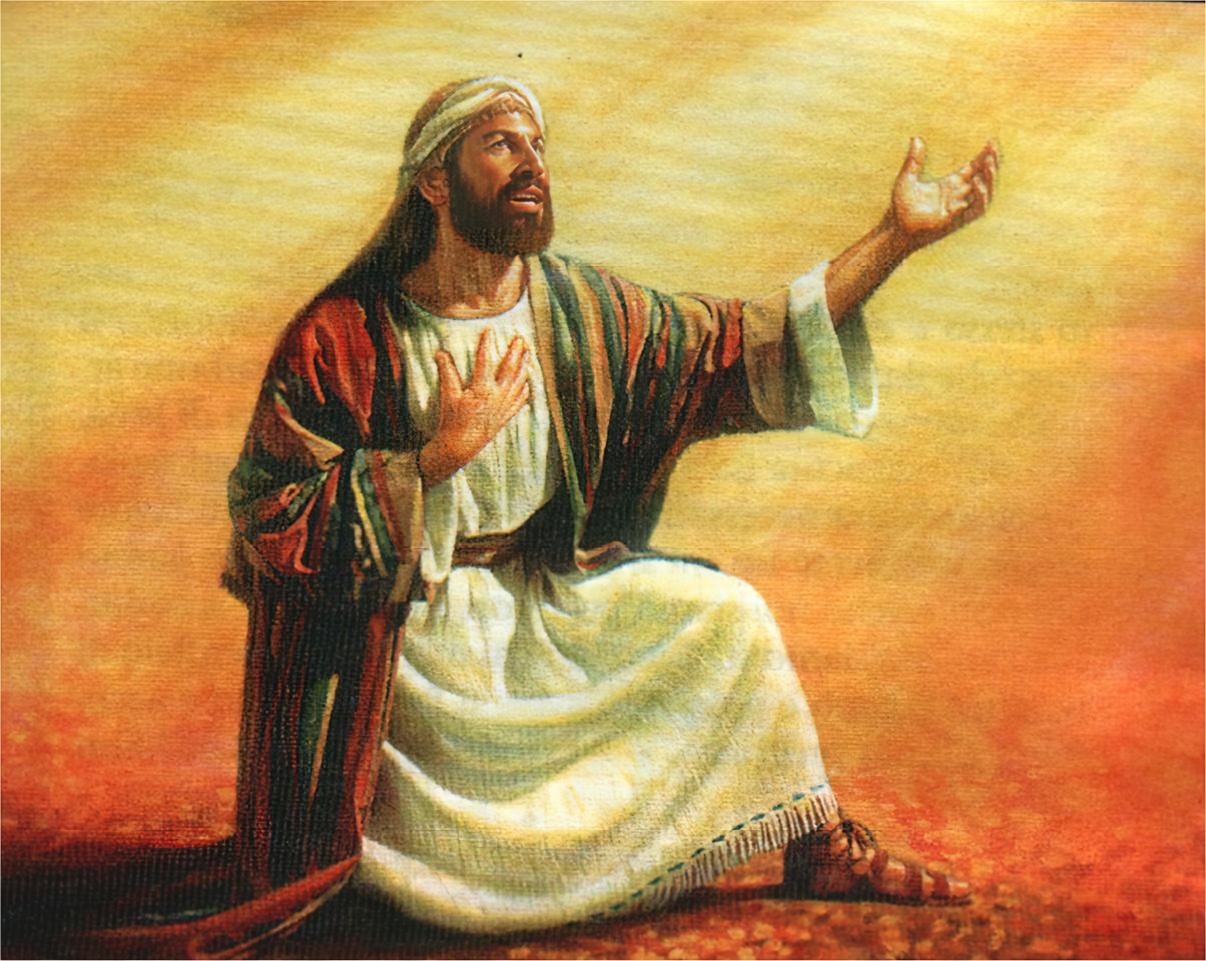
“Also I heard the voice of the Lord, saying: ‘Whom shall I send, and who will go for Us?’ Then I said, ‘Here am I! Send me’ ” Isaiah 6:8, NKJV

Slide 3
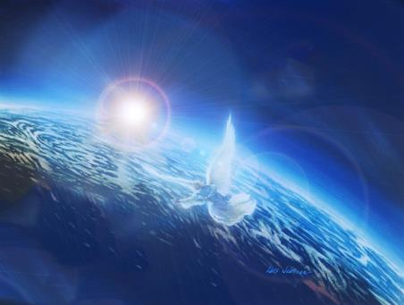
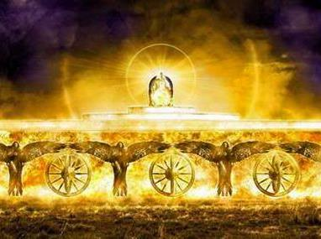
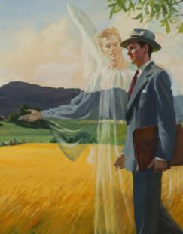
The throne of God is the control center of the universe. The cherubim are the beings closest to him. They command the legions of angels.
Since sin entered the world, cherubim have played an important role in God's relationship with humanity.
Thanks to prophecy, the veil that allows us to see the invisible and inaccessible world is lifted. We can see these cherubs standing beside the throne, acting under God's command to help us.
God and the cherubim:
Messengers of fire
What do cherubim do?
A reflection of God's glory
The cherubim and humanity:
Lion, man, ox and eagle
Replacing the fallen

Slide 4
GOD AND THE CHERUBIM

Slide 5
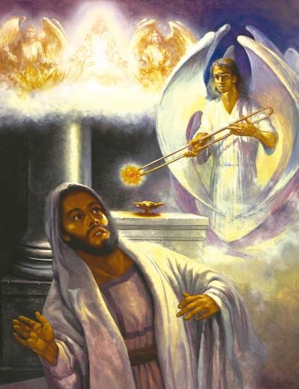
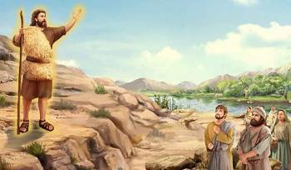
MESSENGERS OF FIRE
“One of the flaming creatures flew over to me with a burning coal that it had taken from the altar with a pair of metal tongs.” (Isaiah 6:6 CEV)
Imagine being illuminated by a light so intense and special that all your thoughts and emotions were laid bare. That's what Isaiah experienced when he saw God's throne. His reaction? "Woe is me, for I am undone!" (Isaiah 6:5 NKJV).
Then a fiery being (in Hebrew, seraph), stops singing the holiness of God, takes a burning coal from the altar, and assures Isaiah that his sin is forgiven (Is. 6:1-7 NKJV).
Of course, the cherub didn't forgive Isaiah's sin. He simply conveyed God's message, for that is the function of a cherub.
And from then on, it was also the role of Isaiah (Is. 6:8). It is interesting that Jesus said of John the Baptist, another messenger of God: “He was the burning and shining lamp” (Jn . 5:35).

Slide 6
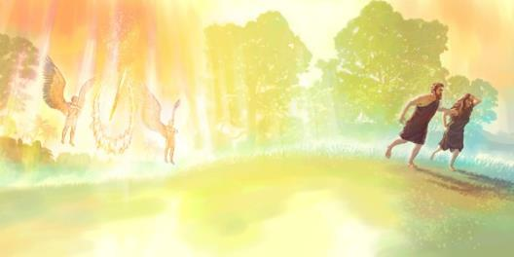
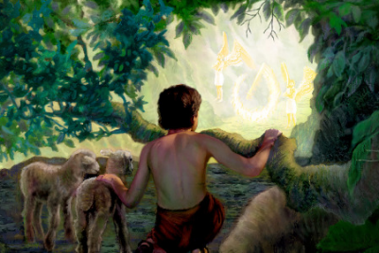
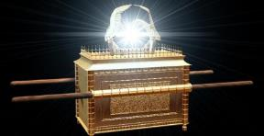
WHAT DO CHERUBIM DO?
“So He drove out the man; and He placed cherubim at the east of the garden of Eden, and a flaming sword which turned every way, to guard the way to the tree of life” (Genesis 3:24)
The Bible first introduces us to the cherubim immediately after Adam and Eve's sin. What work did God give them? (Gen. 3:24)
They were to "guard the way to the tree of life." That is, to prevent humans from entering the Garden of Eden. However, their presence was not intimidating. They made the gate of Eden a miniature representation of the divine throne, from which grace emanates.
The word translated “placed” (shakan) is used to indicate that God “dwells” in the Sanctuary. From this comes the word “shekinah ”, which designates the glory of God manifested in the ark… between the cherubim!, which represented God’s throne (1 Chron. 13:6; Is. 37:16).
And what do they do at the throne? They worship and carry out God's direct orders on behalf of those who will inherit salvation. (Rev. 4:8; Rev. 5:8-9; Heb. 1:14).

Slide 7
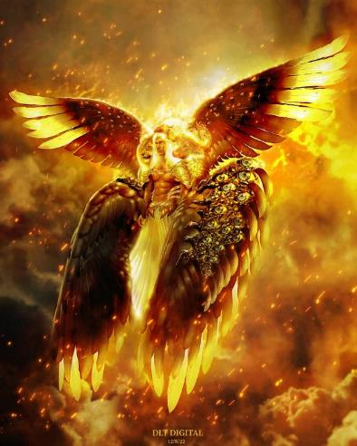
A REFLECTION OF THE GLORY OF GOD
“Before the throne there was a sea of glass, like crystal. And in the midst of the throne, and around the throne, were four living creatures full of eyes in front and in back” (Revelation 4:6)
Isaiah 6:1-4
Ezekiel 1:5-14
Revelation 4:6-8
Beings of fire (seraphim )
Fire torches
Living beings
Six wings
They praise: “Holy, holy, holy”
They fill the temple with smoke
Four wings
Four faces: man; lion; ox; and eagle
They shine
Six wings
They praise: “Holy, holy, holy”
Like a lion, a calf, a man, and an eagle
Full of eyes
The descriptions of the cherubim surrounding the throne of God recorded by Isaiah, Ezekiel, and John have great similarities:
The cherubim shine and glow (the "eyes" are symbols of brilliance), reflecting God's glory. All of God's creatures were designed to reflect His glory, both human beings, made in His image, and the angelic beings who sit beside His glorious throne.

Slide 8
THE CHERUBIM AND HUMANITY

Slide 9
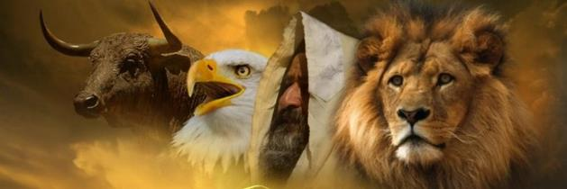
LION, CALF, MAN AND EAGLE
“The first living creature was like a lion, the second living creature like a calf, the third living creature had a face like a man, and the fourth living creature was like a flying eagle” (Revelation 4:7)
EPHRAIM
+ Manasseh
+ Benjamin
DAN
+ Asher
+ Naphtali
The description of the cherubim matches the standards of the four main tribes that camped on each side of the Sanctuary (Ezek. 1:10; Rev. 4:7).
The New Jerusalem is described with the same layout: 12 gates, three on each of its four sides. (Rev. 21:12-13).
RUBEN
+ Simeon
+ Gad
JUDAH
+ Issachar
+ Zebulun
God wants to surround himself with his people, just as he is surrounded by the cherubim.
God wants us to dwell with Him. This will only become a reality when Jesus takes us with Him at His Second Coming (Rev. 21:3).
But we don't have to wait until that moment to feel at the throne of God (Eph. 2:4-6).

Slide 10
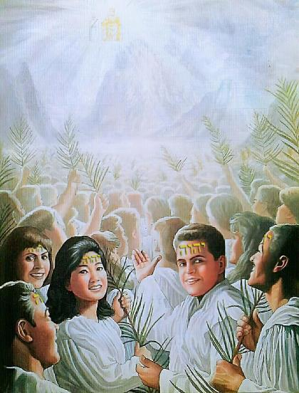
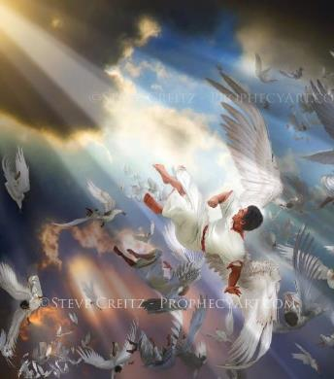
REPLACING THE FALLEN
“Then I looked, and behold, a Lamb standing on Mount Zion, and with Him one hundred and forty-four thousand, having His Father’s name written on their foreheads” (Revelation 14:1)
Unfortunately, not all cherubim have performed their duties properly. There was one who, filled with glory and splendor, thought that all that glory came from himself, rather than from God (Ezek. 28:14, 17).
Lucifer and his angels were on the “mountain of God,” but they were expelled from it. Their place will be taken by those who remain faithful to the Lamb (Rev. 14:1).
At this wonderful miracle, the heavenly beings sing in unison: “You are worthy [Jesus] … because you were slain, and with your blood you purchased for God persons from every tribe and language and people and nation. You have made them to be a kingdom and priests to serve our God, and they will reign on the earth” (Rev. 5:9-10 NIV).

Slide 11
“All these heavenly beings have one object above all others, in which they are intensely interested— His church in a world of corruption.... They are working for Christ under His commission, to save to the uttermost all who look to Him and believe in Him. These heavenly intelligences are speeding on their mission.... They are united in a holy alliance, in a grand and sublime unity of purpose, to show forth the power and compassion and love and glory of the crucified and risen Saviour.
In their service, these armies of heaven illustrate what the church of God should be. Christ is working in their behalf in the heavenly courts, sending out His messengers to all parts of the globe, to the assistance of every suffering one who looks to Him for relief, for spiritual life and knowledge.
EGW (The Truth About Angels, pg. 250-251)

