Slide 1
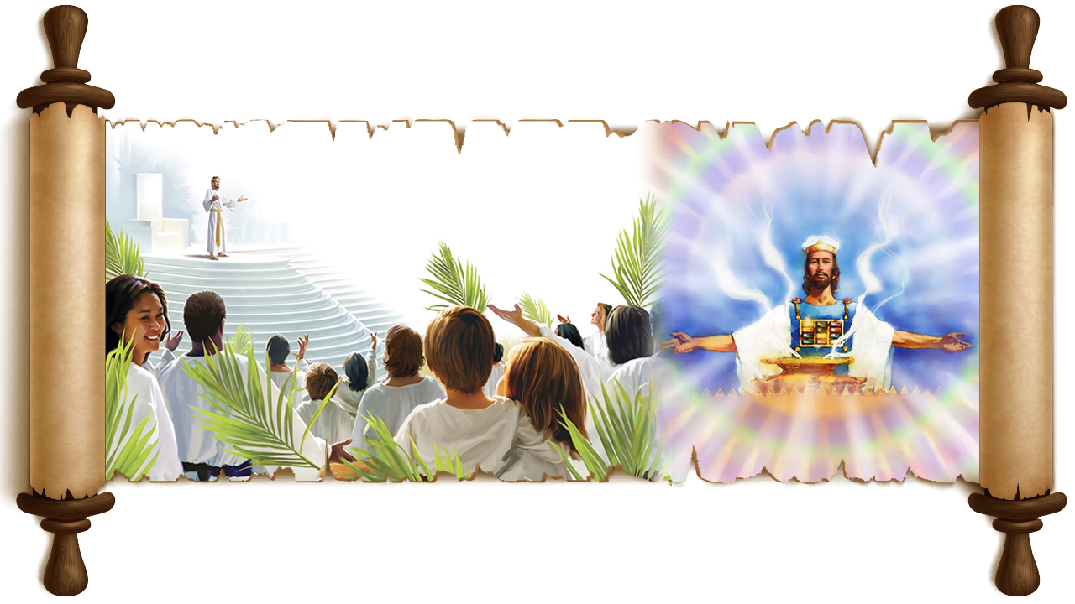
IN THE PSALMS
PART 1
Lesson 8 for May 24, 2025

Slide 2
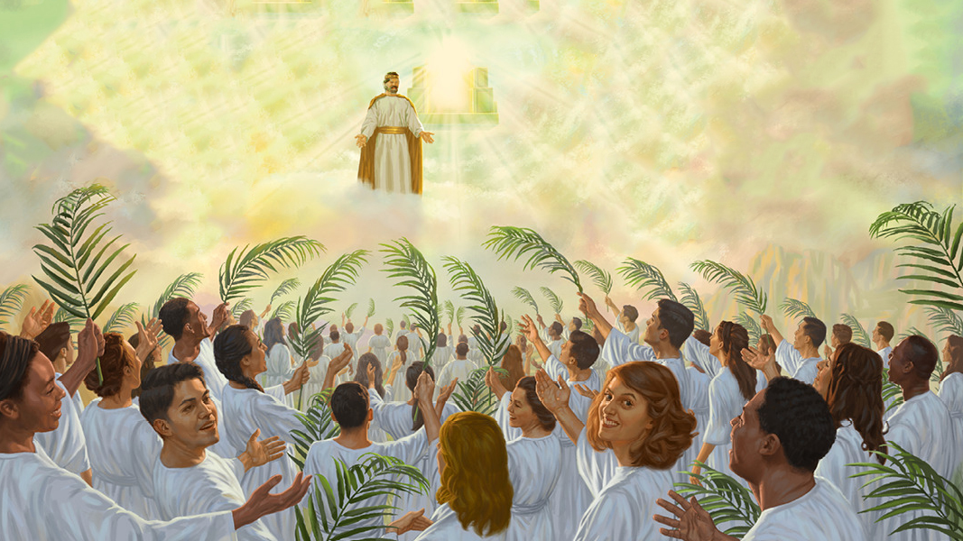
“Then I looked, and behold, a Lamb standing on Mount Zion, and with Him one hundred and forty-four thousand, having His Father’s name written on their foreheads”
Revelation 14:1, NKJV

Slide 3
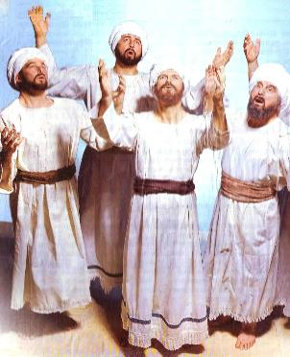
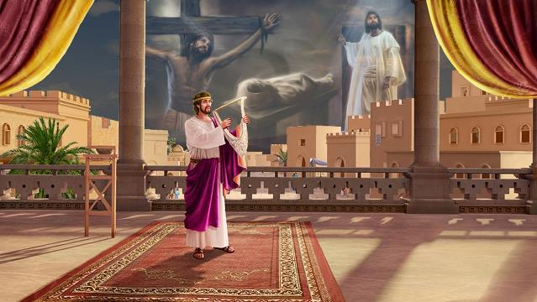
Beyond its function as a hymnal to be used in public and private worship, the book of Psalms is an eminently prophetic book, written by prophets (Acts 2:30-31).
The New Testament authors used it as a prophetic text to show that Jesus was the Messiah (e.g., Acts 13:33; Heb. 1:8).
But Psalms are not limited to prophesying about Jesus' earthly ministry, but are rich in various themes related to the history of Redemption.
Psalm 122: The Heavenly Sanctuary
Psalms 15 and 24: The Holy Mountain
Psalm 119: The Name of God
Psalm 5: The Redeemed
Psalm 51: The Proclamation of the Gospel

Slide 4
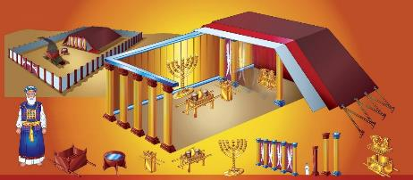
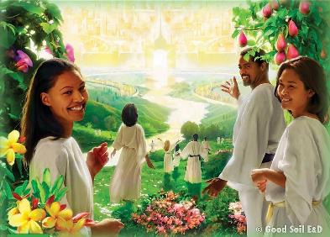
THE CELESTIAL SANCTUARY
“I rejoiced with those who said to me, "Let us go to the house of the LORD.’” (Psalm 122:1)
By studying the details of Israel's Sanctuary and Temple, we see how God related to his people and how he taught the Plan of Redemption.
By moving the ark, David centralized divine worship in Jerusalem. That was where the house of God was located.
Psalm 122 prophetically points to the gathering of the redeemed into the New Jerusalem, to worship at the real, heavenly sanctuary (Heb. 8:1-2; 9:11-12, 24; Rev. 14:17; 21:3).
Revelation offers several visions of this Heavenly Sanctuary (from which the Courtyard, which represents the Earth (Rev. 11:2), is excluded):
THE LAMPSTAND Revelation 4:5
THE GOLDEN ALTAR Revelation 6:9; 8:3; 14:18; 16:7
THE ARK Revelation 11:19
Examining Psalm 122, we can also appreciate other themes closely linked to the message of Revelation: praise (v. 4); judgment (v. 5); peace (v. 6, 8); security (v. 7).

Slide 5
“Christ, our great High Priest, is “a minister of the sanctuary, and of the true tabernacle, which the Lord pitched, and not man.” Hebrews 9:9, 23; 8:2. […] The prophet was permitted to behold the first apartment of the sanctuary in heaven; and he saw there the “seven lamps of fire” and the “golden altar” represented by the golden candlestick and the altar of incense in the sanctuary on earth. […] Here he beheld “the ark of His testament” (Revelation 11:19), represented by the sacred chest constructed by Moses to contain the law of God.
Moses made the earthly sanctuary, “according to the fashion that he had seen.” Paul declares that “the tabernacle, and all the vessels of the ministry,” when completed, were “the patterns of things in the heavens.” Acts 7:44; Hebrews 9:21, 23. And John says that he saw the sanctuary in heaven. That sanctuary, in which Jesus ministers in our behalf, is the great original, of which the sanctuary built by Moses was a copy.
EGW (Patriarchs and Prophets, pg. 324)

Slide 6
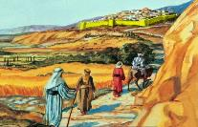
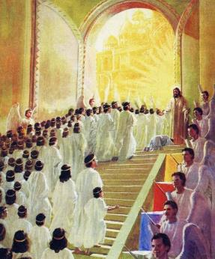
“Lord, who may dwell in your sacred tent? Who may live on your holy mountain?” (Psalm 15:1)
THE HOLY MOUNTAIN
He who walks uprightly does righteousness and does not lie (Ps. 15:2)
He who does not slander does no harm to his neighbor, nor does he allow evil to be spoken of (Ps. 15:3)
He who honors those who fear God and does not change, even if it is detrimental (Ps. 15:4)
He who does not love money nor can be bribed (Ps. 15:5)
He who has clean hands and a pure heart, who is neither proud nor a liar (Ps. 24:4)
Mount Zion occupied part of the city of Jerusalem and, by extension, was used to name the hill where the Temple was built (originally called Mount Moriah). It is also called the holy mountain (Ps. 2:6), as it is a symbol of God's throne (Is. 8:18).
In prophetic writings, it is used to define the place where the redeemed will gather (Is. 37:32; Ps. 74:2; Rev. 14:1). Who will be able to stand on Mount Zion with Jesus?
Psalms 15 and 24 define the characteristics of those who are worthy to be there.
It's clear that none of us, on our own, meet all these requirements. Therefore, we can only be there by the grace and power of Jesus. Praise be to Him!

Slide 7
“The vision of the prophet pictures them as standing on Mount Zion, girt for holy service, clothed in white linen, which is the righteousness of the saints. But all who follow the Lamb in heaven must first have followed Him on earth, not fretfully or capriciously, but in trustful, loving, willing obedience, as the flock follows the shepherd.”
EGW (The Acts of the Apostles, p. 591)

Slide 8
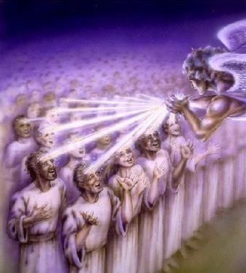
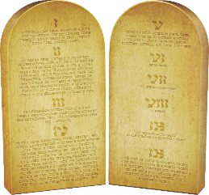
THE NAME OF GOD
“In the night, Lord, I remember your name, that I may keep your law!” (Psalm 119:55 NIV )
Mount Zion is also closely linked to the name of God (Is. 18:7; Rev. 14:1). The name, especially in biblical times, was associated with a person's character (Gen. 32:28).
Therefore, the name of God, inscribed on the forehead of the redeemed, goes beyond the four Hebrew letters that define it: יהוה (YWHW).
God’s name is his unique and unrepeatable character: “I AM WHO I AM” (Ex. 3:14). His name—which is his character—is his glory and his goodness (Ex. 33:18-19).
When the psalmist evoked the name of God (meditated on his character), he was overcome with the desire to keep God's Law (Ps. 119:55 NIV).
Why? Because God's Law is a transcript of His character. God's name will be inscribed on the foreheads of those who love God and desire to obey His Law.

Slide 9
“The glory of Christ is his character, and his character is an expression of the law of God. He fulfilled the law in its every specification, and gave to the world in his life a perfect pattern of what it is possible for humanity to attain unto by cooperation with divinity. In his humanity Christ was dependent upon the Father, even as humanity is now dependent upon God for divine power in attaining unto perfection of character.”
EGW (The Signs of the Times, December 12, 1895)

Slide 10
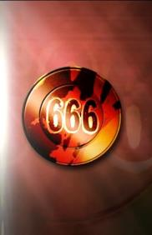
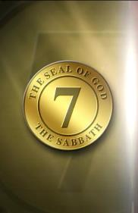
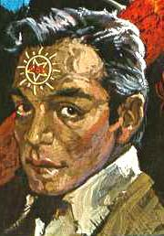
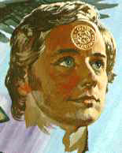
THE REDEEMED
“For you are not a God who is pleased with wickedness; with you, evil people are not welcome” (Psalm 5:4)
Psalm 5 draws a sharp contrast between those who accept God and those who reject him. This psalm anticipates the definition of the two groups facing each other in the end-time: those who receive the name of God, or the name of the beast (Rev. 13 and 14).
THE NAME OF THE BEAST
They shall not dwell with God (Ps. 5:4)
They worship the beast (Rev. 13:8)
THE NAME OF GOD
They will dwell with God (Rev. 14:1)
They worship God (Ps. 5:7)
They are liars (Ps. 5:9)
They proclaim salvation with joy (Ps. 5:11; Rev. 14:6-7)
They will be punished (Ps. 5:10)
They do not lie (Rev. 14:5)
They will be redeemed (Rev. 14:4)
They blaspheme against God (Rev. 13:6)

Slide 11
“Difficulties will arise that will try your faith and patience. Face them bravely. Look on the bright side. […] Heaven is full of joy. It resounds with the praises of Him who made so wonderful a sacrifice for the redemption of the human race. Should not the church on earth be full of praise? Should not Christians publish throughout the world the joy of serving Christ? […]
If you make a mistake, turn your defeat into victory. The lessons that God sends will always, if well learned, bring help in due time. Put your trust in God. Pray much, and believe. Trusting, hoping, believing, holding fast the hand of Infinite Power, you will be more than conquerors.
EGW (Testimonies for the Church, volume 7, page 244)

Slide 12
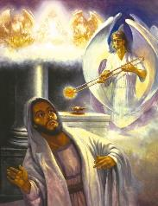
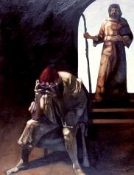
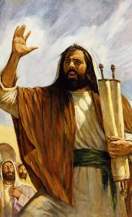
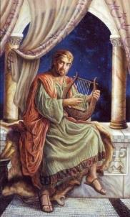
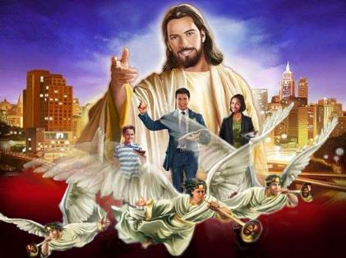
THE PROCLAMATION OF THE GOSPEL
“Then I will teach transgressors your ways, so that sinners will turn back to you” (Psalm 51:13)
We cannot deceive ourselves: we are all sinners (Ps. 14:3; Rom. 3:10; 1 Jn. 1:8). As sinners, we are not worthy to proclaim the gospel of salvation. That was the sentiment of Isaiah (Is. 6:5) and of King David (Ps. 51:3-5).
But there is good news: our experience can be the same as that of these two prophets. Both were forgiven of their sin (Is. 6:7; Ps. 51:12); and both began proclaiming God's message to the world. (Is. 6:8; Ps. 51:13).
Of the threefold message proclaimed to the world in the last generation, the last two are a call to abandon sin (Rev. 14:8-10). Therefore, it is essential that, before pointing out sin, its solution be proclaimed through the first message: the everlasting gospel (Rev. 14:6-7).

Slide 13
“The prophecies in the eighteenth of Revelation will soon be fulfilled. During the proclamation of the third angel's message, “another angel” is to “come down from heaven, having great power,” and the earth is to be “lightened with his glory.” The Spirit of the Lord will so graciously bless consecrated human instrumentalities that men, women, and children will open their lips in praise and thanksgiving, filling the earth with the knowledge of God, and with His unsurpassed glory, as the waters cover the sea.”
EGW (Maranatha: The Angel of Revelation 18, July 29)

Slide 14
EGW (Education, p. 125)
«The central theme of the Bible, the theme about which every other in the whole book clusters, is the redemption plan, the restoration in the human soul of the image of God. From the first intimation of hope in the sentence pronounced in Eden to that last glorious promise of the Revelation, “They shall see His face; and His name shall be in their foreheads” (Revelation 22:4), the burden of every book and every passage of the Bible is the unfolding of this wondrous theme, —man's uplifting, —the power of God, “which giveth us the victory through our Lord Jesus Christ.”»

