Slide 1
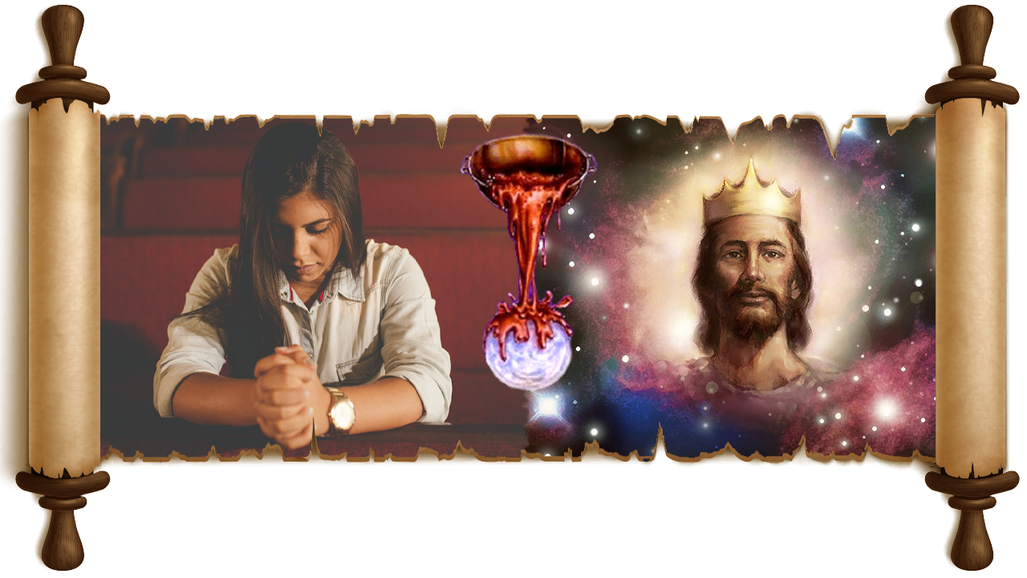

IN THE PSALMS
PART 2
Lesson 9 for May 31, 2025

Slide 2
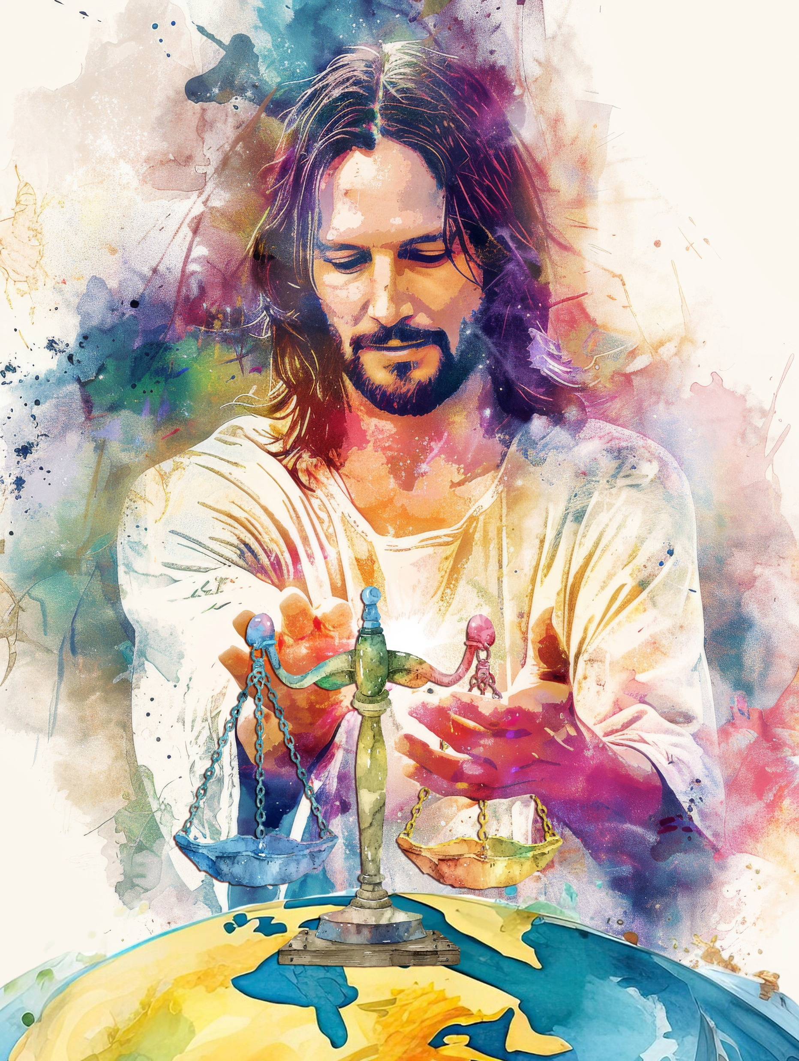
“Let the peoples praise You, O God; let all the peoples praise You. Oh, let the nations be glad and sing for joy! For You shall judge the people righteously, and govern the nations on earth. Selah”
Psalm 67:3, 4, NKJV

Slide 3

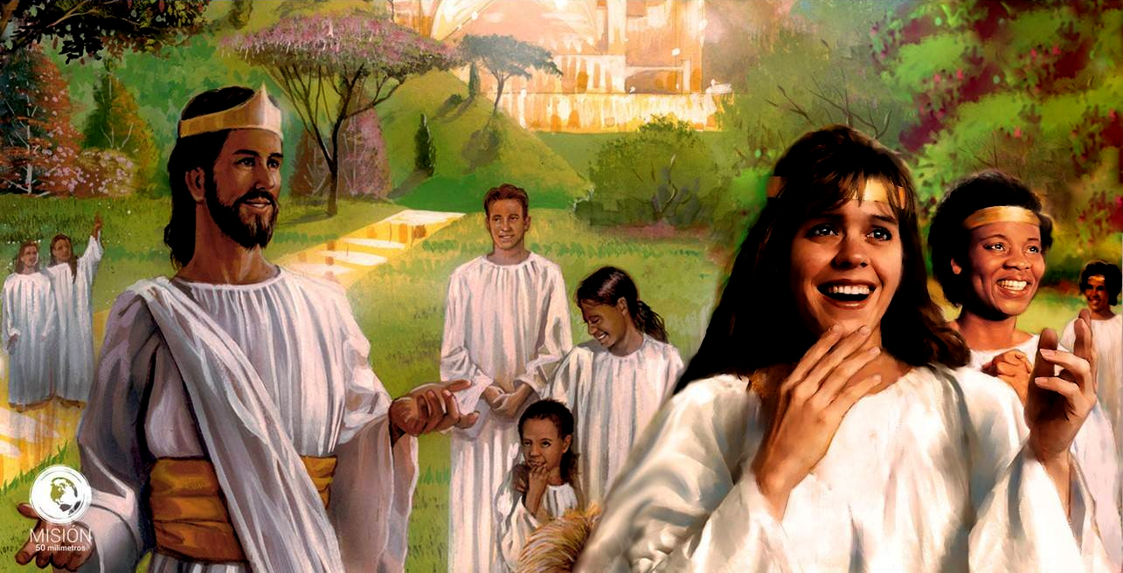




Among the prophecies we find in Psalms, we can appreciate the final events that lead to the definitive establishment of God's government on this Earth.
In the various psalms we will study, we will see the progression of events that will unfold from the moments prior to the Second Coming until the destruction of sin after the Millennium.
With these events in mind, what is our mission now?
Psalm 46: Hope in Distress.
Psalm 47: The Final Victory.
Psalm 75: The End of Sin.
Psalm 67: Our Task Today.

Slide 4

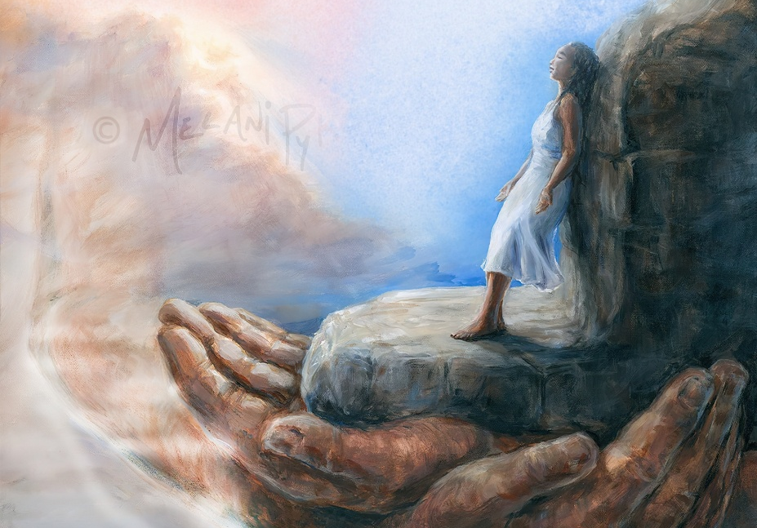
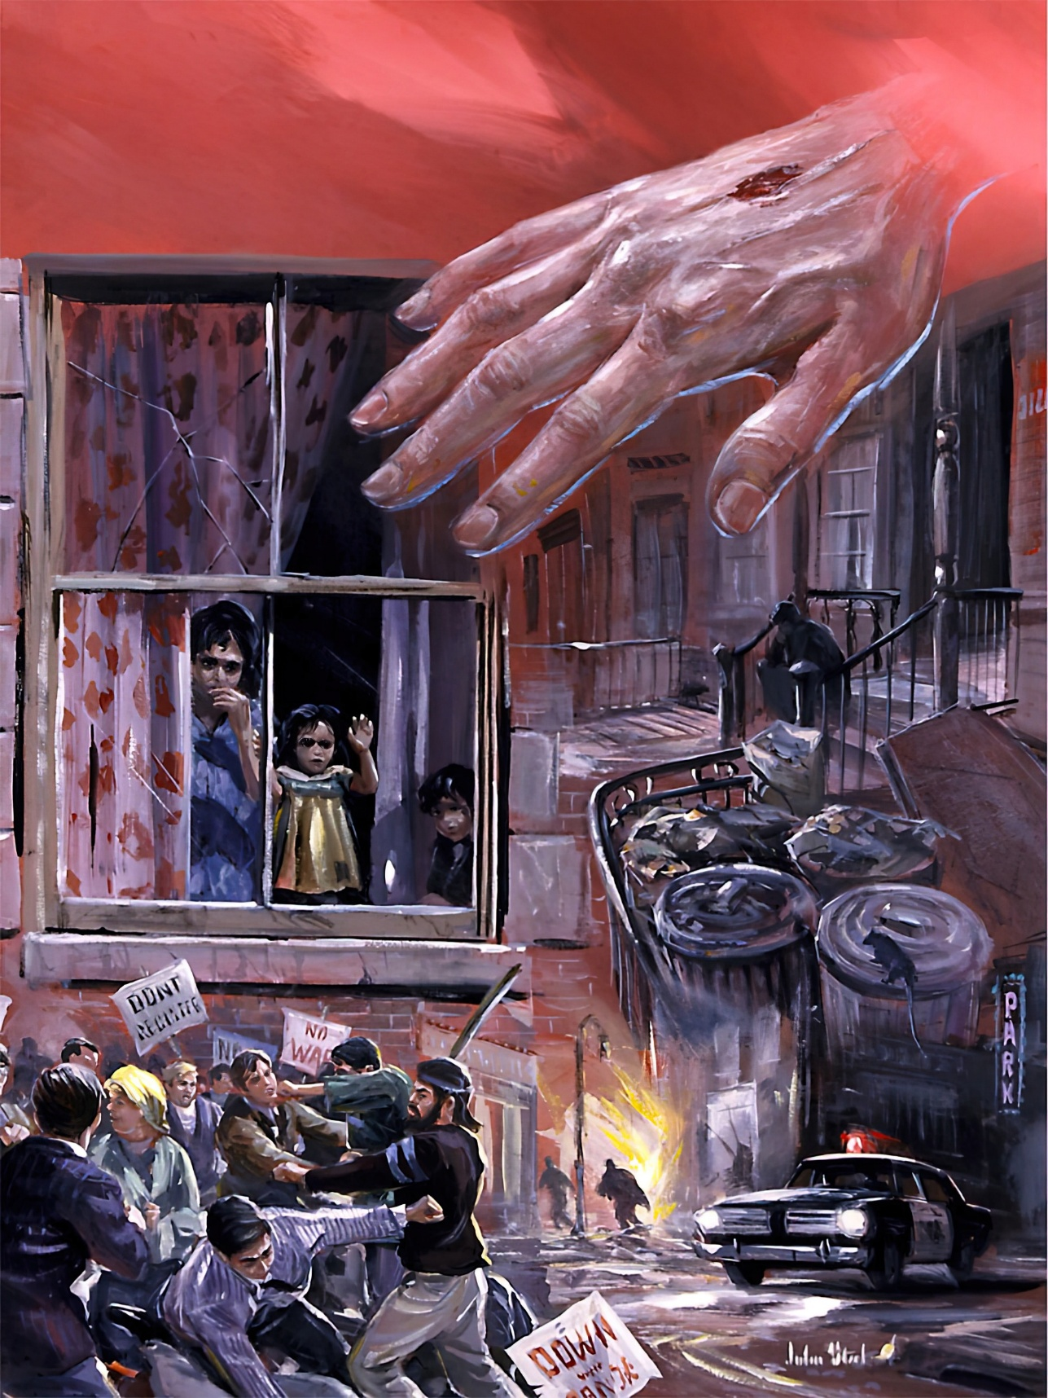
HOPE IN DISTRESS (1)
“God is our refuge and strength, an ever-present help in trouble” (Psalm 46:1)
What events does Psalm 46 predict? How do they relate to the prophecies of Revelation 6:14 or 2 Peter 3:12? How will they affect me?
What's happening on Earth?
It is removed
The mountains move
What does God do?
Protects and strengthens us
He helps us in tribulation and gives us joy
What do I do?
See the works of God
Do not fear
The waters roar
The nations roar
Melts the earth
It is our refuge
He puts an end to wars
He is exalted and exalted among the nations
Be still and know God
Take refuge in God

Slide 5

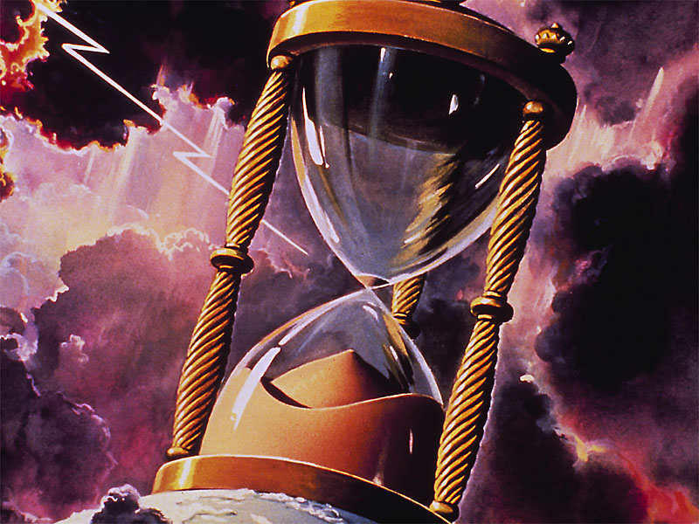
HOPE IN DISTRESS (2)
“Nations are in uproar, kingdoms fall; he lifts his voice, the earth melts” (Psalm 46:6 NIV)
In just one verse, verse 6 (NIV), Psalm 46 describes what the end of the known world will be like:
Nations are in uproar
Kingdoms fall
God lifts his voice
The earth melts
Because of the ongoing natural and political disorders, governments will unite under a common body (the image of the Beast) seeking desperate solutions. This will negatively affect God's people, who will be persecuted as the cause of these disorders.
The last plagues will ravage and shake the nations, which will turn against one another (Rev. 17:16).
Jesus, “with a shout […] and with the trumpet of God” will come to end the history of the nations
(1 Thess. 4:16).
As Jeremiah indicates, the land will be left desolate and empty (Jer. 4:23-26).

Slide 6


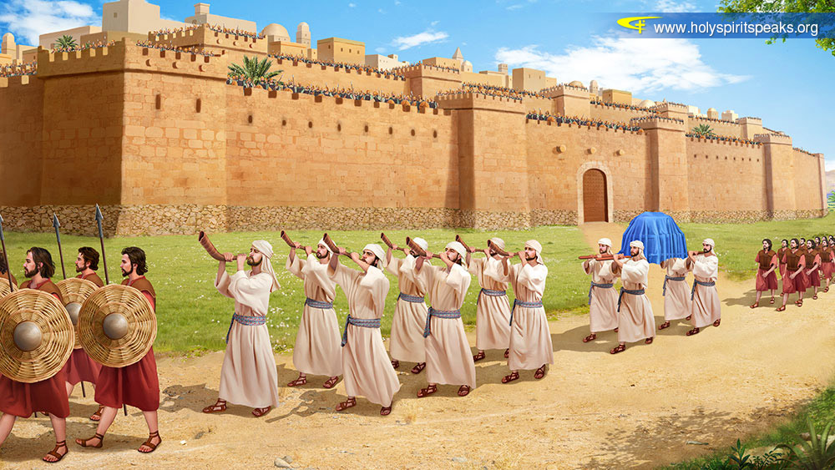
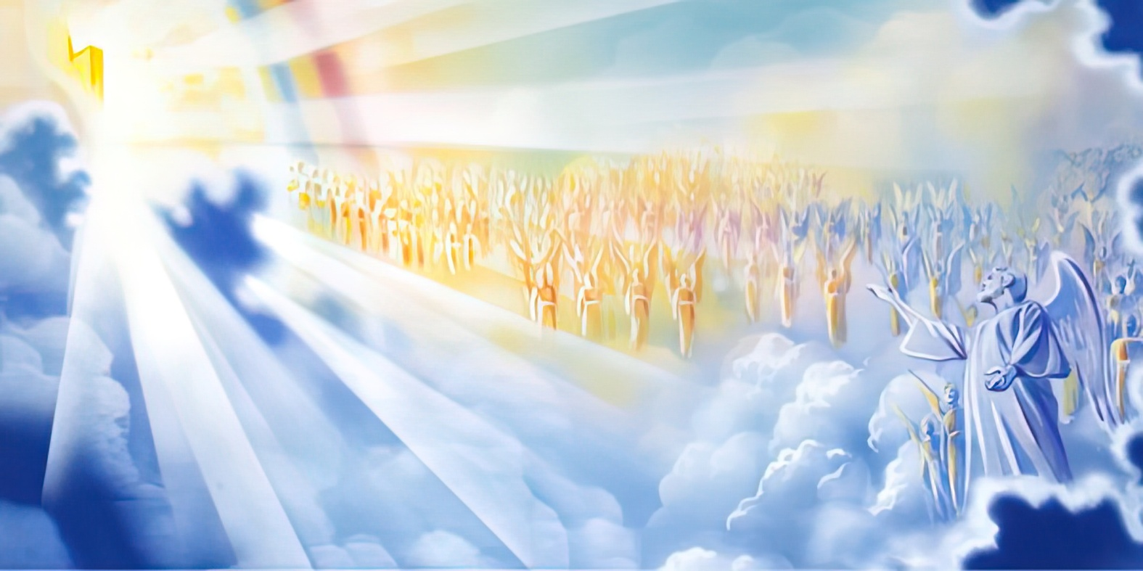
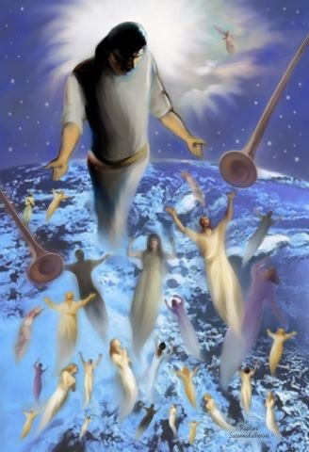
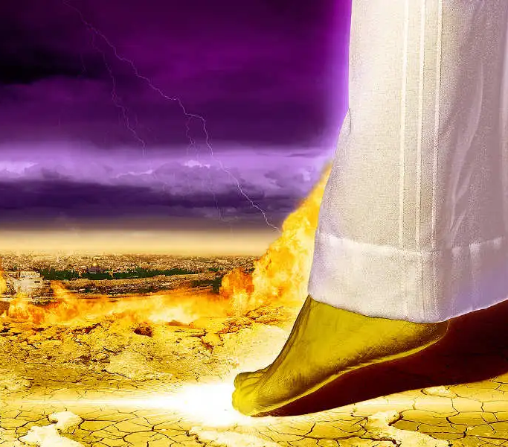
THE FINAL VICTORY
“He subdued nations under us, peoples under our feet” (Psalm 47:3)
Setting foot in a place was in ancient times a way of representing the right to possession of the territory (Dt. 11:24), something similar to what is done now by planting or raising a specific flag in a place.
When Satan stood before God and said he had come “From roaming throughout the earth, going back and forth on it” (Job 1:7), he was manifesting his ownership of our planet.
The day will come when the property he usurped will be restored to its rightful owner. But it will not be at the Second Coming, when Jesus will not touch the earth with his foot, but rather we will ascend to Him
(1 Thess. 4:16-17).
It will be after the Millennium, when Jesus will touch the ground with his foot, making room to house the New Jerusalem – in the presence of his enemies – and defeating them definitively (Zech. 14:4-5; Rev. 20:7-9).

Slide 7

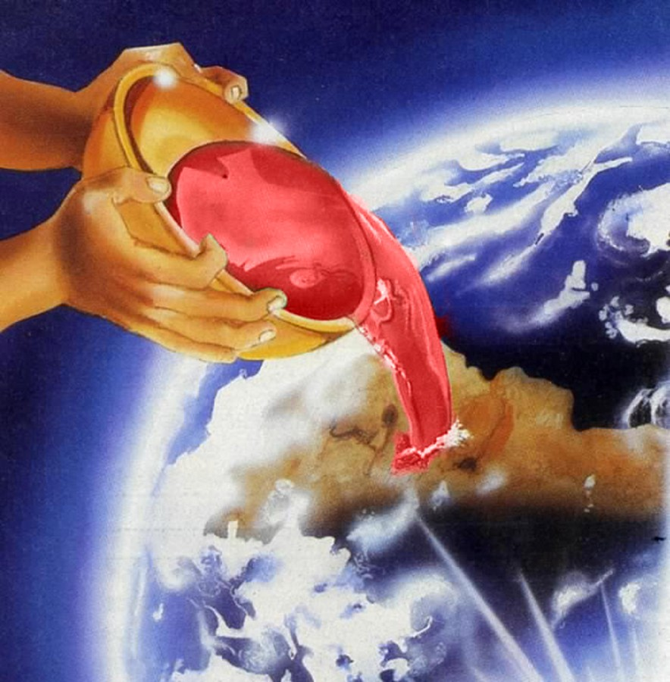
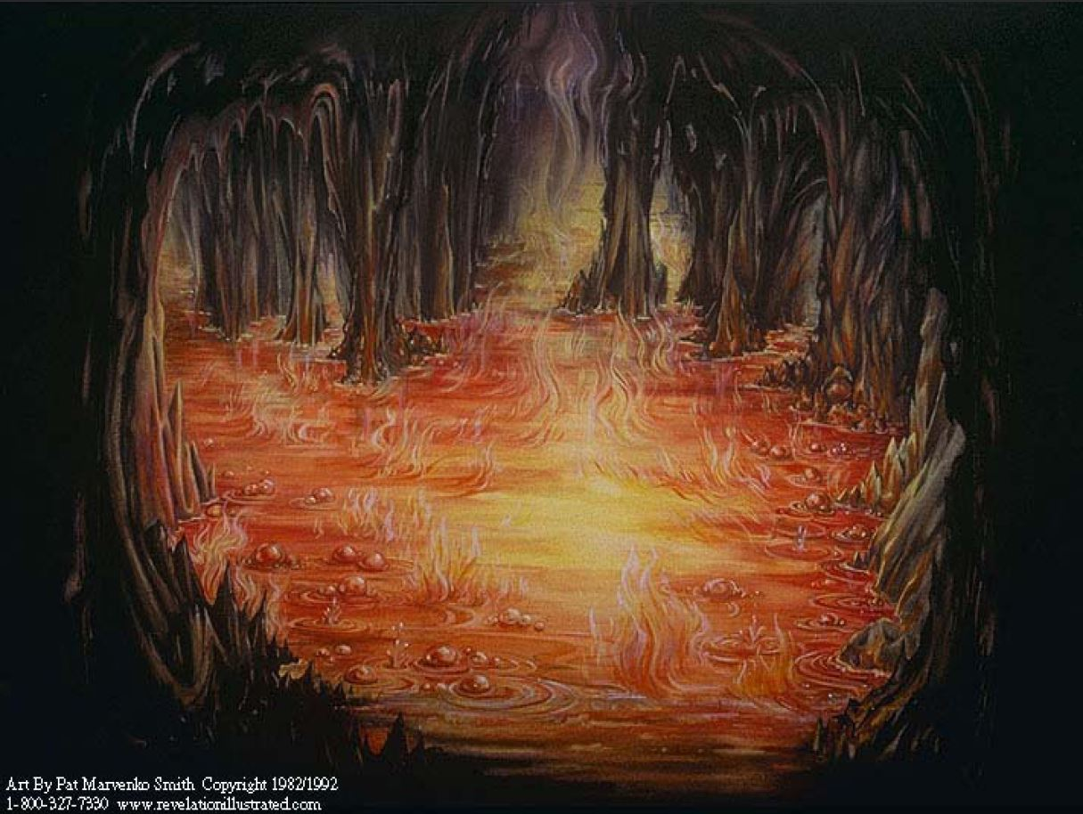

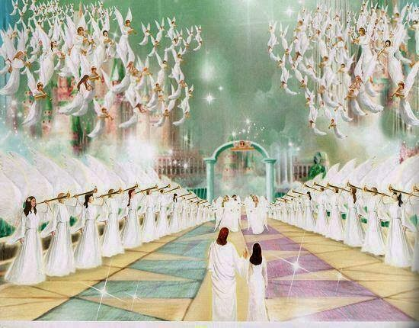
THE END OF SIN
“In the hand of the Lord is a cup full of foaming wine mixed with spices; he pours it out, and all the wicked of the earth drink it down to its very dregs” (Psalm 75:8)
Psalm 75 sounds very similar to the third angel's message, where the wicked must drink from the cup of God's wrath (Ps. 75:8; Rev. 14:9-10).
The crucial point that determines the destiny of individuals and nations is pride (Ps. 75:4-5). The pride of leaders, seeking to maintain and increase their power; and the pride of individuals, which leads them to stubbornly reject God and exalt themselves (and their most vile sins, which they proudly proclaim).
When will this happen? After the final judgment, when all the wicked will be destroyed in the lake of fire, which is the second death (Ps. 75:2, 7; Rev. 20:11-15).
But for the humble who submit to God, the future will be very different, for we will be exalted by God before all the universe (Ps. 75:10; James 4:10).

Slide 8

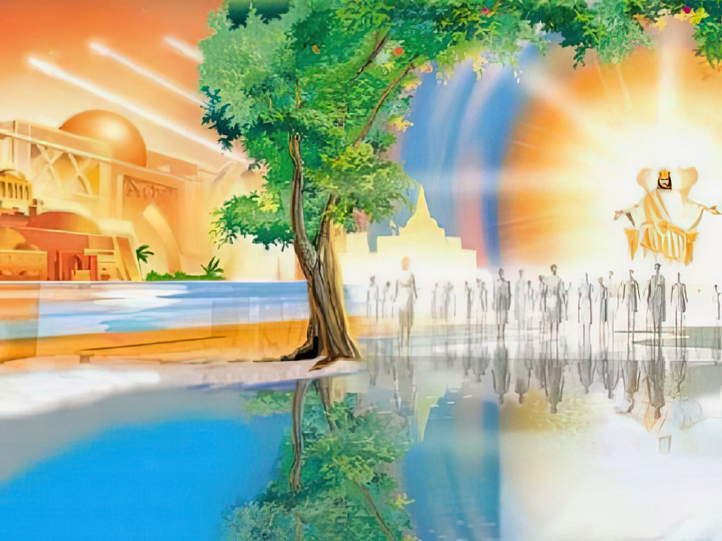
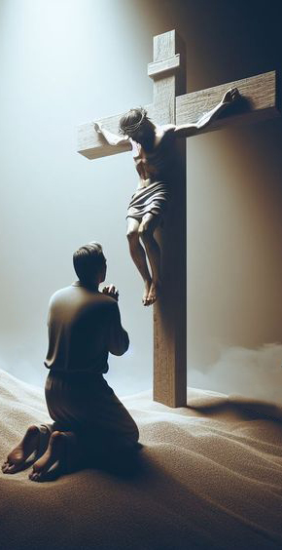

OUR TASK TODAY
“so that your ways may be known on earth, your salvation among all nations” (Psalm 67:2)
Revelation tells us of a day when the glory of God will shine so brightly that we will not need the light of the sun (Rev. 22:5).
Psalm 67:1 seems to anticipate that moment, asking God to “make his face shine on us.” This idea is also present in the priestly blessing (Numbers 6:25).
Only Christ's death on the cross makes it possible for God's face to shine upon us. It is evident that this will only fully occur when we are with Him. But can God's face shine upon us now?
Yes! But He doesn't do it just to make us happy and encouraged. God's face shines upon us so that we may reflect His glory for the benefit of others, so that the world may know God and praise Him (Ps. 67:3-7).

Slide 9

“Fellow pilgrim, we are still amid the shadows and turmoil of earthly activities; but soon our Saviour is to appear to bring deliverance and rest. Let us by faith behold the blessed hereafter as pictured by the hand of God. He who died for the sins of the world is opening wide the gates of Paradise to all who believe on Him. Soon the battle will have been fought, the victory won. Soon we shall see Him in whom our hopes of eternal life are centered. And in His presence the trials and sufferings of this life will seem as nothingness.”
EGW (Prophets and Kings, pg. 732)

