Slide 1
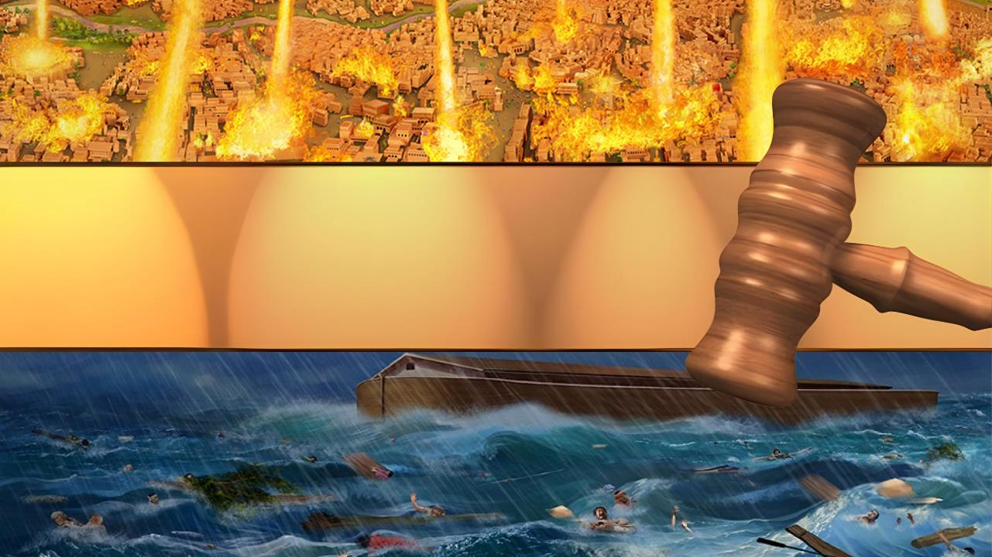
UPON WHOM THE ENDS HAVE COME
Lesson 10 for June 7, 2025

Slide 2
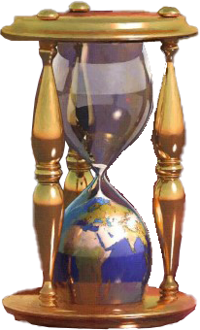
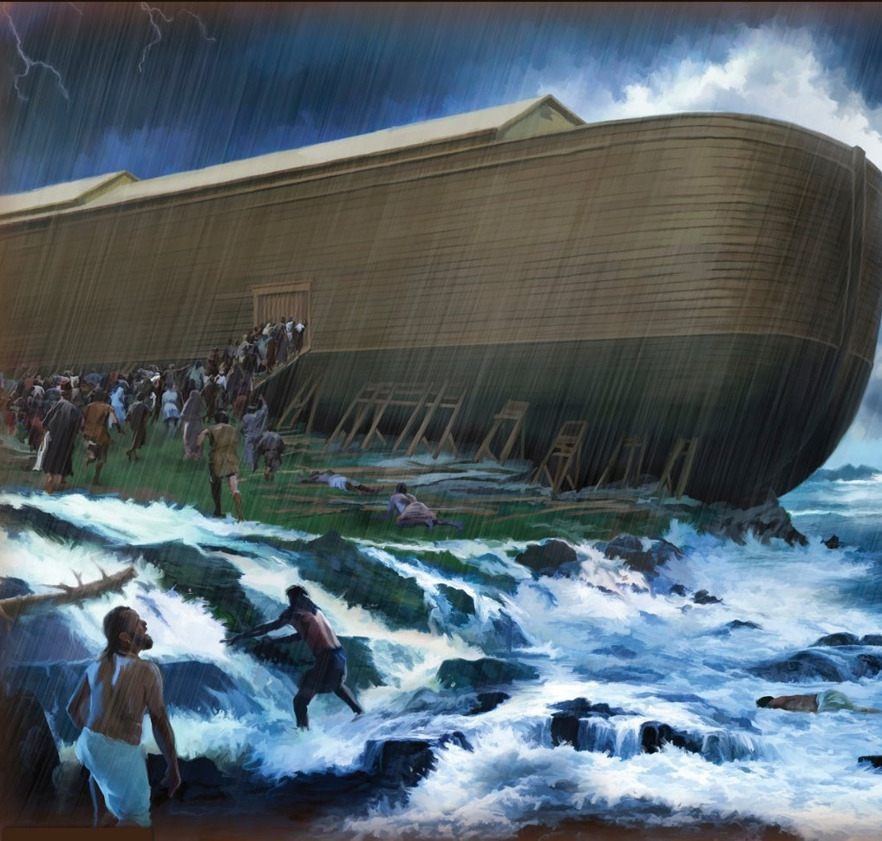
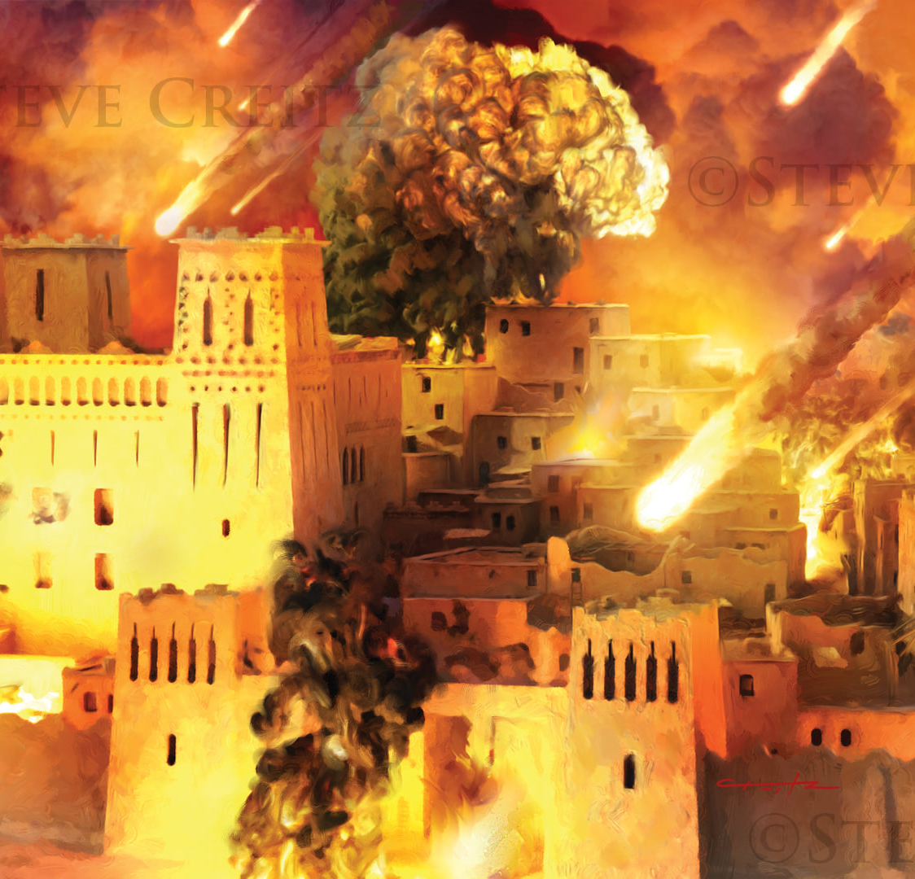
“Now all these things happened to them as examples, and they were written for our admonition, upon whom the ends of the ages have come. Therefore let him who thinks he stands take heed lest he fall”
1 Corinthians 10:11, 12, NKJV

Slide 3

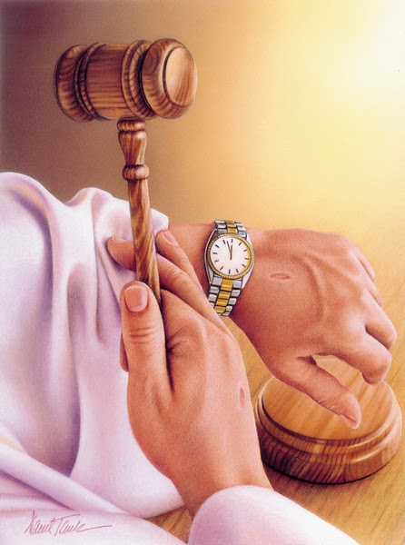
On several occasions, Jesus spoke about the end of our world.
When speaking about this topic, he gave as an example the moments in which God had to destroy the antediluvian world, and the cities of Sodom, Gomorrah, Admah and Zeboim.
These two historic occasions were crucial in the life of humanity. They are a clear example of divine judgment and a warning about the end of redeeming grace.
The end is coming for the antediluvian world:
  A long-announced end
  The closing of the door of grace
The end comes for the cities of Sodom and Gomorrah:
  The reasons for the destruction
  The judgment before destruction
The end of our world is coming:
  The judgment before the close of grace

Slide 4

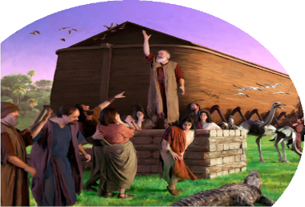
THE END IS COMING FOR THE ANTEDILUVIAN WORLD

Slide 5

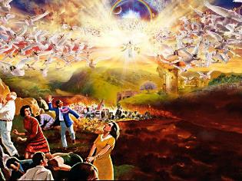
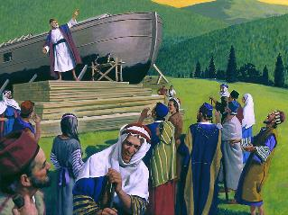
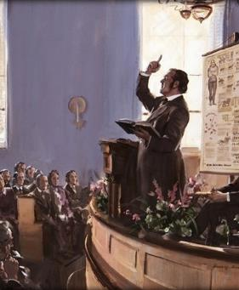
A LONG-ANNOUNCED END
“But as the days of Noah were, so shall also the coming of the Son of man be” (Matthew 24:37)
The world reels as if it were spinning out of its orbit. Everything shakes. Suddenly, the sky fades like a scroll being rolled up… The hour has come. Jesus appears, filling the heavens with His glory (Rev. 6:12-14).
But many do not receive it with shouts of joy and gladness, but with cries of panic and fear: “Hide us from the face […] of the Lamb [Jesus]” (Rev. 6:16).
Jesus compared the end of the world to the days of Noah (Matthew 24:37). What similarities do you find with the description in Revelation?
The world was shaken. Along with the rain, waters emerged from the earth itself (Gen. 7:11-12). But it did not happen without warning. For 120 years, the “preacher of righteousness” had been warning of the coming flood (Gen. 6:3; 2 Pet. 2:5).
Similarly, since the end of the 18th century, people have been preaching about the imminent coming of Jesus. So, those who flee from Jesus at that time will not be because of ignorance but because they have not wanted to believe in Him.

Slide 6

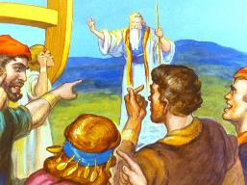
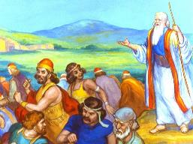
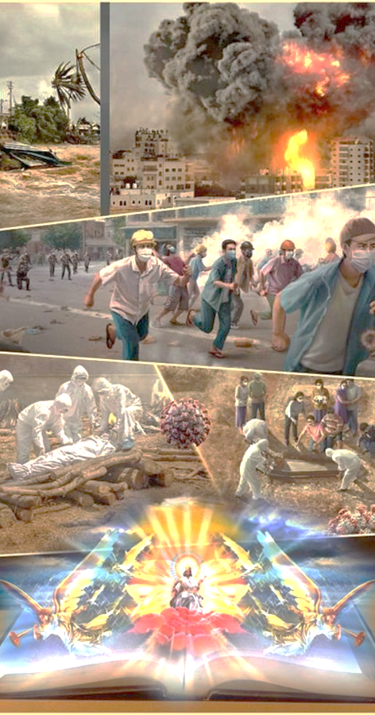
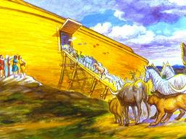
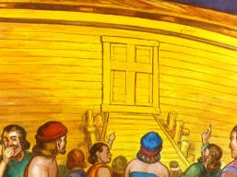
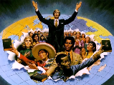
THE CLOSING OF THE DOOR OF GRACE
“By faith Noah, being warned of God of things not seen as yet, moved with fear, prepared an ark to the saving of his house; by the which he condemned the world, and became heir of the righteousness which is by faith” (Hebrews 11:7)
While preparing the ark, Noah warned his fellow citizens of its impending destruction and called them to repentance. Seven days before the event, Noah entered the ark, and God closed the door (Gen. 7:1-4, 15-16).
Despite observing extraordinary events, such as the peaceful entry of the animals into the ark, they continued with their daily activities (Luke 17:27). No one wanted to enter the ark before the door was closed.
World events warn us of Jesus' imminent arrival. It is our duty to warn this world and give them the opportunity to accept Jesus before the door of divine grace closes. Many will scoff, but others will accept. Take heart, the final harvest will be far more abundant than that reaped by Noah!

Slide 7

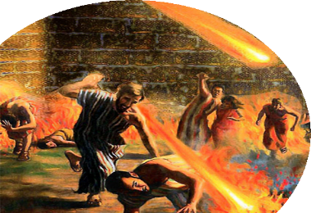
THE END IS COMING FOR THE CITIES OF SODOM AND GOMORRAH

Slide 8

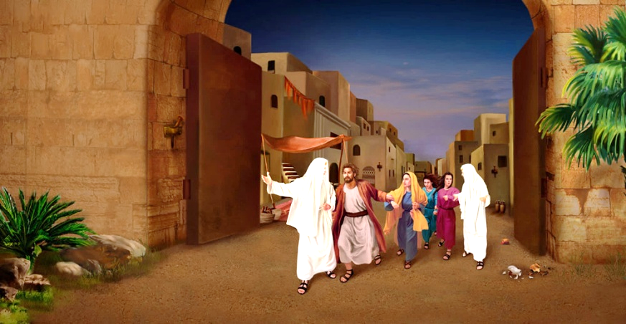
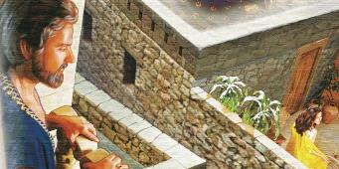
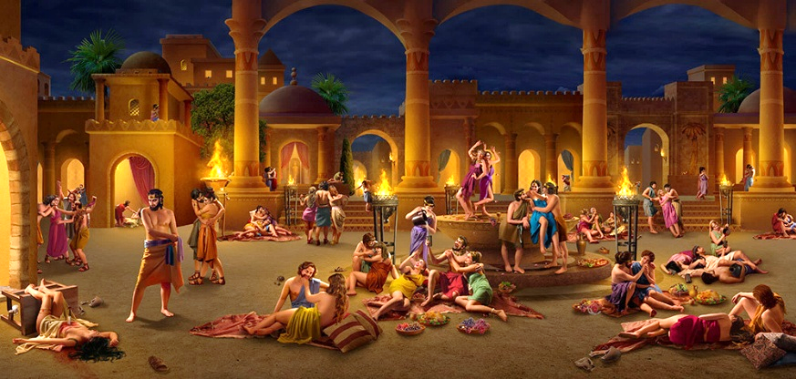
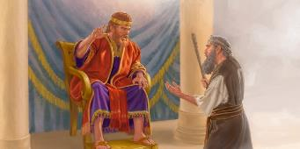

THE REASONS FOR THE DESTRUCTION
“Even as Sodom and Gomorrah, and the cities about them in like manner, giving themselves over to fornication, and going after strange flesh, are set forth for an example, suffering the vengeance of eternal fire” (Jude 1:7)
Jesus compared His Second Coming to the time when Lot was taken out of Sodom and fire consumed the city (Luke 17:28-30).
If the comparison with the time of Noah speaks to us of unbelief, the times of Lot speak to us of immorality and social disorder
(Jude 1:7; Ezek. 16:49-50; 2P. 2:6-8).
The hearts of men have always been wicked (Jer. 17:9; Rom. 1:24-32). Even Christians have committed shameful acts. However, these days wickedness is proclaimed as virtue, and virtue itself is ridiculed. Consciences, like David's, have been numbed.
Our world needs people like Nathan who will awaken those consciences and encourage them with the message: “The Lord has taken away your sin. You are not going to die” (2 Sam. 12:13 NIV).

Slide 9

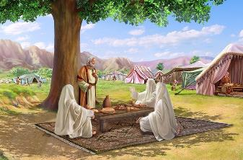
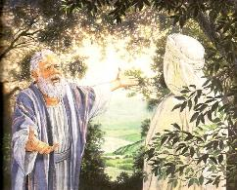
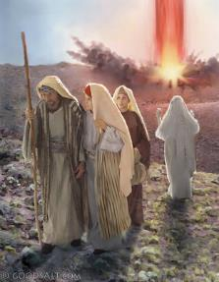
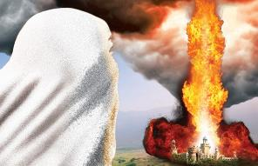
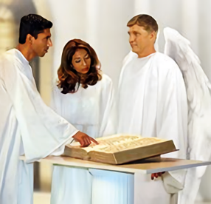
THE JUDGMENT BEFORE DESTRUCTION
“I will go down now, and see whether they have done their work according to the cry of it that is come unto me; and if not, I will know” (Genesis 18:21)
The wickedness of Sodom was evident. But before destroying it, God carried out an investigative judgment (Gen. 18:21). Accompanied by two angels, he went to Sodom and intentionally passed by Abraham's house.
Not wanting to hide his intentions from Abraham, he told him what he was going to do (Gen. 18:17-21; Amos 3:7). Then the unexpected happened: God's own character was judged (Gen. 18:23-25).
The next morning, Abraham could see that God was indeed a just Judge. He had executed justice, condemning the wicked and saving the righteous
(Gen. 19 :27-29).
For a thousand years, we will have opportunity to review divine judgment, and to know for ourselves the just character of God in his dealings with sin. (Rev. 20:4).

Slide 10

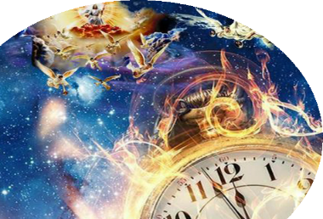
THE END IS COMING FOR OUR WORLD

Slide 11

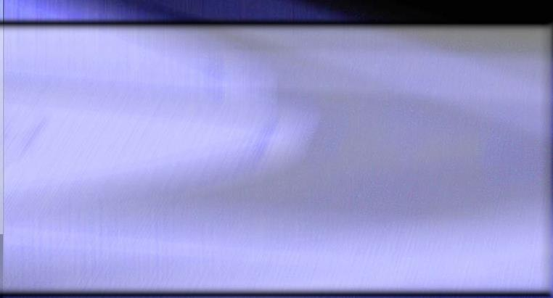
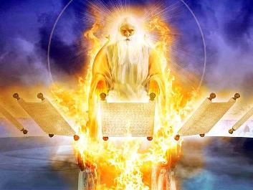
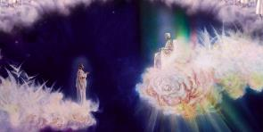
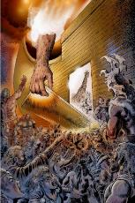
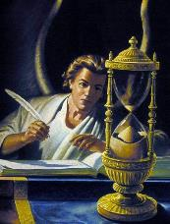
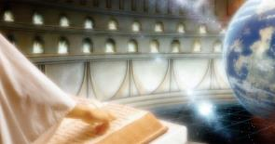
THE JUDGMENT BEFORE THE CLOSE OF GRACE
“thrones were set in place, and the Ancient of Days took his seat, […] The court was seated, and the books were opened” (Daniel 7:9-10)
Daniel recounts a scene of judgment taking place in Heaven while human activities continue their course, oblivious to what is happening there (Dan. 7:9-12).
At that judgment before the Second Coming, Jesus is recognized as worthy of “dominion, glory, and a kingdom” (Dan. 7:13-14). Then he will come to end the history of this world (Dan. 7:26) and make us sharers in his eternal kingdom (Dan. 7:27).
Does God need to make a judgment to determine who is saved? He doesn't, but his angels do. That's why he sent angels to Sodom to investigate
(Gen. 18:21-22).
The time between the end of the Judgment and the Second Coming is exemplified by the closing of the ark's door seven days before the flood. Every case will have been decided, and divine grace will have covered all of us who have clung to it (James 2:12-13; 1 John 4:17).

Slide 12

EGW ( Present Truth, November 4 , 1886)
“If the saints of the Old Testament were to be bright and shining lights to the world, we are bound to shine brighter than they, because we have all the light which they had flashing upon our pathway from the prophetic past and the additional light which has come to us in the life of Christ. Fuller prophecies reveal the true Jehovah to those upon whom the ends of the world are come. God has a special light in this age of the world, a special message to give in the proclamation of the third angel's message—the commandments of God and the testimony of Jesus Christ.”

