Slide 1
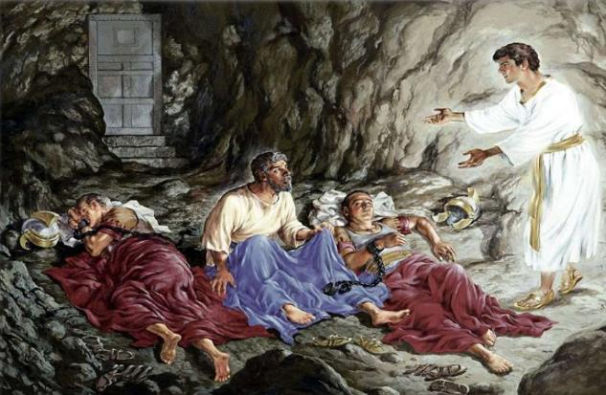
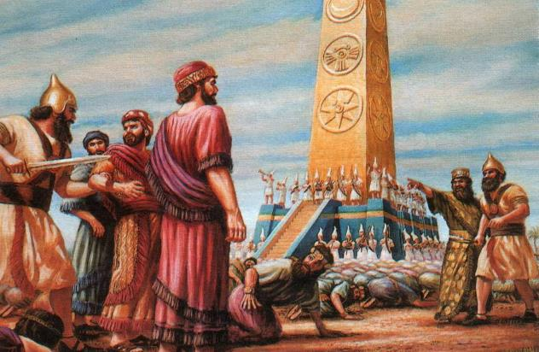
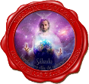
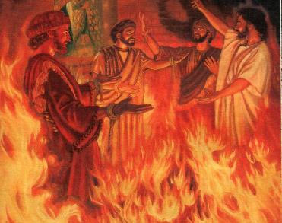
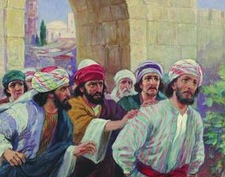
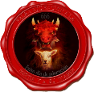
Lesson 12 for June 21, 2025
PRECURSORS

Slide 2
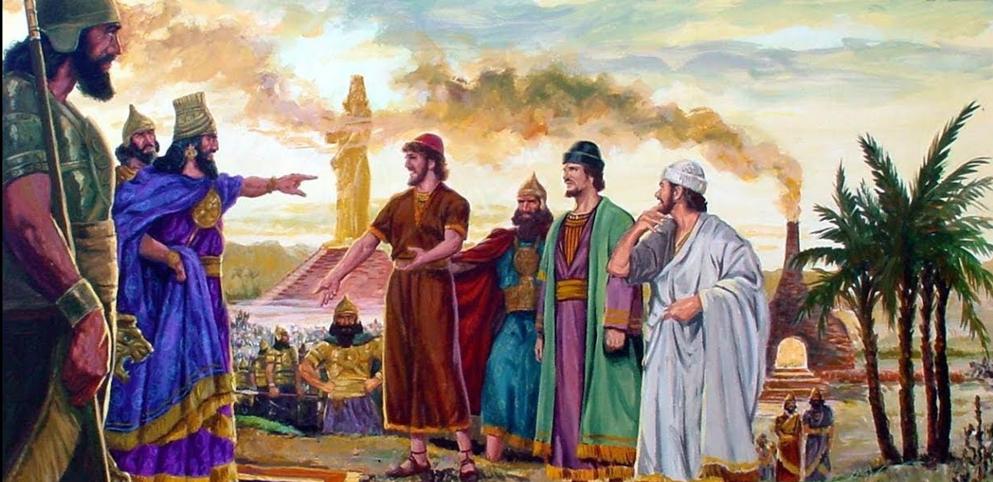
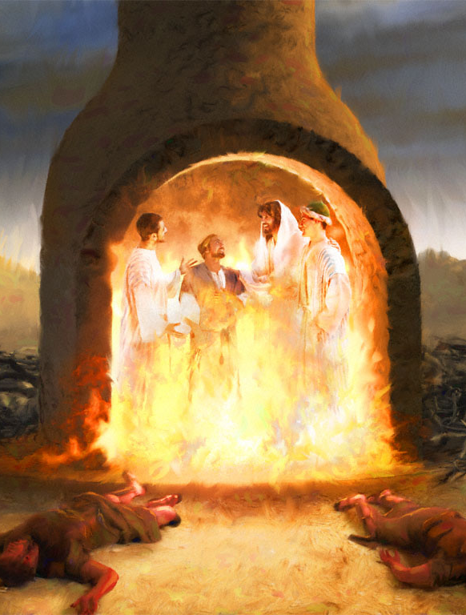
“For God has not given us a spirit of fear, but of power and of love and of a sound mind”
2 Timothy 1:7, NKJV

Slide 3
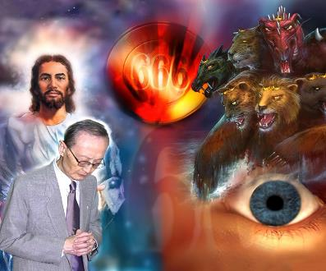
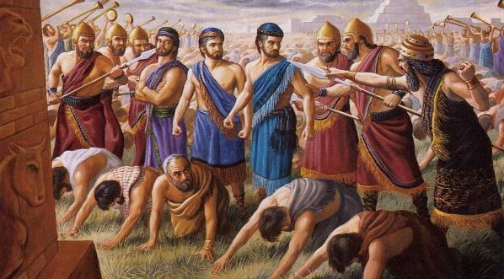
Revelation prophetically recounts the events that will occur in the end times. These events include times of persecution, and even death, for those who choose to worship God instead of the image of the beast. But it is not the only place in the Bible where we can investigate these events.
In the experience of the three young Hebrew friends of Daniel; in the death of James; in the liberation of Peter; or in the persecution Jesus himself suffered because of the Sabbath, we see precursors of those crucial moments yet to come.
Precursors in the Old Testament:
A warning image
Worship or die
Worship in the end time
Precursors in the New Testament:
James and Peter
The Sabbath and the End Time

Slide 4
PRECURSORS IN THE OLD TESTAMENT

Slide 5
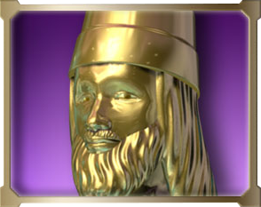
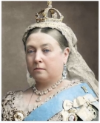
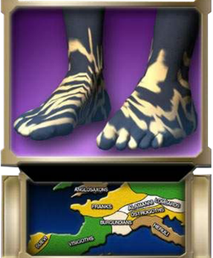
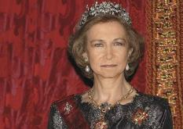
A WARNING IMAGE
“And whereas thou sawest iron mixed with miry clay, they shall mingle themselves with the seed of men: but they shall not cleave one to another, even as iron is not mixed with clay” (Daniel 2:43)
The interpretation of the image dreamed by King Nebuchadnezzar, recorded in Daniel 2, lays the foundation for the biblical interpretation of world empires.
For example, Babylon is announced as a wealthy but temporary empire. It is also foretold what the nations of the end will be like: mixed “through human alliances,” but not united (Dan . 2:43).
Queen Victoria of England (reigned 1837–1901) is considered the “Grandmother of Europe” for marrying her nine children and 26 of her 42 grandchildren to other members of European royalty or nobility.
In 1962, Sofia, the daughter of King Paul of Greece, married Juan Carlos I, the King of Spain. She is also the niece of the Duke of Edinburgh; she has family ties to the King and Queen of England; Queen Margrethe of Denmark; and King Harald of Norway.

Slide 6
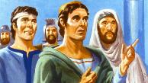
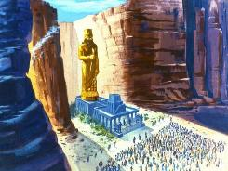
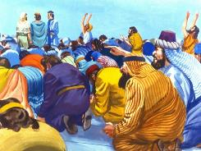
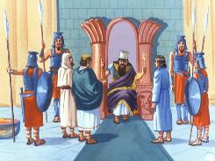
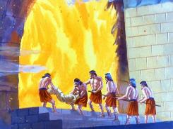
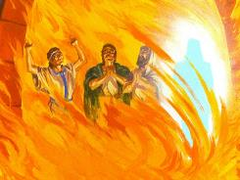
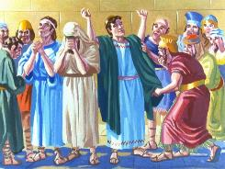
WORSHIP OR DIE
“But if not, be it known unto thee, O king, that we will not serve thy gods, nor worship the golden image which thou hast set up” (Daniel 3:18)
In clear rebellion against the history that had been revealed to him in dreams, Nebuchadnezzar set up a golden statue to indicate that his kingdom would have no end (Dan. 3:1).
Not content with that, he made everyone accept his “eternal” leadership by having them worship that statue. (Dan. 3:2). This order was accompanied by a death sentence for anyone who refused to do so (Dan. 3:6).
But three faithful young men were not prepared to worship an image, thus breaking God's Law. They could have pretended not to, but that would have been tantamount to openly denying their beliefs.
They accepted the consequences and chose to die (Dan. 3:15-18). However, God did not allow His faithful subjects to die in the fire. He Himself walked with them through the trial and delivered them (Dan. 3:23-27).

Slide 7
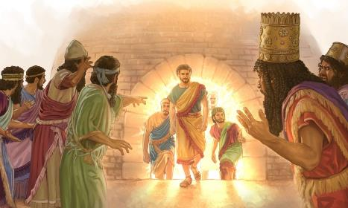
WORSHIP OR DIE
“But if not, be it known unto thee, O king, that we will not serve thy gods, nor worship the golden image which thou hast set up” (Daniel 3:18)
According to the story of their endurance, these three Hebrews did not waver in their conviction to remain faithful to God.
BABYLON GROUP
Noisy (Dan. 3:4)
Powerful (Dan. 3:2)
GROUP OF FAITHFUL
Silent (Dan. 3:16)
Humble (Dan. 3:12)
Numerous (Dan. 3:7)
Only three men (Dan. 3:23)
Present-oriented: “worshipped” (Dan . 3:7)
Future-oriented: “God is able to deliver us” (Dan. 3:17)
Obey out of fear (Dan. 3:10-11)
They obey, even though God does not deliver them (Dan. 3:18)
The two groups of worshippers, that of Babylon and that of the three Hebrews, were thus clearly delineated and contrasted, just as will occur in the time of the end:

Slide 8
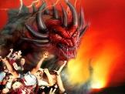
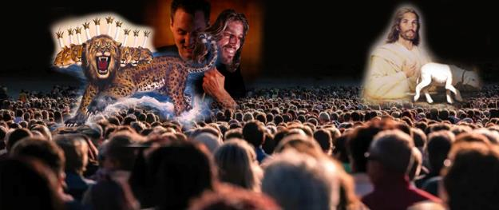
WORSHIP IN THE END TIME
“And he had power to give life unto the image of the beast, that the image of the beast should both speak, and cause that as many as would not worship the image of the beast should be killed” (Revelation 13:15)
Daniel 3
Nebuchadnezzar makes a statue
Forces everyone to worship it
Revelation 13 and 14
The 2nd beast makes a statue
Forces everyone to worship it
Whoever does not worship it must die
Whoever does not worship it must die
Three young people refuse
The remnant people refuse
They testify before the king and his subjects
Testify before the whole world
They are thrown into the oven
They are persecuted
Jesus comes to rescue them
Jesus comes to rescue them
The final moments of this world revolve around worship. Worshiping the Creator, or the creature. Being loyal to God, or to whatever else or anyone compels us to obey Him.
In such difficult times, faithfulness to God will be rewarded: “Be thou faithful unto death, and I will give thee a crown of life. […] He that overcometh shall not be hurt of the second death” (Rev. 2:10-11).

Slide 9
“Will the Lord forget His people in this trying hour? […] Did He forget the three worthies in the fiery furnace? or Daniel in the den of lions? […]
Though enemies may thrust them into prison, yet dungeon walls cannot cut off the communication between their souls and Christ. One who sees their every weakness, who is acquainted with every trial, is above all earthly powers; and angels will come to them in lonely cells, bringing light and peace from heaven. The prison will be as a palace; for the rich in faith dwell there, and the gloomy walls will be lighted up with heavenly light as when Paul and Silas prayed and sang praises at midnight in the Philippian dungeon.”
EGW (The Great Controversy, p. 626-627)

Slide 10
PRECURSORS IN THE NEW TESTAMENT

Slide 11
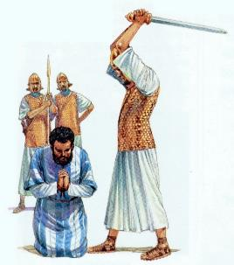
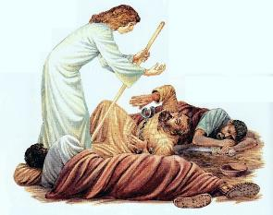
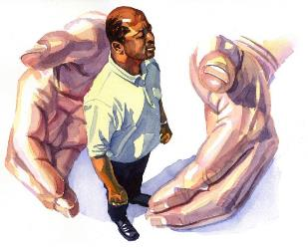
JACOB AND PETER
“Now about that time Herod the king stretched forth his hands to vex certain of the church” (Acts 12:1)
End-time persecution is nothing new for the Church. From its very birth, two nations persecuted it: the Jews and the Romans.
King Herod wanted to please the Jews and had the apostle James killed. (Acts 12:1-2 ). Seeing that his plan was working, he arrested Peter to carry it out (Acts 12:3-4 ).
Faced with this crisis, the church prayed without ceasing (Acts 12:5). The prayer was not answered immediately. Peter was saved just hours before his execution (Acts 12:6 ). Interestingly, Peter wasn't worried; he was fast asleep.
At the end of time, God will allow a few to die, like James, and the majority will be protected, like Peter. Angels will protect and sustain us. Jesus asks only one thing of us: “It does not matter whether I let you die or live until I come, only follow me to the end” (John 21:18-22 paraphrased).

Slide 12
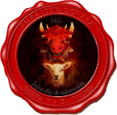
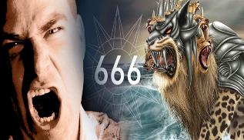
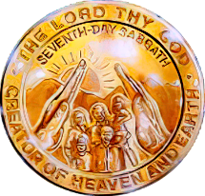
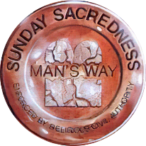
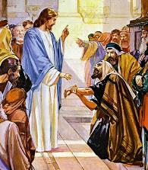
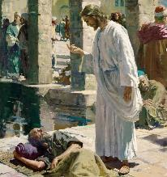
THE SABBATH AND THE END TIME
“so that they could not buy or sell unless they had the mark, which is the name of the beast or the number of its name” (Revelation 13:17 NIV)
To distinguish between those who worship the image and those who do not, a mark is placed on them. This mark is identified with the name or number of the beast. (Rev. 13:17 NIV).
Those of us who refuse to worship her bear the name of God as our distinctive mark. That is, some will have the character of Jesus, and others will have the character of the devil (the mark on their foreheads), or will deny Jesus with their actions (the mark on their hands).
How will this be manifested externally? The first angel's invitation speaks to us about worshiping the Creator. This leads us directly to the commandment to observe the Sabbath (Rev. 14:7; Ex. 20:8-11; Rev. 14:12).
This is nothing new. One of the reasons the Jewish leaders wanted to kill Jesus was related to his Sabbath-keeping (Matthew 12:9-13; John 5:1-16).

Slide 13
“There can be only two classes. Each party is distinctly stamped, either with the seal of the living God, or with the mark of the beast or his image. Each son and daughter of Adam chooses either Christ or Barabbas as his general. And all who place themselves on the side of the disloyal are standing under Satan's black banner, and are charged with rejecting and despitefully using Christ. They are charged with deliberately crucifying the Lord of life and glory.
Each one has an important question to answer for himself: Are you on the side of Satan, a transgressor of God's law, or are you loyal to that God”
EGW (The Review and Herald, January 30, 1900)

