Slide 1
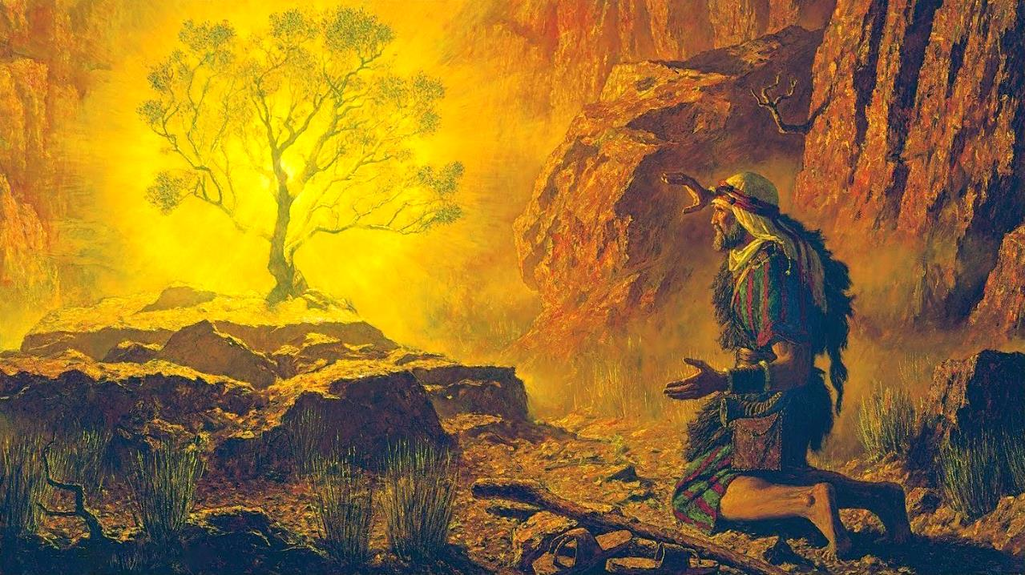
THE BURNING BUSH
Lesson 2 for July 12, 2025

Slide 2
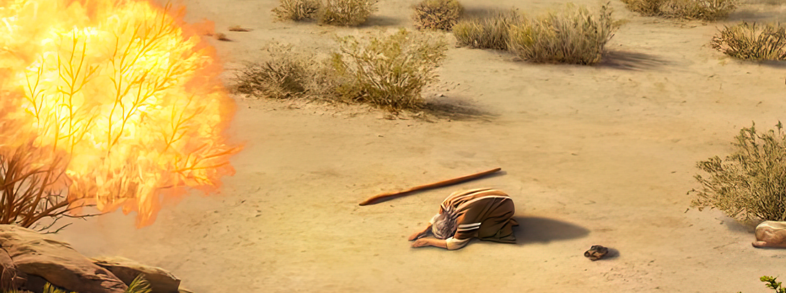
“And the Lord said: ‘I have surely seen the oppression of My people who are in Egypt, and have heard their cry because of their taskmasters, for I know their sorrows. So I have come down to deliver them out of the hand of the Egyptians, and to bring them up from that land to a good and large land, to a land flowing with milk and honey’ ” Exodus 3:7, 8, NKJV

Slide 3

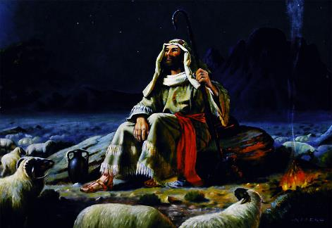
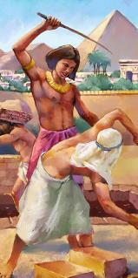
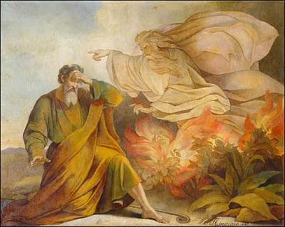







After failing in his attempt to liberate the people of Israel, Moses spent 40 years in the Midian Desert as a shepherd. During that time, although he continued his intimate relationship with God, he abandoned his idea of being Israel's liberator.
But God hadn't abandoned that idea. Moses remained, for Him, the chosen liberator. Because He hadn't forgotten the suffering of His people either. Now, the time had come to lead Israel out of their harsh slavery.
The Call (Exodus 3):
  The Burning Bush (Exodus 3:1-6)
  God's Orders (Exodus 3:7-12)
  The Name of God (Exodus 3:13-22)
Accomplish the mission (Exodus 4):
  Excuses and More Excuses (Exodus 4:1-17)
  The Return to Egypt (Exodus 4:18-31)

Slide 4

THE CALL

Slide 5

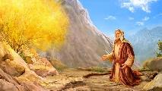
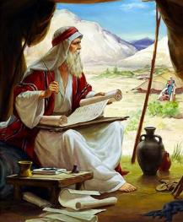
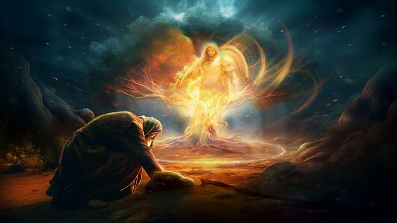
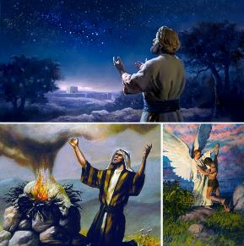
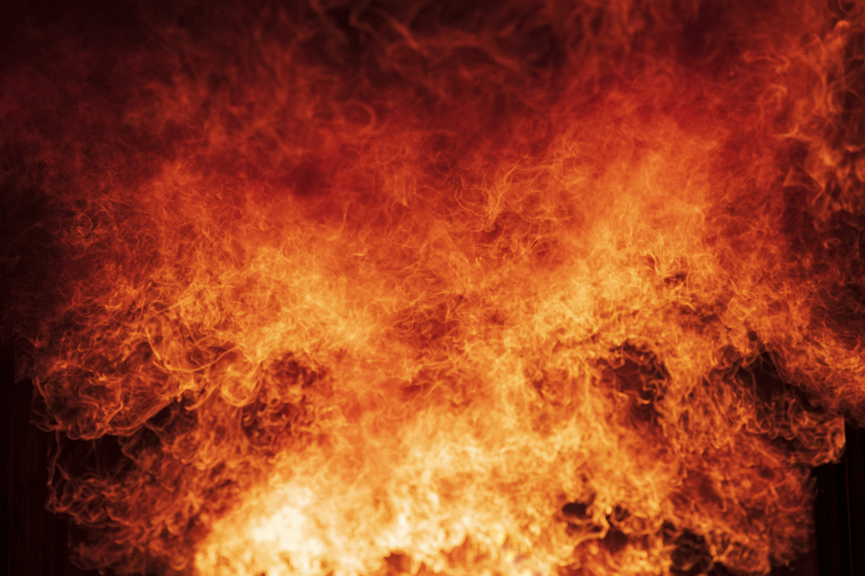
THE BURNING BUSH
“There the angel of the Lord appeared to him in flames of fire from within a bush. Moses saw that though the bush was on fire it did not burn up” (Exodus 3:2)
The 40 years Moses lived in Midian can be summed up as follows: he married, had two sons, and served as a shepherd for his father-in-law. He also dedicated that time to writing two books: Job and Genesis, essential to understanding the crucial themes of salvation. But everything changed in a moment.
At Horeb (Mount Sinai), the Angel of God appeared to Moses in a burning bush (Exod. 3:1-3). Who was this Angel? God Himself (Exod. 3:4).
Before becoming incarnate, Jesus appeared on multiple occasions as “the Angel of Jehovah” (Gen. 22:11-17; Judges 6:11, 16; 13:17-22; Zech. 3:1-2).
When speaking to Moses, God presented himself as the God of Abraham, Isaac, and Jacob. The idea was clear: God had come down to fulfill the promise made to these patriarchs and to give Israel the land of Canaan (Gen. 12:7; 26:3; 48:3-4).

Slide 6

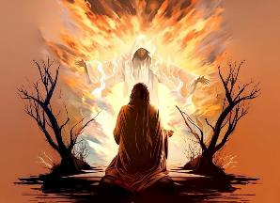
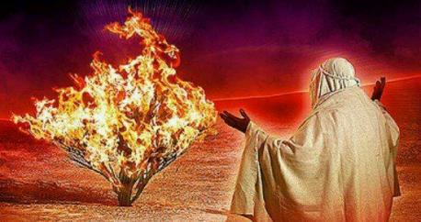
GOD'S ORDERS
“So now, go. I am sending you to Pharaoh to bring my people the Israelites out of Egypt” (Exodus 3:10)
God presents Himself as a dynamic Person, using action verbs: see, descend, and take out (Ex. 3:7-8).
SEE: God is not indifferent to suffering. He sees everything. He especially sees the pain and injustice committed against his people (2 Kings 9:26).
DESCEND: God does not stay still. He comes down to walk among us. He dwells among human beings
(Ex. 29:45; Jn. 14:16-17)
TAKE OUT: God, in His time, acts to free us from suffering and fulfill His promises (Jer. 29:11)
God also required definite actions from Moses: Go to Egypt and bring my people out of there (Ex. 3:10, 12). Moses was completely overwhelmed by the task. He no longer wanted to use his strength; he no longer felt capable of fulfilling the mission; he could only exclaim, “Who am I?” (Ex. 3:11). His pride had been transformed into humility. In fact, it was at this moment that he was ready for his mission.

Slide 7


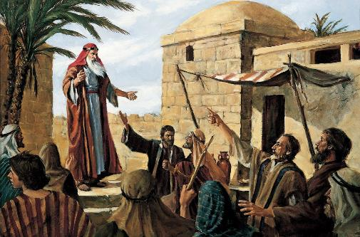
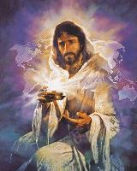
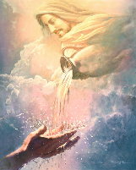
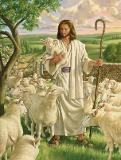
THE NAME OF GOD
“God said to Moses, “I am who I am. This is what you are to say to the Israelites: ‘I am has sent me to you.” (Exodus 3:14)
Every Egyptian god had a name, but Israel worshipped “God Almighty” (Exod. 6:3). After centuries of Egyptian pollution, the Israelites wanted to know the name of their Deliverer (Exod. 3:13).
Since in that time a name was linked to a person's character, God introduces himself with one of his main attributes: 'ehyeh (to be). God is eternal, has always been, is, and always will be. He is “I AM” (Ex. 3:14).
Over time, the pronunciation of this name was lost. God allowed this because what matters is not the name itself, but its character. He adapts to our needs. We can call Him “Shepherd,” “Healer,” “Provider,” “Father,” …, “Love.”
The important thing is that God wants us to feel close, accessible, necessary, and a close friend.

Slide 8
ACCOMPLISH
THE MISSION

Slide 9

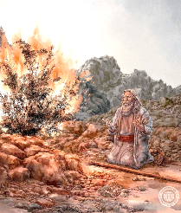
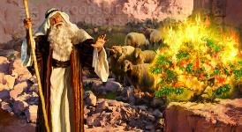
EXCUSES AND MORE EXCUSES
«But Moses said, “Pardon your servant, Lord. Please send someone else.”»
(Exodus 4:13 NIV)
Before openly admitting that he did not want to fulfill the mission God had entrusted to him, Moses presented four “perfect” excuses for rejecting it. For each excuse, God responded with a promise.
“Who am I?” (Ex. 3:11)
“I will be with you” (Ex. 3:12)
The power to fulfill God's commission lies not in us, but in the fact that God empowers us. He will be with us as He was with Moses.
“What is your name?” (Ex. 3:13)
“I am who I am” (Ex. 3:14)
God is true, eternal, and personal; he promises and always keeps his promises; timeless; always reliable.
“They will not believe me nor listen to my voice” (Ex. 4:1)
“They will believe you because of the signs you will do” (Ex. 4:8)
God gave Moses power to perform miracles, and he worked in the hearts of the people to believe in those miracles. Jesus also promised to do the same for us (Mark 16:17-18).
“I have never been a man of easy speech” (Ex. 4:10)
“I will teach you what you shall say”
(Ex. 4:12)
He who created the tongue will give us the necessary words at the necessary time (Ex. 4:11; Luke 12:11-12)
Finally, God said to Moses, “Enough with your excuses; you can do it, and you will do it” (Ex. 4:14-17).

Slide 10


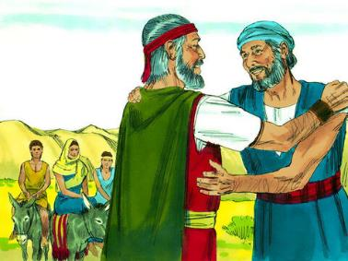
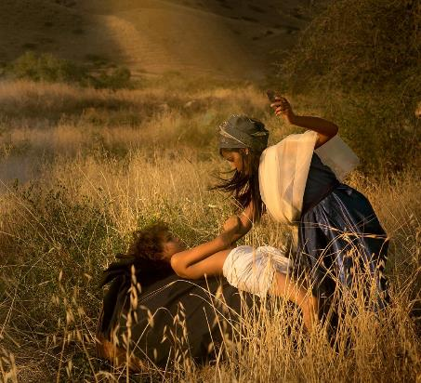
THE RETURN TO EGYPT
“At a lodging place on the way, the Lord met Moses and was about to kill him” (Exodus 4:24)
The first step Moses took in returning to Egypt was to ask his father-in-law for permission (Exod. 4:18 ). Taking his family, he began the journey (Exod. 4:20). But something surprising happened. Along the way, God wanted to kill him (Exod. 4:24 ).
Zipporah understood what was happening, and took the necessary measures to avoid the fatal outcome: she circumcised her son (Ex. 4:25).
Moses (influenced by his wife) had not circumcised his son. Therefore, he was disobeying the conditions of the covenant that God had established with Abraham (Gen. 17:10).
The conscious refusal to obey a clear divine command disqualified Moses from leading the people. This situation had to be remedied before he could fulfill his mission.

Slide 11

“A man will gain power and efficiency as he accepts the responsibilities that God places upon him, and with his whole soul seeks to qualify himself to bear them aright. However humble his position or limited his ability, that man will attain true greatness who, trusting to divine strength, seeks to perform his work with fidelity. Had Moses relied upon his own strength and wisdom, and eagerly accepted the great charge, he would have evinced his entire unfitness for such a work. The fact that a man feels his weakness is at least some evidence that he realizes the magnitude of the work appointed him, and that he will make God his counselor and his strength.”
EGW (Patriarchs and Prophets, p. 255)

