Slide 1

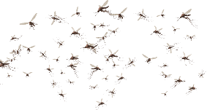
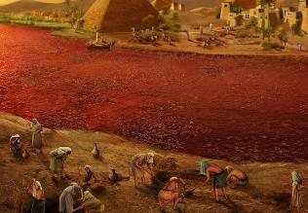
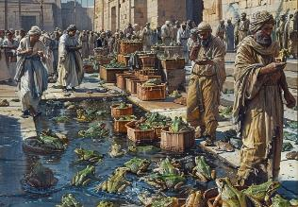
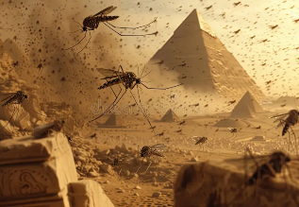
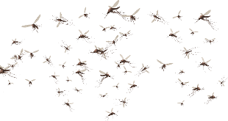
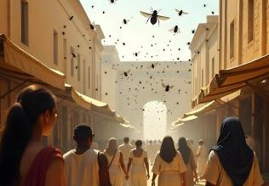
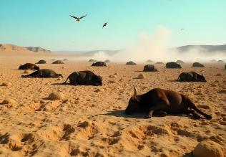
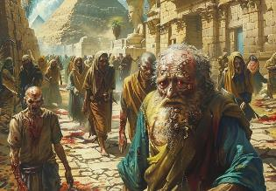
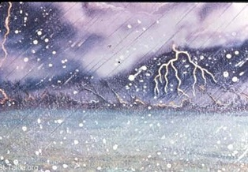
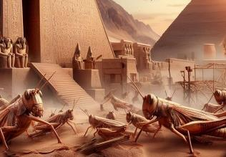
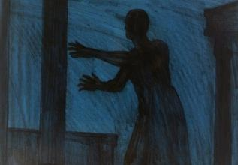
THE PLAGUES
Lesson 4 for July 26, 2025

Slide 2
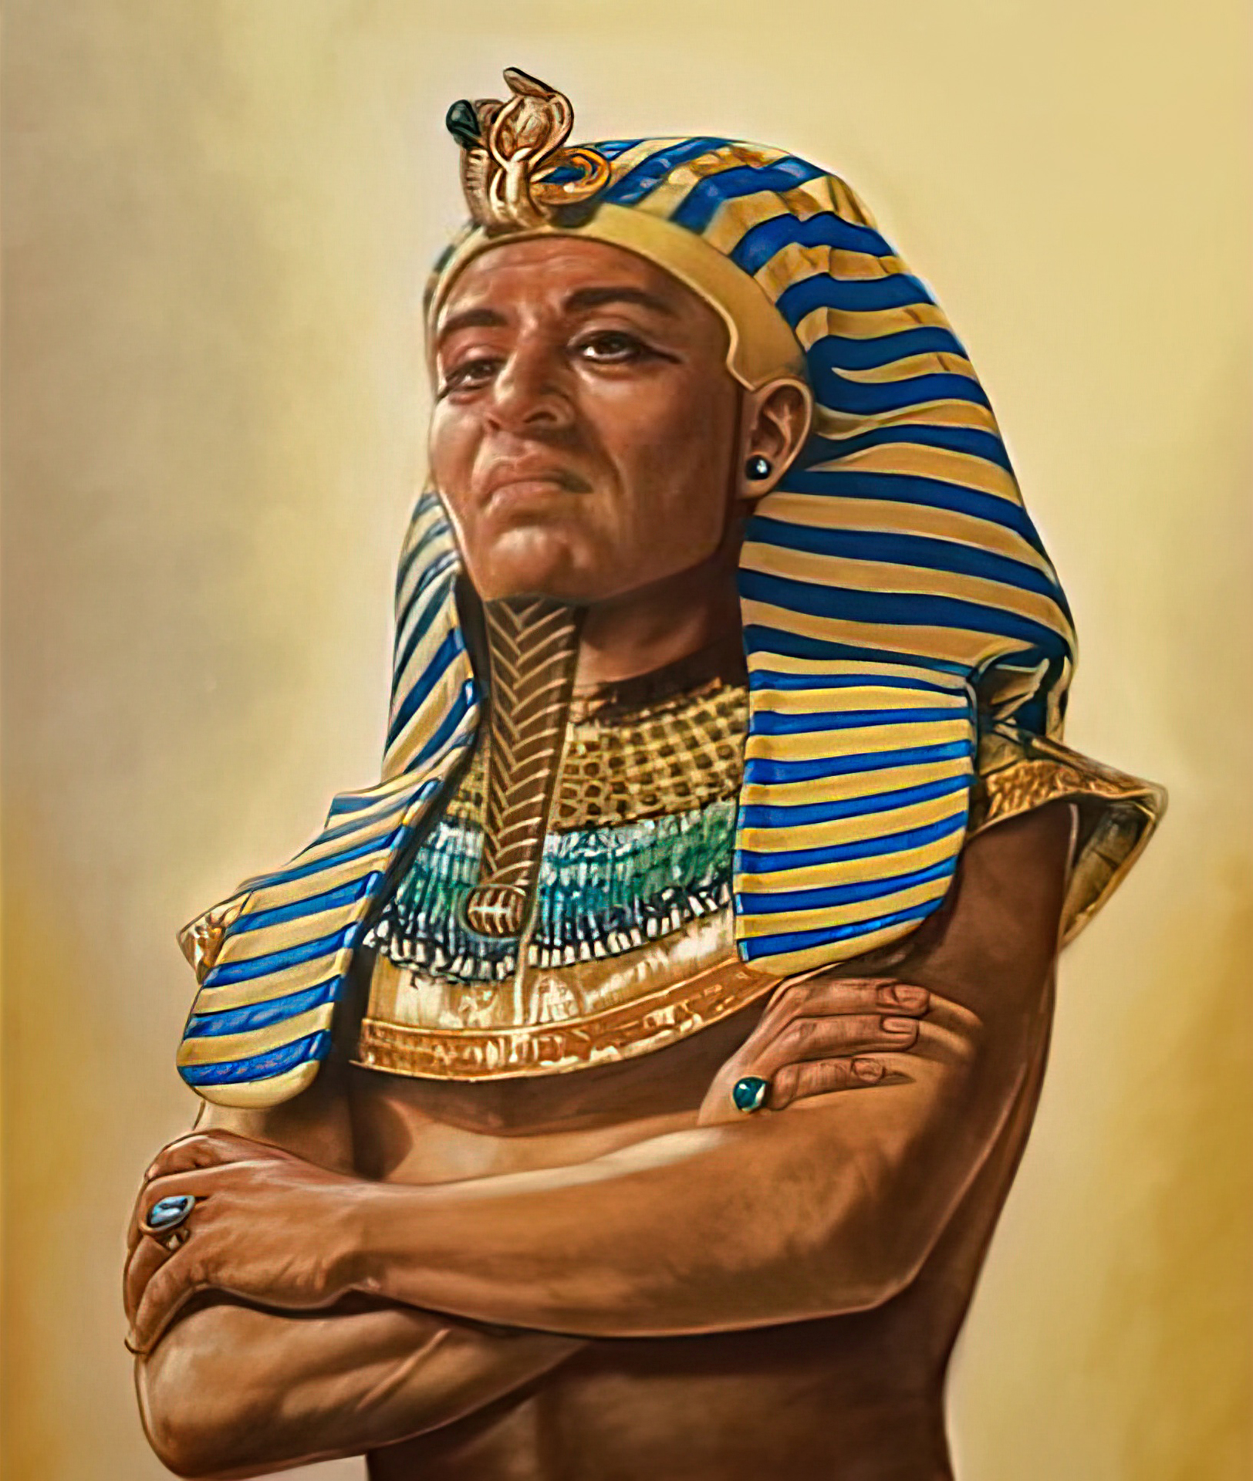
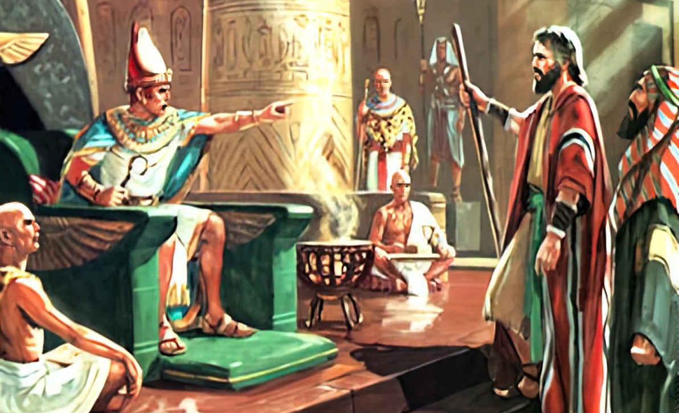
“So the heart of Pharaoh was hard; neither would he let the children of Israel go, as the Lord had spoken by Moses”
Exodus 9:35, NKJV

Slide 3

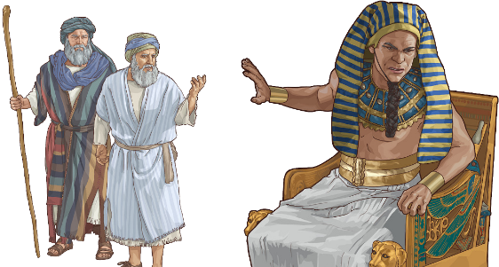
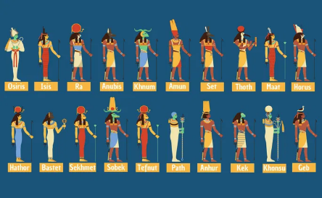
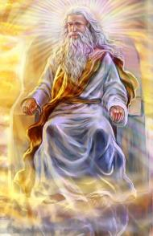




When God's people faced a war, God instructed them to first negotiate terms of peace. If an agreement could not be reached, then action was to be taken
(Deut. 20:10-12).
This was how God dealt with Egypt. A peaceful solution had been attempted, but Thutmose refused to accept it. The time had come for action.
When the plagues fell, no god in the vast Egyptian pantheon could protect Egypt from the power of the one true God.
The prelude:
  Snake Fight (Exodus 7:8-12)
  A hardened heart (Exodus 7:13)
The plagues:
  Three mild plagues (Exodus 7:14-8:19)
  Three serious plagues (Exodus 8:20-9:12)
  Three devastating plagues (Exodus 9:13-10:29)

Slide 4

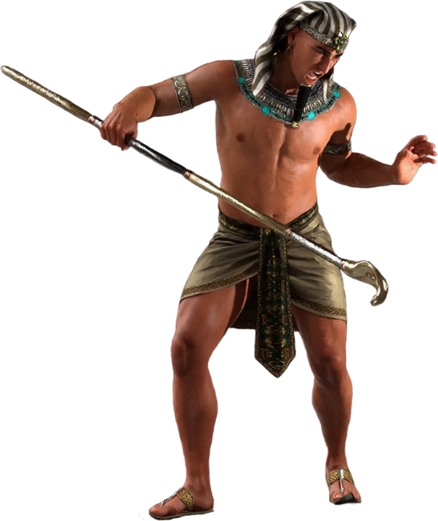
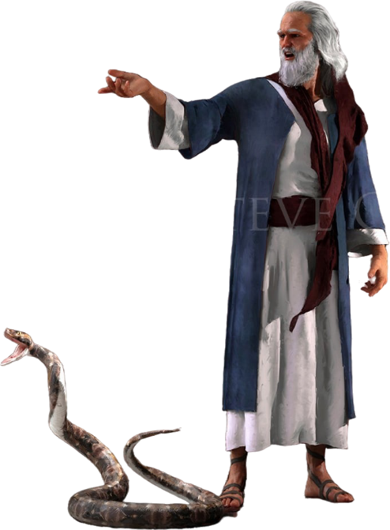
THE PRELUDE

Slide 5

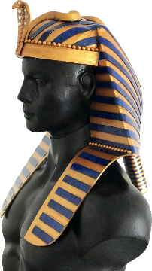
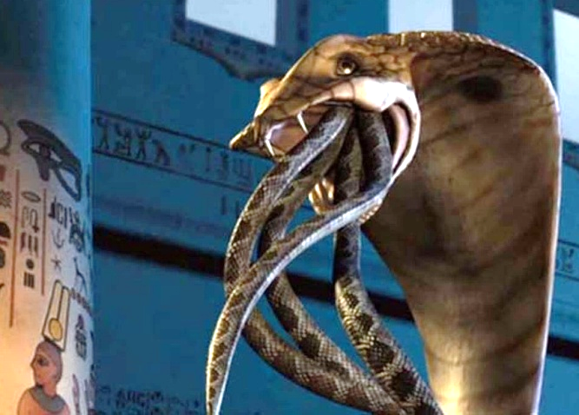
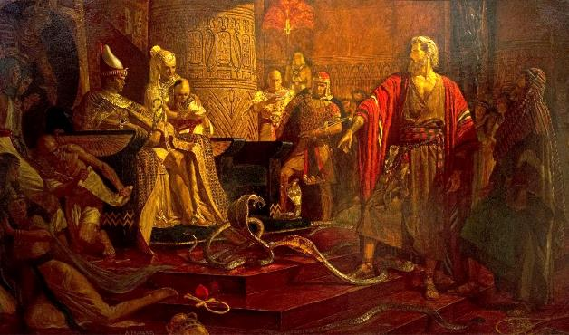
SNAKE FIGHT
“Each one threw down his staff and it became a snake. But Aaron’s staff swallowed up their staffs.” (Exodus 7:12 NIV)
God expressed that Israel's deliverance was a war that he personally fought against the Egyptian gods. (Ex. 12:12; Num. 33:4).
On his crown, a symbol of his power, the pharaoh wore a beautiful cobra representing the goddess Uadyet .
By turning the rod into a serpent, God was directly challenging this goddess (Ex. 7:10). Would she be able to protect Pharaoh?
Satan imitated the miracle through the magicians
(Exod. 7:11). But he cannot create life; his snakes only looked like snakes. However, God had created a living snake, capable of devouring inanimate creatures (Exod. 7:12).
God thus showed that He, not the Egyptian gods, is the one who possesses sovereign power and authority.

Slide 6

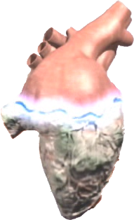
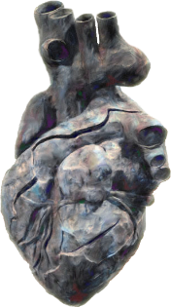


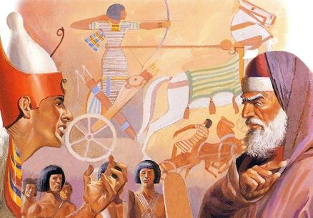

A HARDENED HEART
“Yet Pharaoh’s heart became hard and he would not listen to them, just as the Lord had said” (Exodus 7:13)
In the book of Exodus, it is said 9 times that God hardened Pharaoh’s heart (Ex. 4:21; 7:3; 9:12; 10:1; 10:20; 10:27; 11:10; 14:4; 14:8), and another 9 times it is said that Pharaoh himself hardened his heart
(Ex. 7:13; 7:14; 7:22; 8:15; 8:19; 8:32; 9:7; 9:34; 9:35). Tie! Who hardened Pharaoh’s heart?
After the first five plagues, it is explicitly stated that Pharaoh hardened his heart. That is, he refused to respond positively to the Holy Spirit's call to let Israel go free.
After the sixth plague, God hardens the heart (Exod. 9:12). Pharaoh had apparently passed the threshold of repentance. However, in the seventh plague, he is given another chance, but he hardens his heart again (Exod. 9:34-35 ).
From then on, his fate was sealed. God had hardened Pharaoh's heart because he had firmly decided not to repent.

Slide 7

EGW ( The Review and Herald , February 17, 1891)
“At each rejection of light, the Lord manifested a more marked display of his power; but the king's obstinacy increased with every new evidence of the power and majesty of the God of heaven, until the last arrow of mercy was exhausted from the divine quiver. Then the man was utterly hardened by his own persistent resistance. Pharaoh sowed obstinacy, and he reaped a harvest of the same in his character. The Lord could do nothing more to convince him, for he was barricaded in obstinacy and prejudice, where the Holy Spirit could not find access to his heart. Pharaoh was given up to his own unbelief and hardness of heart.”

Slide 8

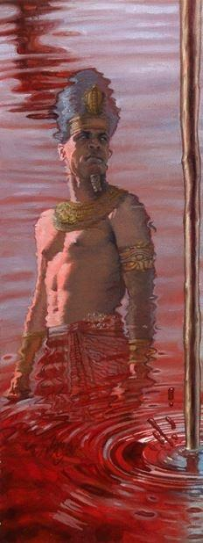
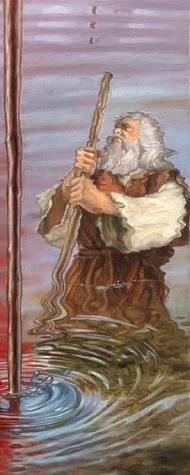
THE PLAGUES

Slide 9

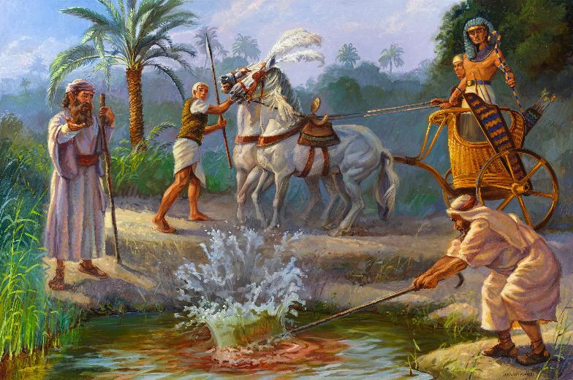
FIRST PLAGUE (MILD): BLOOD
“This is what the Lord says: By this you will know that I am the Lord: With the staff that is in my hand I will strike the water of the Nile, and it will be changed into blood.” (Exodus 7:17)
Hapi, god of the Nile
Exodus 7:14-25
The Nile, with its floods, gave life to Egypt. But who created the sources of water? The magicians simulated the transformation of the water, but they could not reverse it.

Slide 10

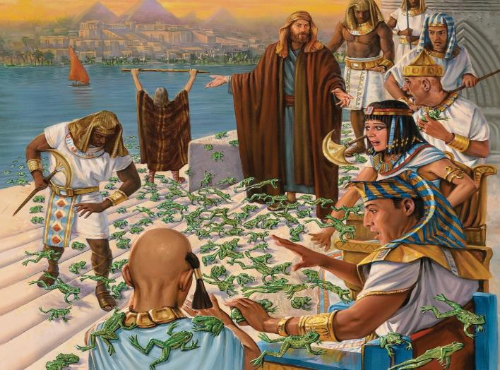
SECOND PLAGUE (MILD): FROGS
“Then the Lord said to Moses, “Tell Aaron, ‘Stretch out your hand with your staff over the streams and canals and ponds, and make frogs come up on the land of Egypt” (Exodus 8:5)
Heket, god of frogs
Exodus 8:1-15
Again the magicians imitated the plague, but were unable to stop it.

Slide 11

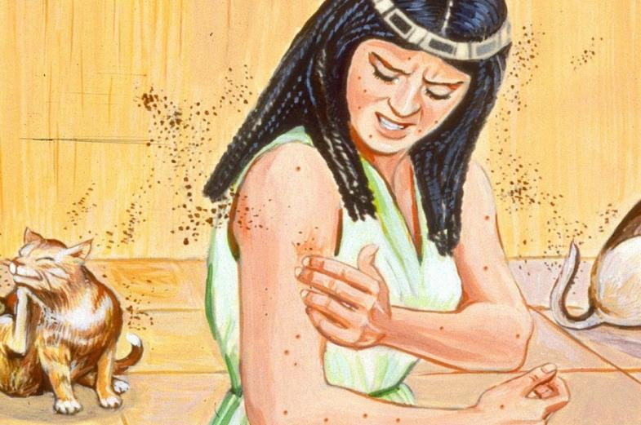
THIRD PLAGUE (MILD): LICE
“Then the Lord said to Moses, “Tell Aaron, ‘Stretch out your staff and strike the dust of the ground,’ and throughout the land of Egypt the dust will become gnats.’” (Exodus 8:16)
Geb, god of the earth
Exodus 8:16-19
Creating life from the dust of the ground (Gen. 1:24)? There was no longer any doubt about the origin of the plagues: “This is the finger of God” (Ex . 8:19). And the magicians finally fell silent.

Slide 12

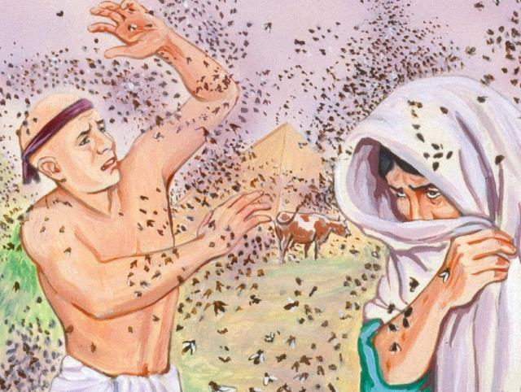
FOURTH PLAGUE (SERIOUS): FLIES
“And the Lord did this. Dense swarms of flies poured into Pharaoh’s palace and into the houses of his officials; throughout Egypt the land was ruined by the flies” (Exodus 8:24)
Uatchit, goddess of the marshes
Exodus 8:20-32.
For the first time, the Israelites were protected from the plague. This led Pharaoh to negotiate, but he ultimately failed to keep his end of the bargain.

Slide 13

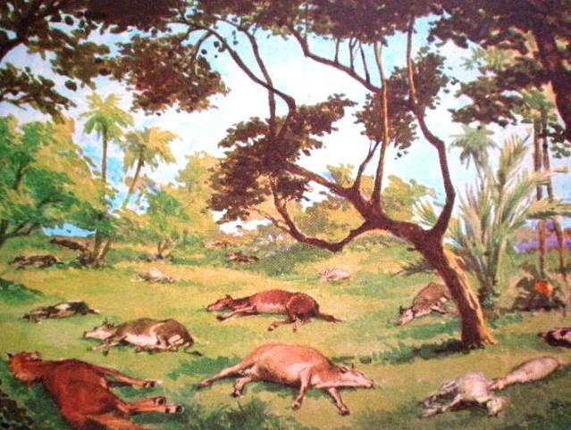
FIFTH PLAGUE (SERIOUS): DEATH OF CATTLE
“he hand of the Lord will bring a terrible plague on your livestock in the field—on your horses, donkeys and camels and on your cattle, sheep and goats” (Exodus 9:3)
Khnum, creator god
Exodus 9:1-7.
Many gods had animal heads, so this plague humiliated most of them.

Slide 14

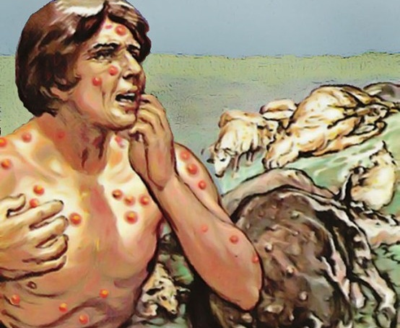
SIXTH PLAGUE (SERIOUS): ULCERS
“So they took soot from a furnace and stood before Pharaoh. Moses tossed it into the air, and festering boils broke out on people and animals” (Exodus 9:10)
Sekhmet, goddess of healing
Exodus 9: 8-12 .
Not even the magicians could heal themselves (Exod. 9:11). Pharaoh had no doubt about the source of the plagues. But he had decided to refuse to bow down to God, and God allowed him to reap the fruit of his rebellion (Exod. 9:12).

Slide 15

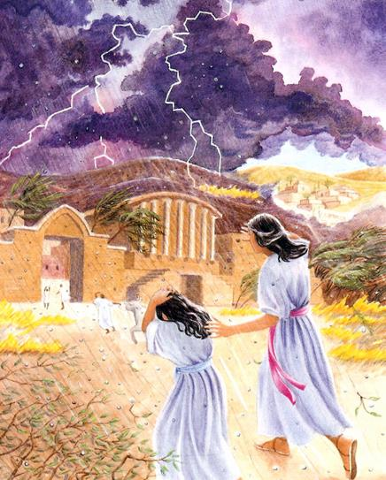
SEVENTH PLAGUE (DEVASTATING): HAIL
“Therefore, at this time tomorrow I will send the worst hailstorm that has ever fallen on Egypt, from the day it was founded till now” (Exodus 9:18)
Nut, goddess of the sky
Exodus 9:13-35.
The Egyptians' faith was tested. Those who believed saved the lives of their servants and their livestock (Ex. 9:20). Pharaoh did not believe, and although he confessed his sin, his confession was not sincere (Ex. 9:27-30).
Seth, god of storms

Slide 16

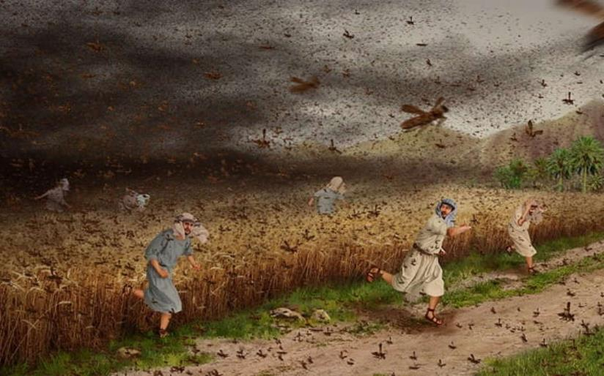
EIGHTH PLAGUE (DEVASTATING): LOCUSTS
“If you refuse to let them go, I will bring locusts into your country tomorrow” (Exodus 10:4)
Neper, god of grain
Exodus 10:1-20.
With Egypt devastated, the Egyptians themselves begged Pharaoh to let Israel go (Ex. 10:7).

Slide 17

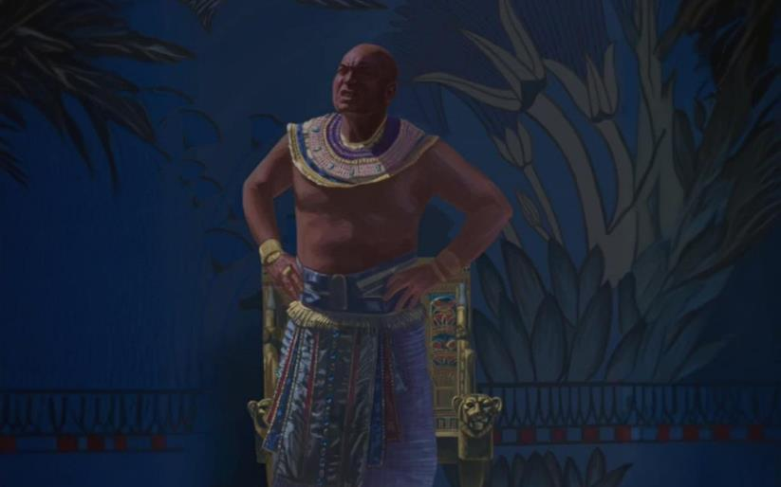
NINTH PLAGUE (DEVASTATING): DARKNESS
“Then the Lord said to Moses, “Stretch out your hand toward the sky so that darkness spreads over Egypt—darkness that can be felt.’” (Exodus 10:21)
Ra, god of the sun
Exodus 10:21-29.
Life in Egypt came to a standstill for three days (Except in Goshen). God granted a time of reflection, which Pharaoh did not take full advantage of.

Slide 18

EGW (Patriarchs and Prophets, p. 263)
“Before the infliction of each plague, Moses was to describe its nature and effects, that the king might save himself from it if he chose. Every punishment rejected would be followed by one more severe, until his proud heart would be humbled, and he would acknowledge the Maker of heaven and earth as the true and living God. The Lord would give the Egyptians an opportunity to see how vain was the wisdom of their mighty men, how feeble the power of their gods, when opposed to the commands of Jehovah. He would punish the people of Egypt for their idolatry and silence their boasting of the blessings received from their senseless deities. God would glorify His own name, that other nations might hear of His power and tremble at His mighty acts, and that His people might be led to turn from their idolatry and render Him pure worship.”

