Slide 1
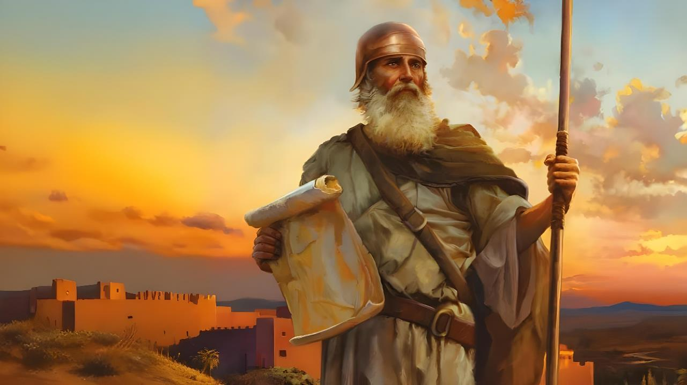

RECIPE FOR SUCCESS
Lesson 1 for October 4, 2025

Slide 2
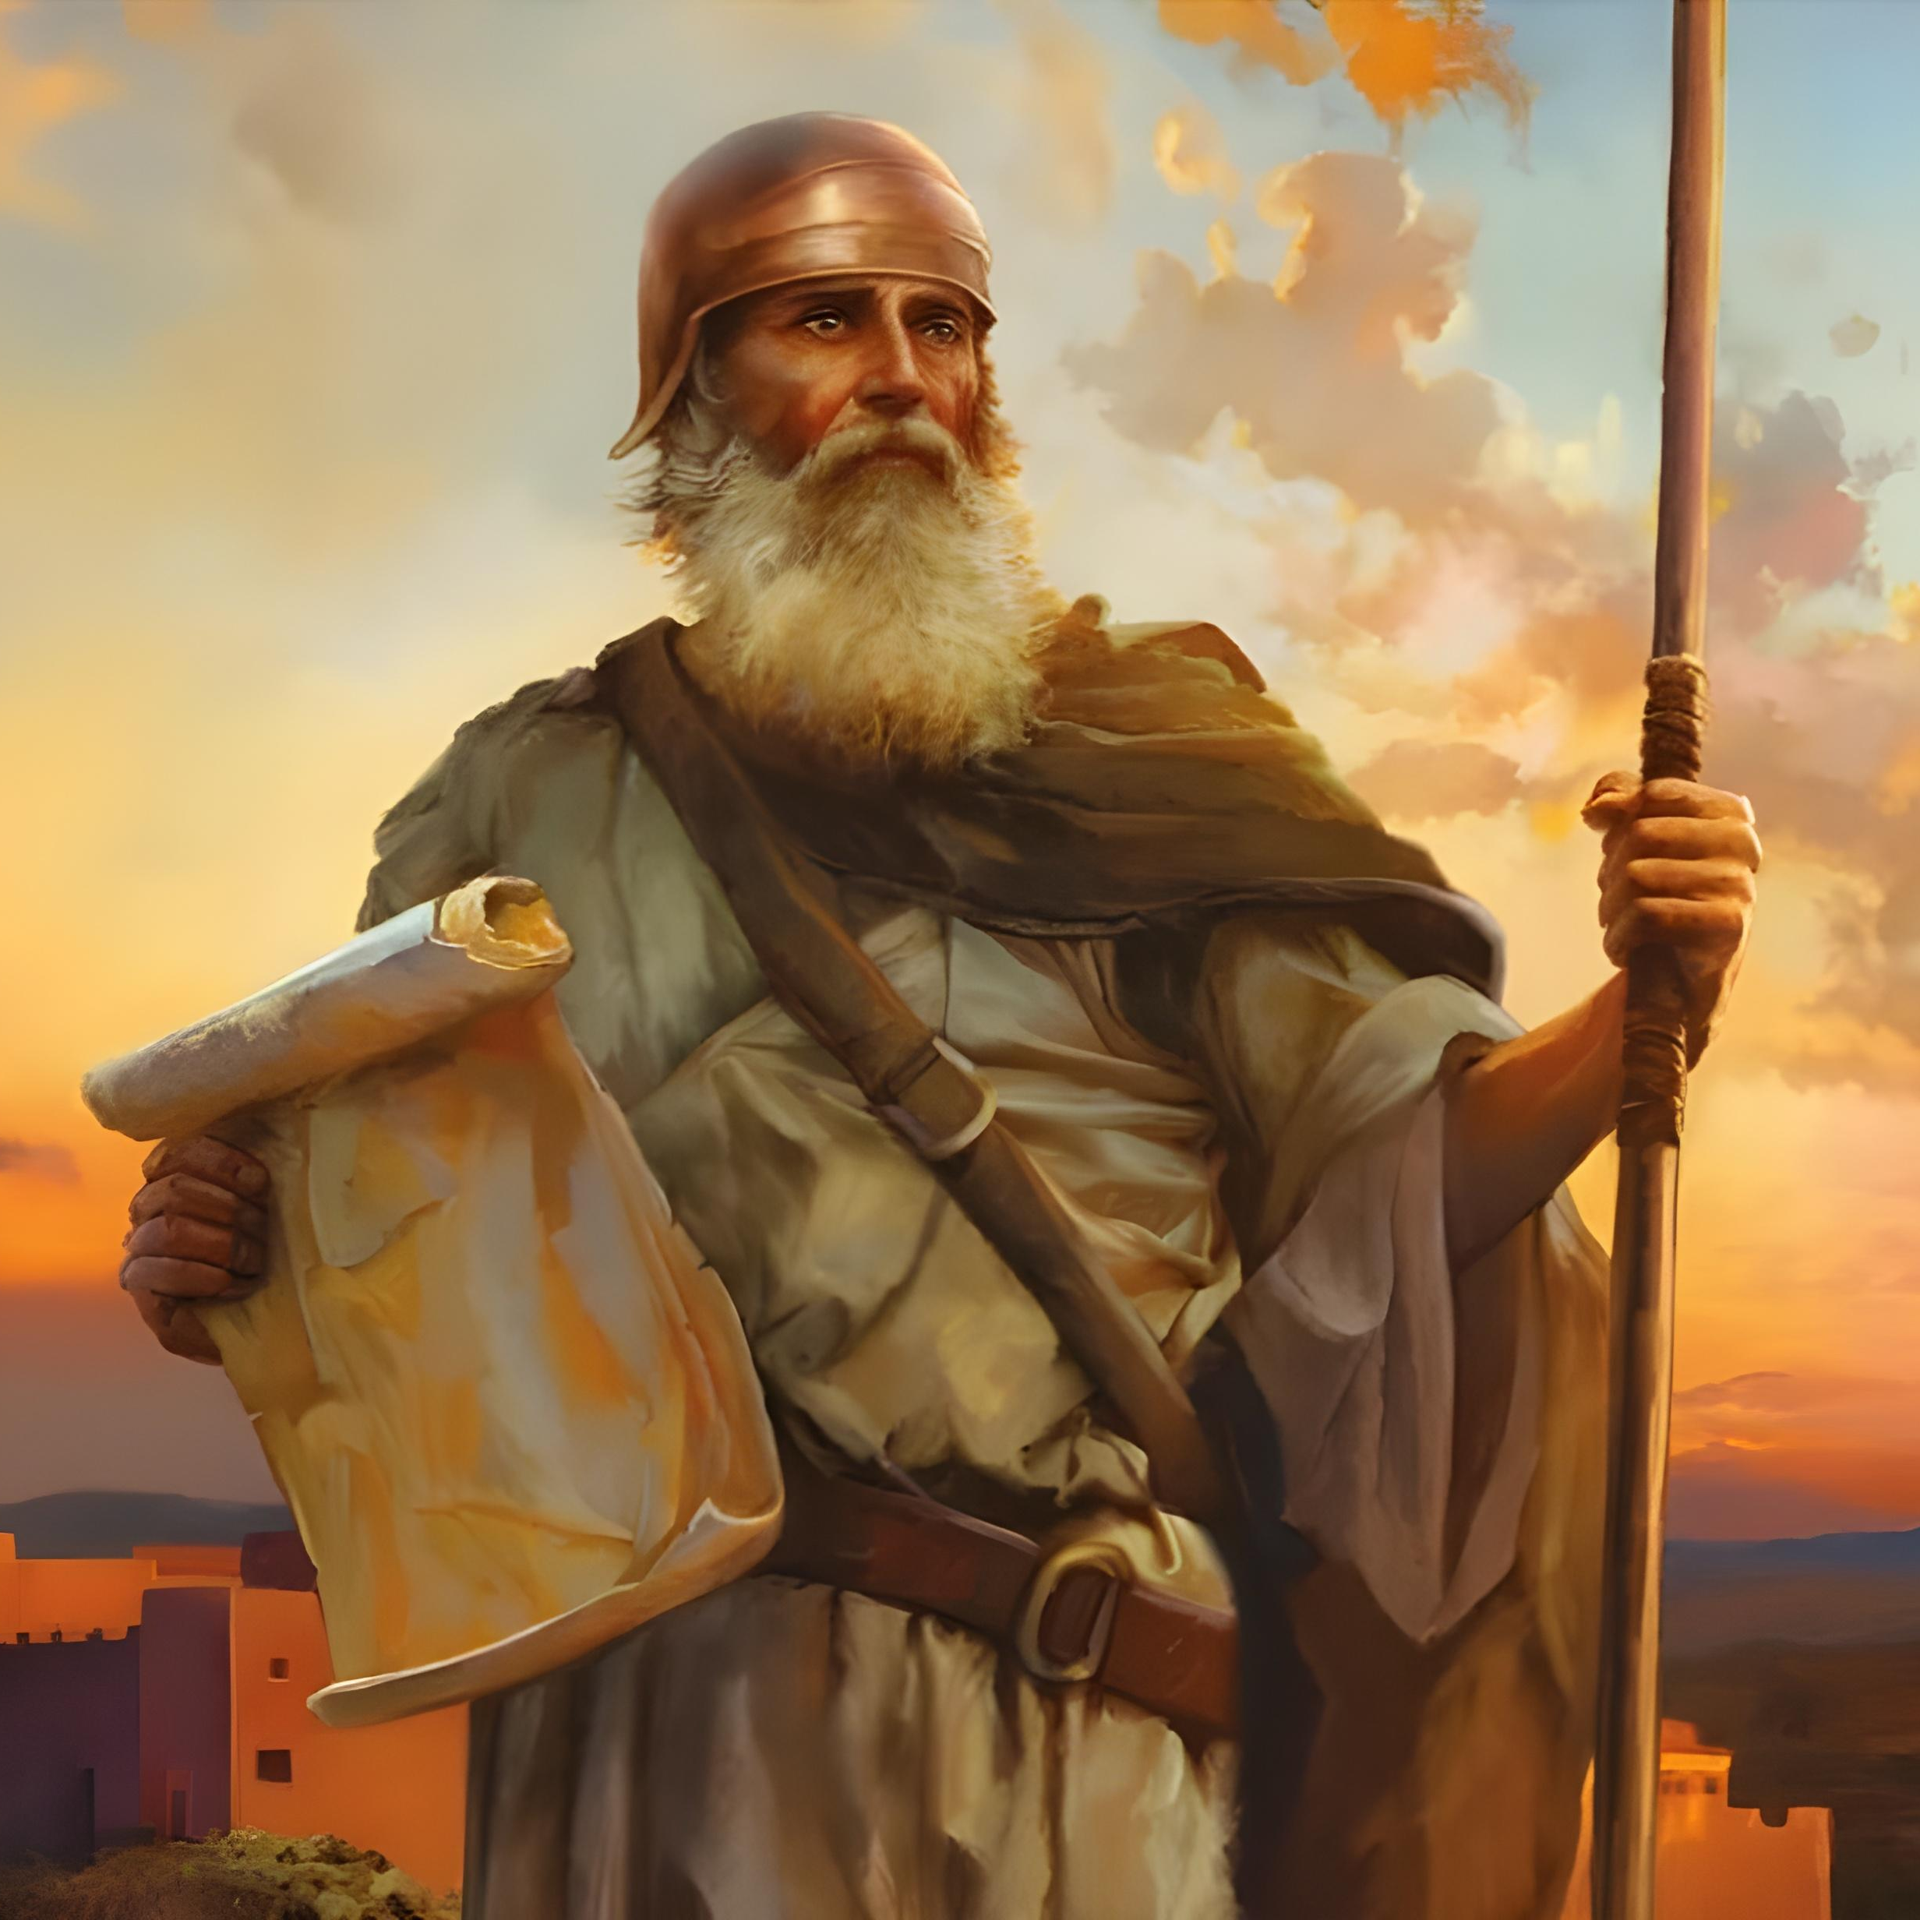
“Only be strong and very courageous, that you may observe to do according to all the law which Moses My servant commanded you; do not turn from it to the right hand or to the left, that you may prosper wherever you go” Joshua 1:7, NKJV

Slide 3

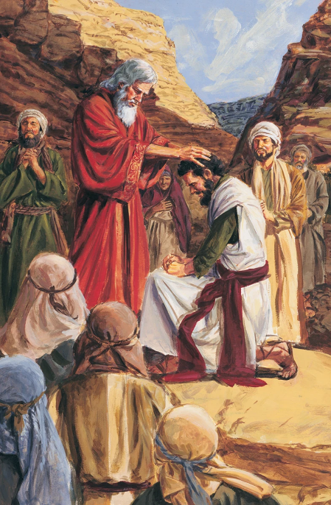
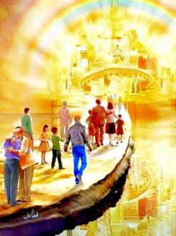


After 40 years of wandering, a new generation has risen, and the time has come to conquer the Promised Land. Moses has died, and a new leader has been chosen by God for this task: Joshua.
Before embarking on the conquest, both the new leader and the new generation are called to trust fully in God.
As the present generation (us) stands on the border of the heavenly Canaan, the divine call still rings out powerfully: “Only be strong and very courageous” (Josh. 1:7).
Introduction (Joshua 1:1-3):
  Moses and Joshua
  Structure of the book
Joshua's Mission (Joshua 1:4-9):
  Inherit the promises
  Strength and courage
  The success of the mission

Slide 4

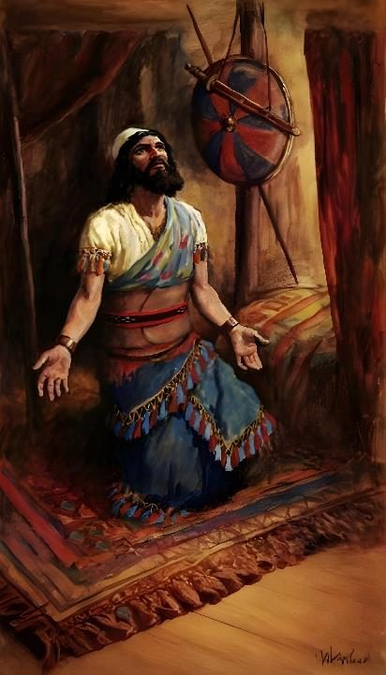
INTRODUCTION
(JOSHUA 1:1-3)

Slide 5







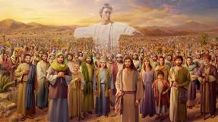
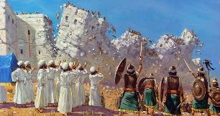








MOSES AND JOSHUA
God appeared to them
(Ex. 3:2-4; Josh. 5:13-14)
They were asked to remove their shoes
(Ex. 3:5 ; Josh. 5:15)
God promised them that He would be with them (Ex. 3:12; Josh. 1:5)
They celebrated the Passover
(Ex. 12:21-23; Josh. 5:10)
They passed through the water on dry ground
(Ex. 14:21-22; Josh. 3:14-17)
With one came the manna, with the other it ceased
(Ex . 16:4-5, 31; Josh. 5:11-12)
They sent spies to spy out the land
(Num. 13:1-3; Josh. 2:1)
“After the death of Moses the servant of the LORD, the LORD said to Joshua son of Nun, Moses’ aide” (Joshua 1:1)
In the first chapter of Joshua, Moses is mentioned eleven times, and his name appears repeatedly throughout the book.
There are many similarities between the two leaders:
Although the first chapter of Joshua records the transition between Israel's two great leaders, neither is the true protagonist of the book. The most important figure is God himself, whose words open the book, and whose leadership is the dominant theme. There is no doubt about who Israel's true leader was.

Slide 6

“Joshua was now the acknowledged leader of Israel. He had been known chiefly as a warrior, and his gifts and virtues were especially valuable at this stage in the history of his people. Courageous, resolute, and persevering, prompt, incorruptible, unmindful of selfish interests in his care for those committed to his charge, and, above all, inspired by a living faith in God—such was the character of the man divinely chosen to conduct the armies of Israel in their entrance upon the Promised Land. During the sojourn in the wilderness he had acted as prime minister to Moses, and by his quiet, unpretending fidelity, his steadfastness when others wavered, his firmness to maintain the truth in the midst of danger, he had given evidence of his fitness to succeed Moses, even before he was called to the position by the voice of God.”
EGW (Patriarchs and Prophets, p. 481)

Slide 7

STRUCTURE OF THE BOOK
“Moses my servant is dead. Now then, you and all these people, get ready to cross the Jordan River into the land I am about to give to them—to the Israelites” (Joshua 1:2)
The Book of Joshua presents the fulfillment of the promises God made to Israel when he brought them out of Egypt, that is, to give them Canaan. Both the preamble (chapter 1) and the book itself are divided into four major sections:
CROSS to Canaan
Joshua 1:1-9
Joshua 1:1-5:12
TAKE Canaan
Joshua 1:10-11
Joshua 5:13-12:24
DIVIDE the land
Joshua 1:12-15
Joshua 13:1-21:45
SERVICE through obedience to the Law
Joshua 1:16-18
Joshua 22:1-24:33

Slide 8
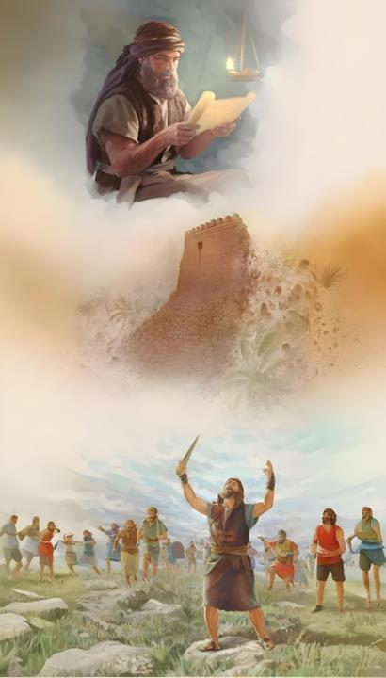
JOSHUA'S MISSION
(JOSHUA 1:4-9)

Slide 9

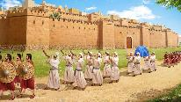
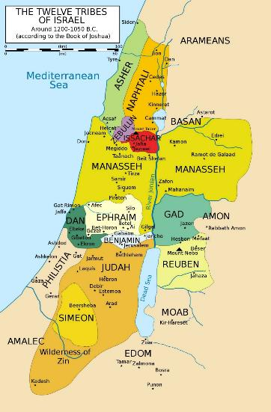
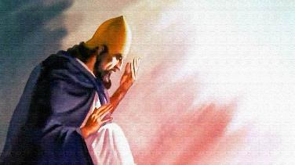
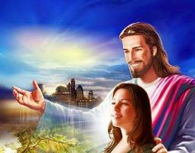
INHERIT THE PROMISES
“I will give you every place where you set your foot, as I promised Mose” (Joshua 1:3)
In Joshua 1:3, God speaks in the prophetic present tense. He speaks of Canaan as if it had already been given to Israel. This means that God gave them complete assurance of the success of the conquest.
EUPHRATES
He then reminds them of the limits that the conquest will reach (Josh. 1:4): the strip between the Jordan River (east) and the Mediterranean Sea (west), from the desert (south) to the Euphrates River (north).
He then turns to Joshua and assures him that if he is strong and courageous, no one will be able to stand against him (Josh. 1:5-6).
MEDITERRANEAN
JORDAN
But victory lay not in Joshua's own efforts, but in God's presence. He assured him, as He assures each of us: "I will be with you" (Josh. 1:5; Mt. 28:20).
DESERT

Slide 10

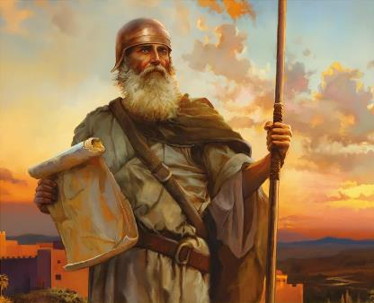
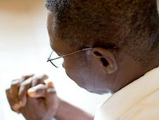
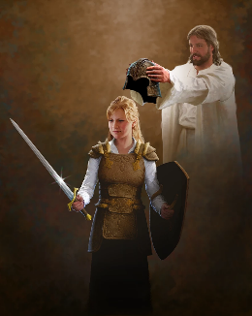
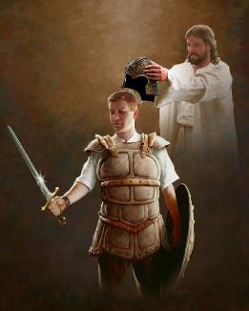
STRENGTH AND COURAGE
“Have I not commanded you? Be strong and courageous. Do not be afraid; do not be discouraged, for the Lord your God will be with you wherever you go.” (Joshua 1:9)
Before asking Joshua for strength and courage in battle (Josh. 1:9), God asked him for strength and courage to obey the Law (Josh. 1:7).
This is also the case today. God asks us to strive to keep His law (Rev. 14:12). This requires great courage on our part.
For His part, He promises that “will be with you wherever you go” (Josh. 1:9), helping us fight the battle we are engaged in. Not a physical battle, but “against the rulers, against the authorities, against the powers of the darkness of this age, against spiritual wickedness in high places” (Eph. 6:12). To do this, He has provided us with the necessary weapons
(Eph. 6:13-17).
The key to success is to fully trust in God. And to do so, we need to relate to Him every day (Eph. 6:18).

Slide 11


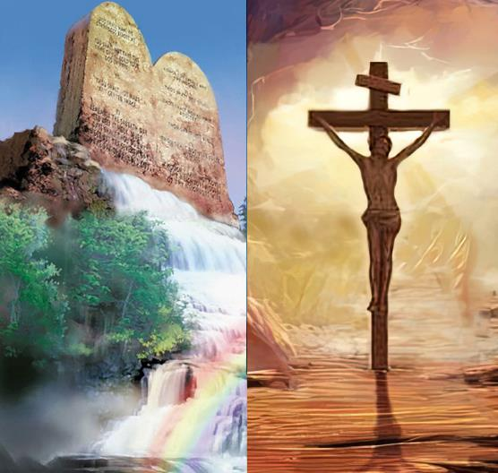
THE SUCCESS OF THE MISSION
“Keep this Book of the Law always on your lips; meditate on it day and night, so that you may be careful to do everything written in it. Then you will be prosperous and successful.” (Joshua 1:8)
Success from a divine point of view does not coincide with success from a human point of view.
Fleeting success in this world can be achieved by breaking divine and human laws, but true and eternal success cannot (Josh. 1:8).
We will be successful if we follow the principles and values expressed in God's Law. But isn't this salvation by works?
Not at all. Faith and the Law are not mutually exclusive, but rather complement each other (Rom. 3:31). When we speak of the Law, we are speaking of the way we should live, not the way we are saved. Our relationship with God is manifested in our obedience to His will.

Slide 12

“The Christian always has a strong helper in the Lord. The way of the Lord’s helping we may not know; but this we do know: He will never fail those who put their trust in Him. Could Christians realize how many times the Lord has ordered their way, that the purposes of the enemy concerning them might not be accomplished, they would not stumble along complainingly. Their faith would be stayed on God, and no trial would have power to move them. They would acknowledge Him as their wisdom and efficiency, and He would bring to pass that which He desires to work out through them.”
EGW (Prophets and Kings, p. 576)

