Slide 1

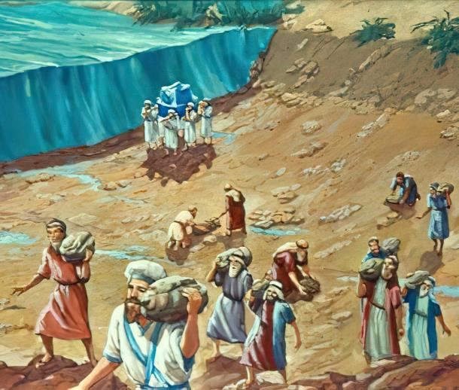
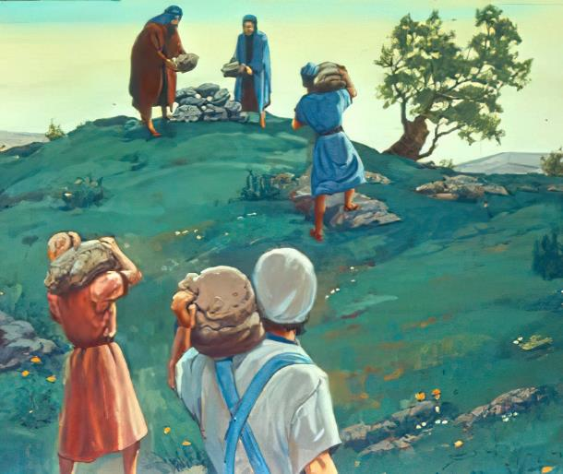

Lesson 3 for October 18, 2025
MEMORIALS OF GRACE

Slide 2

“For the Lord your God dried up the waters of the Jordan for you until you passed over, as the Lord your God did to the Red Sea, which he dried up for us until we passed over, so that all the peoples of the earth may know that the hand of the Lord is mighty, that you may fear the Lord your God forever”
Joshua 4:23, 24, ESV

Slide 3
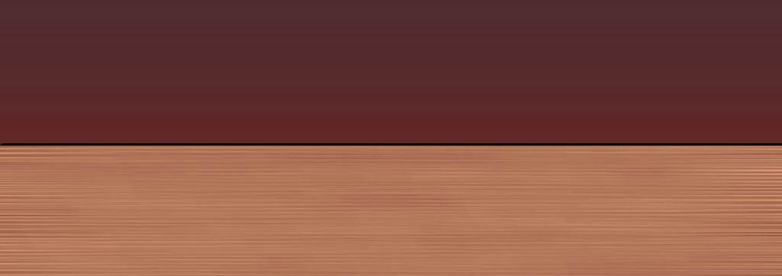
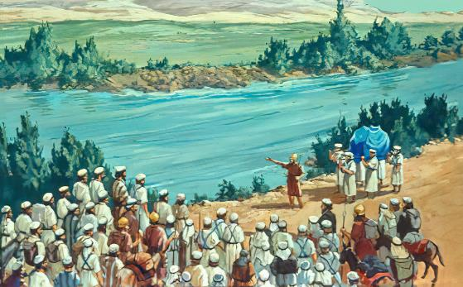
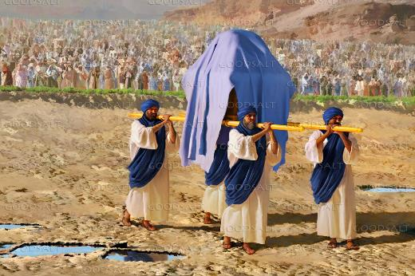







Spring. Rain and melting snow have filled the Jordan River to the point of overflowing. Its waters rush swiftly toward the Dead Sea. Even in the shallowest parts—the Jordan fords—crossing the river is a dangerous venture.
How can an entire village cross it, carrying elderly people, pregnant women, children and livestock?
For man, impossible. For God, easy: “Sanctify yourselves and cross the Jordan.”
The Crossing of the Jordan (Joshua 3):
  Need for holiness
  The wonders of God
Remember and forget (Joshua 4):
  Signs for remembrance
  The dangers of forgetting
Jordan River Milestones

Slide 4

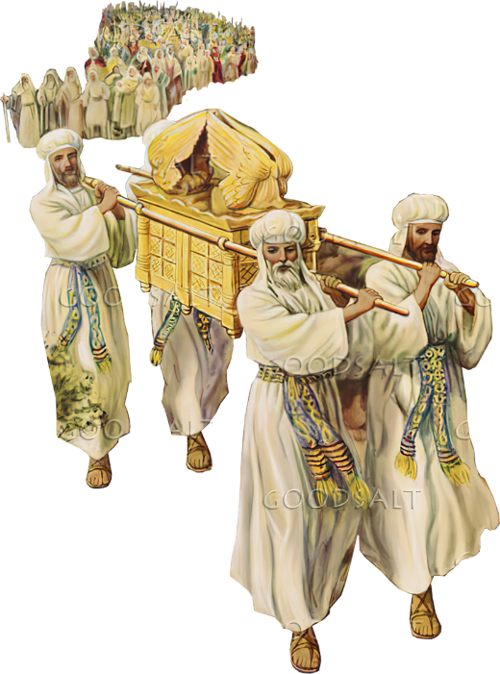
THE CROSSING OF THE JORDAN
(JOSHUA 3)

Slide 5
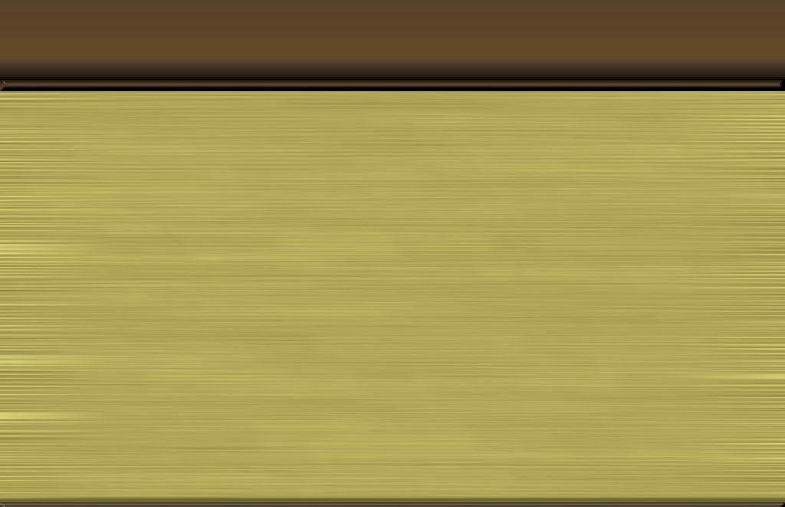
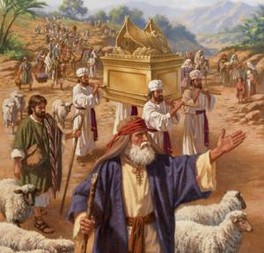
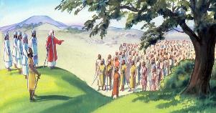
NEED FOR HOLINESS
“Joshua told the people, ‘Consecrate yourselves, for tomorrow the Lord will do amazing things among you.’ ” (Joshua 3:5)
For 40 years, the cloud had signaled the time to break camp and set out, and the ark guided Israel to its new destination (Num. 9:17; 10:33).
Following the ark involved
Obey God (The 10 Commandments)
Trusting in God's care (the vessel with manna)
Respect the leaders appointed by God (Aaron's rod)
The time had come to move. They broke camp at Shittim and encamped for three days across the Jordan. Then they received the order to follow the ark into the Promised Land (Josh. 3:1-3).
But there was a prerequisite: they had to be sanctified (Josh. 3:5). This consecration involved ceremonial purification (washing clothes and body), forsaking sin, and having a receptive attitude toward obeying God's commands.

Slide 6

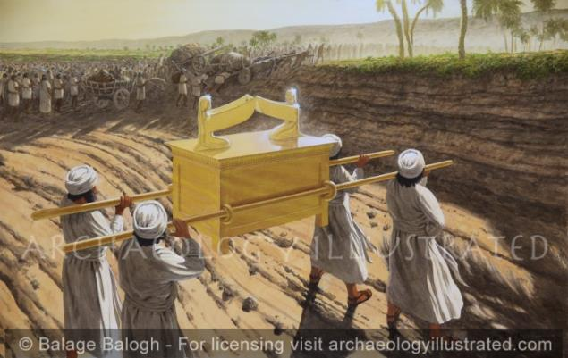
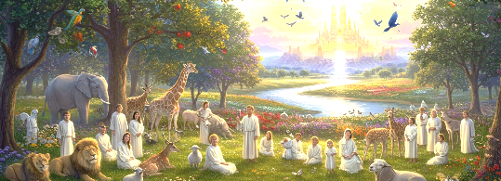
THE WONDERS OF GOD
“the water from upstream stopped flowing. It piled up in a heap a great distance away, at a town called Adam in the vicinity of Zarethan, while the water flowing down to the Sea of the Arabah (that is, the Dead Sea) was completely cut off. So the people crossed over opposite Jericho” (Joshua 3:16)
God is “Who only does wondrous things” (Ps. 72:18). Therefore, we recognize him as the One God (Ps. 86:10); we remember his wonders (Ps. 77:11); and we recount his amazing deeds (Ps. 96:3).
Nothing is too difficult or too wonderful for Him, who created all things (Jer. 32:17; Luke 1:37). So we can trust that He can also work wonders in our lives (Ps. 107:8).
The crossing of the Jordan is one of God's wonders, which prophetically points to another of the great wonders that God has promised to perform in us: entry into the heavenly Canaan (Zech. 8:6-8).

Slide 7

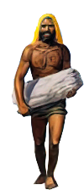
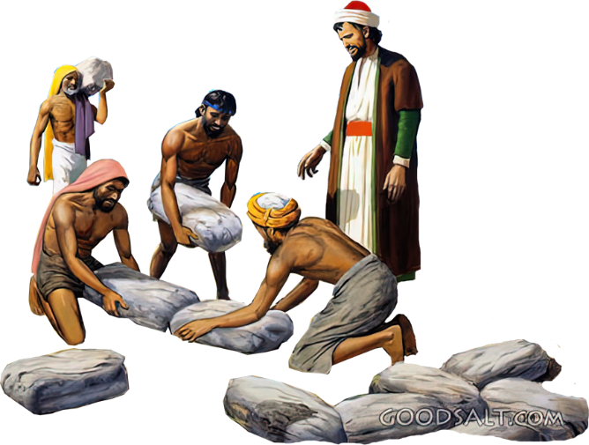
REMEMBER AND FORGET
(JOSHUA 4)

Slide 8

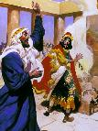
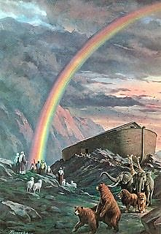
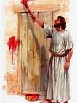
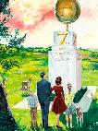
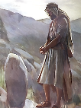
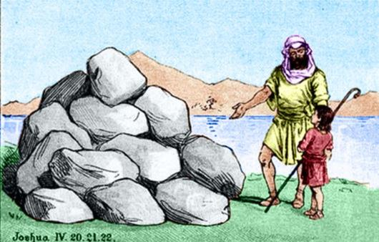
SIGNS FOR REMEMBRANCE
“to serve as a sign among you. In the future, when your children ask you, ‘What do these stones mean?’ tell them…” (Joshua 4:6-7a NIV )
In the Bible, a sign can have several meanings:
A prodigious act (1 Kings 13:3)
A symbol of something
(Gen. 9:13)
A mark of warning (Ex. 12:13)
A distinctive mark (Ezek. 20:20)
A memorial (Gen. 28:18)
The 12 stones taken from the Jordan that Joshua set up as a sign belong to the latter type: a memorial.
Beyond the memory itself, what was the objective that God had in mind when asking for these stones to be erected (Josh. 4:6-7)?
The new generations had to know what God had done. Their faith had to be based on the wonders of God. It was the responsibility of parents to pass this knowledge on to their children (Deut. 4:9). With this knowledge, each of us must live by our own faith.

Slide 9
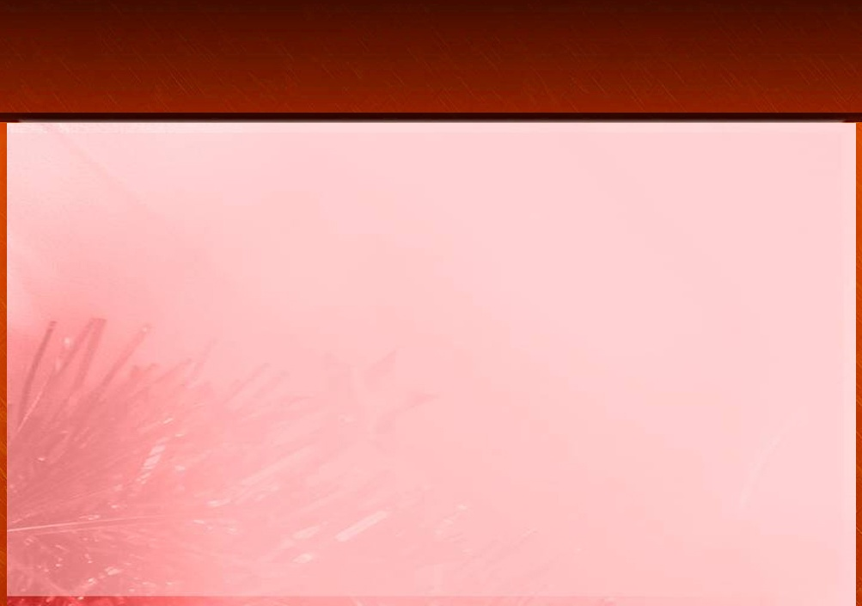
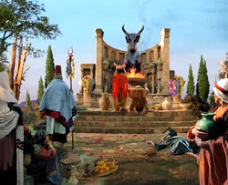
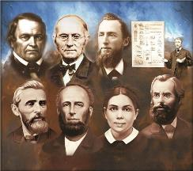
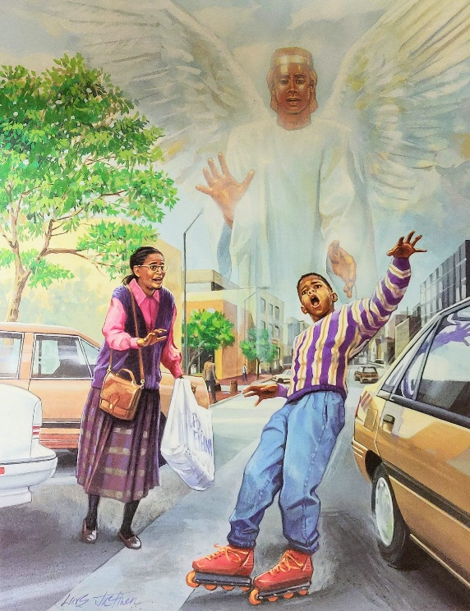
THE DANGERS OF FORGETTING
“The Israelites did evil in the eyes of the Lord; they forgot the Lord their God and served the Baals and the Asherahs” (Judges 3:7)
In setting up the 12 memorial stones at Gilgal, Joshua emphasized two points (Josh. 4:23):
God dried up the Red Sea before us (Joshua, Caleb, and the few who were still alive from the generation that came out of Egypt)
God dried up the Jordan River before you (the new generation born in the desert, and destined to conquer Canaan)
The new generation was in danger of making the same mistake as their parents: forgetting God's mighty deeds. Unfortunately, they forgot, and they paid the consequences (Judg. 3:7-8).
How important it is, then, that we keep fresh in our minds how God has cared for our ancestors, and the moments when we have seen with our own eyes the mighty hand of God!

Slide 10

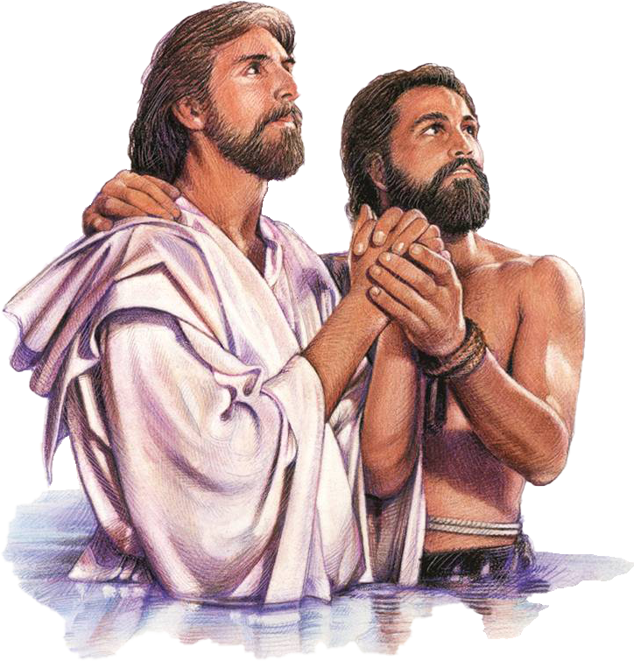
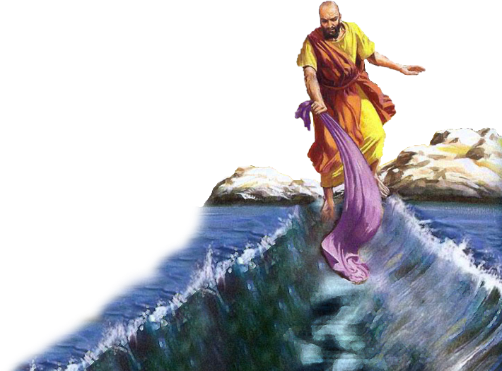
JORDAN RIVER MILESTONES

Slide 11

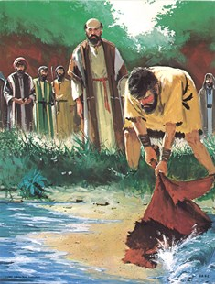
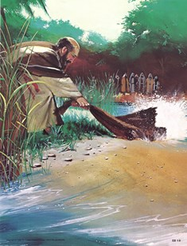
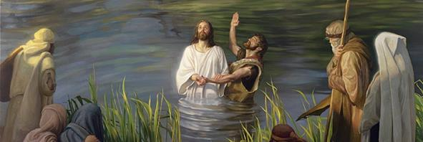
“He turned the sea into dry land; They went through the river on foot. There we will rejoice in Him!” (Psalm 66:6 NKJV)
“When the sea saw Israel, it fled, and the Jordan River turned back” (Psalm 114:3 NKJV)
The crossing of the Red Sea and the Jordan are two historical events that have become intertwined as milestones in the history of redemption (Ps. 66:6; Ps. 114). Together, they mark our liberation from sin and our access to eternal life.
Miraculously crossing the Jordan River and being brought into the very presence of God was a reality for Elijah (2 Kings 2:1, 7, 8, 11).
For Elisha, however, the same event was a sign of the reception of the Holy Spirit, which enabled him to fulfill his mission (2 Kings 2:14-15).
Entering the waters of the Jordan had the same effect on Jesus, who was empowered by the Holy Spirit to fulfill his mission: to free us from sin and give us eternal life (Mark 1:9-11;
John 1:29; 3:16).

Slide 12

“Let us then remember the loving-kindness of the Lord, and the multitude of His tender mercies. Like the people of Israel, let us set up our stones of witness, and inscribe upon them the precious story of what God has wrought for us. And as we review His dealings with us in our pilgrimage, let us, out of hearts melted with gratitude, declare, "What shall I render unto the Lord for all His benefits toward me? I will take the cup of salvation, and call upon the name of the Lord. I will pay my vows unto the Lord now in the presence of all His people." Psalm 116:12-14”
EGW (The Desire of Ages, p. 348)

