Slide 1
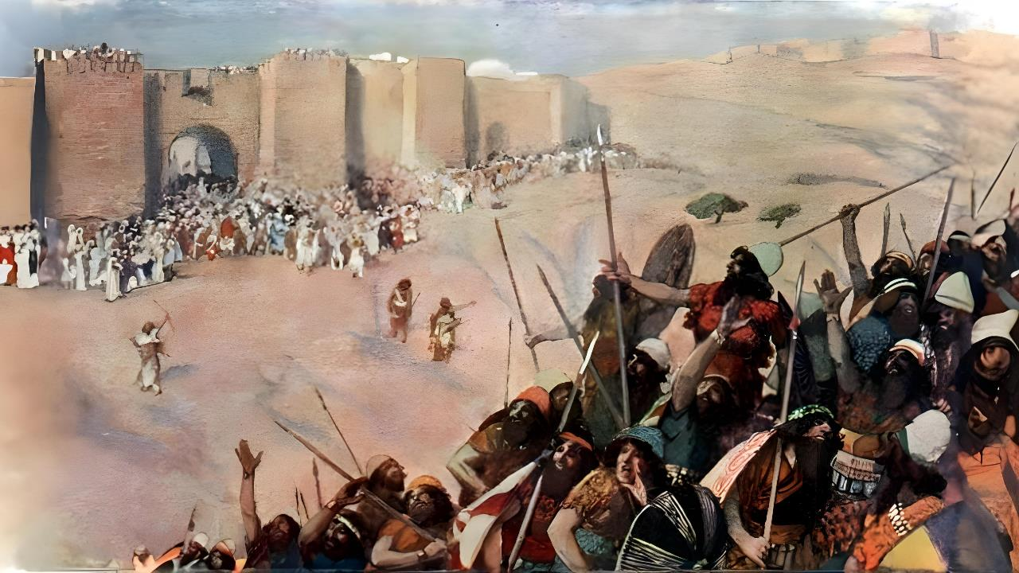
GOD FIGHTS FOR YOU
Lesson 5 for November 1, 2025

Slide 2

“And Joshua captured all these kings and their land at one time, because the Lord God of Israel fought for Israel”
Joshua 10:42, ESV

Slide 3

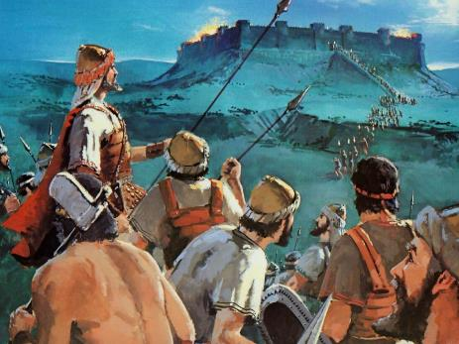
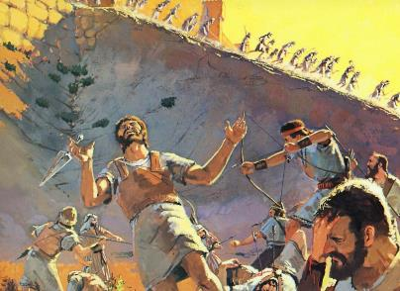
Understanding the war that led Israel to take possession of the land of Canaan is not an easy matter.
Just as God never intended for sin to exist, neither did He intend for war to exist.
So why did so many people die? Can that war be considered "holy"?
To understand this problem, we must delve into the biblical concept of war and the moral values at stake at that critical moment in history.
A matter of iniquity
A matter of justice
The biblical concept of war
Destroyed by their own choice
Seek peace

Slide 4

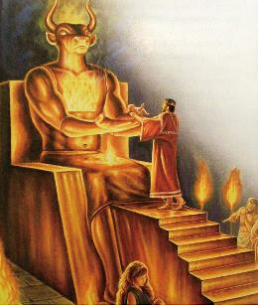
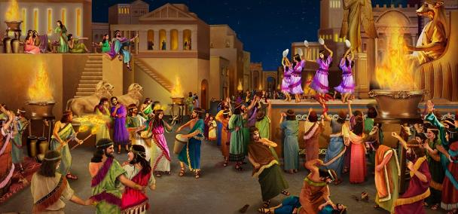
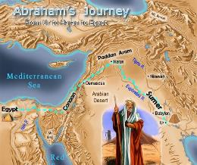
A MATTER OF INIQUITY
“In the fourth generation your descendants will come back here, for the sin of the Amorites has not yet reached its full measure.” (Genesis 15:16)
Archaeology has revealed that Canaan's religion was exactly what the Bible says: sorcery, divination, communication with the dead, spiritism... and child sacrifice! (Deut. 18:9-12).
To this must be added the rite of “sacred prostitution” – which had very little to do with sacredness – practiced by both priests and priestesses.
Although these practices were already common in Abraham's time, God gave them more than 400 years to rectify their behavior.
Finally, these aberrant rites, which lowered people's morality and fostered all kinds of vices, had to be put to an end. The extermination of the Canaanites would prevent—at least for a time—the moral degradation of humanity.

Slide 5

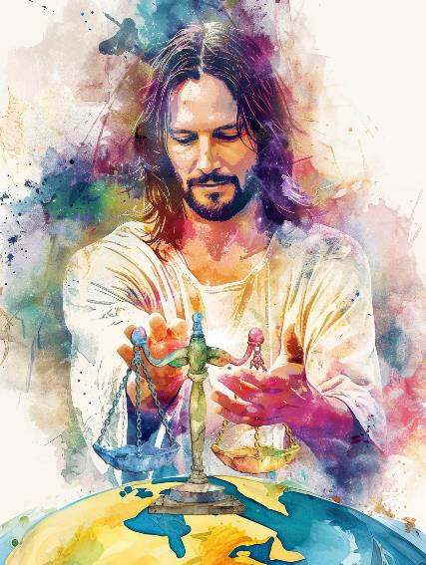
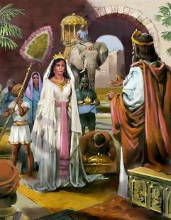
A MATTER OF JUSTICE
“God is a righteous judge, a God who displays his wrath every day. If he does not relent, he will sharpen his sword; he will bend and string his bow” (Psalm 7:11-12 NIV)
Love and justice are the foundation of God's character. This makes Him a just and impartial judge, who postpones punishment so that the sinner may be converted, but who will not tolerate evil forever.
The war to conquer Canaan was not waged for imperialist reasons, but by divine order to carry out the punishment that its wicked inhabitants deserved.
God's desire was to establish a just government in that territory, which would be an example to all nations, motivating them to elevate their moral concepts, and thus achieve a state of peace and justice worldwide (Dt. 4:5-6).
As a warrior and judge, God is committed to implementing, stabilizing, and maintaining the rule of law, which is a reflection of his character.

Slide 6

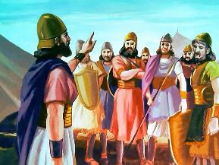
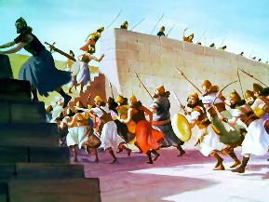
THE BIBLICAL CONCEPT OF WAR
“But be assured today that the Lord your God is the one who goes across ahead of you like a devouring fire. He will destroy them; he will subdue them before you. And you will drive them out and annihilate them quickly, as the Lord has promised you.” (Deuteronomy 9:3)
Biblically, wars were to be limited to specific situations and were defined by God Himself. These are the rules that governed wars authorized by God:
A professional army was not allowed
The soldiers were not paid and sometimes could not even take loot
Warfare was only permitted for the conquest or defense of the Promised Land at that particular historical moment
They were led by prophets inspired by God (such as Moses or Joshua)
Spiritual preparation was required before the battle
Any Israelite who did not comply with the rules of war was treated as an enemy
On many occasions, God intervened directly in the battle

Slide 7

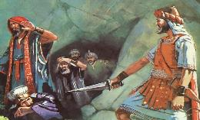
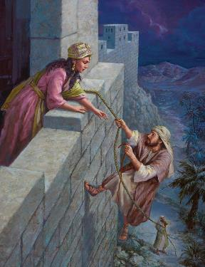
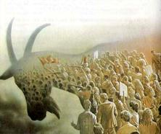
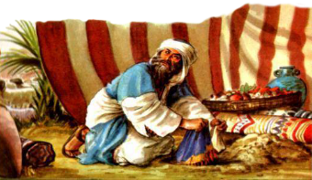
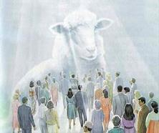
DESTROYED BY THEIR OWN CHOICE
“So Joshua subdued the whole region, including the hill country, the Negev, the western foothills and the mountain slopes, together with all their kings. He left no survivors. He totally destroyed all who breathed, just as the LORD, the God of Israel, had commanded.” (Joshua 10:40)
The entire territory of Canaan was declared anathema, that is, dedicated to destruction. Every living thing was to die (Deut . 20:16-18; Josh. 10:40).
Those destined for destruction who obeyed God could live (e.g., Rahab)
Israelites who disobeyed God were to be put to death (e.g., Achan).
However, there were exceptions:
Before God, Canaanites and Israelites were viewed equally: impartially. The difference was that some chose to persist in their rebellion against God, while others chose to obey Him.
Now, the decision is still ours. When Jesus comes, we will be saved or destroyed by our own choice.

Slide 8

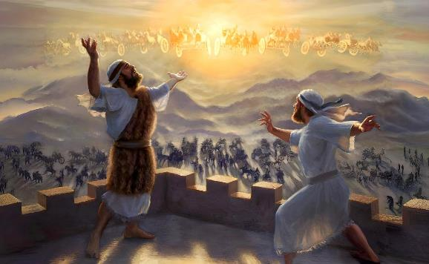
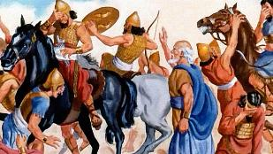
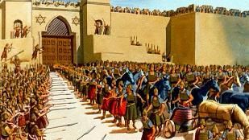
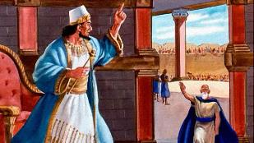
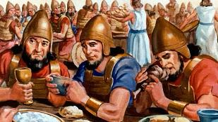
SEEK PEACE
“I will make peace your governor
and well-being your ruler” (Isaiah 60:17b NIV)
Jesus is called the “Prince of Peace” (Isaiah 9:6). He came to bring peace, and he will reign in peace (John 14:27; Isaiah 60:17).
But until his kingdom of peace becomes a reality, we remain in a territory at war, immersed in the cosmic conflict between good and evil.
When the Syrian army besieged Dothan to capture the prophet Elisha, he didn't ask God to have the heavenly army surrounding him destroy the Syrians. Instead, he asked to lead the blinded Syrian army to Samaria so that, once there, he could bring peace between the two warring nations (2 Kings 6:12-23).
This is the example Jesus taught us: to always seek peace in conflict. To overcome evil with good (Rom. 12:20-21).

Slide 9

“The utter destruction of the people of Jericho was but a fulfillment of the commands previously given through Moses concerning the inhabitants of Canaan [...] To many these commands seem to be contrary to the spirit of love and mercy enjoined in other portions of the Bible, but they were in truth the dictates of infinite wisdom and goodness. God was about to establish Israel in Canaan, to develop among them a nation and government that should be a manifestation of His kingdom upon the earth. They were not only to be inheritors of the true religion, but to disseminate its principles throughout the world. The Canaanites had abandoned themselves to the foulest and most debasing heathenism, and it was necessary that the land should be cleared of what would so surely prevent the fulfillment of God’s gracious purposes.”
EGW (Patriarchs and Prophets, p. 492)

