Slide 1
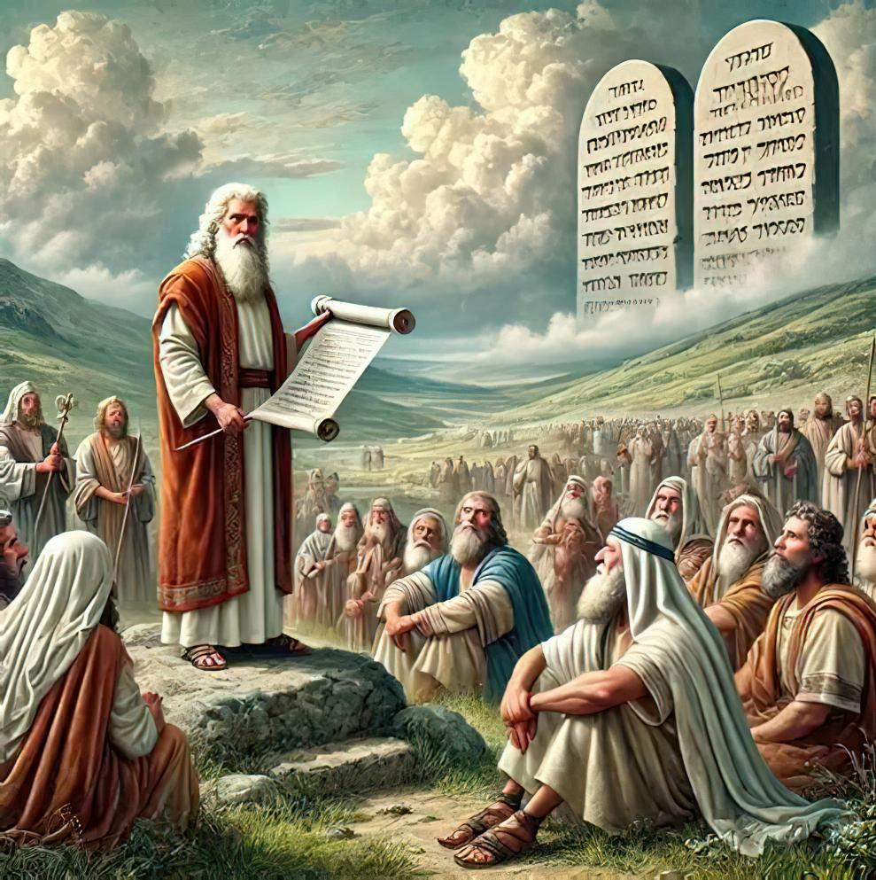
ULTIMATE LOYALTY: WORSHIP IN A WAR ZONE
Lesson 7 for November 15, 2025

Slide 2
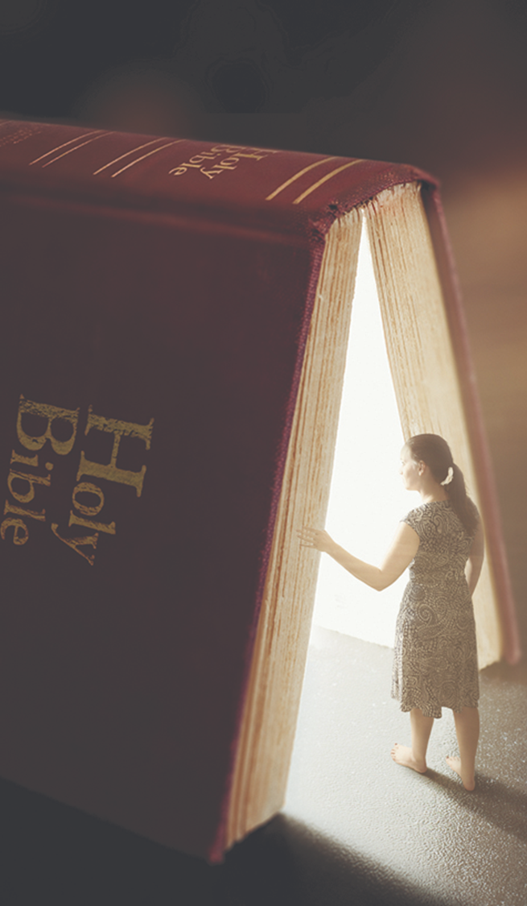

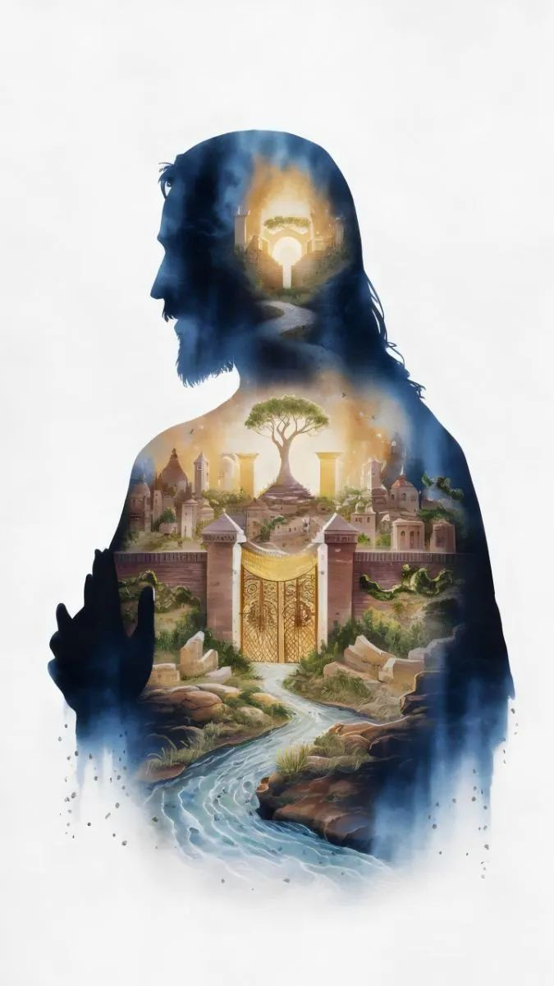
“But seek first the kingdom of God and his righteousness, and all these things will be added to you”
Matthew 6:33, ESV

Slide 3

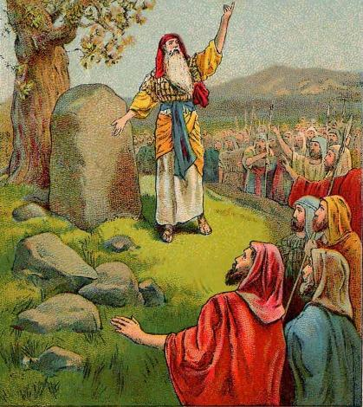
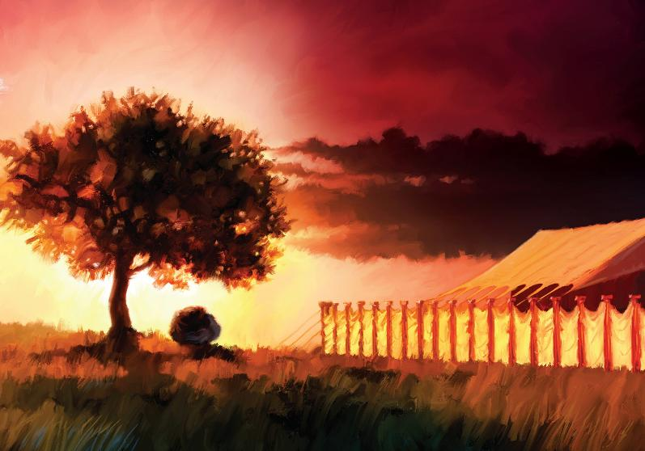








At the miraculous crossing of the Jordan, all the Canaanite kings were terrified (Joshua 5:1). The ground was prepared for immediate conquest.
However, this was not Israel's priority. They were to first seek communion with God.
In the midst of the conquest, they also decided to take a break to rededicate themselves to the Lord in a great meeting between the mountains of Ebal and Gerizim.
Almost concluding the conquest, they achieved a new milestone of worship: they built the Sanctuary in Shiloh.
Worship before conquering:
  The renewal of the covenant (Joshua 5:1-9)
  The First Passover in Canaan (Joshua 5:10-12)
Worship among mountains:
  An altar for worship (Joshua 8:30-31)
  Remember the law (Joshua 8:32-35)
A special place to worship:
  Raising the Sanctuary (Joshua 18:1)

Slide 4
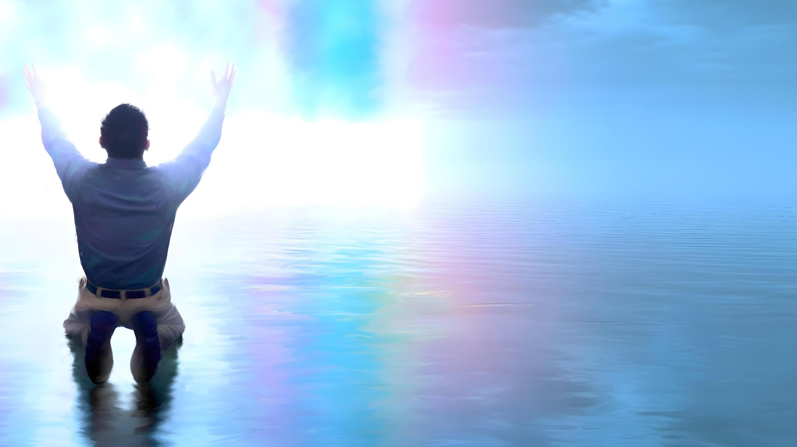
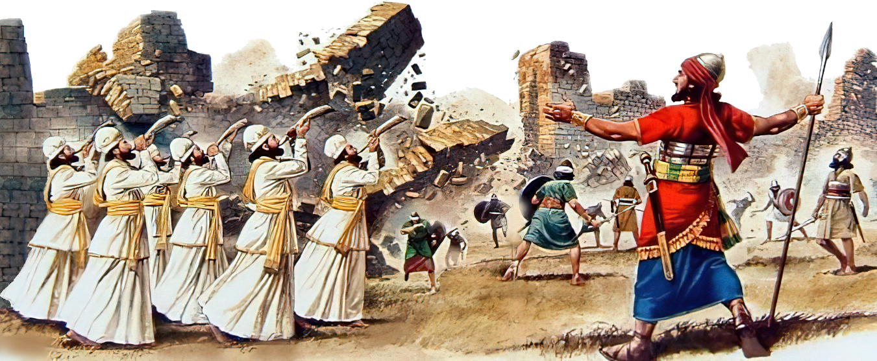
WORSHIP BEFORE CONQUERING

Slide 5

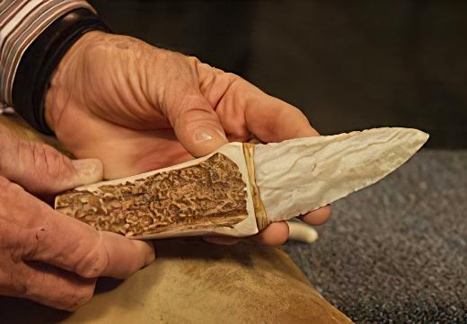
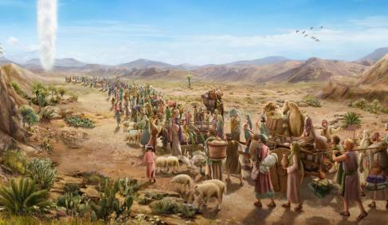

THE RENEWAL OF THE COVENANT
“At that time the Lord said to Joshua, ‘Make flint knives and circumcise the Israelites again.’ ” (Joshua 5:2 NIV )
Gilgal is the name given to the Israelite camp, the command center during the early part of the conquest. What significance was given to this name (Josh. 5:9)?
Although more than 40 years had passed since they left Egypt, Israel had not yet entered the Promised Land. Now, their feet were treading on it. It was time to remove “the reproach of Egypt” and renew the covenant with God.
Before eating the first Passover, Israelite males were circumcised, for no uncircumcised person could partake of it (Ex. 12:48). But because they refused to enter Canaan the first time, the covenant was broken, and no Israelite was circumcised in the wilderness (Josh. 5:5).
To renew the covenant, it was necessary to repeat that physical sign (Gen. 17:10). This act put what was important first. For us, it is an example to follow: “But seek first his kingdom and his righteousness, and all these things will be given to you as well.” (Mt. 6:33).

Slide 6

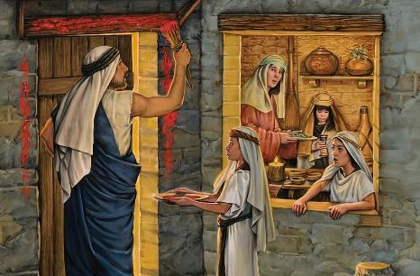
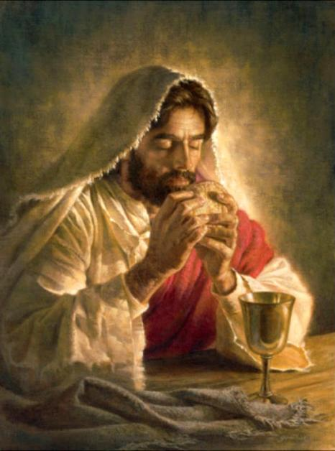
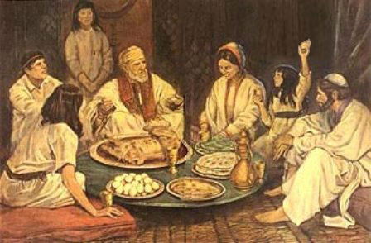
THE FIRST PASSOVER IN CANAAN
“On the evening of the fourteenth day of the month, while camped at Gilgal on the plains of Jericho, the Israelites celebrated the Passover” (Joshua 5:10)
From Egypt to Canaan, Israel followed a “chiastic” process, repeating the events in reverse order:
Egypt
Circumcision and Passover
Crossing the Red Sea
Desert
Crossing the Jordan
Circumcision and Passover
Canaan
The first Passover was a symbol of the liberation from Egypt. The second Passover, celebrated by the new generation, was a symbol of their taking possession of the Promised Land.
Shortly before his crucifixion, Jesus gave this rite a new meaning, with new symbols: the lamb became bread, and the blood became wine.
They are now symbols of the body and blood of our Redeemer, who brings us out of Egypt (that is, out of our sin), and brings us to the Promised Land (1 Cor. 11:23-26).

Slide 7

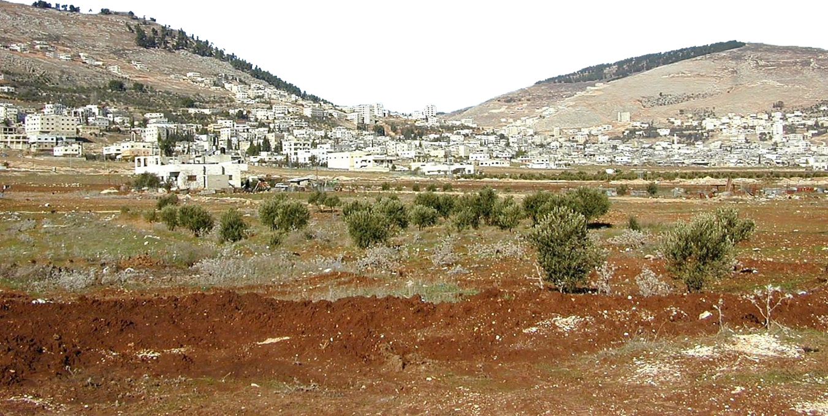
WORSHIP AMONG MOUNTAINS

Slide 8

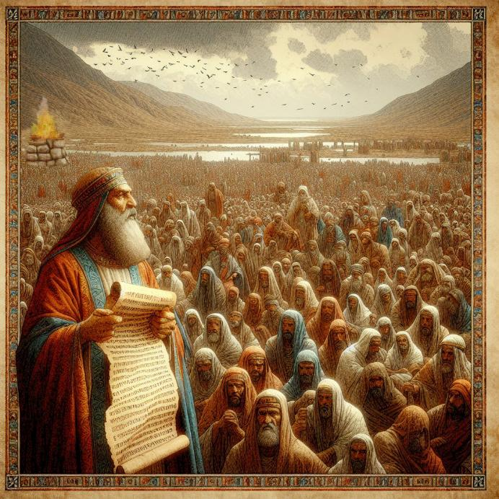
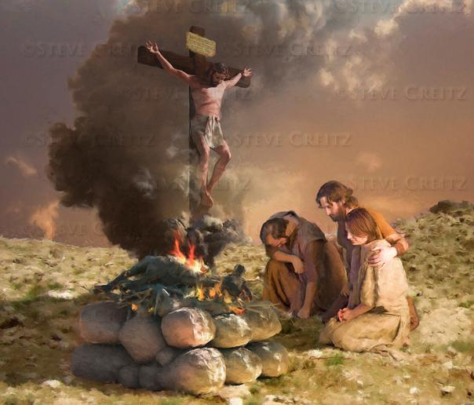
AN ALTAR FOR WORSHIP
“Then Joshua built on Mount Ebal an altar to the Lord, the God of Israel” (Joshua 8:30)
Moses had commanded that upon entering Canaan, an altar should be built on Mount Ebal, and praise should be given to God (Deut. 27:5-7). Why on Mount Ebal and not on Gerizim?
Both the altar and the laws that were to be written on a monument and read to the people were related to blessings and curses. (Deut. 27:12-13). The blessing was pronounced on Gerizim, and the curse on Ebal.
Jesus became a curse for us, so that we might receive the blessing (Gal. 3:13-14). This altar is, for us, a clear image of Jesus' sacrifice on our behalf.
In the midst of conquest, Israel sought a moment to rededicate itself to God. This is an invitation for us to imitate their example, rededicating ourselves to God, not only individually, but also as God's chosen people.

Slide 9

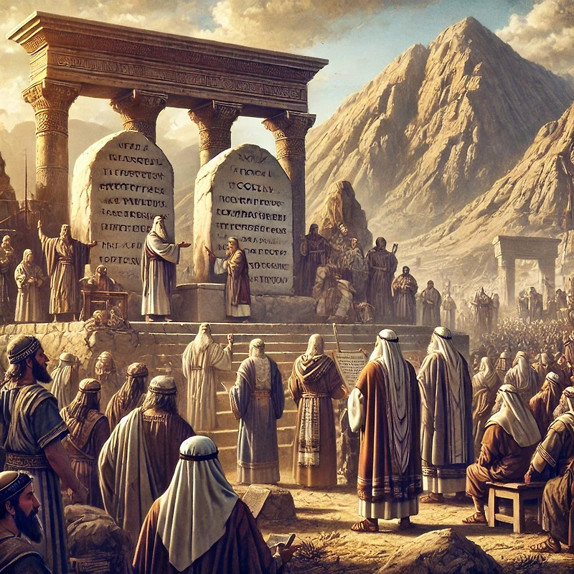
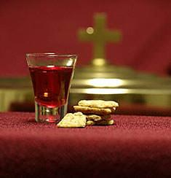
REMEMBER THE LAW
“There, in the presence of the Israelites, Joshua wrote on stones a copy of the law of Moses” (Joshua 8:32)
After building the altar on Mount Ebal, Joshua set up some stones and plastered them with lime. Then he wrote on them a copy of the law [Deuteronomy, which included the Ten Commandments and various laws, along with blessings and curses] (Josh. 8:32; Deut. 27:2-3).
Finally, the law was read to the people, divided into two parts—one on each mountain side (Josh. 8:33-35). In this way, the covenant between God and his people was renewed.
This is a calling for us as well. As God's remnant people, we must periodically renew our covenant with Him, remembering how He has led us this far and the blessings He has bestowed upon us.
In addition to our personal renewal, the Holy Communion also provides us with that special moment of renewal as the people of God.

Slide 10
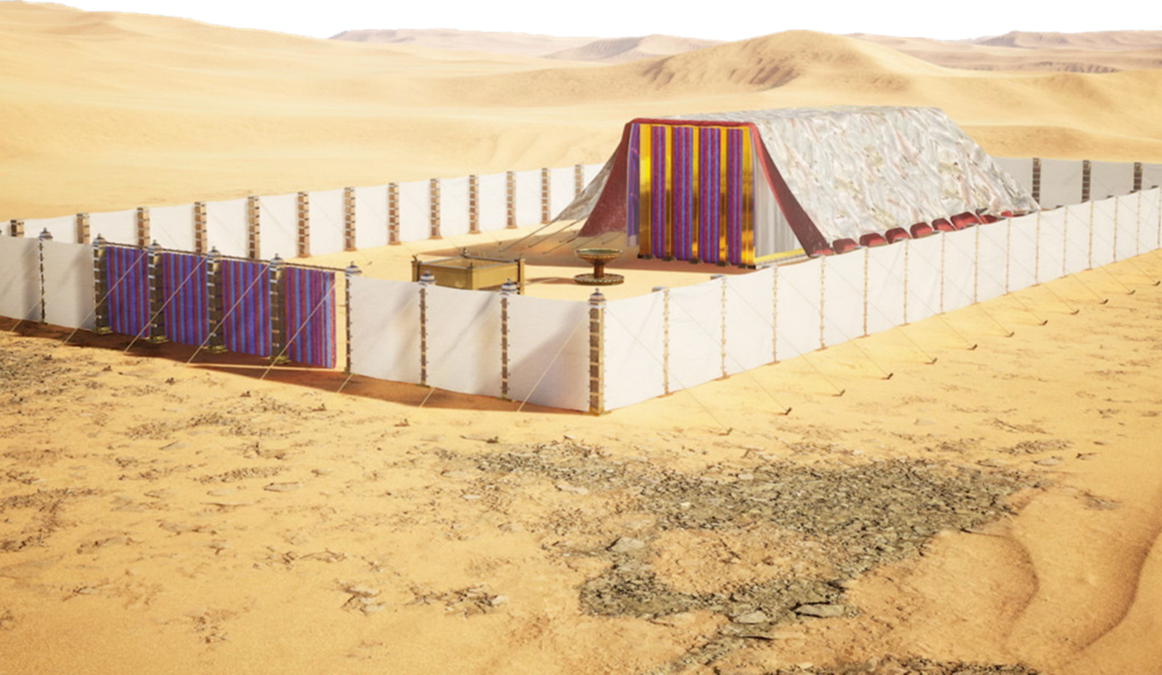
A SPECIAL PLACE TO WORSHIP

Slide 11
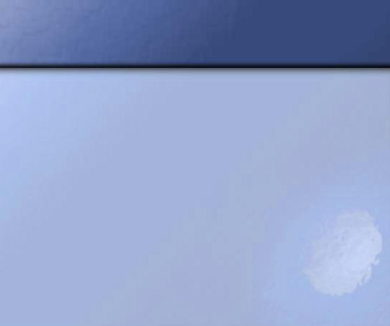
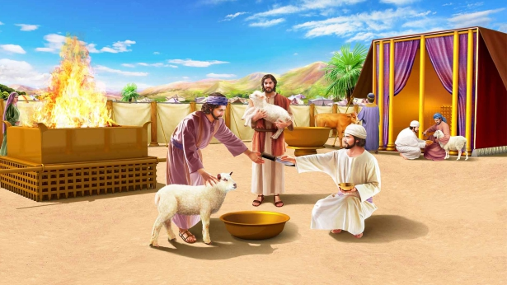
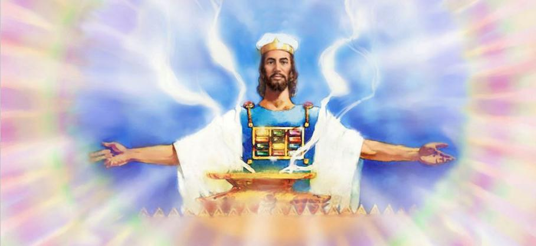
RAISING THE SANCTUARY
“The whole assembly of the Israelites gathered at Shiloh and set up the tent of meeting there. The country was brought under their control” (Joshua 18:1)
The land had been subdued by Israel. The territory had been divided among the most prominent tribes, although seven tribes had not yet received their share. The warriors of Reuben, Gad, and the half-tribe of Manasseh were to be sent to their possessions beyond the Jordan.
Before the tribes separated, a special and essential act was performed: the erection of the Tabernacle, the center of Israel's worship (Josh. 18:1).
The Sanctuary, as God's visible dwelling place, was the point of unity where all united in worship. Without God's presence, the possession of the land was meaningless.
Today, when there are still modern and postmodern giants to overcome, it is vitally important that we focus our attention on the Heavenly Sanctuary, where Jesus intercedes for us.

Slide 12
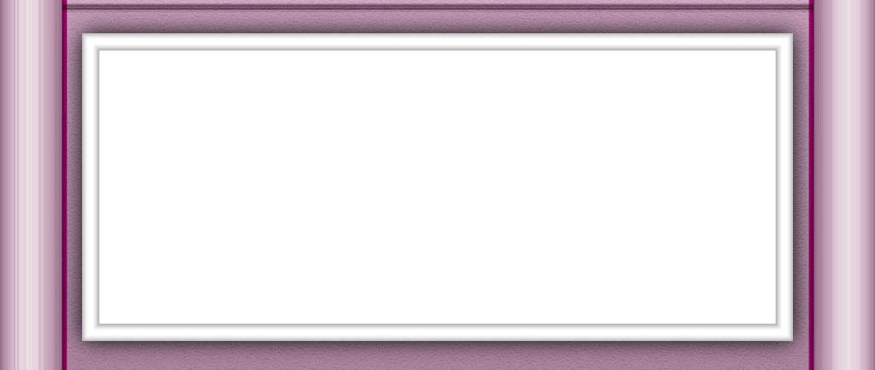
“It had not been many weeks since Moses gave the whole book of Deuteronomy in discourses to the people, yet now Joshua read the law again.”
Not alone the men of Israel, but “all the women and the little ones” listened to the reading of the law; for it was important that they also should know and do their duty. […]
Every chapter and every verse of the Bible is a communication from God to men. We should bind its precepts as signs upon our hands and as frontlets between our eyes. If studied and obeyed, it would lead God’s people, as the Israelites were led, by the pillar of cloud by day and the pillar of fire by night.
EGW (Patriarchs and Prophets, pp. 500-504)

