Slide 1

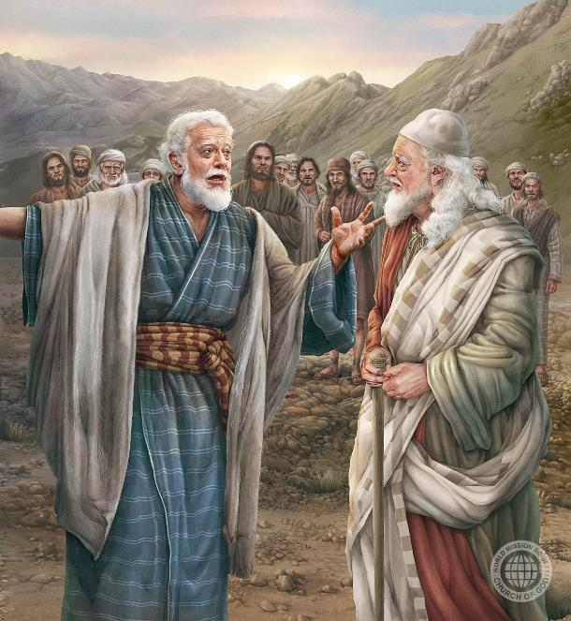
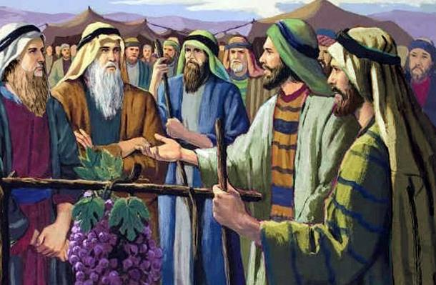
GIANTS OF FAITH: JOSHUA AND CALEB
Lesson 8 for November 22, 2025

Slide 2
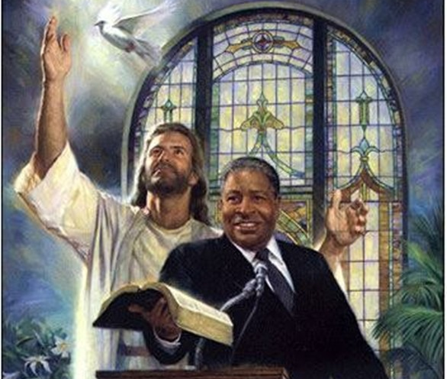
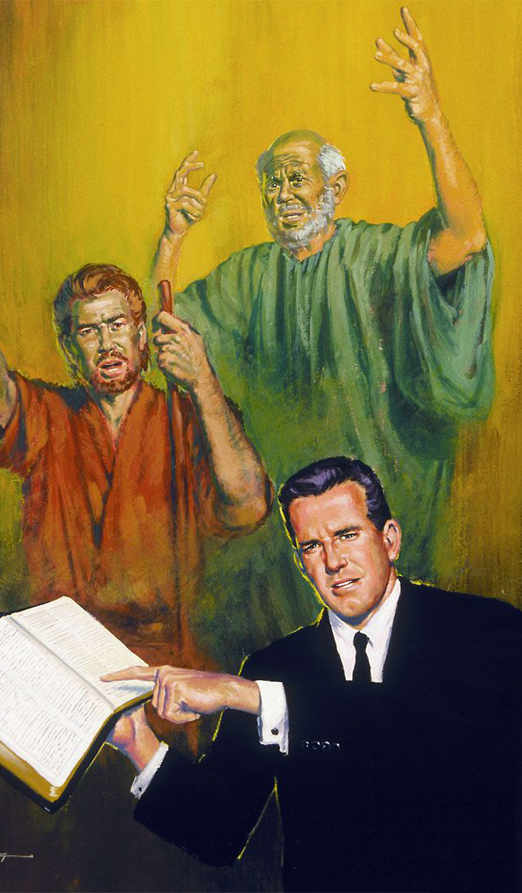
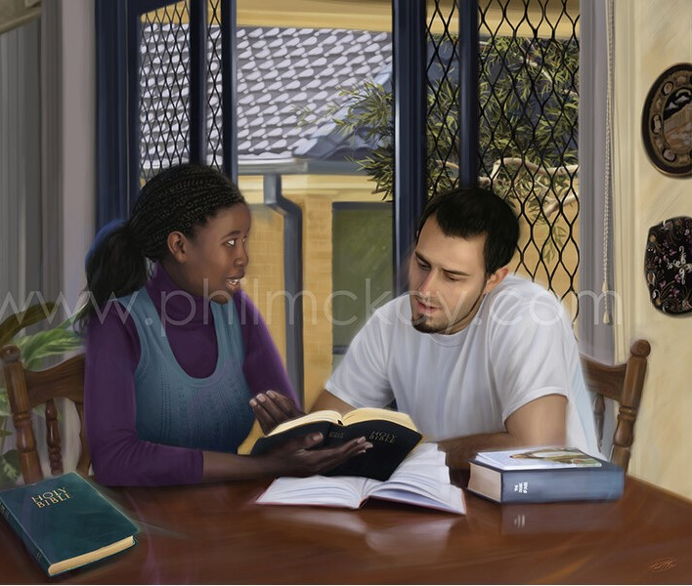
“Remember your leaders, those who spoke to you the word of God. Consider the outcome of their way of life, and imitate their faith”
(Hebrews 13:7, ESV)

Slide 3


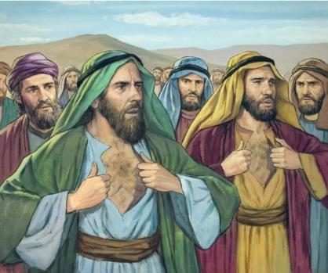




Do you know these ten people: Shammua, Shaphat, Igal, Palti, Gaddiel, Gaddi, Ammiel, Sethur, Nahbi and Geuel?
His “fame” consisted in distrusting the power of God, and thereby bringing about his death and that of an entire generation. (Num. 14:36-37).
But you've probably heard of these two people: Joshua and Caleb. They stood firm, believed in God's promises, and lived to see them fulfilled (Num. 14:38).
How can we imitate their faith and come to fully trust that God can do the impossible, just as they did?
The faith of Caleb:
Making the impossible possible.
Faith in action.
Passing the torch.
The faith of Joshua.
How to obtain faith.

Slide 4

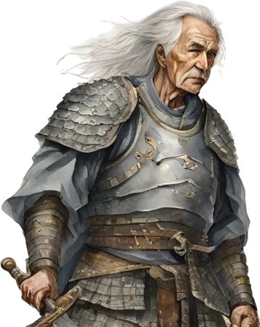
THE FAITH OF CALEB

Slide 5

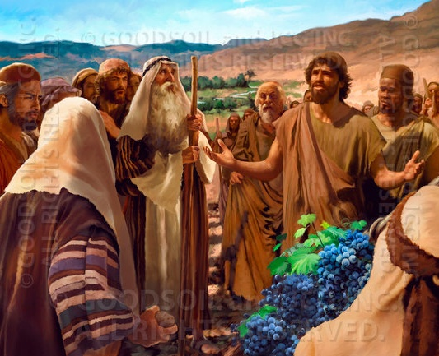
MAKING THE IMPOSSIBLE POSSIBLE
“Nevertheless my brethren who went up with me made the heart of the people melt, but I wholly followed the Lord my God” (Joshua 14:8 NKJV)
The name "Caleb" means "dog." As his life demonstrated, he didn't receive that name as a derogatory term, but because of his unwavering loyalty. He was faithful where others were unfaithful. He remained loyal to God where others flinched.
Where ten spies saw cities impossible to conquer, and giants impossible to overcome, Caleb saw cities conquered and giants “eaten like bread” (Num. 13:28-33; 14:6-9).
Together with Joshua (somewhat younger than him), he stood firm in his opinion, even when the crowd wanted to stone them (Num. 14:10).
His example encourages us to maintain our firm faith in God, who can make possible what is impossible for us.

Slide 6

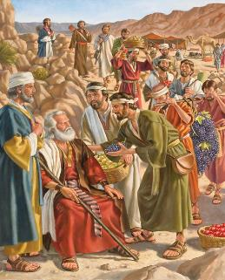
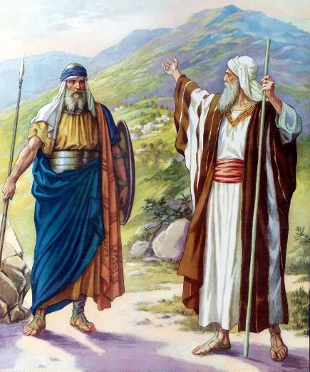

FAITH IN ACTION
“Now give me this hill country that the LORD promised me that day. You yourself heard then that the Anakites were there and their cities were large and fortified, but, the Lord helping me, I will drive them out just as he said.” (Joshua 14:12 NIV)
According to Caleb himself, when Moses asked for an account, “I brought him back a report according to my convictions” (Josh. 14:7 NIV), and “I followed the Lord my God wholeheartedly” (Josh. 14:8 NIV). Because of his faithfulness, he was promised that he would inherit the place where his feet had set foot during the inspection (Josh. 14:9).
Caleb was 40 years old when he was sent as a spy. After five years of conquest, he was now an old man of 85 (Josh. 14:10). His body and mind were still as vigorous, and his thoughts were still the same (Josh. 14:11).
The time had come to claim the promise and prove that his words were not in vain. With God's help, he was going to devour the giants and conquer their cities (Josh. 14:12-14).

Slide 7

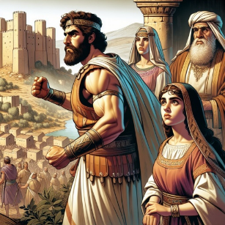
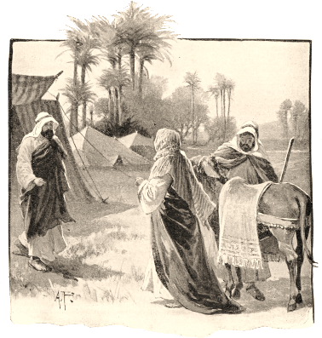
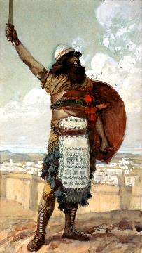
PASSING THE TORCH
“And Caleb said, ‘I will give my daughter Aksah in marriage to the man who attacks and captures Kiriath Sepher’ ” (Joshua 15:16)
When he had conquered part of the territory that was rightfully his, Caleb considered the legacy he would leave behind. Would his descendants continue to trust in God as he had?
He had proven that God could be trusted, now he wanted to find someone who had the same faith, so he could pass the torch to them.
For this reason, he promised his daughter's hand to the one who conquered Kiriath-sepher, also called Debir (Josh. 15:15-16).
His nephew Othniel was the mighty man who conquered the city, and became the first judge of Israel (Josh. 15:17; Judges 3:9-11).
After marrying Achsah, Caleb's daughter, she persuaded her father to allow him to expand the conquered area (Josh. 15:18-19), thus proving himself a worthy heir to Caleb.

Slide 8

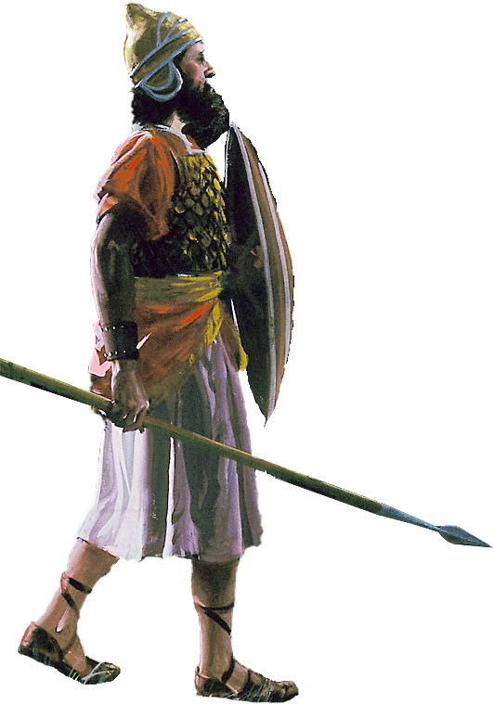
THE FAITH OF JOSHUA

Slide 9

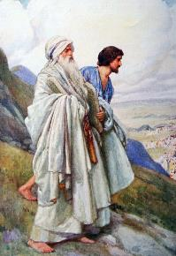
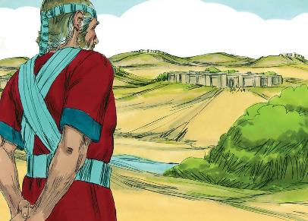
“When they had finished dividing the land into its allotted portions, the Israelites gave Joshua son of Nun an inheritance among them” (Joshua 19:49)
As a young man, Joshua was chosen by Moses as his assistant. He proved to be obedient, courageous, faithful, helpful, and a lover of the things of God (Ex. 33:11).
When the time came to claim his own territory, he waited until all the tribes had obtained their inheritance, and he chose “the portion left over” [Timnath-serah] (Josh. 19:50), a city near Shiloh, where the Sanctuary had been erected.
From his story, we learn that:
Faith does not ignore the facts; it simply offers a different angle of understanding
Instead of complaining, we are called to trust and submit to God's plans
Blessings come to those who remain totally in the Lord
Life in all its dimensions must be lived according to the plans established by God
It is worth living close to God (Ps. 84:10)

Slide 10

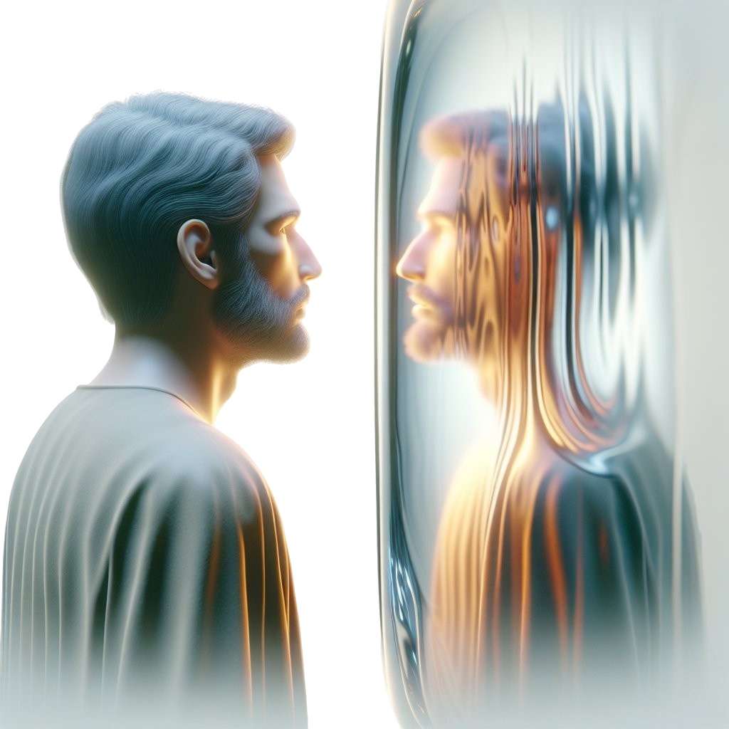
HOW TO OBTAIN FAITH

Slide 11

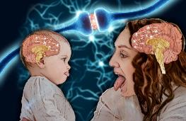
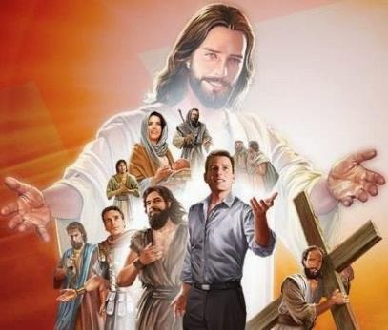
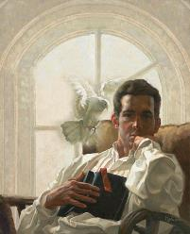
“Therefore, since we are surrounded by such a great cloud of witnesses, let us throw off everything that hinders and the sin that so easily entangles. And let us run with perseverance the race marked out for us, fixing our eyes on Jesus, the pioneer and perfecter of faith. For the joy set before him he endured the cross, scorning its shame, and sat down at the right hand of the throne of God.” (Hebrews 12:1-2 NKJV)
Our behavior tends to reflect what we see. There are even so-called "mirror neurons" that blur the distinction between observing something and doing it.
The Bible invites us to observe the example of the great heroes of faith, with special attention to Jesus, the supreme example (Heb. 12:1-2).
By studying the lives of people of faith like Caleb and Joshua, we learn to trust God as they did; to be humble as they were; to bear witness to the truth with courage, as they did.
But how can we be transformed? The Bible is clear: by allowing the Holy Spirit to work in us (2 Cor. 3:18). This is an active work. We must choose to be transformed and, like Caleb, get to work. We are called to be living sacrifices for God (Rom. 12:1-2).

Slide 12

“Today we need men of thorough fidelity, men who follow the Lord fully, men who are not disposed to be silent when they ought to speak, who are as true as steel to principle, who do not seek to make a pretentious show, but who walk humbly with God, patient, kind, obliging, courteous men, who understand that the science of prayer is to exercise faith and show works that will tell to the glory of God and the good of His people.... To follow Jesus requires wholehearted conversion at the start, and a repetition of this conversion every day.
It was Caleb’s faith in God that gave him courage, that kept him from the fear of man, and enabled him to stand boldly and unflinchingly in the defense of the right. Through reliance on the same power, the mighty General of the armies of heaven, every true soldier of the cross may receive strength and courage to overcome the obstacles that seem insurmountable.
EGW ( Sons and Daughters of God , July 19)

