Slide 1
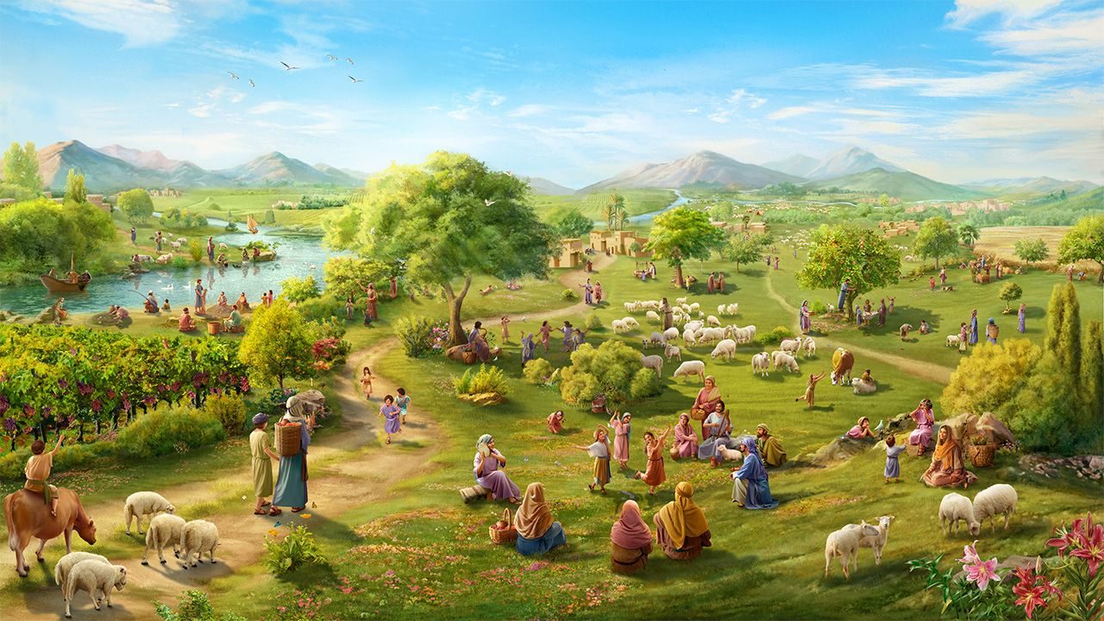
HEIRS OF PROMISES, PRISIONERS OF HOPE
Lesson 9 for November 29, 2025

Slide 2
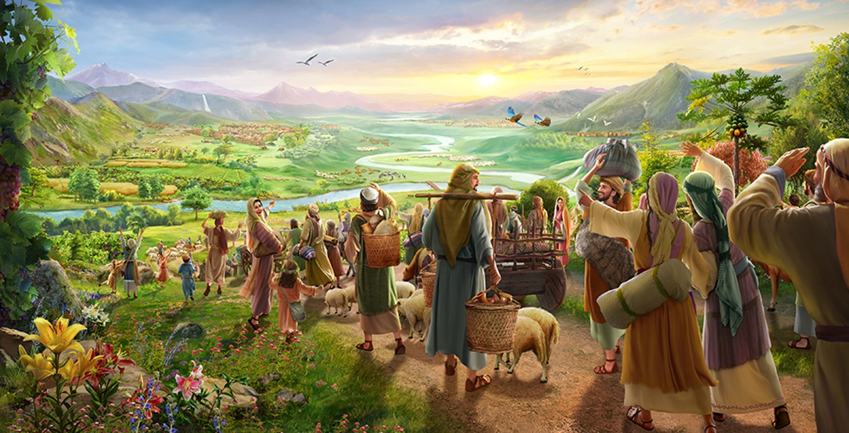
“Return to your stronghold, O prisoners of hope; today I declare that I will restore to you double” (Zechariah 9:12, ESV)

Slide 3

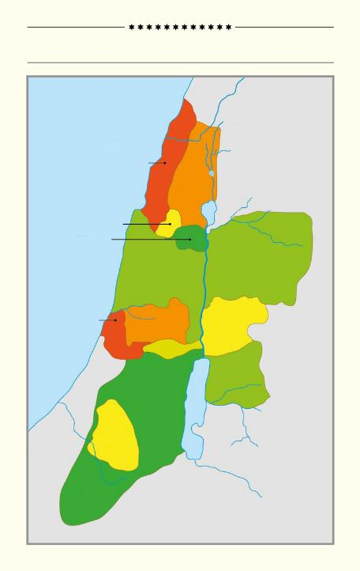
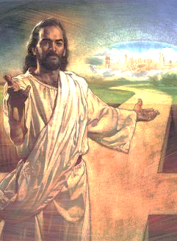
Much of the book of Joshua, chapters 13 through 21, deals with the distribution of the land of Canaan among the various tribes of Israel.
THE 12 TRIBES OF ISRAEL
Mediterranean Sea
Between the references to places, peoples, and tribes, we can see a land that was already Israel's inheritance, but which, at the same time, they did not yet completely possess.
ASER
NEPHTHALI
Jesus' death assures us that we have now inherited the land that Adam and Eve once lost. However, we are still "captives of the hope" of receiving it.
ZEBULON
ISSACHAR
MANASSEH
MANASSEH
The land that was lost
The land that God gives
Conquer the land
Keep the gift
The recovered land
DAN
A
EPHRAIM
GAD
BENJAMIN
RUBEN
B
JUDAH
C
SIMEON
B'
A'

Slide 4



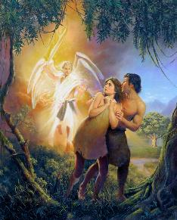
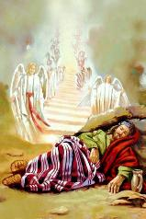
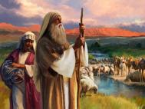
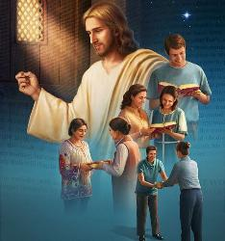
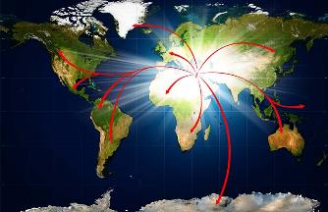
THE LAND THAT WAS LOST
“So the LORD God banished him from the Garden of Eden to work the ground from which he had been taken” (Genesis 3:23 NIV)
God appointed Adam and Eve rulers of this world (Gen. 1:27-28), and placed them in the Garden of Eden (Gen. 2:8).
When they disobeyed God, they were expelled from there (Gen. 3:23). They had lost dominion over the Earth.
But God had a plan for humanity to recover the lost land. In the first phase, He gave Abraham, Isaac, and Jacob a small piece of land: Canaan (Gen. 13:14-15).
Gradually, the possession would be extended to the whole earth, as the knowledge of God was reaching every people and nation (Is. 11:9).
Israel's disobedience led to a change in the original plans. God raised up children of Abraham from the stones to inherit his promises: us (Luke 3:8; Hebrews 6:11-12).

Slide 5



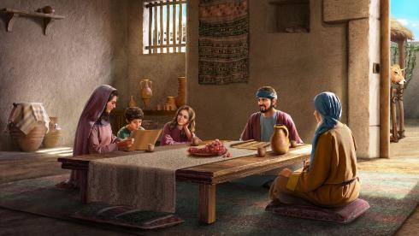
THE LAND THAT GOD GIVES
“The earth is the Lord’s, and everything in it, the world, and all who live in it.” (Psalm 24:1)
Just as Adam and Eve did nothing to deserve the Garden of Eden, Abraham and his descendants did nothing to deserve the Promised Land. It was a gift from God.
We can compare this gift to a rented house. Although Israel could live in Canaan, the land remained God's possession (Ps. 24:1).
The owner of the house is the one who takes care of the maintenance of the roof, the plumbing, etc. Similarly, God is the one who provided the rain, protected the crops, etc., so that Israel could live confidently in the land that God gave them.
As in Eden, there was rent to “pay”: obedience (Lev. 20:22). It was really a matter of relationship: loving God and enjoying His blessings.
Yesterday, as today, it remains a matter of faith (Heb. 11:9-13).

Slide 6


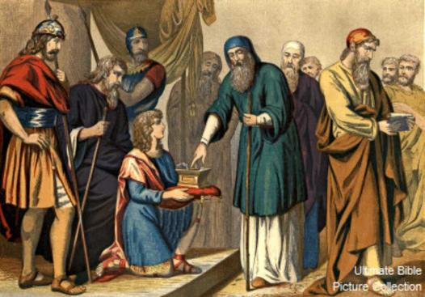
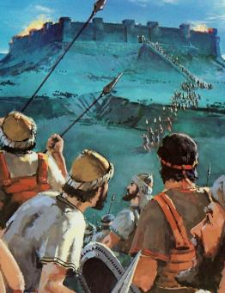
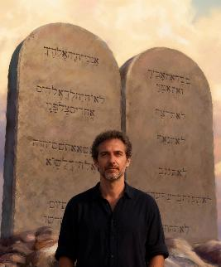
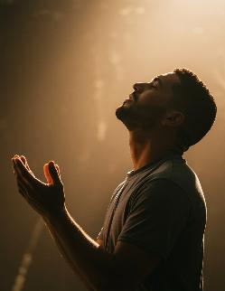
CONQUER THE LAND
“and divide it as an inheritance among the nine tribes and half of the tribe of Manasseh” (Joshua 13:7)
When Joshua was old, God commanded him to divide the land among the tribes of Israel, including the unconquered territories (Josh. 13:1-7).
The land was theirs, but they still had to make an effort to possess it. God does not act independently of man; He wants us to do our part.
Although they fought for victory, their success was not their own merit, but God's (Deut. 9:5). Like Israel, we can do nothing to obtain salvation and inherit the promises. (Eph. 2:8-9; Gal. 3:29). But if they fought… what should we do today?
Once saved, God requires two things of his heirs: obedience (Phil. 2:12); and gratitude (Heb. 12:28).

Slide 7

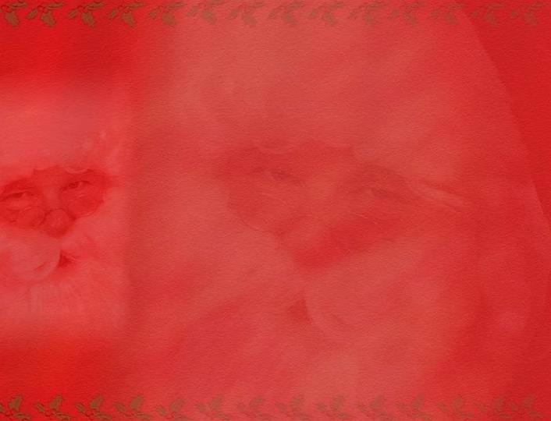
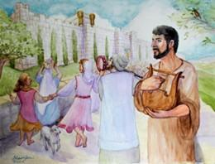
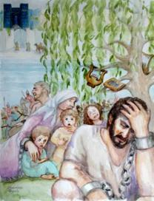
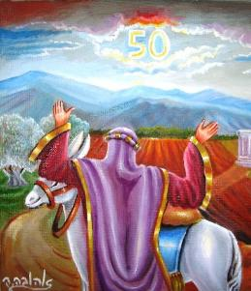
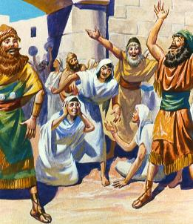
KEEP THE GIFT
“The land must not be sold permanently, because the land is mine and you reside in my land as foreigners and strangers” (Leviticus 25:23)
Once the inheritance was received, there were special rules governing the use of the land: the sabbatical year and the jubilee.
The Sabbatical year, a large-scale extension of the Sabbath, allowed the land to rest (Lev. 25:2-5). Failure to observe this law was one of the reasons for the exile (2 Chron. 36:20-21).
The jubilee involved the return of lands to their original owners, avoiding social inequalities (Lev. 25:10, 23, 40-41).
In essence, this is the main purpose of the gospel: to erase the distinction between rich and poor, employer and employee, privileged and underprivileged, putting us all on equal footing by recognizing our complete need of God’s grace.

Slide 8

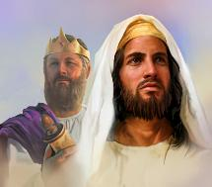
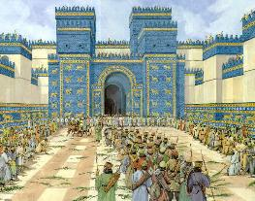
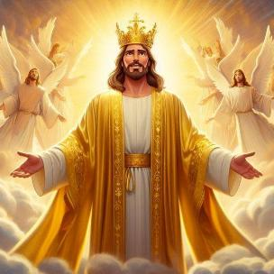
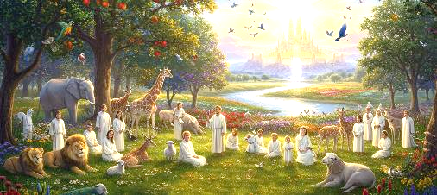
THE RECOVERED LAND
“They will live in the land I gave to my servant Jacob, the land where your ancestors lived. They and their children and their children’s children will live there forever, and David my servant will be their prince forever” (Ezekiel 37:25)
Because of their disobedience, Israel was uprooted from their land and cast into Babylon. But God did not abandon them.
He promised to bring them back, give them the land forever, and set David as king over them (Ezek. 37:25). But Israel did not possess that land forever, and David had been dead for a long time. What, then, does this prophecy mean?
Here Jesus is proclaimed, the true King who reigns eternally. He who, through his blood, assures us of an eternal inheritance.
He is the fulfillment of all the promises (Rom. 15:8; 2 Cor. 1:20). In Him we receive blessings now and, in the future, the promised inheritance (1 Pet. 1:3-4). Soon, our feet will set foot in the Promised Land.

Slide 9

“Through disobedience to God, Adam and Eve had lost Eden, and because of sin the whole earth was cursed. But if God's people followed His instruction, their land would be restored to fertility and beauty. God Himself gave them directions in regard to the culture of the soil, and they were to co-operate with Him in its restoration. Thus the whole land, under God's control, would become an object lesson of spiritual truth. As in obedience to His natural laws the earth should produce its treasures, so in obedience to His moral law the hearts of the people were to reflect the attributes of His character.”
EGW (Christ's Object Lessons, p. 289)

