Slide 1
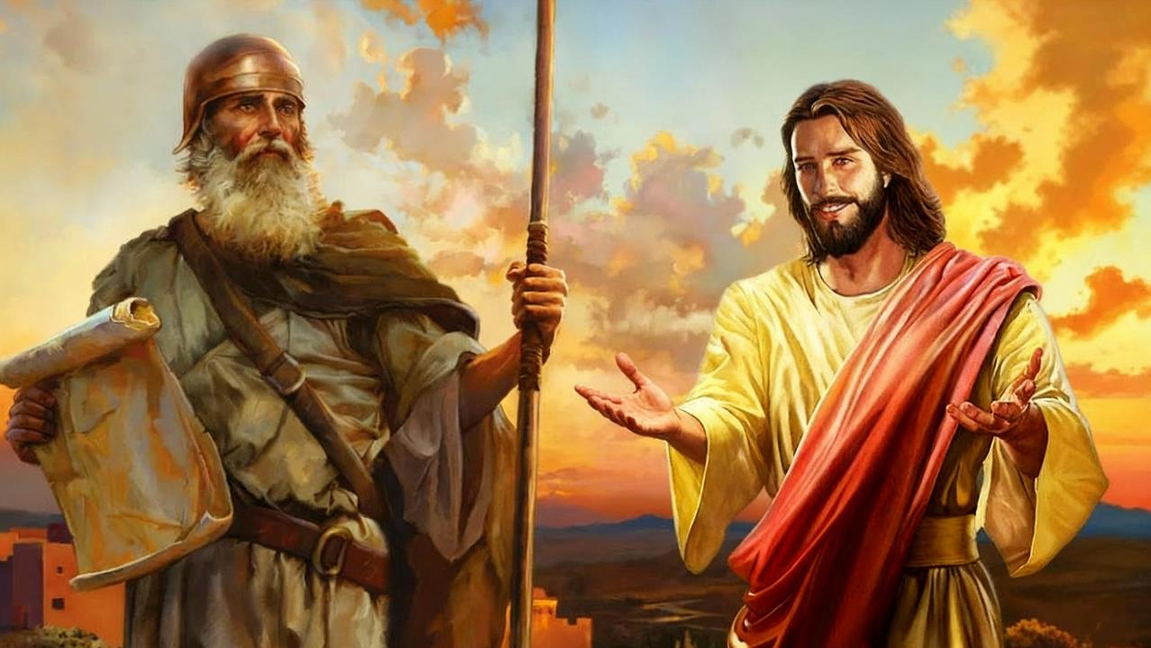
THE TRUE JOSHUA
Lesson 10 for December 6, 2025

Slide 2
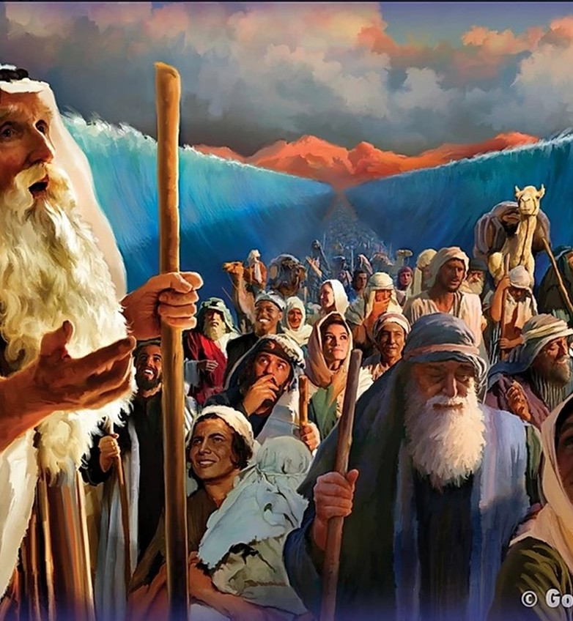
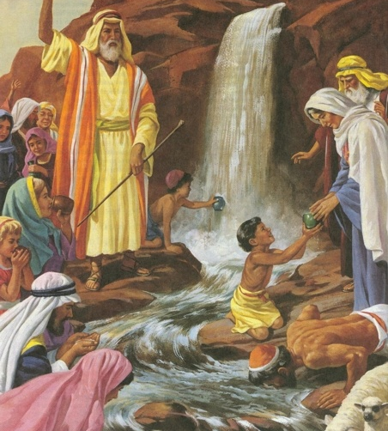
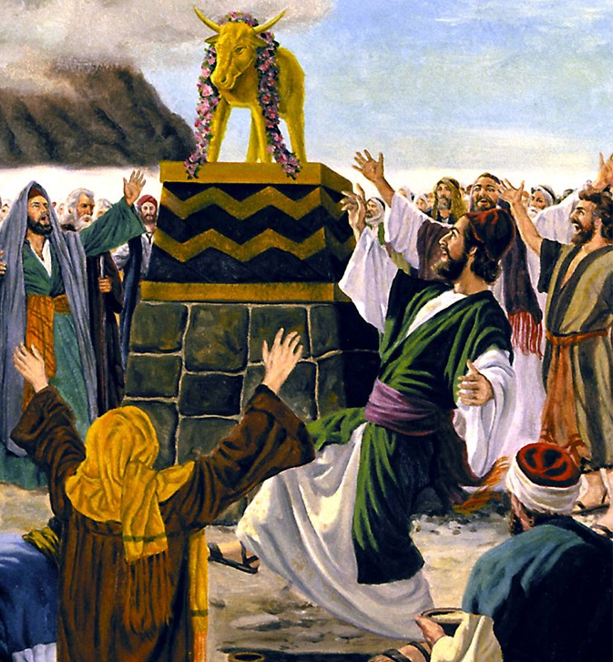
“Now these things happened to them as an example, but they were written down for our instruction, on whom the end of the ages has come” (1 Corinthians 10:11, ESV)

Slide 3

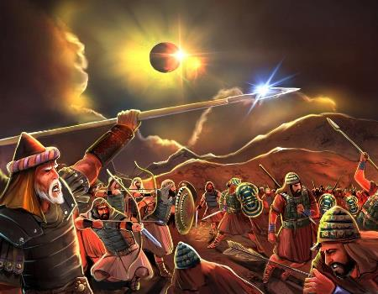
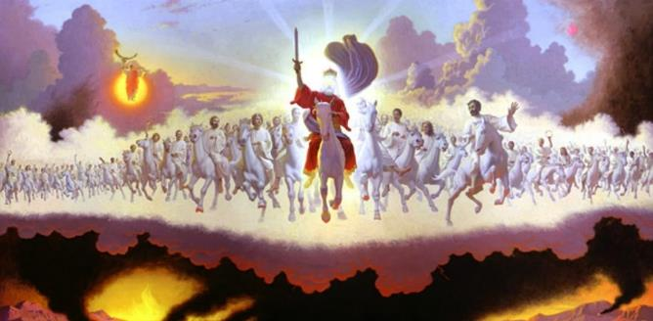







We can read the life of Joshua, described in the Pentateuch and in the book of Joshua itself, in two different (and complementary) ways: as history and symbolically.
In order to make a correct symbolic interpretation of the figure of Joshua, we must first know the rules that govern biblical symbolism: types and antitypes.
Once this is done, we will trace the symbolism of Joshua through the rest of the Bible to find the messages that God has left us through His Word in relation to the “symbolic Joshua”.
Biblical symbolism:
  What is typology?
  Typology classes
The symbolism of Joshua:
  Joshua as a type
  The antitype of Joshua
  Joshua as a type of the Church

Slide 4

BIBLICAL SYMBOLISM

Slide 5


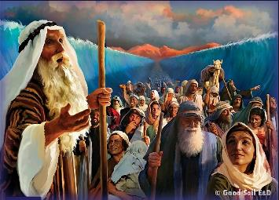
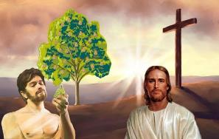
WHAT IS TYPOLOGY?
“Now these things happened to them as an example, but they were written down for our instruction, on whom the end of the ages has come.” (1 Corinthians 10:11)
Paul – and other biblical authors – use the word “type” to refer to a historical figure or event that represents something or someone from his own time and/or the future (called an “antitype”).
For example, Romans 5:14 speaks of Adam as a type [“figure” in KJV] “of him who was to come,” that is, of Jesus—the antitype.
The type
David (Psalm 22:1)
Antitype advertisement
A new David (Jer. 23:5)
The antitype
Jesus (Mt. 27:46)
The type
Sacrifices (Lev. 1:3-5)
Antitype advertisement
Suffering servant (Is. 53:5-7)
The antitype
Death of Jesus (Jn. 19:16-18)
On many occasions, we find in the Old Testament an indication that specific characters or events are types of something to come. Let's look at two examples:

Slide 6

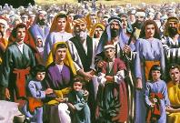
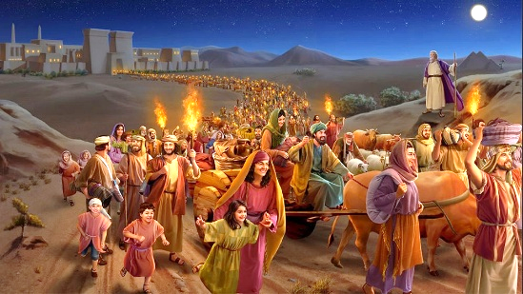
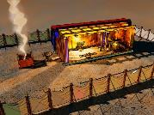
TYPOLOGY CLASSES
“where he stayed until the death of Herod. And so was fulfilled what the Lord had said through the prophet: ‘Out of Egypt I called my son’ ” (Matthew 2:15)
The types in the Old Testament point to three distinct kinds of antitype in the New Testament: Christ; the Church; and the end times.
TYPES AND ANTITYPES
Israel
The Exodus
The sanctuary
Christ
Church
End times
Christ
Church
End times
Christ
Church
End times
He was taken to Egypt
Matthew 2:13-15
The new Israel
Galatians 6:16
The 144,000
Revelation 7:4
40 Days in the Desert
Matthew 3:16-4:2
Baptized and sustained by Christ
1 Corinthians 10:1-6
Exodus from apostate churches
Revelation 18:4
It was like a temple among us
John 1:14; 2:21-22
We are the temple of God
1 Corinthians 3:16-17
The New Jerusalem, our temple
Revelation 21:2-3
TYPE
ANTITYPE

Slide 7

THE SYMBOLISM OF JOSHUA

Slide 8


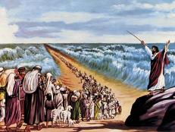
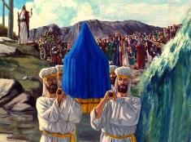
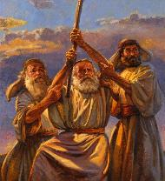
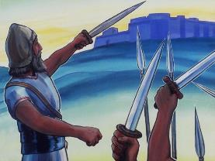
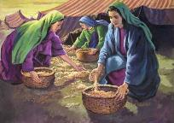
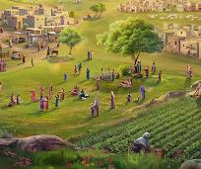
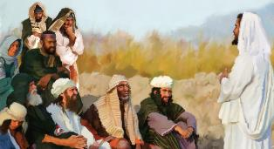
JOSHUA AS A TYPE
“The Lord your God will raise up for you a prophet like me from among you, from your fellow Israelites. You must listen to him.” (Deuteronomy 18:15)
Joshua partially fulfilled Moses' prophecy concerning a second prophet who would lead the people (Deut. 18:15-19).
Like Moses, Joshua received direct messages from God; he celebrated Passover; he crossed the waters; he saw the Angel of the Lord; his outstretched hand brought victory; he invited the people to remain faithful after his death; etc.
While the manna began to fall under Moses, it ceased under Joshua. Furthermore, Joshua carried out the instructions regarding the division of the land and the cities of refuge that Moses had given.
But the people understood that Moses' prophecy extended beyond Joshua (John 1:21). Thus, both Moses and Joshua become types of the true antitype who fully realized the prophecy given to Moses concerning “the Prophet”: Jesus (Acts 3:22-26).

Slide 9


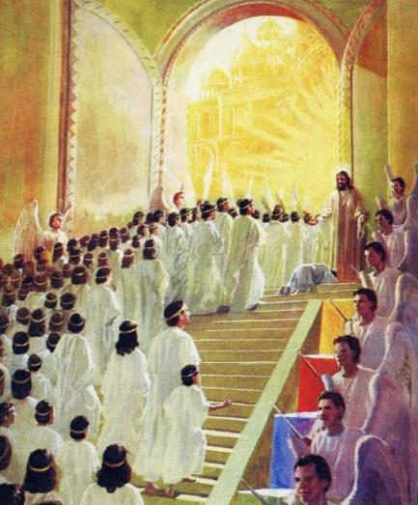
THE ANTITYPE OF JOSHUA
“In the time of my favor I will answer you, and in the day of salvation I will help you; I will keep you and will make you to be a covenant for the people, to restore the land and to reassign its desolate inheritances ” (Isaiah 49:8 NIV )
The objective of the wars led by Joshua was to establish the Israelites in the Promised Land. Isaiah presents the work of the Messiah as consisting of assigning the “desolate inheritances [to his people]” (Isa. 49:8, NIV), using the same terminology as the book of Joshua.
In what sense is the life and work of Joshua (as a type) reflected in the life and work of Jesus (the antitype)?
After his baptism in the Jordan, Jesus fought against
the forces of evil
He began his work after 40 days in the desert
He defeated the enemy on the cross
He gives us victory over our spiritual enemies
He gives us true rest
He assigns us an incorruptible inheritance

Slide 10

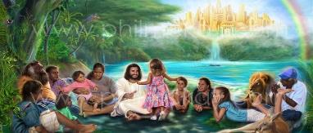
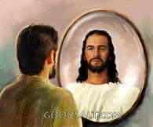
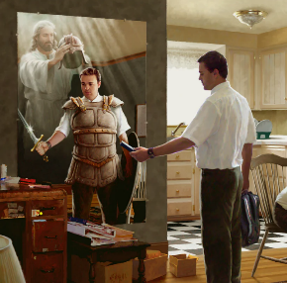

JOSHUA AS A TYPE OF THE CHURCH
“For our struggle is not against flesh and blood, but against the rulers, against the authorities, against the powers of this dark world and against the spiritual forces of evil in the heavenly realms.” (Ephesians 6:12)
JOSHUA AND THE CHURCH
Today we have a battle to fight, in which we are led by our “Joshua”, who equips us with the necessary armor (Eph. 6:10-12).
Furthermore, he already assigns us an inheritance, and fills us with spiritual blessings (Eph. 1:3, 11).
JOSHUA AND THE END TIMES
But the complete typological fulfillment of Joshua will be at the end, when all the hosts of evil are destroyed, and we take full possession of our inheritance: a land where we can live in confidence (Rev. 20:7-9; Ezek. 28:26).
Until that time comes, let us grow in grace as Joshua did, allowing God to transform us to become a little more like Him each day.

Slide 11

“The Israel of God, journeying to the heavenly Canaan, have a Captain who needed no human teaching to prepare Him for His mission as a divine leader; yet He was made perfect through sufferings; and “in that He Himself hath suffered being tempted, He is able to succor them that are tempted.” Hebrews 2:10, 18. Our Redeemer manifested no human weakness or imperfection; yet He died to obtain for us an entrance into the Promised Land.”
EGW (Patriarchs and Prophets, p. 480)

