Slide 1
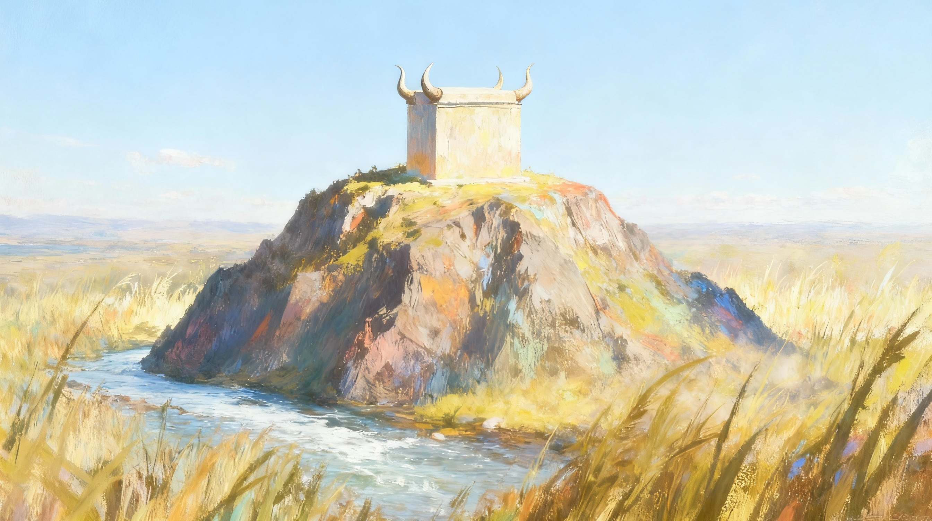
LIVING IN THE LAND
Lesson 11 for December 13, 2025

Slide 2
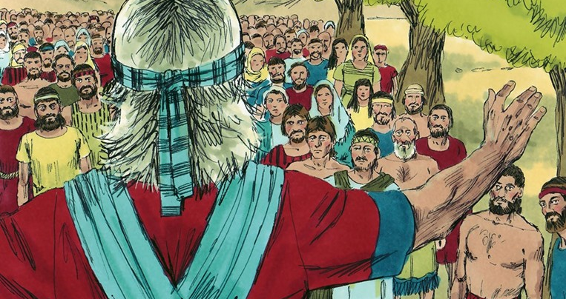

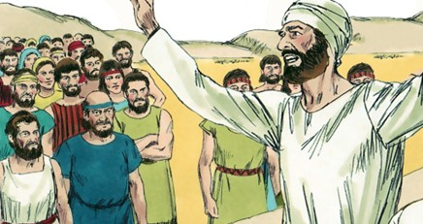
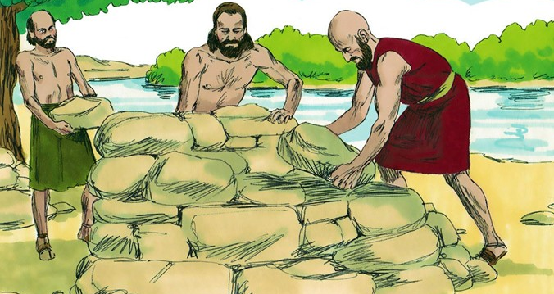
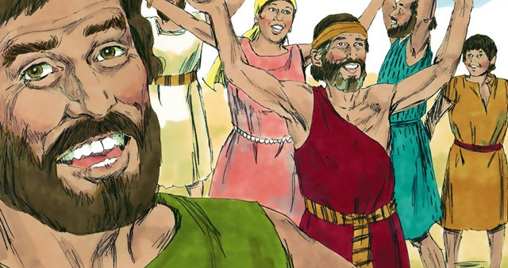
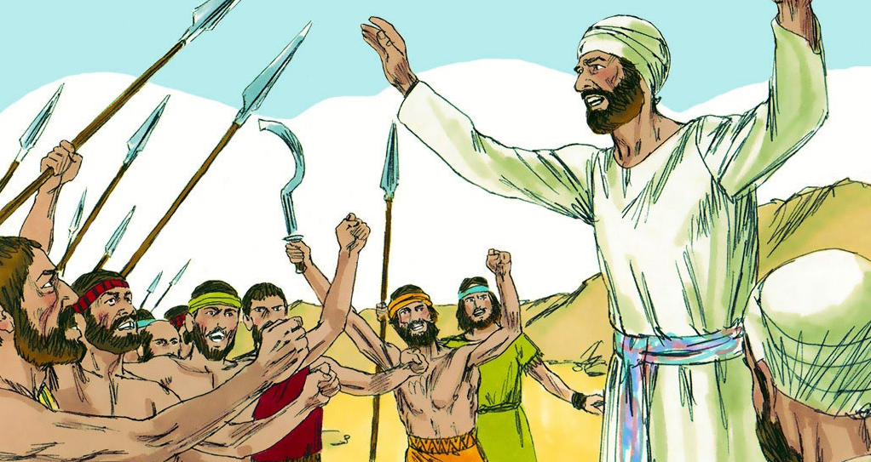
“A gentle answer turns away wrath, but a harsh word stirs up anger” (Proverbs 15:1, NIV)

Slide 3

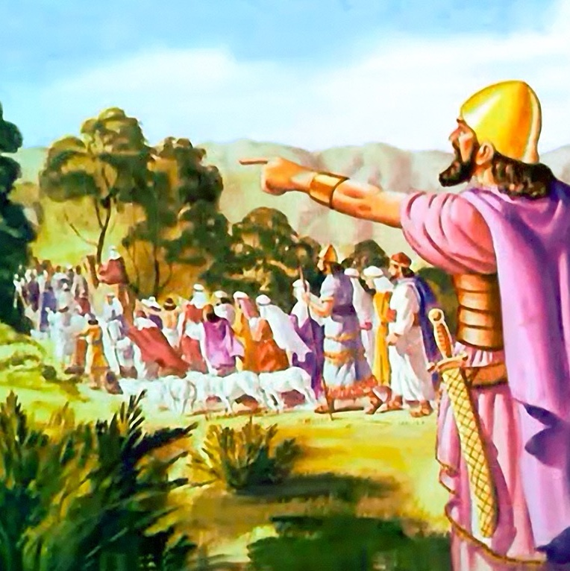
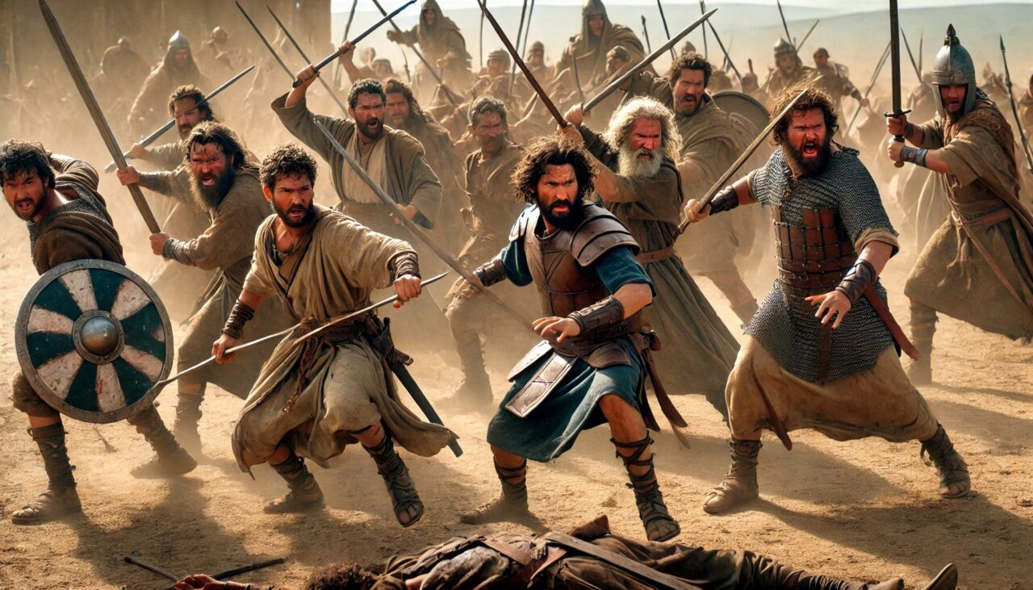





After several years of war, Israel had conquered Canaan, although not all of its inhabitants had yet been expelled.
The two and a half tribes that had taken possession of the eastern part (Reuben, Gad and the half tribe of Manasseh), and that had crossed the Jordan to help in the conquest, had faithfully fulfilled their commitment.
Finally, the time for parting had arrived. After blessing them and advising them to continue on God's path, Joshua dismissed them. But the farewell was overshadowed by a serious misunderstanding that could easily have destroyed the unity of the people of Israel.
The Farewell Speech (Joshua 22:1-8)
The reason for the conflict (Joshua 22:10-12)
The accusations (Joshua 22:13-20)
The kind answer (Joshua 22:21-29)
Reconciliation (Joshua 22:30-34)

Slide 4


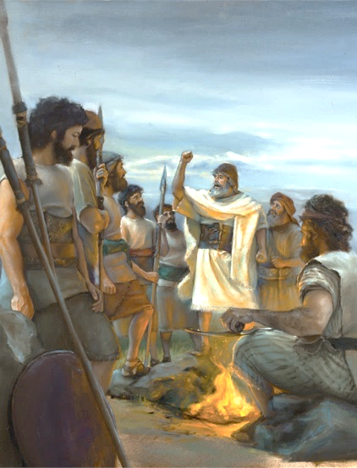
THE FAREWELL SPEECH
“But be very careful to keep the commandment and the law that Moses the servant of the Lord gave you: to love the Lord your God, to walk in obedience to him, to keep his commands, to hold fast to him and to serve him with all your heart and with all your soul.”(Joshua 22:5 NIV)
Since the Jordan was going to cause a separation between the tribes, Joshua gave wise advice to the two and a half tribes so that they could remain faithful (Joshua 22:5):
To love the Lord your God
To walk in obedience to him
To keep his commands
To hold fast to him
To serve him with all your heart and with all your soul
Love is the principle that should lead us to God. We love Him because He first loved us
(1 John 4:19)
This is how Joshua indicates the conduct expected of those who choose to walk with God
Obedience is the natural result of a grateful heart that understands what God has done
We must cling to God without letting any distraction break that bond
We find our true purpose, satisfaction, and abundant life when we willingly serve our Creator with love

Slide 5


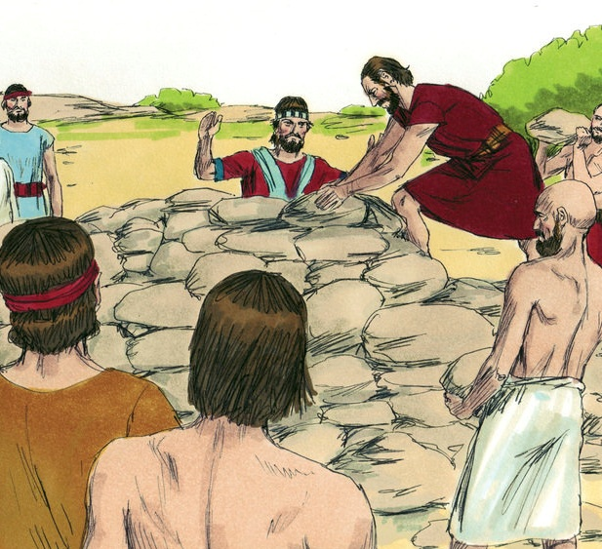

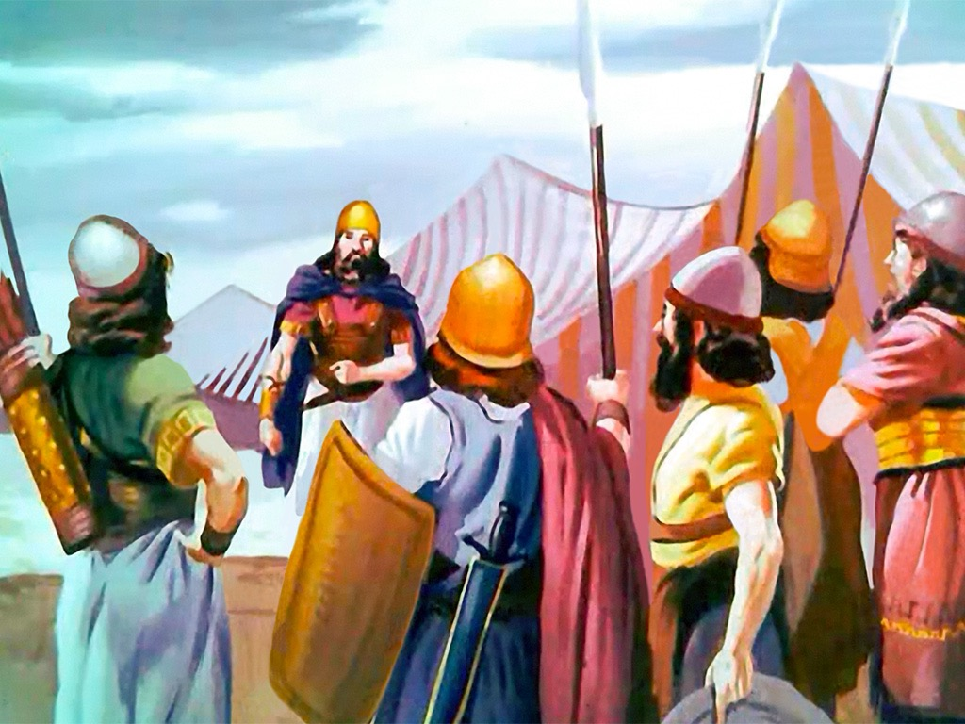
THE REASON FOR THE CONFLICT
“When they came to Geliloth near the Jordan in the land of Canaan, the Reubenites, the Gadites and the half-tribe of Manasseh built an imposing altar there by the Jordan” (Joshua 22:10)
Near the place where Joshua had erected a memorial of the miraculous crossing of the Jordan, the two and a half tribes built an altar similar to the altar of the Sanctuary (Josh. 22:10, 28).
This act was interpreted as a transgression of the law that prohibited offering sacrifices in a place other than the altar of burnt offerings in the Sanctuary (Lev. 17:8-9).
The rest of the Israelites decided to eradicate this sin by attacking their brothers (Josh. 22:12). But God intervened to prevent a bloody civil war. He raised up people who chose not to judge without all the evidence; they granted the benefit of the doubt; and they decided to give their brothers the opportunity to explain themselves (Josh. 22:13-14).
As it turned out, his only mistake had been not informing his brothers of his intentions… but that is not a sin.

Slide 6

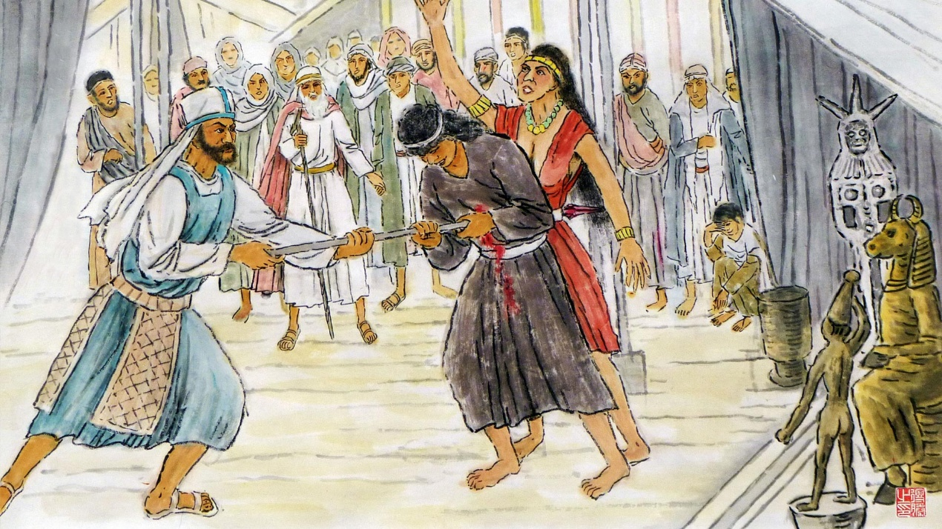
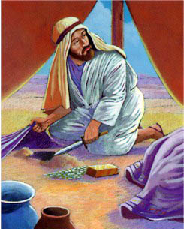
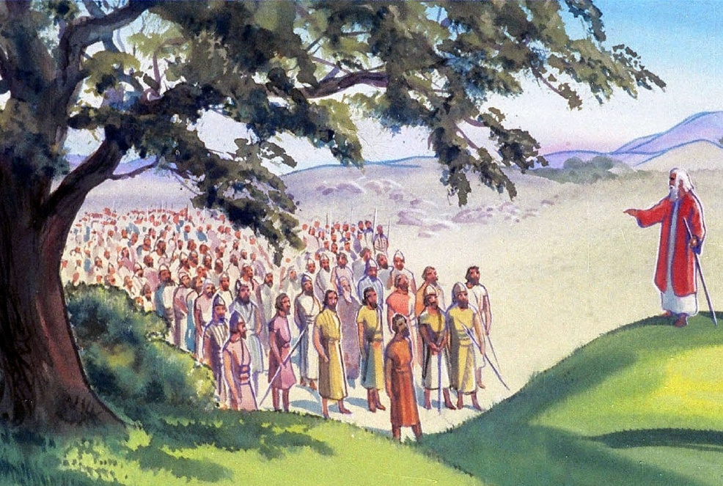
THE ACCUSATIONS
“The whole assembly of the Lord says: ‘How could you break faith with the God of Israel like this? How could you turn away from the Lord and build yourselves an altar in rebellion against him now?’ ”
(Joshua 22:16)
Why was Phinehas chosen to head the investigating committee
(Josh. 22:13-14)?
Phinehas, the high priest's son, had been relentless in stopping the sin at Baal-Peor (Num. 25:7-8). In his speech, he linked this sin to Achan's sin and equated it with the one supposedly committed by the two and a half tribes (Josh. 22:16-20).
Phinehas's speech made perfect sense. If sacrifices were offered on the newly erected altar, God would punish all of Israel for it (Josh. 22:18b).
However, he gave them the opportunity to rectify this mistake, before they committed the sin: he offered them the chance to return to the Jordan side where the Sanctuary was (Josh. 22:19).

Slide 7


THE KIND ANSWER
“If we have built our own altar to turn away from the Lord and to offer burnt offerings and grain offerings, or to sacrifice fellowship offerings on it, may the Lord himself call us to account.” (Joshua 22:23)
The tribes of Reuben and Gad, and the half-tribe of Manasseh, when accused, acted in an exemplary manner:
They listened to the accusations in silence
They called God as their witness
They accepted to be punished if they had sinned
They revealed their true motivations
When the Israelites did not know the motivations of their brothers for building the altar, they assumed: rebellion, a desire for separation, and divine punishment.
The reality was: a desire to remain united with their brothers and avoid a future separation on the part of the Israelites
(Josh. 22:24-26).
Although the accused tribes could have felt offended by the accusations and reacted violently in their defense, thanks to their friendly response, war was avoided.

Slide 8

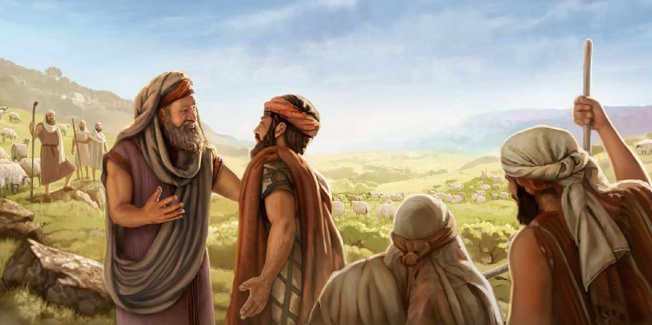
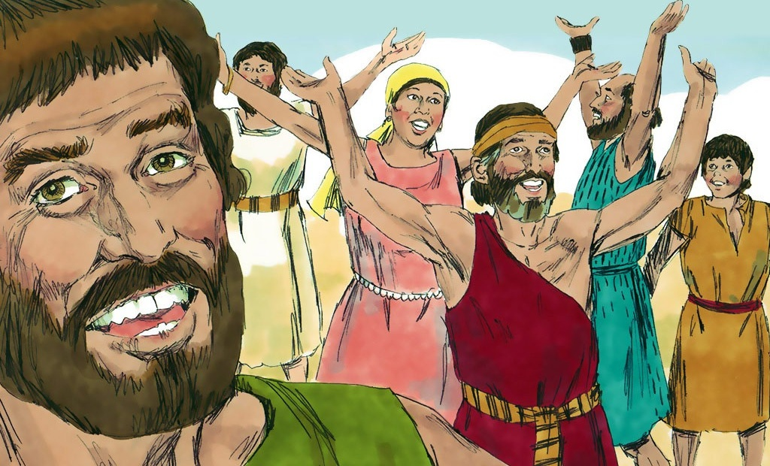
RECONCILIATION
“They were glad to hear the report and praised God. And they talked no more about going to war against them to devastate the country where the Reubenites and the Gadites lived” (Joshua 22:33)
Seeing that the accusation was unfounded, Phinehas and the Israelite delegation were relieved (Josh. 22:30-31). For their part, when the Israelites learned the truth, they rejoiced and praised God (Josh. 22:32-33).
Through their example, we can see the necessary steps to restore peace in similar situations when relating to family, church, and community:
Do not jump to conclusions
Talk about the problems before acting
Be willing to make sacrifices to achieve unity
Give a polite response to the accusations
Rejoice and bless God when peace is restored
Communicating our thoughts

Slide 9

“The children of Gad and Reuben now placed upon their altar an inscription pointing out the purpose for which it was erected; and they said, “It shall be a witness between us that Jehovah is God.” Thus they endeavored to prevent future misapprehension and to remove what might be a cause of temptation.
How often serious difficulties arise from a simple misunderstanding, even among those who are actuated by the worthiest motives; and without the exercise of courtesy and forbearance, what serious and even fatal results may follow […]
No one was ever reclaimed from a wrong position by censure and reproach; but many are thus driven further from the right path and led to harden their hearts against conviction. A spirit of kindness, a courteous, forbearing deportment may save the erring and hide a multitude of sins”
EGW (Patriarchs and Prophets, pp. 519)

