Slide 1
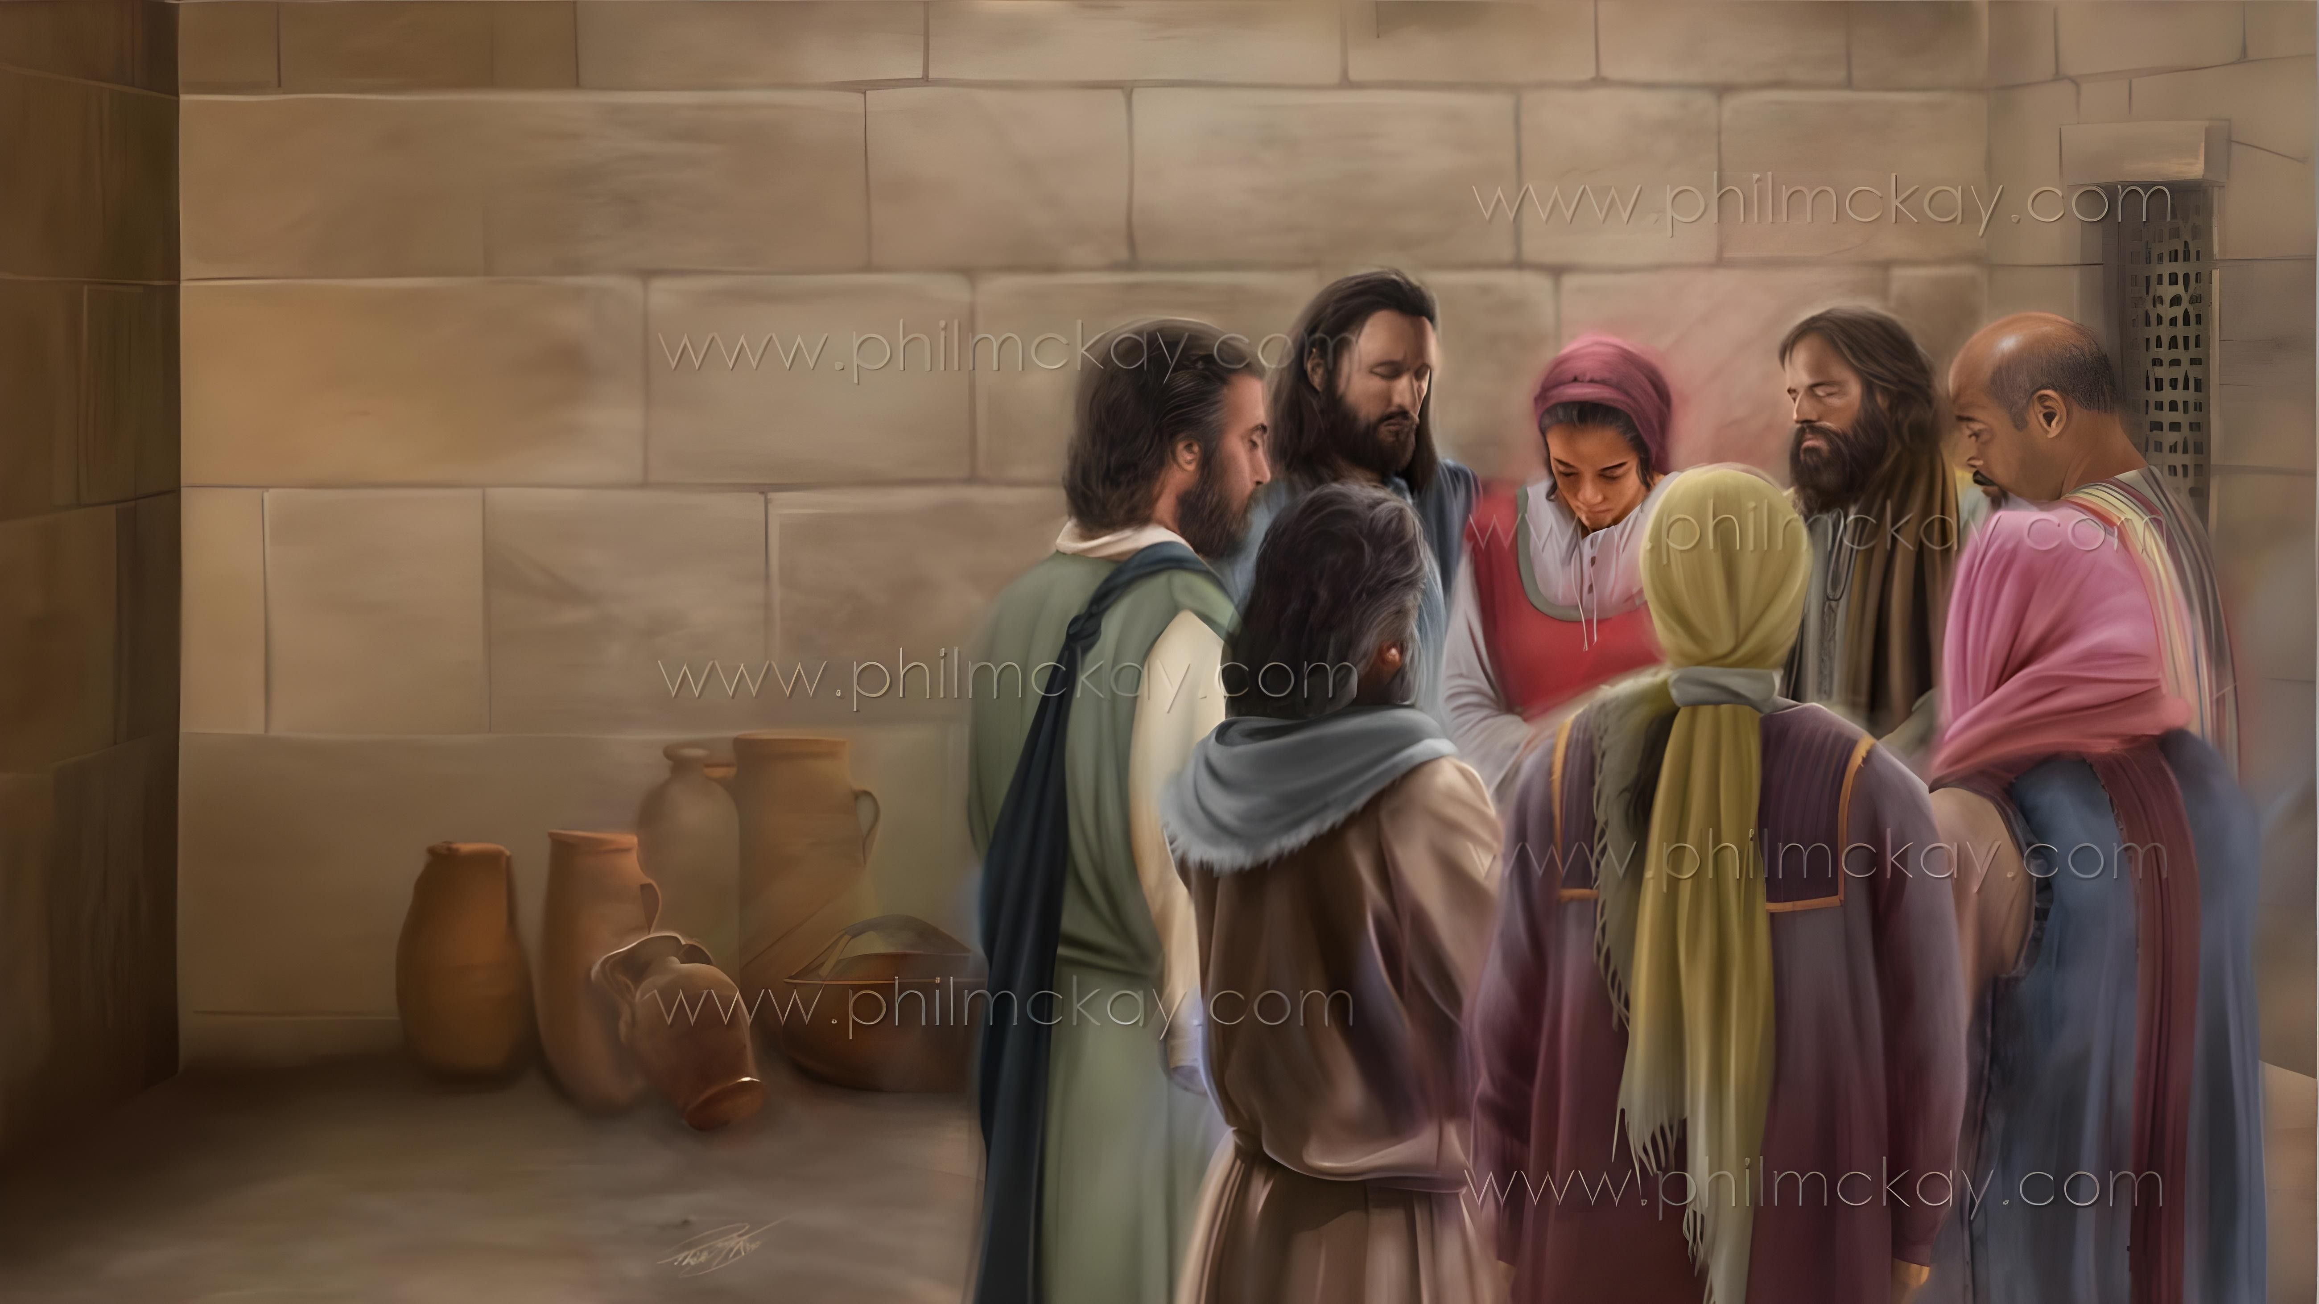
REASONS FOR THANKSGIVING AND PRAYER
Lesson 2 for January 10, 2026

Slide 2


“Being confident of this very thing, that He who has begun a good work in you will complete it until the day of Jesus Christ”
Philippians 1:6, NKJV

Slide 3

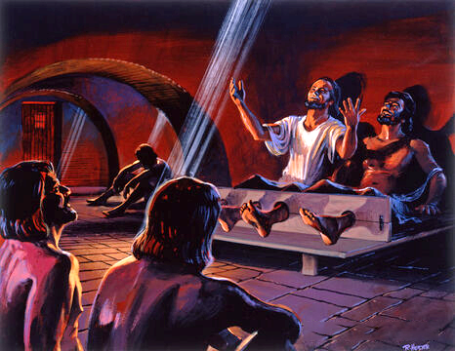
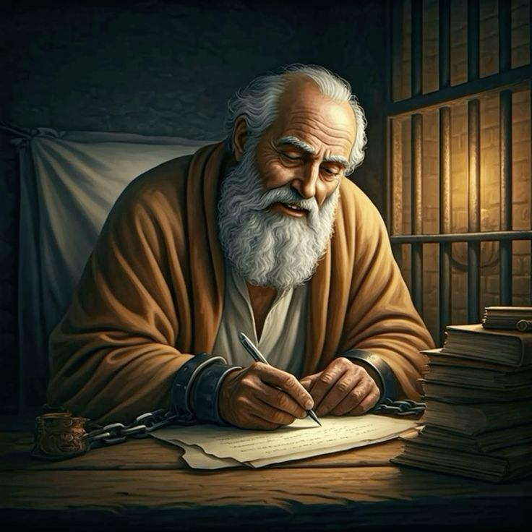







These were not easy times for Paul. It would have been easy to give in to despair at the loss of his freedom.
However, just as he had sung hymns in his grim Philippian prison, Paul found reasons for gratitude to convey to his brothers and sisters in Philippi and Colossae.
His imprisonment did not prevent him from continuing to communicate with his Father, and interceding for others through prayer.
Reasons to give thanks and pray in the letter to the Philippians:
Reasons to be thankful (Philippians 1:3-8)
Prayer requests (Philippians 1:9-11)
Giving thanks and praying in difficult times (Philippians 1:12-18)
Reasons to give thanks and pray in the letter to the Colossians:
Reasons to be thankful (Colossians 1:3-8)
Prayer requests (Colossians 1:9-12)

Slide 4
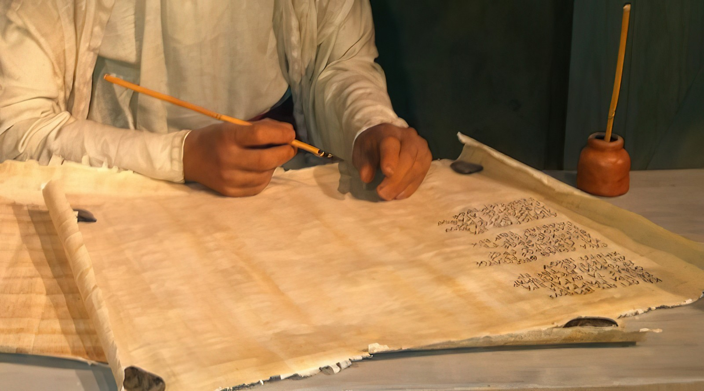
Reasons to Give Thanks and Pray in the Letter to the Philippians

Slide 5

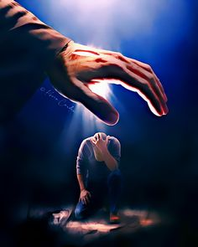
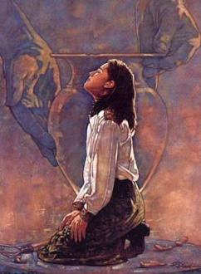
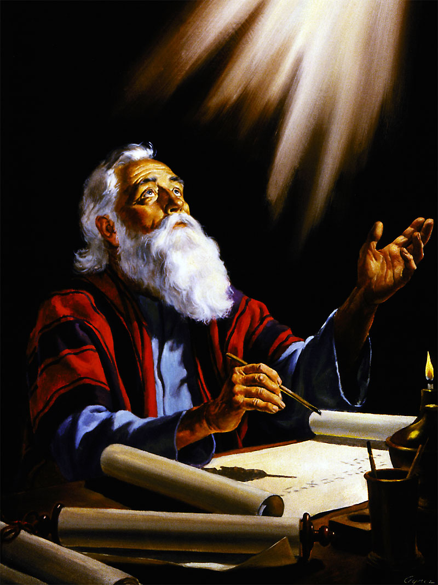
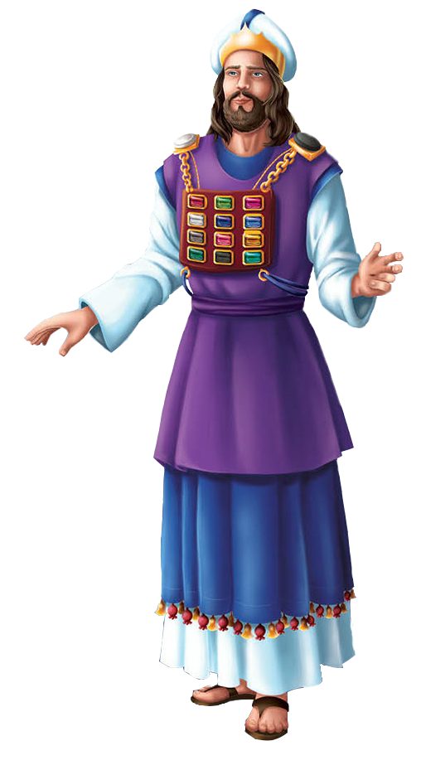
REASONS TO BE THANKFUL
“being confident of this, that he who began a good work in you will carry it on to completion until the day of Christ Jesus” (Philippians 1:6)
Paul begins his letter by thanking God for the believers in Philippi (Phil. 1:3), whom he dearly loved (Phil. 1:8).
Just as the high priest wore on his breastplate, next to his heart, the names of the tribes of Israel engraved on gems when he stood before God, Paul carried “in his heart” each member of the church when he stood before God in prayer to intercede for them (Phil. 1:7).
His gratitude included the fact that the Philippians remained faithful to the gospel, and that God was perfecting them every day (Phil. 1:5-6).
The third reason for gratitude was that the Philippians shared with him “in my bonds, and in the defence and confirmation of the gospel” (Phil. 1:7).

Slide 6


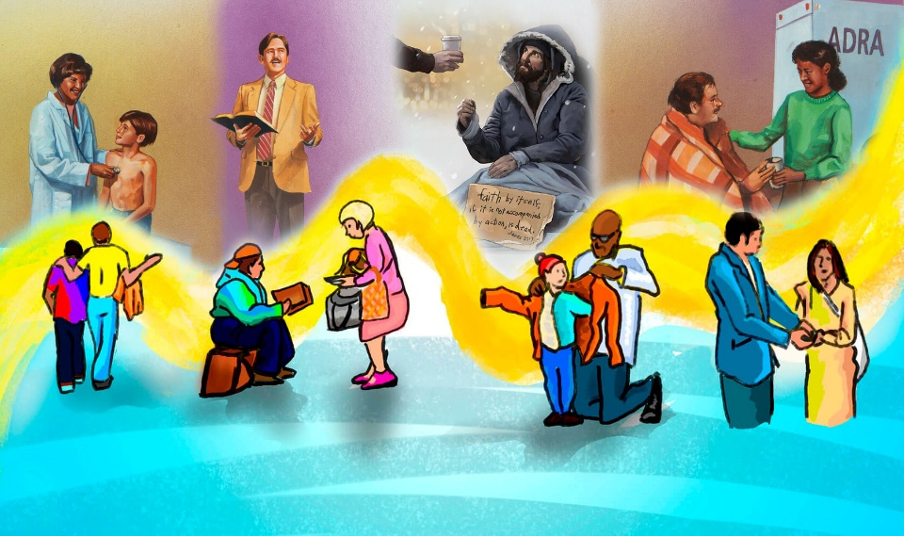
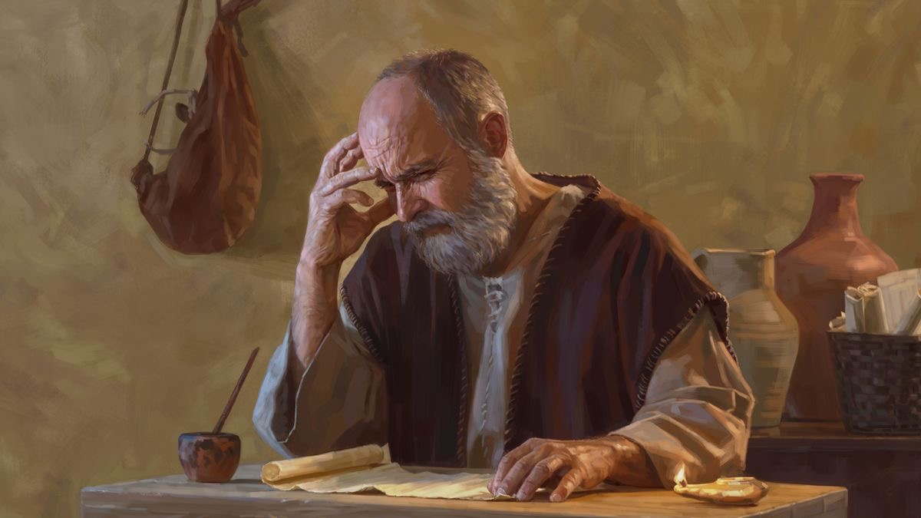
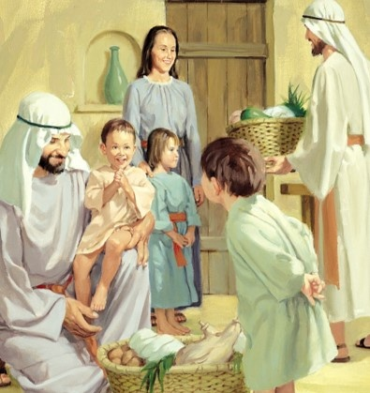
PRAYER REQUESTS
“And this is my prayer: that your love may abound more and more in knowledge and depth of insight, so that you may be able to discern what is best and may be pure and blameless for the day of Christ, filled with the fruit of righteousness that comes through Jesus Christ—to the glory and praise of God.” (Philippians 1:9-11 NIV)
We can consider Paul's prayer motivation as a “chained reason” (Phil. 1:9-11 NIV):
May love abound in you
It will make you wiser
You will discern the best
You will be pure and upright
You will bear fruit through Jesus Christ
This will result in glory and praise for God
How can our love “abound still more and more”? Why is that so important for the Christian life?

Slide 7
GIVING THANKS AND PRAYING IN DIFFICULT TIMES

Slide 8

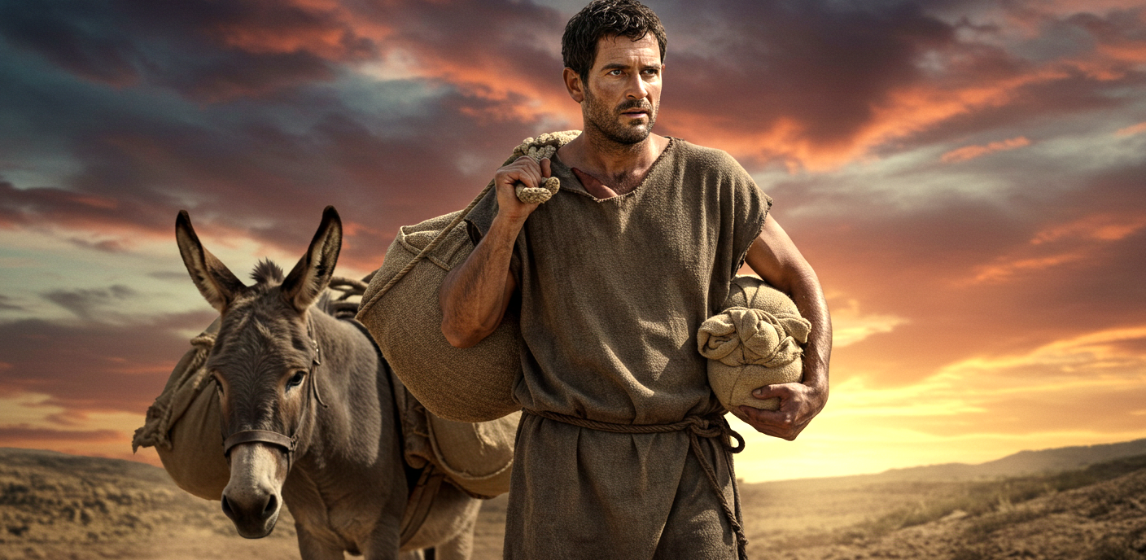
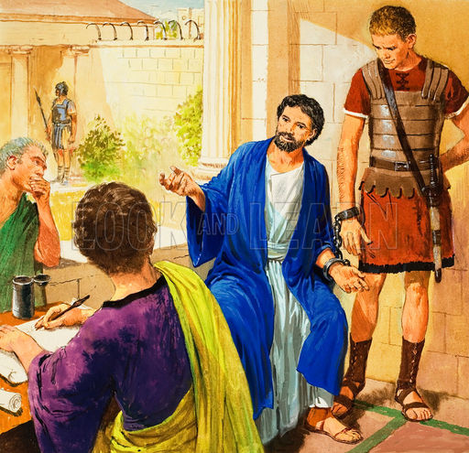
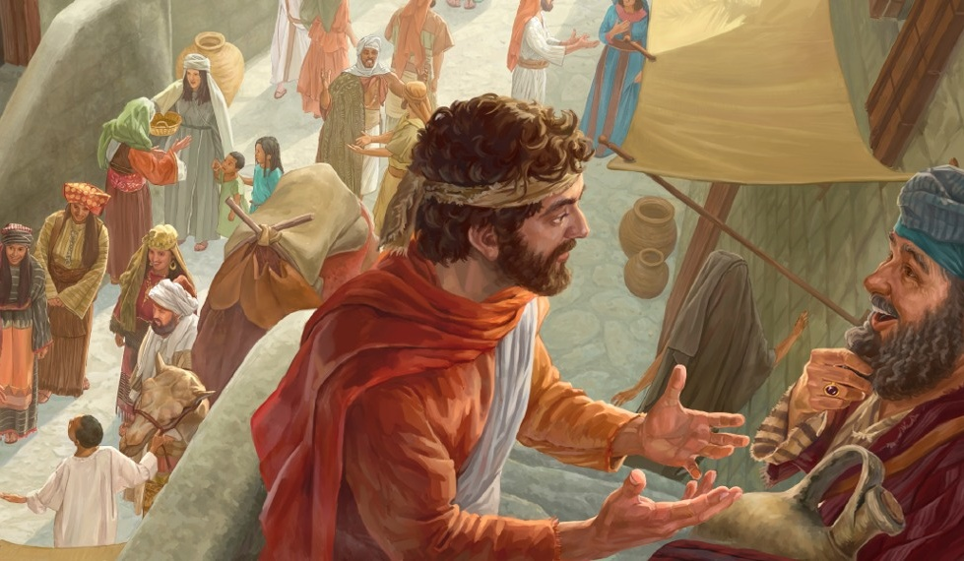
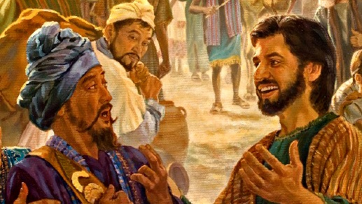
AN OPPORTUNITY TO DEFEND THE GOSPEL
“Now I want you to know, brothers and sisters, that what has happened to me has actually served to advance the gospel.” (Philippians 1:12)
When the Philippians learned that Paul was imprisoned in Rome, they were greatly distressed, and they sent Epaphroditus with help for the apostle (Phil. 4:18).
Far from being distressed, Paul gave thanks to God for his imprisonment. Why give thanks? Because in this way he was able to preach to who, otherwise, he could never have reached (Phil. 1:13).
Furthermore, seeing the apostle's attitude, other faithful brothers were encouraged, and began to preach the gospel regardless of the difficulties involved (Phil. 1:14).
Others, thinking that speaking openly about the gospel would bring difficulties for Paul, also helped –unintentionally– to spread it (Phil. 1:15-18).

Slide 9
Reasons to Give Thanks and Pray in the Letter to the Colossians

Slide 10


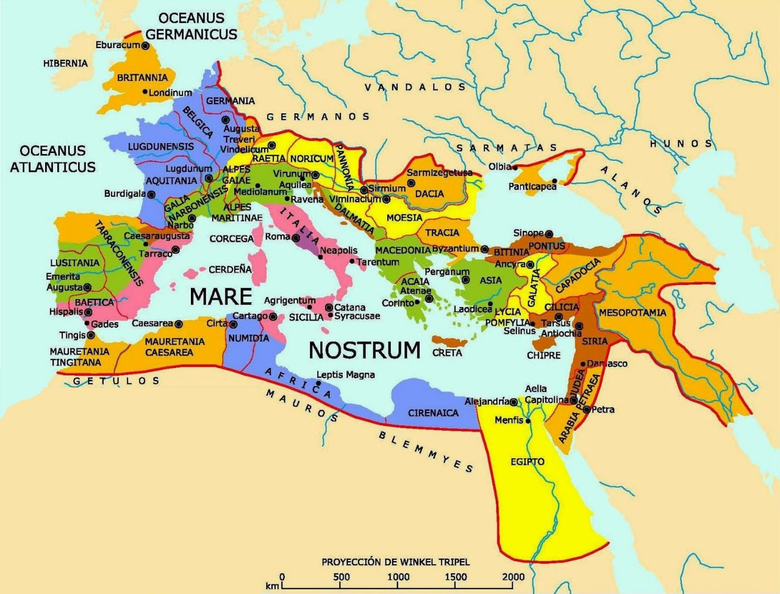
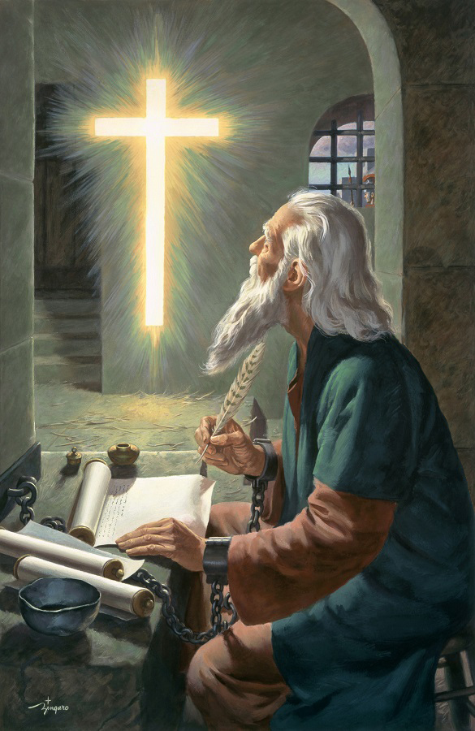
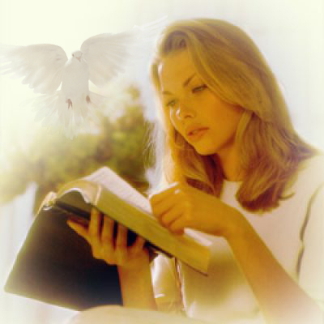
REASONS TO BE THANKFUL
“We always thank God, the Father of our Lord Jesus Christ, when we pray for you” (Colossians 1:3)
Echoing the words of 1 Corinthians 13:13, Paul thanks God because the Colossians have these three Christian virtues: faith, hope, and love (Col. 1:4-5).
These virtues arise “in Christ Jesus”, affect our relationships with “all the saints”, and have been transmitted to us through “the true word of the gospel”.
Paul emphasizes that this gospel has not been preached only to the Colossians, but “throughout the whole world” (Col. 1:6)... and in just 30 years!
The power of God, which is transmitted through the gospel by the work of the Holy Spirit, makes the Bible “the word of life” (Phil. 2:16). This means that, by accepting the gospel, we have eternal life and an inheritance “stored up for you in heaven” (Col. 1:5).

Slide 11


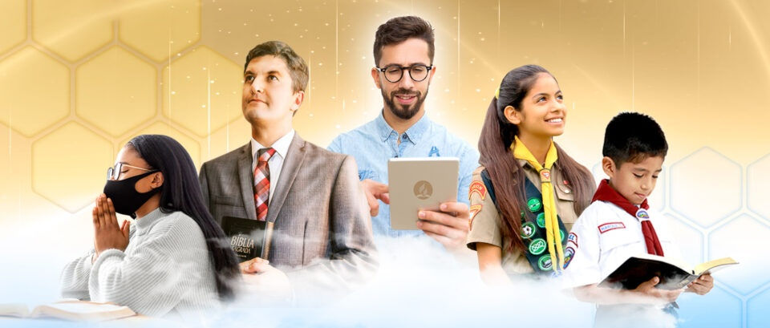
PRAYER REQUESTS
“For this reason, since the day we heard about you, we have not stopped praying for you. We continually ask God to fill you with the knowledge of his will through all the wisdom and understanding that the Spirit gives.” (Colossians 1:9)
Paul's prayer request includes many good things for the Colossians (Col. 1:9-11):
May they receive the knowledge of God, which will give them wisdom and spiritual understanding
Live as children of God, pleasing him in every way
May they bear fruit and grow in knowledge
May they be strengthened with God's power so that they may be patient
This prayer is made “giving joyful thanks to the Father” (Col. 1:12).
There are four channels through which God acts to make Paul's prayer a reality in us:
The Bible (Psalm 119:105)
The spirit of prophecy (Rev. 19:10), manifested through Ellen G. White
God's providential guidance (Col. 4:3)
The Holy Spirit (Is. 30:21)

Slide 12

“Our life is to be bound up with the life of Christ; we are to draw constantly from Him, partaking of Him, the living Bread that came down from heaven, drawing from a fountain ever fresh, ever giving forth its abundant treasures. If we keep the Lord ever before us, allowing our hearts to go out in thanksgiving and praise to Him, we shall have a continual freshness in our religious life. Our prayers will take the form of a conversation with God as we would talk with a friend. He will speak His mysteries to us personally. Often there will come to us a sweet joyful sense of the presence of Jesus. Often our hearts will burn within us as He draws nigh to commune with us as He did with Enoch. When this is in truth the experience of the Christian, there is seen in his life a simplicity, a humility, meekness, and lowliness of heart, that show to all with whom he associates that he has been with Jesus and learned of Him.”
EGW (Christ’s Object Lessons, p. 129)

