Slide 1
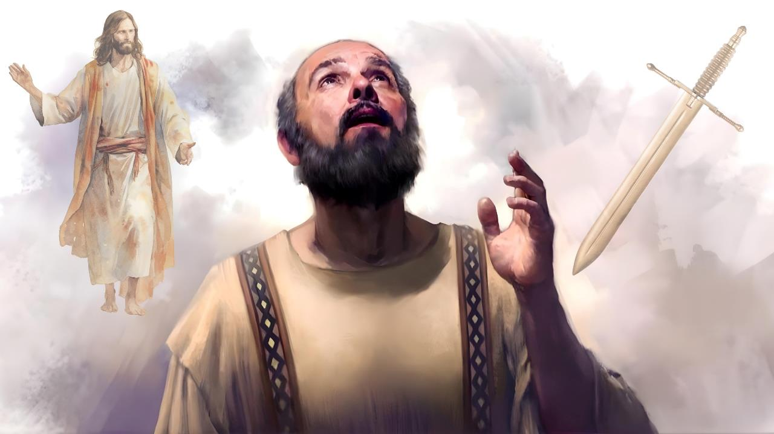
LIFE AND DEATH
Lesson 3 for January 17, 2026

Slide 2

“For to me, to live is Christ, and to die is gain”
Philippians 1:21, NKJV

Slide 3


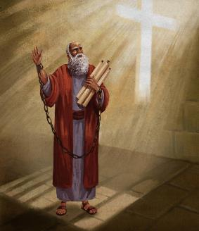


Paul was waiting to be judged by the ruthless Nero. His future depended more on Caesar's mood than on justice.
But he knew that his fate was not truly in Nero's hands, but in God's. Therefore, he was certain that, through the prayers offered for him in the churches, he would be freed.
However, if his death was going to benefit the gospel (as his imprisonment was), he was willing to give his life for Christ.
To live for Christ or to die for Christ?
Christ exalted in Paul (Philippians 1:10-20, 25-26)
To live or to die for Christ (Philippians 1:21-22)
Paul's dichotomy (Philippians 1:23-24)
What does it mean to live for Christ?
Behave in a way worthy of the gospel (Philippians 1:27a)
To fight united for the gospel (Philippians 1:27b-30)

Slide 4

TO LIVE FOR CHRIST OR TO DIE FOR CHRIST?

Slide 5



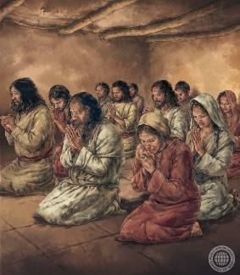
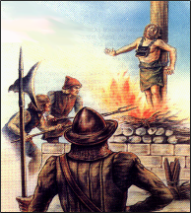
CHRIST EXALTED IN PAUL
“I eagerly expect and hope that I will in no way be ashamed, but will have sufficient courage so that now as always Christ will be exalted in my body, whether by life or by death.” (Philippians 1:20 NIV)
Paul rejoiced in the sufferings he endured, which were many (Col. 1:24a; 2 Cor. 11:23-27). Of course, he did not rejoice in the suffering itself, but in the reasons for which he endured hardships, one of which was the benefit it brought to the church of Christ (Col. 1:24b; 2 Cor. 11:28).
By imitating Jesus in his suffering—and even in his death—Christ was exalted in Paul (Phil. 1:20 NIV).
In his letter to the Philippians, Paul makes it clear that, for the moment, he did not expect to exalt Jesus with his death, but hoped, through the prayers of the church and the work of the Holy Spirit, to be freed and continue serving Christ with his life. (Phil. 1:19, 25-26).
Because of the evil that prevails in our world, living as Christ lived often involves suffering as Christ suffered and, in some cases, dying as Christ died (2 Tim. 3:12).

Slide 6



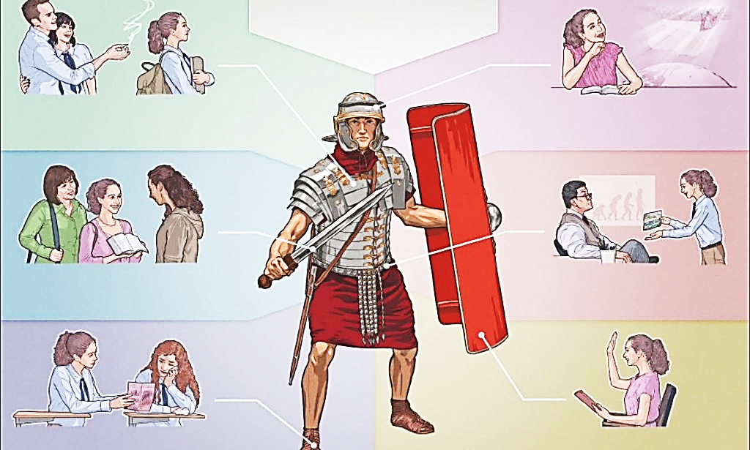

TO LIVE OR TO DIE FOR CHRIST
“For to me, to live is Christ, and to die is gain.” (Philippians 1:21)
The root of all suffering lies in the cosmic battle being waged today between good and evil, between Christ and Satan.
This is a spiritual war, which must be fought with spiritual weapons. The enemy's followers use weapons that are illicit against Christians (lies, criticism, peer pressure, etc.).
But we use weapons like truth and justice (2 Cor. 6:4-7). Powerful weapons “to demolish strongholds” (2 Cor. 10:3-5).
But what happens when, in battle, the result is the death of the righteous? According to Paul, this results in a gain for us (Phil. 1:21).
For those of us who are faithful to Christ, death places us beyond the reach of the enemy, and relieves us of all affliction (Pr. 14:32; Is. 57:1).

Slide 7



PAUL'S DICHOTOMY
“I am torn between the two: I desire to depart and be with Christ, which is better by far; but it is more necessary for you that I remain in the body.” (Philippians 1:23-24 NIV )
Although he could not make the decision, Paul is torn between two possibilities (Phil. 1:23-24):
To depart
To be with Christ
To remain
To benefit the church
Taking this text in isolation, we can deduce that Paul teaches that as soon as we die we ascend to Heaven to be with Jesus, contradicting other biblical passages (Eccl. 9:5; Ps. 6:5).
In the same letter to the Philippians he says that, to be fully with Christ, he must wait for the moment of the resurrection (Phil. 3:8-11).
On another occasion, Paul compares the body to a tent that is destroyed (dies) in order to be clothed with immortality (2 Cor. 5:1-4). However, he clarifies that this clothing occurs at the Second Coming, and not at the moment of death (1 Cor. 15:42, 51-54).

Slide 8

WHAT DOES IT MEAN TO LIVE FOR CHRIST?

Slide 9


BEHAVE IN A WAY WORTHY OF THE GOSPEL
“Only let your conduct be worthy of the gospel of Christ” (Philippians 1:27a)
The expression “your conduct” is the translation of the Greek word politeuomai, which means “to live as citizens.” Paul urges the Philippians (and all of us) to conduct ourselves in a manner worthy of citizens of Heaven (Phil . 3:20).
Poor in spirit
Meek
Hungry and thirsty for justice
Merciful
Pure of heart
Peacemakers
Willing to turn the other cheek
Love our enemies
Bless those who curse us
Doing good to those who hate us
To be loving and generous
To be merciful and humble
Etc.
In the Sermon on the Mount, Jesus taught us how the citizens of Heaven should live.
It can be summarized as follows: “but to do justice, and to love kindness, and to walk humbly with your God” (Micah 6:8 ESV).
Paul uses this advice as an introduction to a topic that concerned him: unity in the church.
He knew that disunity often stems from pride and inappropriate behavior towards one another. Therefore, he urges us to conduct ourselves in a dignified manner.

Slide 10



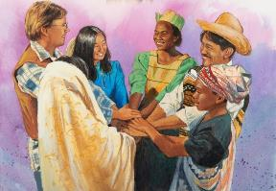
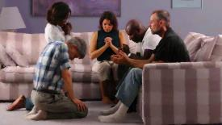
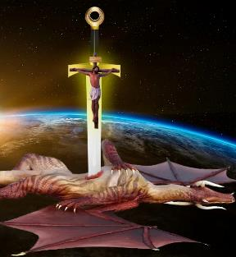

TO FIGHT UNITED FOR THE GOSPEL
“…that whether I come and see you, or else be absent, I may hear of your affairs, that ye stand fast in one spirit, with one mind striving together for the faith of the gospel” (Philippians 1:27b)
Being righteous and upright does not guarantee a life without conflict (Phil. 1:30). On the contrary, Job himself, who was declared by God to be “he is blameless and upright, a man who fears God and shuns evil” (Job 1:8), suffered a terrible conflict, the work of the enemy.
In the war in which we are engaged, unity plays an important role. Paul urges us to fight together to defend the gospel (Phil. 1:27b).
This unity of purpose must be joined with prayer and the study of the Word (Eph. 6:18; Phil. 2:16).
When we come into conflict with evil, we must not be intimidated by those who oppose us (Phil. 1:28). Let us remember that Satan is a defeated enemy, for Christ has already won the battle on the cross (Luke 10:18; Col. 2:15).

Slide 11

“How many years have we been in the Lord’s garden? And what profit have we brought to the Master? How are we meeting the inspecting eye of God? Are we increasing in reverence, love, humility, confidence in God? Do we cherish gratitude for all His mercies? Are we seeking to bless those around us? Do we manifest the spirit of Jesus in our families? Are we teaching His Word to our children, and making known to them the wonderful works of God? The Christian must represent Jesus by both being good and doing good. Then there will be a fragrance about the life, a loveliness of character, which will reveal the fact that he is a child of God, an heir of heaven.”
EGW (You Shall Receive Power, December 10)

