Slide 1

UNITY THROUGH HUMILITY
Lesson 4 for January 24, 2026

Slide 2

“Fulfill my joy by being like-minded, having the same love, being of one accord, of one mind”
Philippians 2:2, NKJV

Slide 3







Paul has just encouraged the believers in Philippi to stand firm in the face of the challenges of the Christian life. He has asked them to conduct themselves in a manner worthy of heavenly citizens, emphasizing unity.
With the expression “therefore”, Paul begins a new section in which he gives us the keys to understanding how to achieve that perfect unity: by imitating the example of Jesus.
The origin of disunity (Philippians 2:1-3a)
Unity through humility (Philippians 2:3b-4)
Think like Jesus (Philippians 2:5)
The attitude of Jesus (Philippians 2:6-8)

Slide 4



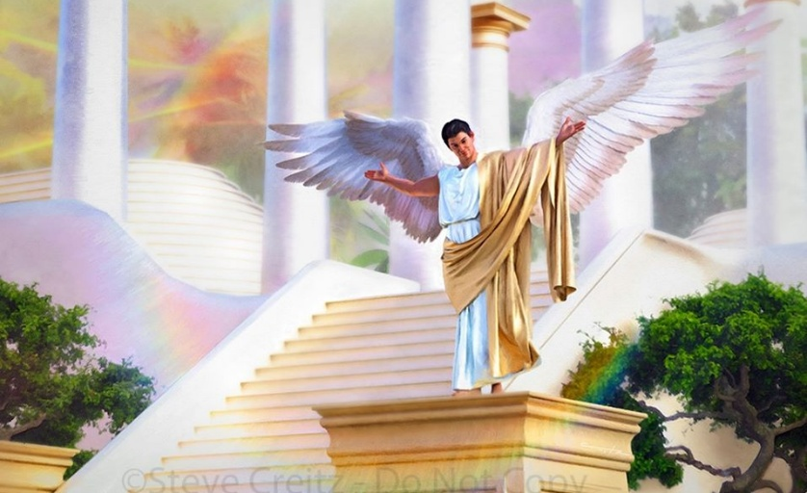

THE ORIGIN OF DISUNITY
“Do nothing out of selfish ambition or vain conceit” (Philippians 2:3a)
Before putting his finger on the sore spot, pointing out the reasons for the disunity that was perceived among the Philippians, what are the first pieces of advice he gives them to achieve unity, completing his joy (Phil. 2:1-2)?
Comfort in Christ
Comfort in love
Communion of the Spirit
Heartfelt affection
Mercy
Unity of feeling and love
He encourages them to study and imitate the model life of Christ
Their love for Christ exerts a stimulating power over their minds
They must submit to the control of the Spirit
They should reflect the tender and warm emotions of human affection
Let them demonstrate the presence of genuine affection through individual acts of mercy.
Mutual love makes thoughts similar and leads to united action
All this they could only achieve if they put aside what separated them: pride and arguments (Phil. 2:3a).
Both of these problems were present in Lucifer's rebellion, and are among the most serious problems in relationships (Gal. 5:26; Jas. 3:16 NIV).

Slide 5



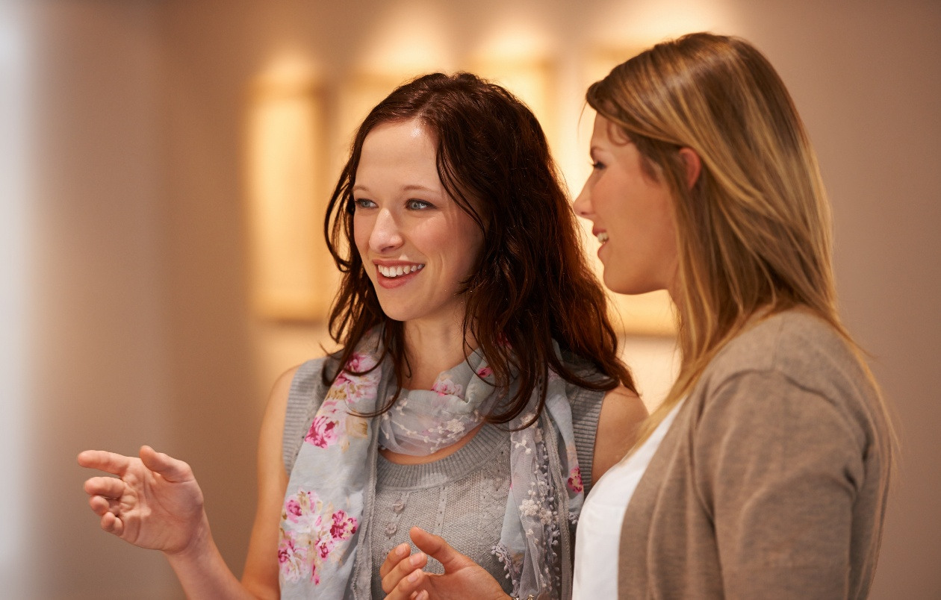
UNITY THROUGH HUMILITY
“…in humility value others above yourselves, not looking to your own interests but each of you to the interests of the others.” (Philippians 2:3b-4)
The formula for unity that Paul proposes is not something external, but an inner attitude: humility. Besides being a characteristic trait of Jesus, He encouraged His listeners to be humble (Mt. 11:29; 18:4; 23:12).
To attain this humility, Paul proposes that we consider others more important than ourselves (Phil. 2:3). But aren't we all equal before God? Shouldn't there be equality in order to have unity?
Paul does not say that we are inferior to others, but that we should consider ourselves as such. Just as a servant seeks the good of his master, we should seek the good of those we consider superior to ourselves (Phil. 2:4).
To be able to help others, we must learn to listen to them and understand their point of view. All of this is undoubtedly the work of the Holy Spirit.

Slide 6




THINK LIKE JESUS
“Let this mind be in you which was also in Christ Jesus” (Philippians 2:5 NKJV )
How are our thoughts shaped? Through the “avenues of the soul,” that is, our senses. Everything we read, see, or hear shapes us in some way. And, of course, Satan bombards our senses to mold our minds to his own way of thinking.
Paul is radical. He not only invites us to watch our thoughts, but he asks us to think as Christ thought (Phil. 4:8; 2:5).
Perhaps we can, with great effort, achieve the first. But changing our minds to conform to the mind of Jesus can only be done in us by the Holy Spirit.
This is because our thoughts are carnal, and our heart deceitful (Jeremiah 17:9). The Spirit will transform our carnal mind into a spiritual mind, like Christ's (Romans 8:1, 5).

Slide 7

EGW (Patriarchs and Prophets, p. 436)
“Yet we have a work to do to resist temptation. Those who would not fall a prey to Satan’s devices must guard well the avenues of the soul; they must avoid reading, seeing, or hearing that which will suggest impure thoughts. The mind should not be left to wander at random upon every subject that the adversary of souls may suggest.”

Slide 8

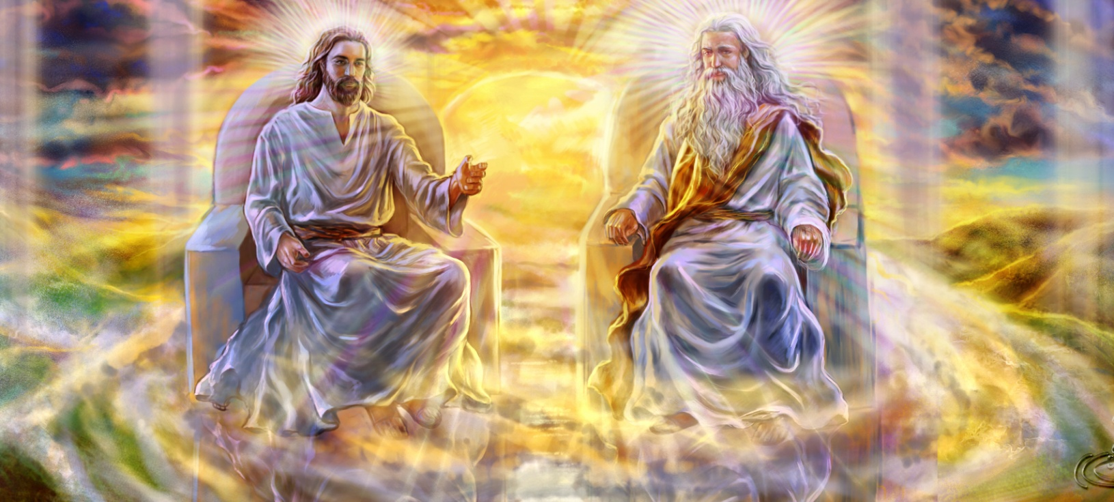


THE ATTITUDE OF JESUS (1)
“who, being in the form of God, did not consider it robbery to be equal with God” (Philippians 2:6)
Paul highlights three qualities of Jesus:
He renounced his divine prerogatives (Phil. 2:6)
He became man to serve us (Phil. 2:7)
He humbly obeyed in everything, even to his death (Phil. 2:8)
Being the Creator, He became a creature. He accepted being mistreated and dying on the cross in order to redeem us.
Despite being on an equal footing with the other two Persons of the Godhead, Jesus' submission to the Father's will was always perfect. There was never a moment when he refused to submit.
When we think about this, we can only bow down and worship our wonderful Savior.
He is our role model. We must be willing to humble ourselves and sacrifice ourselves for the good of others.

Slide 9


THE ATTITUDE OF JESUS (2)
“And without controversy great is the mystery of godliness: God was manifested in the flesh, Justified in the Spirit, seen by angels, preached among the Gentiles, Believed on in the world, Received up in glory” (1 Timothy 3:16)
Christ's amazing condescension in becoming a human being will be a subject of study for the redeemed throughout eternity.
It is incredible that the infinite and eternal Being became a finite human being, subject to death. This is what Paul calls “the mystery of godliness” (1 Tim. 3:16).
Jesus went from universal supremacy to absolute servitude. This is precisely the opposite of what Lucifer aspired to, who, being a servant, desired universal supremacy.
This example calls us to abandon our selfishness and our desire to be served, and replace them with humility and a willingness to serve others.

Slide 10

“God permits every human being to exercise his individuality. He desires no one to submerge his mind in the mind of a fellow mortal. Those who desire to be transformed in mind and character are not to look to men, but to the divine Example. God gives the invitation, “Let this mind be in you, which was also in Christ Jesus.” By conversion and transformation men are to receive the mind of Christ.”
EGW (That I May Know Him, May 8)

