Slide 1
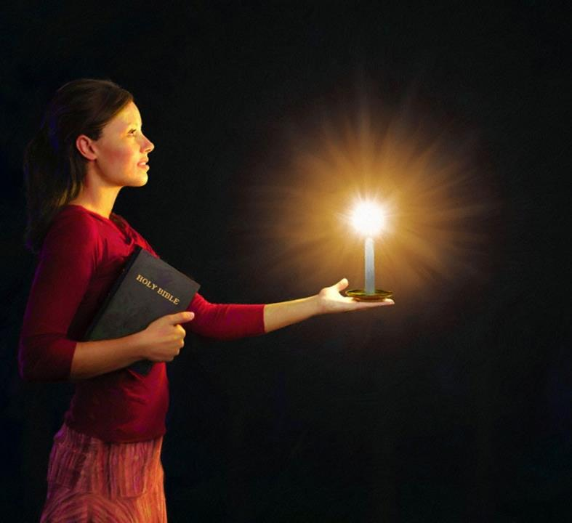
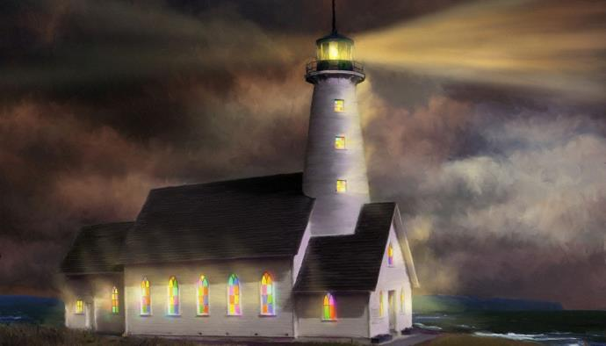

Lesson 5 for January 31, 2024
SHINING AS LIGHTS IN THE NIGHT

Slide 2

“Do all things without complaining and disputing, that you may become blameless and harmless, children of God without fault in the midst of a crooked and perverse generation, among whom you shine as lights in the world”
Philippians 2:14, 15, NKJV

Slide 3

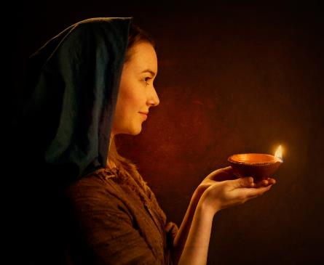



“In the same way, let your light shine before others, that they may see your good deeds and glorify your Father in heaven” (Mt. 5:16).
In Philippians 2:12-18 we can read the Pauline version of this command of Jesus.
Living in a world where God's Law is constantly trampled underfoot, we Christians, who desire to serve God by living in accordance with it, are lights shining in the darkness.
Luminaries in the world:
A reflection of God (Philippians 2:12-13)
A light in the world (Philippians 2:14-16)
A living sacrifice (Philippians 2:17-18)
Examples of light:
Timothy (Philippians 2:19-24)
Epaphroditus (Philippians 2:25-30)

Slide 4
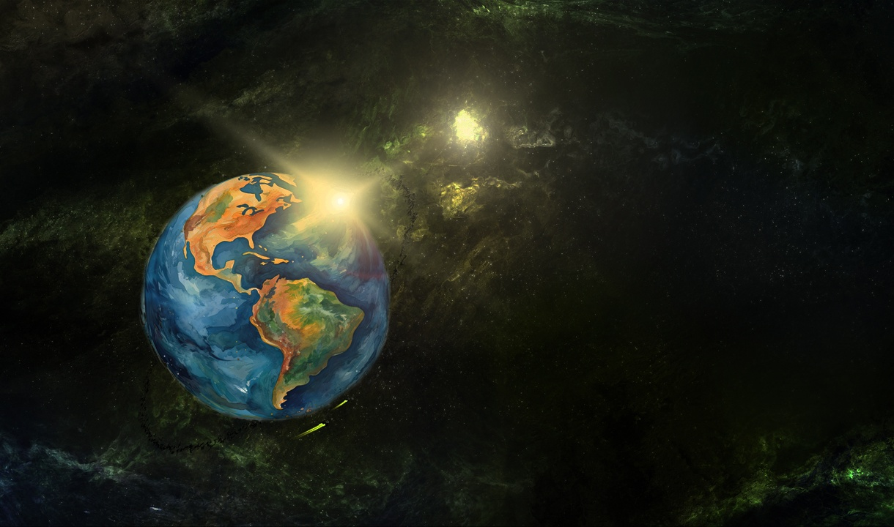
LUMINARIES IN THE WORLD

Slide 5




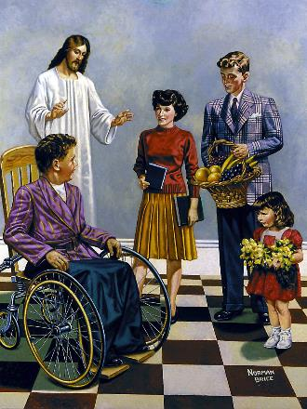
A REFLECTION OF GOD
“For it is God who works in you to will and to act in order to fulfill his good purpose” (Philippians 2:13)
After masterfully detailing the humiliation and exaltation of Jesus, Paul adds the expression “therefore.” That is, since Jesus humbled himself and was exalted so that “and every tongue acknowledge that Jesus Christ is Lord, to the glory of God the Father” (Phil. 2:11), the Philippian believers (and, by extension, all of us) must do something about it.
Our first task is to work out our salvation “with fear and trembling” (Phil. 2:12). If God is the one who saves us (Titus 2:11), why should we be concerned with it?
Fear and trembling are expressions used as synonyms for serving God. (Psalm 2:11). Hence, Paul emphasizes that it is God who produces in us the desire to do good, and gives us the strength to make it a reality. (Philippians 2:13).

Slide 6




A LIGHT IN THE WORLD
“so that you may become blameless and pure, ‘children of God without fault in a warped and crooked generation.’ Then you will shine among them like stars in the sky.” (Philippians 2:15)
Paul proposes three aspects that will make believers shine in the world:
Maintain unity (Phil. 2:14)
When working together, there should be no gossip, criticism, rivalries, or arguments between us.
Conduct yourself blamelessly (Phil. 2:15)
Obeying our Father with simplicity stands in stark contrast to the evil and dissipation that exists all around us.
Being faithful to the Word of God (Phil. 2:16)
Our actions and our thinking must be in accordance with what the Bible teaches
Where darkness is greatest, light shines brightest. In a world where God is systematically rejected, we Christians must shine with the light of Christ.

Slide 7




A LIVING SACRIFICE
“But even if I am being poured out like a drink offering on the sacrifice and service coming from your faith, I am glad and rejoice with all of you.” (Philippians 2:17)
Although Paul hoped to be freed, there was a possibility that he would be condemned. He presents this possibility as being “poured out like a drink offering” (Phil. 2:17).
The libation [drink offering] consisted of pouring a liquid over the sacrifice being offered (Ex. 29:39-40). In this case, the sacrifice in question was the Philippians.
Were the Philippians going to die? Not at all. Their sacrifice consisted of “the service of your faith.” It was a living sacrifice, a sacrifice that we all must offer to God (Rom. 12:1).
Paul did not mind dying because his testimony would give even more strength to the believers who were already being faithful witnesses of the Gospel, speaking of it with courage, and behaving as worthy children of God.

Slide 8
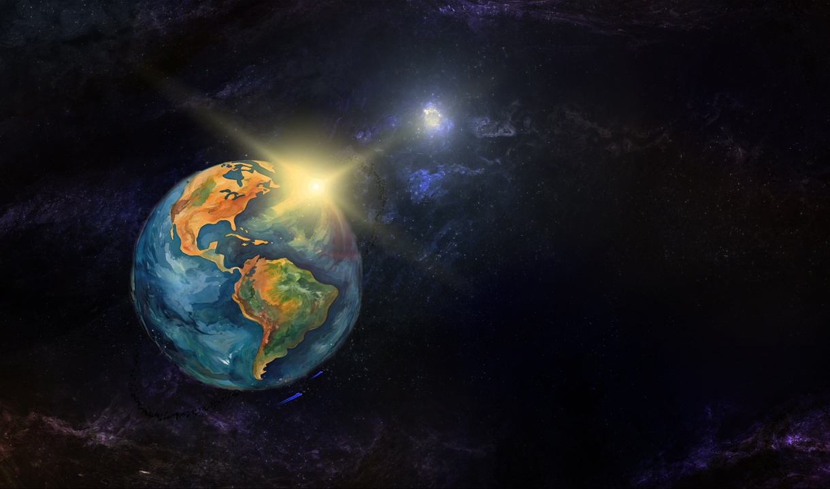
EXAMPLES OF LIGHT

Slide 9

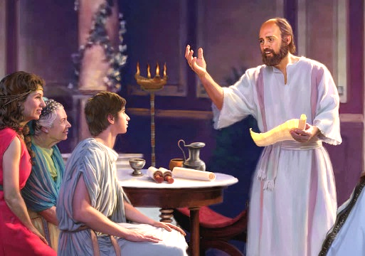


TIMOTHY
“But you know that Timothy has proved himself, because as a son with his father he has served with me in the work of the gospel” (Philippians 2:22)
Timothy was an active collaborator of Paul and co-author of six epistles (2 Corinthians, Philippians , Colossians, 1 Thessalonians, 2 Thessalonians, Philemon). It was Paul himself who chose him as an evangelist (Acts 16:1-3). What did Paul see that was special about this young man?
First, everyone “spoke well of him.” His suitability for ministry was confirmed by prophetic words (1 Tim. 1:18). As a young man, Paul regarded him as a son, (1 Tim. 1:2; 4:12). For his part, Timothy treated Paul with the respect and affection a son has for his father (Phil. 2:22).
Paul considered him as effective a worker as himself (1 Cor. 6:10). He entrusted him with the oversight of several churches, such as Corinth (1 Cor. 4:17); Philippi (Phil. 2:19); and Thessalonica (1 Thess. 3:2). He also suffered imprisonment like Paul (Heb. 13:23).

Slide 10

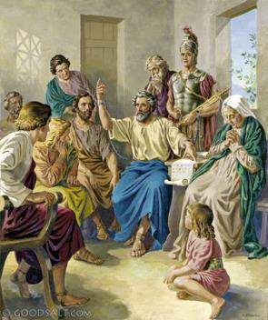


“But I think it is necessary to send back to you Epaphroditus, my brother, co-worker and fellow soldier, who is also your messenger, whom you sent to take care of my needs” (Philippians 2:25)
EPAPHRODITUS
When the Philippians learned that Paul was imprisoned in Rome, they decided to send him help to meet his needs (paying rent, food, clothing, etc.) Epaphroditus was in charge of bringing this help to the apostle (Phil. 4:18; 2:25).
Epaphroditus did not just deliver aid, but accompanied Paul, helped him in his needs, and collaborated with him in spreading the gospel.
In his zeal for the gospel, he risked his own life and fell seriously ill (Phil. 2:27, 30). When the Philippians heard this, they were concerned for him. This was the main reason Paul decided to send him to deliver the epistle to them (Phil . 2:26, 28).
Paul asks that “and honor people like him” (Phil. 2:29 NIV). Epaphroditus was undoubtedly a faithful Christian.

Slide 11

“While Jesus, our Intercessor, pleads for us in heaven, the Holy Spirit works in us, to will and to do of His good pleasure. All heaven is interested in the salvation of the soul. Then what reason have we to doubt that the Lord will and does help us? We who teach the people must ourselves have a vital connection with God. In Spirit and Word we should be to the people as a wellspring, because Christ is in us a well of water springing up unto everlasting life. Sorrow and pain may test our patience and our faith; but the brightness of the presence of the Unseen is with us, and we must hide self behind Jesus.”
EGW (You Shall Receive Power, December 8)

