Slide 1
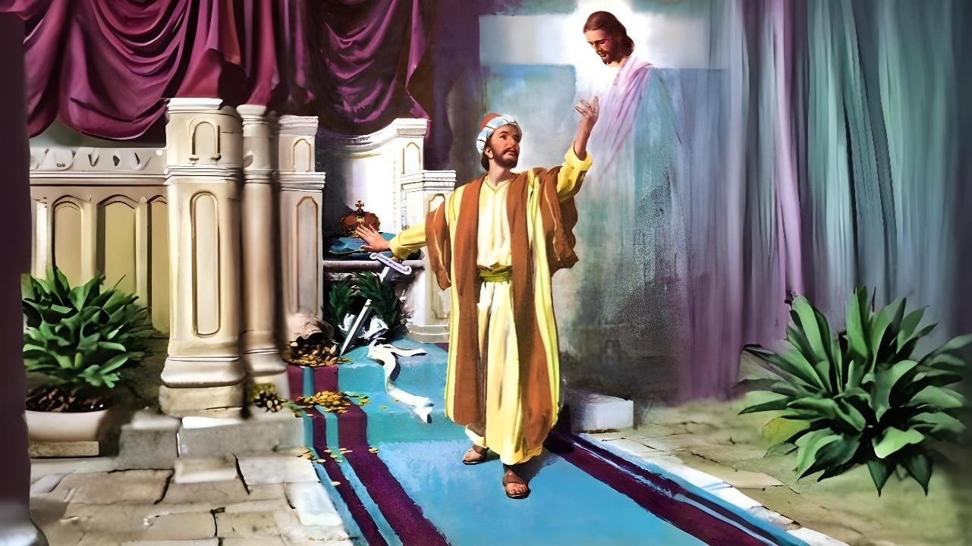
Lesson 6 for February 7, 2026
CONFIDENCE ONLY IN CHRIST

Slide 2


“That I may know Him and the power of His resur­rection, and the fellowship of His sufferings, being conformed to His death, if, by any means, I may attain to the resurrection from the dead”
Philippians 3:10, 11, NKJV

Slide 3










The Philippians knew the way to salvation, as Paul and Silas had clearly told one of the first converts in that city: the jailer (Acts 16:30-31).
Now that the church was firmly established, they were in danger of being led astray from the path of salvation.
For this reason, Paul reminds them of the fundamental pillars of salvation by faith.
Tips to avoid losing your salvation:
  What to avoid (Philippians 3:1-3)
  What is left behind (Philippians 3:4-6)
  The important thing (Philippians 3:7-8)
Tips for remaining in salvation:
  The faith of Christ (Philippians 3:9)
  The knowledge of Christ (Philippians 3:10-16)

Slide 4

TIPS TO AVOID LOSING YOUR SALVATION

Slide 5

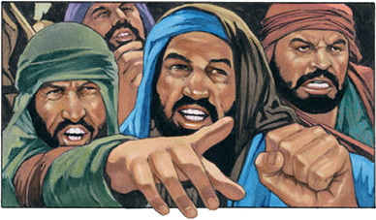

WHAT TO AVOID
“Watch out for those dogs, those evildoers, those mutilators of the flesh” (Philippians 3:2)
Before discussing the dangers that threaten faith, Paul gives us some advice: “Rejoice in the Lord” (Phil. 3:1a). To this he adds something important: it is good to repeat the truth we have, even if we already know it well (Phil. 3:1b).
Receiving God's mercy (Psalm 31:7)
Placing our trust in him (Psalm 5:11)
Receiving the blessings of salvation (Psalm 9:14)
Keeping God's Law (Psalm 119:14; Isaiah 58:13, 14)
Believing in His Word (Psalm 119:162)
Raising Godly Children (Prov. 23:24, 25)
How can we rejoice in the Lord?
Paul points out the greatest danger threatening the church at that time: false teachers who taught strict adherence to the ceremonial law (Phil. 3:2). He refers to these in three distinct ways: dogs (Ps. 22:16;
2 Pet. 2:21-22); evildoers; and mutilators of the flesh (through circumcision).

Slide 6

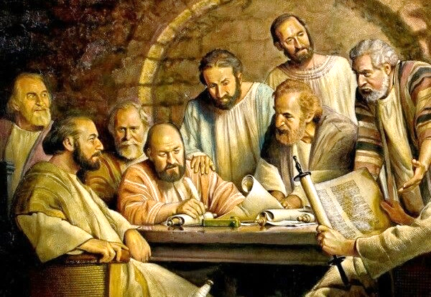
WHAT IS LEFT BEHIND
“circumcised on the eighth day, of the people of Israel, of the tribe of Benjamin, a Hebrew of Hebrews; in regard to the law, a Pharisee” (Philippians 3:5)
At the Council of Jerusalem, it had been decreed that the Gentiles should not be troubled with matters of Jewish ceremonial law (Acts 15:19-21). However, certain teachers had come to Philippi teaching the necessity of circumcision (Phil. 3:2-3).
Going back in time, Paul reminds them how perfect he was when he was like those teachers (Phil. 3:4-6):
Circumcised on the eighth day; son of devout parents
Hebrew of Hebrews; Benjaminite of pure stock
Regarding the law, the strictest Pharisee
Regarding zeal, he was a persecutor of the church
Irreproachable guardian of the Law
But he boasted about all of this before he knew Jesus. Now he knew that he hadn't even understood the Law (Mt. 5:21-22). Now he knew that only Christ saves (Phil. 3:7).

Slide 7

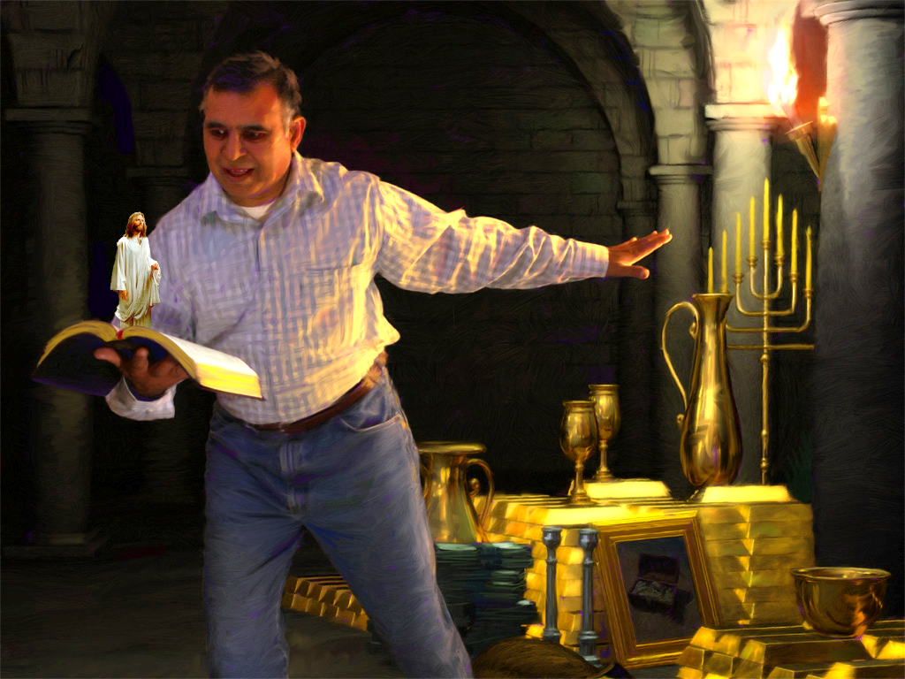
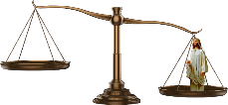
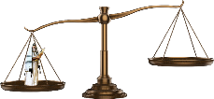

THE IMPORTANT THING
“But whatever were gains to me I now consider loss for the sake of Christ” (Philippians 3:7)
Paul weighs his former life against his current life. On one side, he places all his knowledge; his glorious future as a star pupil of Gamaliel; his magnificent Pharisaical gifts. All gain.
Now, place on the other side of the scale his life since he met Christ. All gain becomes rubbish, because nothing can compare to the love of Christ (Phil. 3:7-8).
What could be more valuable than eternal life in heaven and on the new earth? Yet, worldly values blind many to this reality. There is a natural competition between the things considered important here and what Heaven truly values: Christlike character and the salvation of the soul.

Slide 8

TIPS FOR REMAINING IN SALVATION

Slide 9



THE FAITH OF CHRIST
“and be found in him, not having a righteousness of my own that comes from the law, but that which is through faith in Christ—the righteousness that comes from God on the basis of faith” (Philippians 3:9)
Paul, confident in his own righteousness, went to Damascus to bring the heretics of the sect of the “Way” back to the path of salvation (Acts 9:1-2). But he entered Damascus overcome by another righteousness, the righteousness of God: “that which is through faith in Christ” (Philippians 3:9).
From that moment on, he never again trusted in his own righteousness. For it is useless to trust in our actions to achieve salvation (Gal. 2:16).
He longed to “be found in [Christ]” (Phil. 3:9). What does this imply?
According to 1 Corinthians 1:30, being “in Christ” encompasses everything that comprises the Plan of Salvation, from the dawn of our spiritual intelligence (wisdom), through justification by faith (righteousness) and preparation for heaven (sanctification), to, finally, glorification at the Second Coming (redemption).

Slide 10


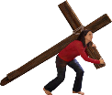




THE KNOWLEDGE OF CHRIST
“that I may know Him and the power of His resurrection, and the fellowship of His sufferings, being conformed to His death” (Philippians 3:10)
How can we know Christ (Phil. 3:10-16)?
When we study His Word
When we are led by the Holy Spirit
When we share in His sufferings
When we proceed to the goal
The Christian life is like a race. We must have our goal clearly in mind. We do not live to stay here and merely enjoy this life. We hope to reach the resurrection of the dead (Phil. 3:11).
Until that moment arrives, we strive to “take hold of that for which Christ Jesus took hold of me”
(Phil. 3:12 NIV). Jesus attained me to give me a city; a prize; an endless life to live with Him (Heb. 11:10; Phil. 3:14; 1Thess. 4:17).

Slide 11

“The great purpose that constrained Paul to press forward in the face of hardship and difficulty should lead every Christian worker to consecrate himself wholly to God’s service. Worldly attractions will be presented to draw his attention from the Saviour, but he is to press on toward the goal, showing to the world, to angels, and to men that the hope of seeing the face of God is worth all the effort and sacrifice that the attainment of this hope demands.
The lowliest disciple of Christ may become an inhabitant of heaven, an heir of God to an inheritance incorruptible.”
EGW (Conflict and Courage, December 13)

