Slide 1

A HEAVENLY CITIZENSHIP
Lesson 7 for February 14, 2026

Slide 2
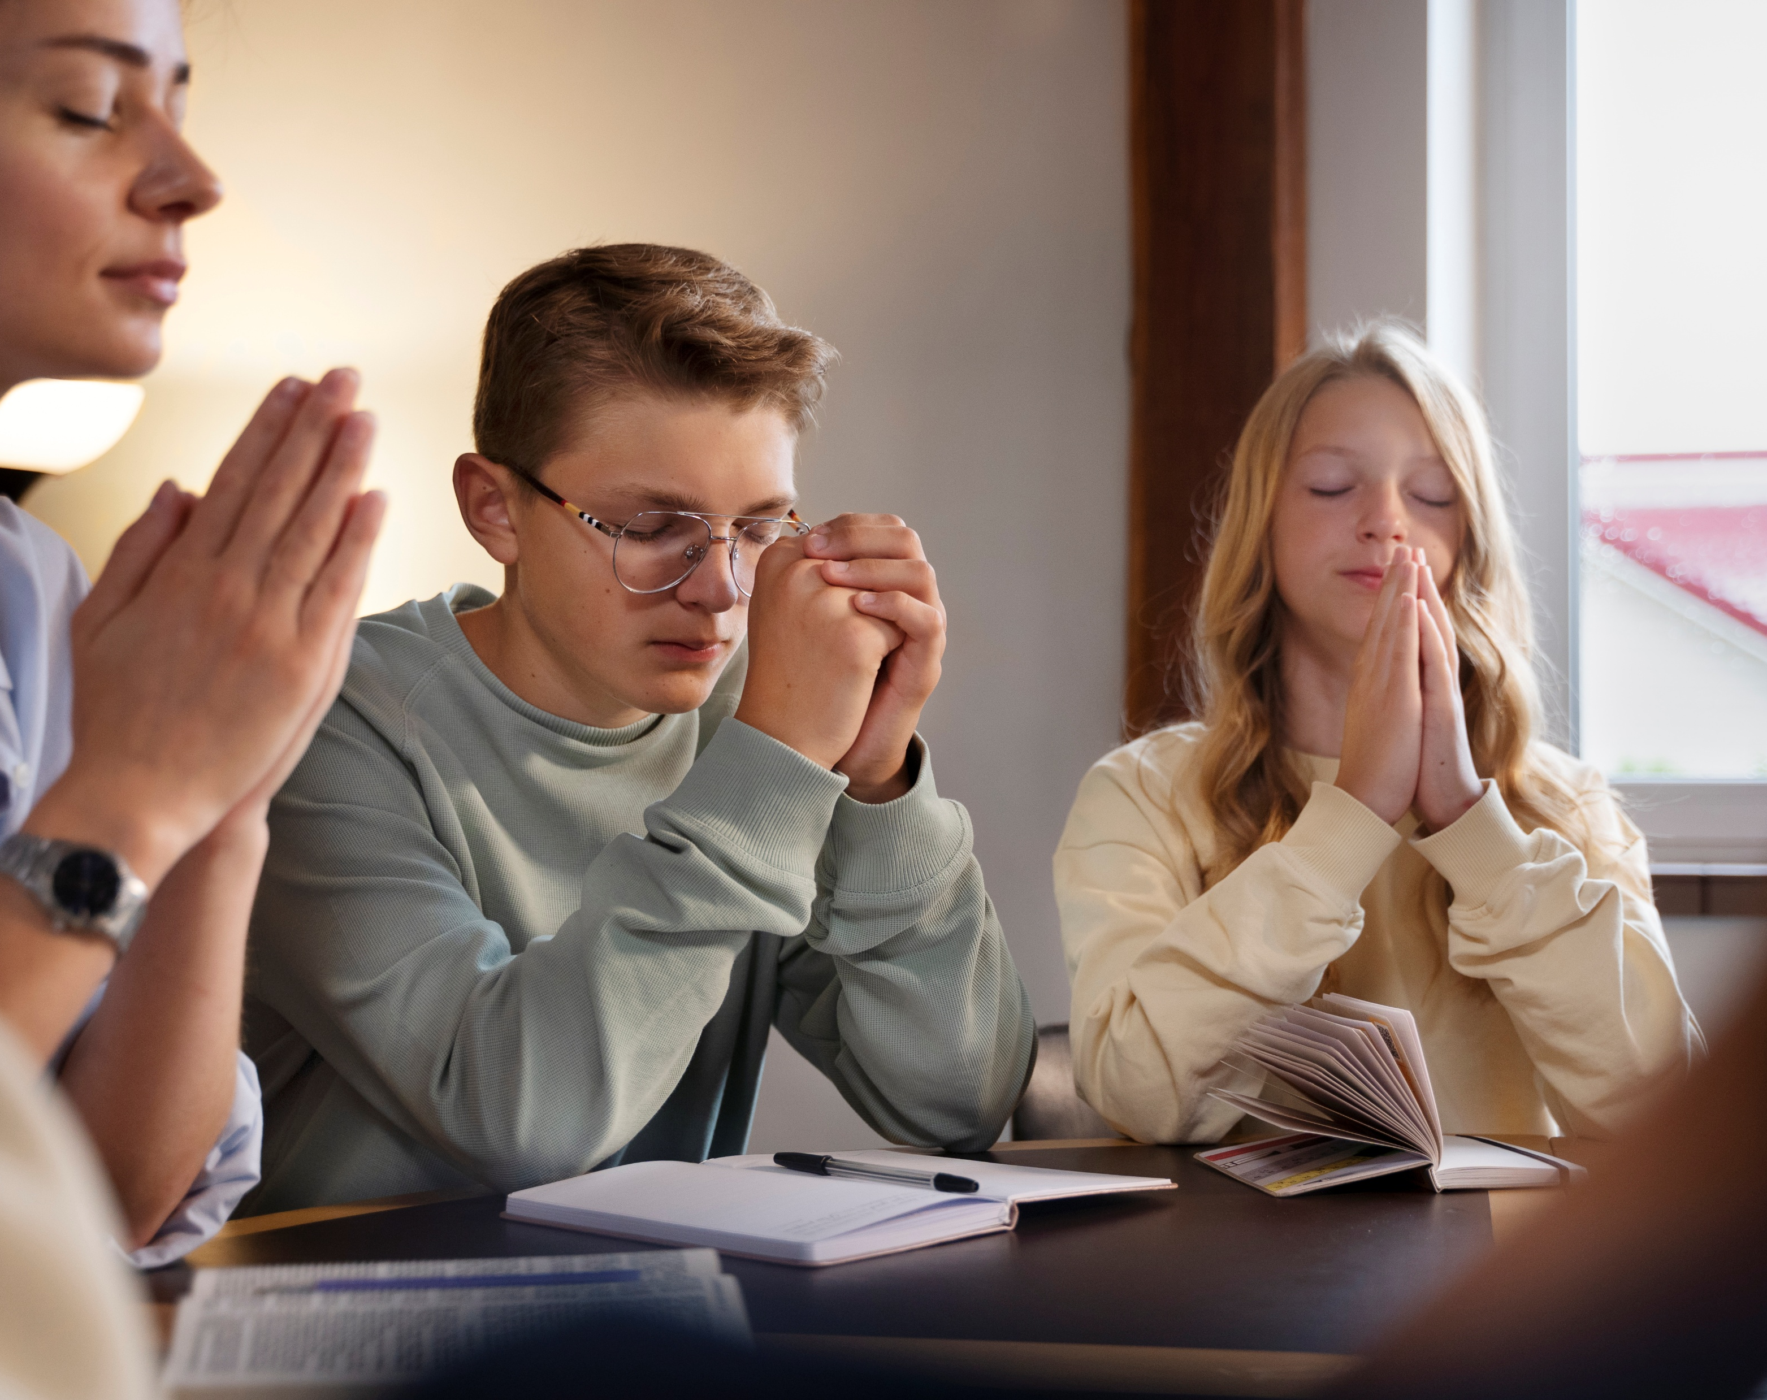
“Be anxious for nothing, but in everything by prayer and supplication, with thanksgiving, let your requests be made known to God”
Philippians 4:6, NKJV

Slide 3


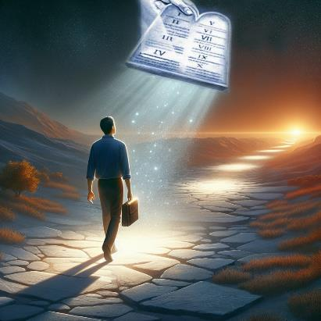


Throughout his letters, Paul makes it clear that we are not citizens of this world. By accepting Jesus as our Savior, we are born again. With this new birth, we become citizens of Heaven.
Although we respect and submit to the laws and norms of this world, our lifestyle is, in reality, broader, of a much higher morality.
Celestial citizenship:
  Imitate the faithful (Philippians 3:17-19)
  Full citizenship (Philippians 3:20-21)
Until we get there:
  Harmony and rejoicing (Philippians 4:1-6)
  Pure thoughts (Philippians 4:7-9)
  Contentment (Philippians 4:10-13, 19)

Slide 4

CELESTIAL CITIZENSHIP

Slide 5
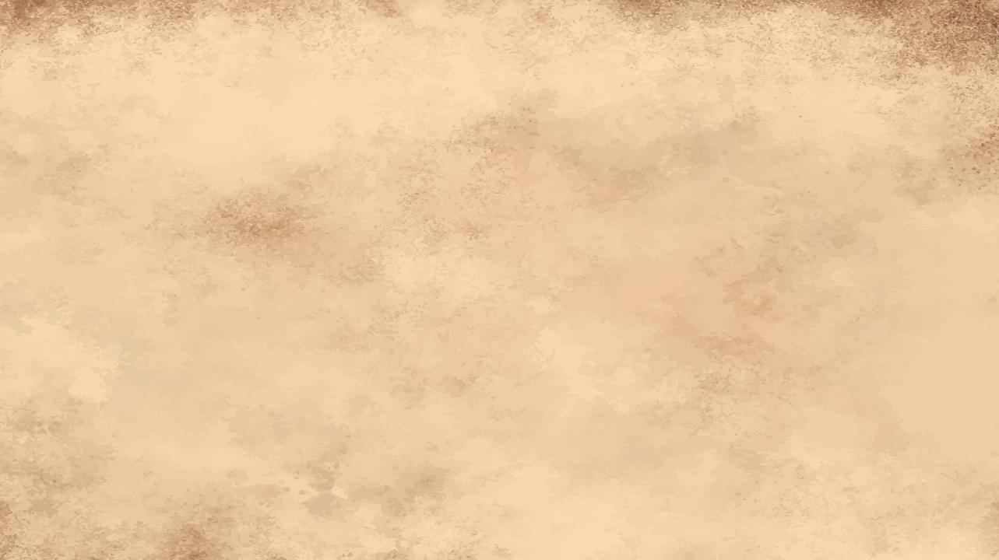

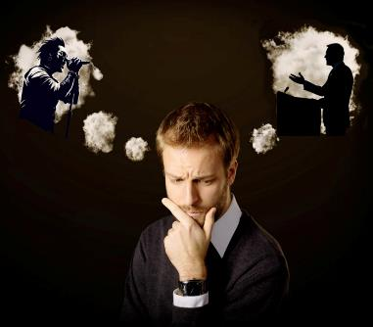
IMITATE THE FAITHFUL
“Join together in following my example, brothers and sisters, and just as you have us as a model, keep your eyes on those who live as we do.” (Philippians 3:17)
We all have people who, in one way or another, have shaped our lives or our thoughts. Perhaps an artist, an athlete, a musician, a singer. Perhaps a pastor, a preacher, a faithful brother or sister.
Have these "role model" people helped us grow as individuals, or led us down paths we should never have tried?
Paul invites us to imitate those whose examples uplift us and encourage us to be better (Phil. 3:17). He also warns us that, even among believers, there are people who are not worthy of imitation (Phil. 3:18-19).
What makes the difference? Some think only of earthly things, while others have their thoughts fixed on Jesus. Good role models are, in turn, imitators of Christ (1 Cor. 11:1).

Slide 6

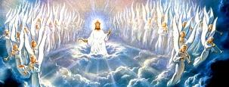

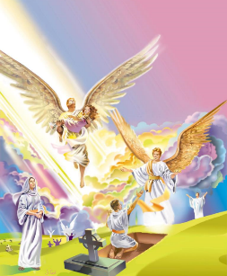
FULL CITIZENSHIP
“But our citizenship is in heaven. And we eagerly await a Savior from there, the Lord Jesus Christ.” (Philippians 3:20)
Let's face it. We Christians have a problem: dual citizenship. We are both citizens of this world and citizens of heaven. This creates serious conflicts for us (Rom. 7:22-23).
Our body will be spiritual, immortal, and incorruptible (1 Cor. 15:42-44, 50-54)
We will be glorified (Col. 3:4;
Phil. 3:21)
We will have a physical body, and our own eyes will see God. (Job 19:25-27)
When will we achieve full citizenship? When will we cease to be citizens of this sinful world? At the Second Coming (Phil. 3:20).
When we are resurrected, (or transformed), and death has no power over us, what will happen?

Slide 7

UNTIL WE GET THERE

Slide 8



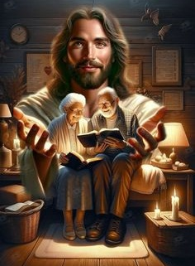
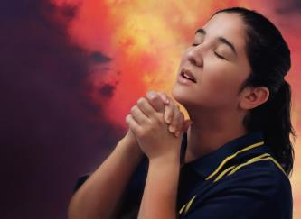
HARMONY AND REJOICING
“Rejoice in the Lord always. I will say it again: Rejoice!” (Philippians 4:4)
Concluding his letter, Paul interweaves personal greetings with practical advice. He asks Syzygus [faithful companion] and Clement to help Euodia and Syntyche live in harmony. Of all of them, Paul's co-workers, he says: “whose names are in the book of life” (Phil. 4:2-3).
The following advice may puzzle us: “Rejoice always […] Do not be anxious about anything” (Phil. 4:4, 6). How can this be possible in a world full of problems and afflictions?
This is possible because our joy is “in the Lord” (Phil. 4:4a). We cast our anxieties on Him, confident that He can bear them for us
(Matt. 6:31-34; 1 Pet. 5:7).
And how do we cast our anxieties on Jesus? Through prayer (Phil. 4:6).

Slide 9



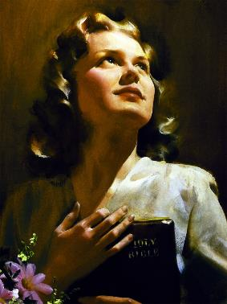
PURE THOUGHTS
“Finally, brothers and sisters, whatever is true, whatever is noble, whatever is right, whatever is pure, whatever is lovely, whatever is admirable—if anything is excellent or praiseworthy—think about such things.” (Philippians 4:8)
In what is true
Honestly
Fair enough
In its purest form
In kindness
In what is of good name
The result of casting our anxiety on Jesus and rejoicing is peace (Phil. 4:7). A peace that the world cannot give or take away (John 14:27; 16:33).
This peace, according to Paul, will be a protection—a guard—for our feelings and thoughts (Phil. 4:7b). For this guard to be effective, what things should we think about (Phil. 4:8)?
In summary: “if anything is excellent or praiseworthy—think about such things.” (Phil 4:8b).

Slide 10






CONTENTMENT
“And my God will meet all your needs according to the riches of his glory in Christ Jesus” (Phil. 4:19)
We are joyful; nothing troubles us; we have peace; our thoughts are pure. We have a perfect and fulfilling life…
or do we?
Like Agur, we trust that God will give us neither more nor less than what is beneficial to us (Pr. 30:8-9).
When we live with this confidence, we are certain that “I can do all this through him who gives me strength” (Phil. 4:13).
We may have prosperity; we may have needs or problems. If, like Paul, we have full assurance that God directs our lives, we will remain confident in Him whatever our situation may be
(Phil. 4:11-12, 19).

Slide 11

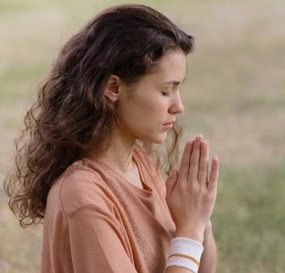
CONTENTMENT
“And my God will meet all your needs according to the riches of his glory in Christ Jesus” (Phil. 4:19)
What happens when we don't have what we think we need?
Let us ask the Lord for it, and if it is according to His will, He will grant it to us (James 4:2b; 1 John 5:14-15).
We don't always know if what we ask for is according to His will, but there are certain requests that we are sure are always according to His will:
Salvation for a loved one or friend (1 Tim. 2:3, 4)
Courage to share our faith (Rev. 22:17)
Forgiveness when we confess and forsake wrong (1 John 1:9)
Strength to obey God’s commandments (Heb. 13:20, 21)
Love for those who hate and mistreat us (Matt. 5:44)
Wisdom for challenging situations (James 1:5)
Understanding the truth in God’s Word (John 8:32)

Slide 12

“We should live for the next world. It is so wretched to live a haphazard, aimless life. We want an object in life—to live for a purpose. God help us all to be self-sacrificing, less self-caring, more forgetful of self and selfish interest; and to do good, not for the honor we expect to receive here, but because this is the object of our life and will answer the end of our existence.”
EGW (Our High Calling, August 24 )

