Slide 1

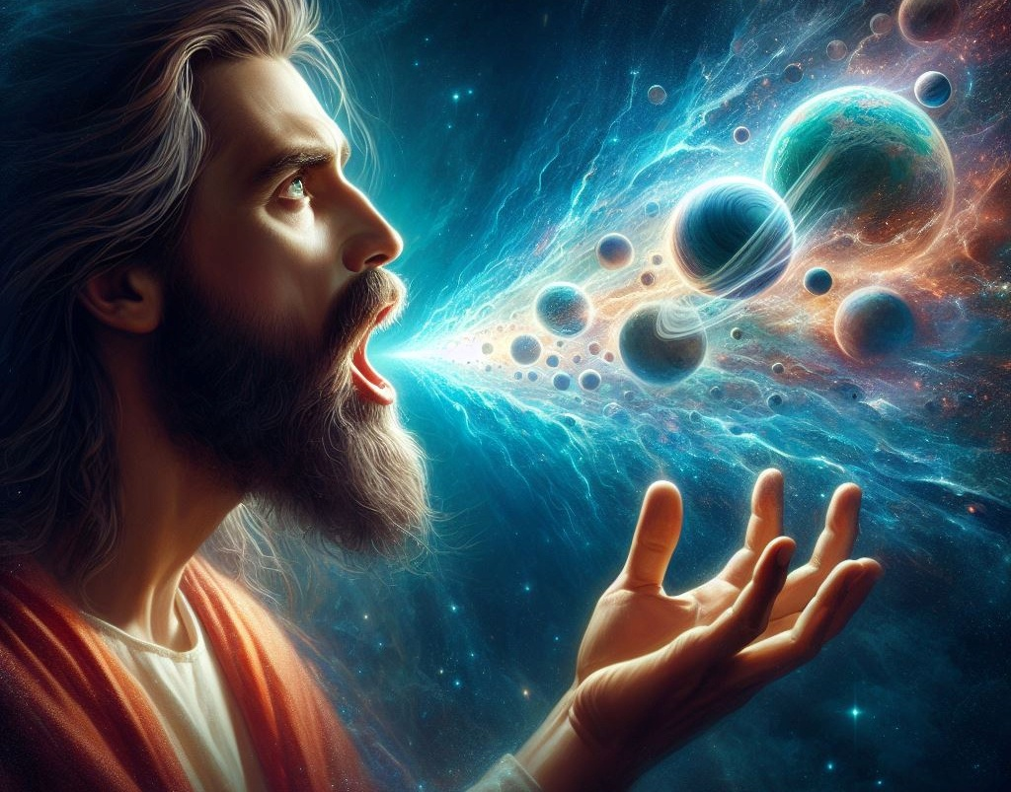
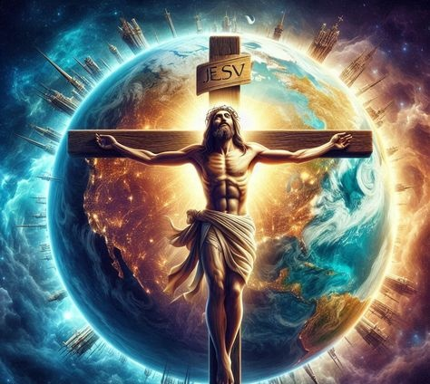
Lesson 8 for February 21, 2026
THE PREEMINENCE OF CHRIST

Slide 2
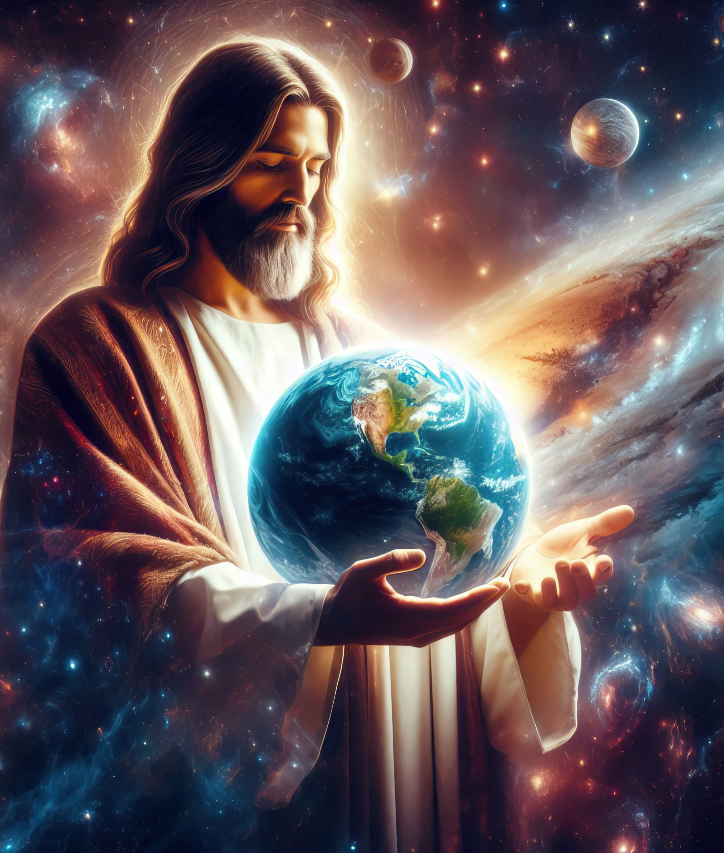
“He [Christ] is the image of the invisible God, the firstborn over all creation. For by Him all things were created that are in heaven and that are on earth, visible and invisible, whether thrones or dominions or principalities or powers. All things were created through Him and for Him. And He is before all things, and in Him all things consist”
Colossians 1:15–17, NKJV

Slide 3


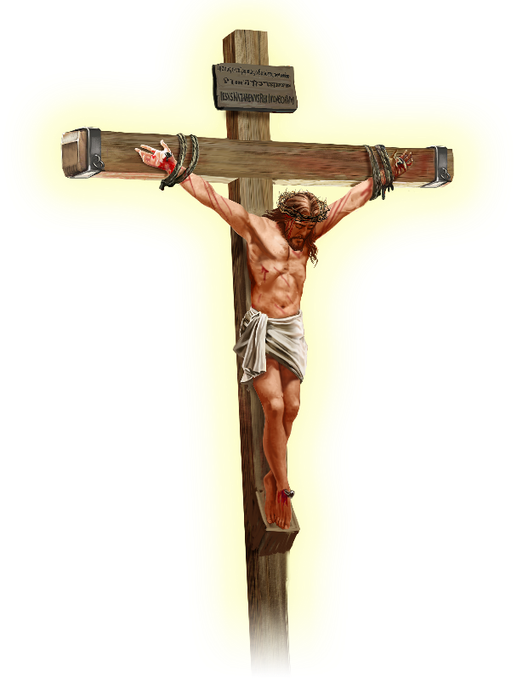






Paul declares that Jesus has brought peace to the entire universe, “whether things on earth or things in heaven” (Col. 1:20 KJ21 ).
Before arriving at this statement, the apostle tells us who Jesus really is. Not a great teacher, nor a philosopher, nor a prophet, nor a preacher, nor a messenger of good news.
Jesus Christ is…
The image of God (Colossians 1:15a)
The firstborn (Colossians 1:15b-17)
The head of the Church (Colossians 1:18a)
The beginning (Colossians 1:18b)
The Reconciler (Colossians 1:19-20)

Slide 4


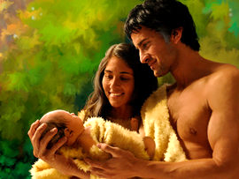


THE IMAGE OF GOD
“The Son is the image of the invisible God” (Colossians 1:15a)
An image can be a copy of reality (a photograph, a hologram, a statue), or even something fictional (a drawing). But the biblical concept of image goes beyond that.
God created Adam and Eve in his image (Gen. 1:27), and Adam fathered a son in his own image (Gen. 5:3). These are not copies of reality, imitations, or figments of their imagination. They are physical, psychological, and social similarities…
Paul says that the ceremonial law was a shadow, “not the very image of the things” (Heb. 10:1), implying that “image = reality.”
The question is: Was Jesus similar to God, or equal to God? In addition to repeatedly attributing to himself the divine name “I am,” Jesus explicitly said: “I and the Father are one” (John 10:30); “He who has seen me has seen the Father” (John 14:9).

Slide 5




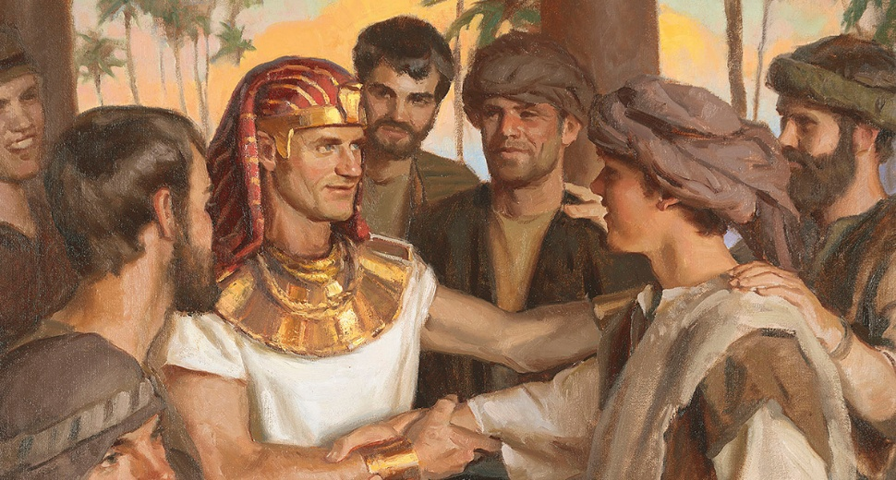
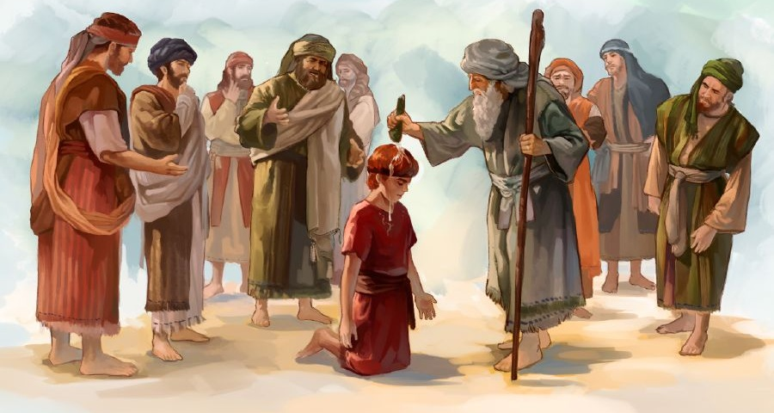

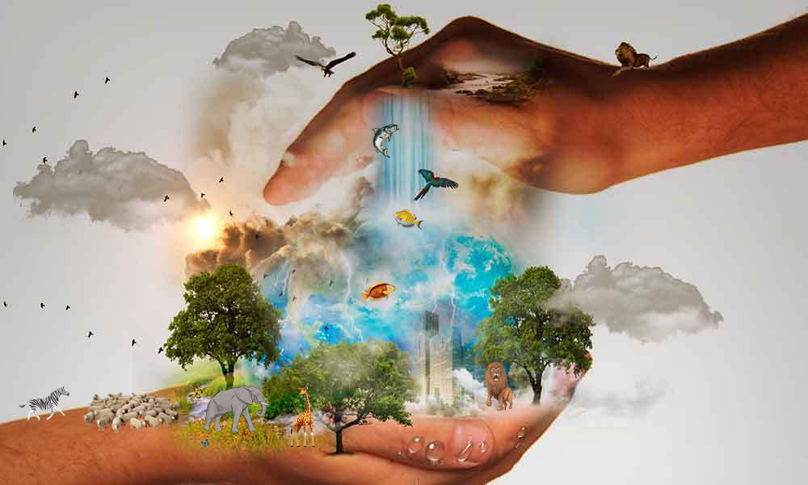
THE FIRSTBORN
“He is before all things, and in him all things hold together.” (Colossians 1:17)
“Firstborn” means the first begotten. Hence, some teach that Jesus was the first being created by God (Col. 1:15). But, as with the term “image,” the word “firstborn” has a broader biblical meaning.
Isaac was the firstborn instead of Ishmael; Jacob was the firstborn instead of Esau; Joseph was the firstborn instead of Reuben; David was the firstborn instead of Eliab (Psalm 89:27). They were all firstborn because they held the preeminent position over their brothers, not because they were born first.
Paul refers to this preeminence in Colossians. To avoid any doubt about its nature, he attributes two divine qualities to He: the creation of all that exists (Col. 1:16; Isa. 45:18); and its sustenance (Col. 1:17; Ps. 119:91).

Slide 6



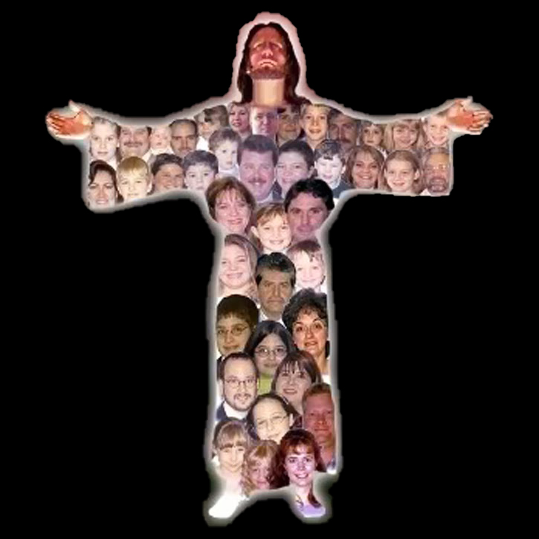
THE HEAD OF THE CHURCH
“And he is the head of the body, the church” (Colossians 1:18a)
In some languages (such as Catalan or English) the word “head” is also translated as “chief” or “principal,” because that is the metaphorical meaning of “head.” This is also the case in Hebrew. For example, “appoint for themselves one head” (Hos. 1:11 NKJV) should be translated as “they will appoint one leader” (NIV).
We are all needed (1 Cor. 12:15)
Each one has his or her own work (1 Cor. 12:17)
We cannot despise anyone (1 Cor. 12:21)
There are no “inferior” believers (1 Cor. 12:22-24)
We care for one another (1 Cor. 12:25-26)
This is also the sense in which Paul uses this word when he applies it to Christ (Col. 1:18a).
But Paul also adds a metaphorical meaning to the body. If Christ is the head, we—the church—are the body. From this idea it follows that:

Slide 7


THE BEGINNING
“He is the beginning and the firstborn from among the dead, so that in everything he might have the supremacy.” (Colossians 1:18b)
The word translated as “beginning” is archē (ἀρχή), a Greek word that means beginning, origin, first cause or principle, but also means ruler, power, authority or principality, depending largely on the context.
We can say that this word, applied to Christ, can have all these meanings (Col. 1:18). Jesus is the origin of everything [the image of God], the reason why everything was created [the firstborn of creation], the supreme ruler [the head]. All this gives him preeminence.
Paul inserts the title “the firstborn from among the dead” here (although Jesus was not the first to be resurrected, but Moses). His victory over death also implies his victory over sin and his power to recreate us in his image.

Slide 8

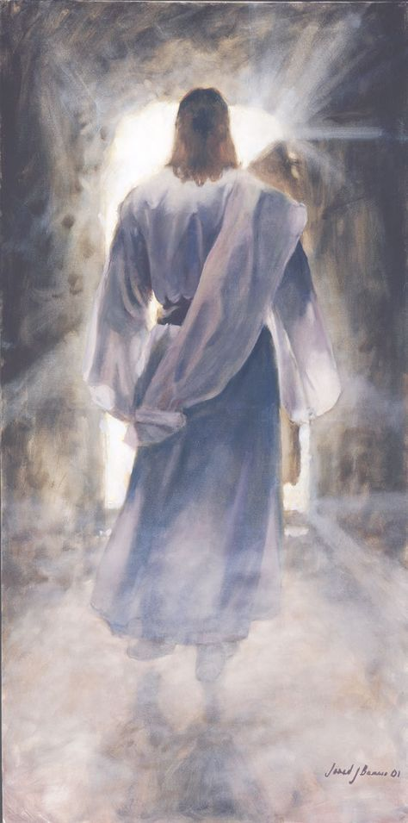



THE RECONCILER
“and through him to reconcile to himself all things, whether things on earth or things in heaven, by making peace through his blood, shed on the cross” (Colossians 1:20)
What Jesus did resulted in him taking first place in everything. According to Paul, Christ is worthy of all these titles “for God was pleased to have all his fullness dwell in him” (Colossians 1:19). In other words, Jesus was fully God and fully human. “We have seen his glory, […] full of grace and truth” (John 1:14).
By dying on the cross and rising again, Jesus fulfilled the necessary requirements to reconcile humanity with God (Col. 1:20).
We can understand that he has reconciled to God “the things on earth.” But how has he reconciled to himself those that are in heaven?
The entire universe has been able to clearly see the nature of evil. Thus, the character of God is vindicated both in Heaven and on Earth.

Slide 9

“Jesus was the majesty of heaven, the beloved commander of the angels, who delighted to do His pleasure. He was one with God, “in the bosom of the Father” (John 1:18), yet He thought it not a thing to be desired to be equal with God while man was lost in sin and misery. He stepped down from His throne, He left His crown and royal scepter, and clothed His divinity with humanity. He humbled Himself even to the death of the cross, that man might be exalted to a seat with Him upon His throne. […] In love He comes to reveal the Father, to reconcile man to God.”
EGW (Selected Messages, Volume 1, p. 321)

