Slide 1
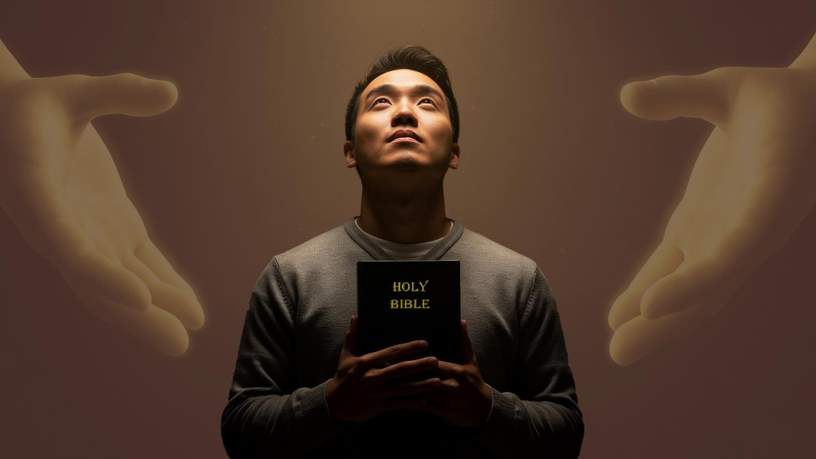
RECONCILIATION AND HOPE
Lesson 9 for February 28, 2026

Slide 2


2 Corinthians 5:21
“For he hath made him to be sin for us, who knew no sin; that we might be made the righteousness of God in him”

Slide 3


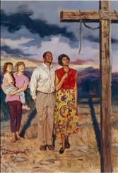
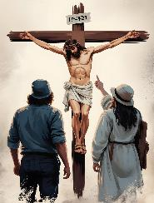
After stating that the cross of Christ had reconciled Heaven and Earth (Col. 1:20), Paul goes on to explain the practical effects for us of this reconciliation.
How has this changed us? How did God foresee all of this? What can we do to help others share in reconciliation and gain hope?
RECONCILIATION AND HOPE THROUGH THE GOSPEL
The effects of reconciliation
From evildoers to saints (Col. 1:21-22)
Grounded and steadfast
(Col. 1:23)
Hope
Bringing hope
(Col.1:24-25)
The mystery of God
(Col. 1:26-27)
The power of the gospel
Announcing the gospel (Col. 1:28-29)

Slide 4

THE EFFECTS OF RECONCILIATION

Slide 5

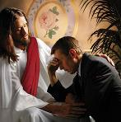
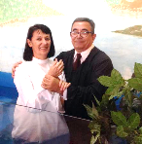
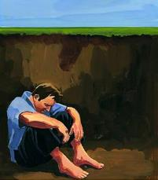
FROM EVILDOERS TO SAINTS
“And you, who once were alienated and enemies in your mind by wicked works, yet now He has reconciled in the body of His flesh through death, to present you holy, and blameless, and above reproach in His sight—.” (Colossians 1:21-22)
The issue is simple. We lived doing evil and, therefore, we were condemned to eternal death (Rom. 6:23; Rev. 21:8).
He died on the cross to pay the price for our sin (Rom. 5:8)
Through faith, repentance, and baptism, we are freed from our sin and are without blemish and blameless before God [justification] (Rom. 5:10; Col. 1:22)
Through the work of the Holy Spirit our lives are gradually transformed and we become holy before God [sanctification] (Rom. 8:1; 2 Cor. 5:17)
By ourselves we were incapable of changing this situation, or of paying for our salvation (Psalm 49:7-8).
But God had a great plan prepared for us:

Slide 6

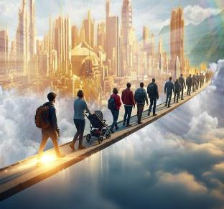
GROUNDED AND STEADFAST
“if indeed you continue in the faith, grounded and steadfast, and are not moved away from the hope of the gospel which you heard” (Colossians 1:23a)
We have already been justified, we are being sanctified, but the journey is not yet over. We run the risk of straying and not reaching the goal. That is why Paul advises us on three things (Col. 1:23a):
Continue in the faith
Be persistent, like Peter was when, after being released from prison, he knocked on the door until it was opened to him
(Acts 12:11-16)
Grounded
Our faith must be solid, founded on the truths we have learned in the Bible
Steadfast
We must be unwavering, never ceasing to trust in “the hope of the gospel”

Slide 7

HOPE

Slide 8

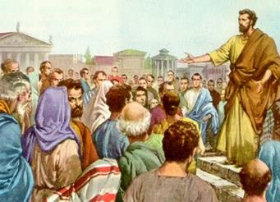
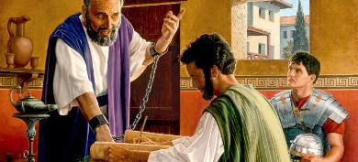
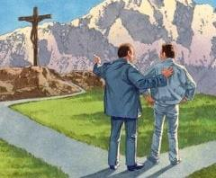
BRINGING HOPE
“of which I became a minister according to the stewardship from God which was given to me for you, to fulfill the word of God,” (Colossians 1:25)
As we saw, God's plan for our salvation is based on the death of Jesus and includes our justification and sanctification. But something important was missing: somehow, we need to come to know this plan in order to accept it. We need someone to reveal it to us.
This is where “God’s administration” [God’s way of ordering circumstances, thoughts, people, etc.] comes in, of which Paul was a minister (Col. 1:25).
Paul rejoiced in being part of this plan, even though it involved afflictions, (Col. 1:24). From his arrest in Rome until his death, he wrote at least seven of the fourteen epistles preserved in the New Testament.
Paul was an important part of God's plan, and he rejoiced in it. We too can be part of this plan by leading others to the knowledge of Christ. That is our joy!

Slide 9

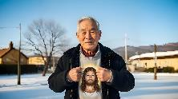
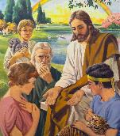

THE MYSTERY OF GOD
“the mystery which has been hidden from ages and from generations, but now has been revealed to His saints” (Colossians 1:26)
Paul speaks of a mystery that has been revealed to the church after the resurrection of Christ
(Col. 1:26). Until then, there had only been glimpses of it. But what is this mystery? “Christ in you, the hope of glory” (Col. 1:27).
It was devised before the foundation of the world (1 Peter 1:20)
It was partially communicated to the angels (1 Peter 1:12)
A first glimpse was given of Adam and Eve (Gen. 3:15)
It was revealed to the prophets (1 Peter 1:10-11)
Jesus first revealed it to the Jews (Mt. 15:24)
Then it was fully revealed to all men (Col. 1:27)
There are still stages to unfold in this mystery. Now we live in the hope of being glorified. What a change! What a mystery! Sinful people are justified, sanctified, and glorified by the redeeming blood of Jesus. This mystery will continue to be a subject of study for all eternity.

Slide 10

THE POWER OF THE GOSPEL

Slide 11

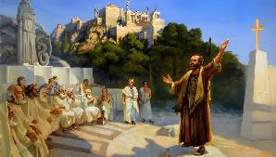
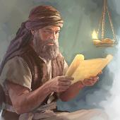
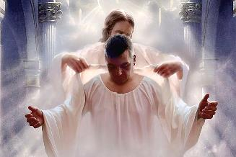
ANNOUNCING THE GOSPEL
“Him we preach, warning every man and teaching every man in all wisdom, that we may present every man perfect in Christ Jesus.” (Colossians 1:28)
How did Paul preach the gospel? The focus of his preaching was Christ crucified (1 Corinthians 1:23). Once people had accepted Jesus, he admonished and taught them until they were perfect (Colossians 1:28-29). How did he do this?
He explained to them Christian doctrine and practice (2 Thessalonians 2:15)
He warned them of the consequences of rejecting the gospel (Heb. 10:25-29)
He warned them about the dangers of false teachers (Acts 20:29-30)
Wait a minute… make them perfect? And not just a few… “every man”! (Col. 1:28b).
The Greek word translated “mature” (teleios) means perfect and without defect. Through the process of Christian growth, we become keenly aware of the depth of God’s law and that its requirements. Our goal, therefore, is to be perfect in Christ Jesus.

Slide 12

“Looking upon the crucified Redeemer, we more fully comprehend the magnitude and meaning of the sacrifice made by the Majesty of heaven. The plan of salvation is glorified before us, and the thought of Calvary awakens living and sacred emotions in our hearts. Praise to God and the Lamb will be in our hearts and on our lips; for pride and self-worship cannot flourish in the soul that keeps fresh in memory the scenes of Calvary.”
EGW (The Desire of Ages, p. 661)

