Slide 1
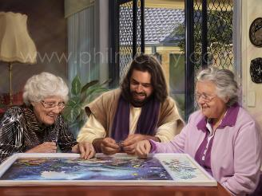
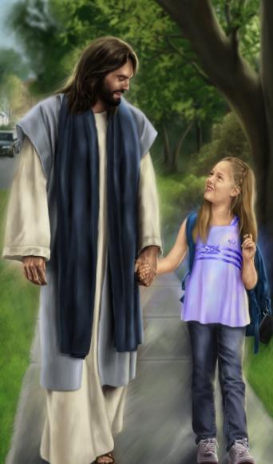
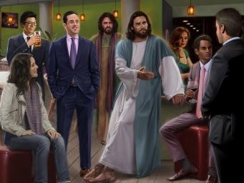
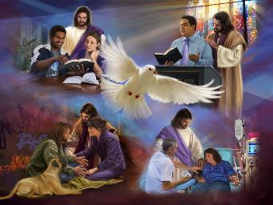
LIVING WITH CHRIST
Lesson 11 for March 14, 2026

Slide 2

“But above all these things put on love, which is the bond of perfection”
Colossians 3:14, NKJV

Slide 3

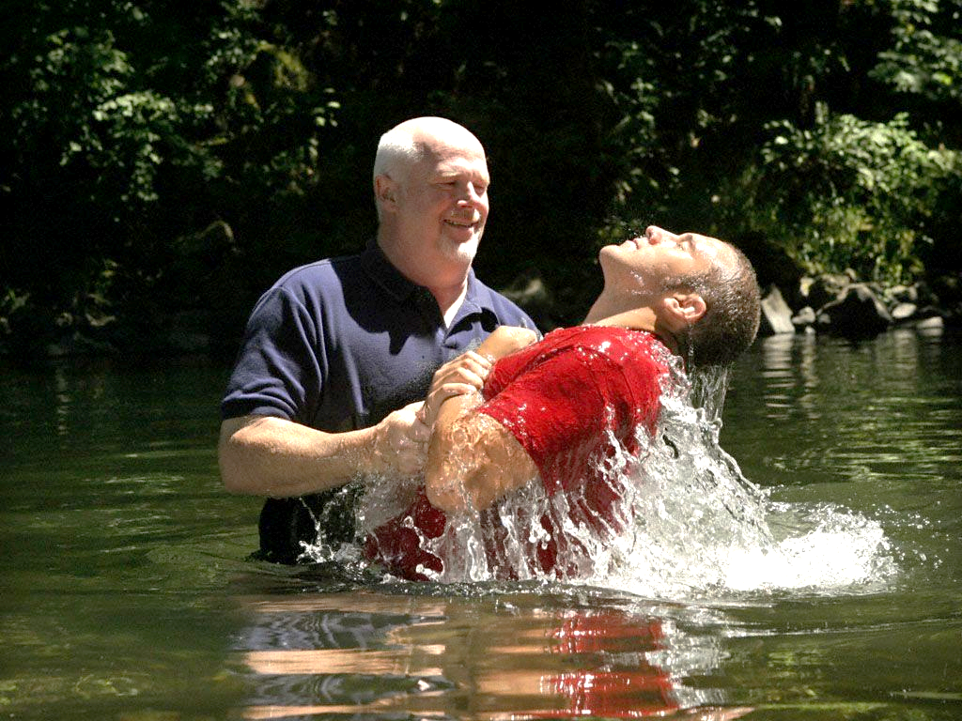
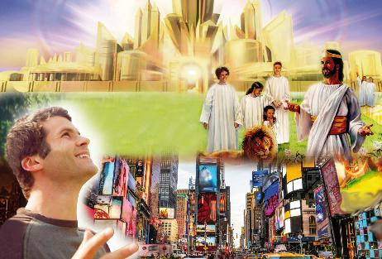





When we are buried in the waters of baptism, we die to our old life of sin. When we come out of the water, we rise as new creatures.
We abandoned our old way of living and thinking. From then on, we lived differently and thought differently. We stopped having an earthly mindset and acquired a heavenly mindset.
For some reason, our old ways keep trying to resurface. That's why the apostle Paul urges us to set our sights on heaven and turn our backs on earthly things.
Earthly or heavenly mindset?
  Our focus (Colossians 3:1-4)
  Dying to earthly things (Colossians 3:5-6)
  To cloth oneself with the celestial (Colossians 3:7-11)
Characteristics of the new life in Christ:
  The bond of perfectness (Colossians 3:12-14)
  The heavenly Food (Colossians 3:15-17)

Slide 4

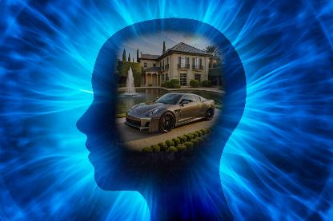
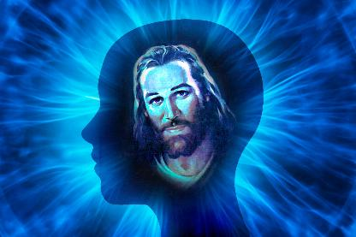
EARTHLY OR HEAVENLY MINDSET?

Slide 5

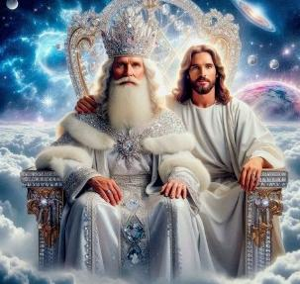

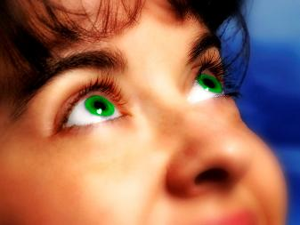
OUR FOCUS
“Set your minds on things above, not on earthly things.” (Colossians 3:2)
Starting from the reasoning that we have been raised with Christ in baptism (Col. 2:12), Paul urges us to follow Jesus to the place where he went after his resurrection: the throne of God (Col. 3:1).
Of course, we will only be able to do this physically when Jesus takes us there at his Second Coming (Col. 3:4). In the meantime, we must set our sights—our goal—on heavenly things (Col. 3:2).
We have “died,” and our life “is hid with Christ in God” (Col. 3:3). The life spoken of here is the one we receive when we accept Christ.
But that life, in order to remain alive, needs to be nourished daily (2 Cor. 4:16). Every day we must seek the “things above,” “fixing our eyes on Jesus” (Heb. 12:2 NIV).

Slide 6

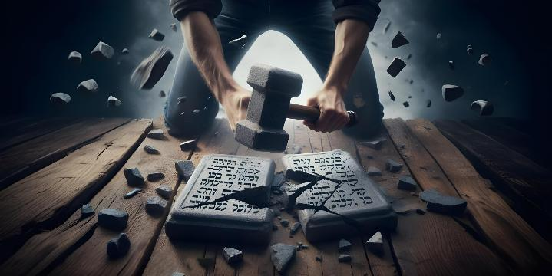




DYING TO EARTHLY THINGS
“Put to death, therefore, whatever belongs to your earthly nature: sexual immorality, impurity, lust, evil desires and greed, which is idolatry.” (Colossians 3:5)
Since we have risen with Christ and live thinking about the heavenly, we must put to death what prevents us from fulfilling our goal: the earthly.
So that no one is mistaken, Paul points out the fundamental pillars of earthly thinking (which he will later develop in more concrete points): “sexual immorality, impurity, lust, evil desires and greed, which is idolatry” (Col. 3:5 NIV).
Human nature has not changed much since Paul's time, as we are still surrounded by the same passions that violate both the letter and the spirit of the Ten Commandments.
And why must we “put to death”—abandon, eliminate—these things from our thoughts and actions? Because they bring “the wrath of God” and are therefore incompatible with our heavenly nature (Colossians 3:6). Kill the earthly before the earthly kills you!

Slide 7




TO CLOTH ONESELF WITH THE CELESTIAL
“and have put on the new self, which is being renewed in knowledge in the image of its Creator” (Colossians 3:10)
In true proverbial style, Paul adds to the five pillars of earthly thinking five earthly acts to avoid: “anger, rage, malice, slander, and filthy language from your lips” (Col. 3:8 NIV), and ends with a sixth act—the worst of all—: “Do not lie to each other” (Col. 3:9 NIV).
Paul assumes that we have already “since you have taken off your old self with its practices” (Col. 3:9 NIV). We have removed our “filthy clothes” when we have allowed Jesus to take away our sins
(Zech. 3:4 NIV).
Stripped of those garments, we need to put on “fine garments.” Clothed in these new garments, we are continually renewed, growing in holiness day by day (Col. 3:10).
As we are renewed by the work of the Holy Spirit and the study of the Word, the barriers that separate us from one another disappear
(Col. 3:11).

Slide 8
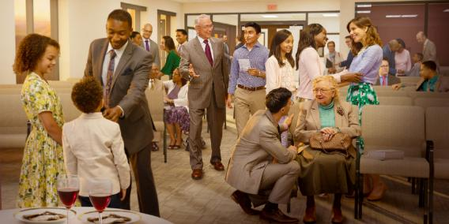

CHARACTERISTICS OF THE NEW LIFE IN CHRIST

Slide 9

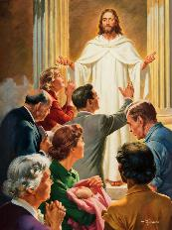

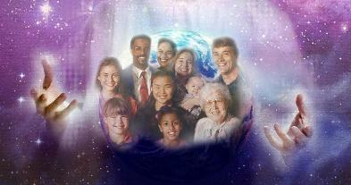
THE BOND OF PERFECTNESS
“And above all these things put on love, which is the bond of perfectness” (Colossians 3:14)
We are “God’s chosen people, holy and dearly loved” (Col. 3:12 NIV). Peter tells us that this brings us great benefits and a great responsibility (1 Pet. 2:9). But how does one of God’s chosen ones behave (Col. 3:12-13)?
1
2
3
4
With tender mercy
With kindness
With humbly
With meekness
With long-suffering
Forbearing one another
Forgiving yourselves
5
6
7
And all of this within the context of the bond of perfectness: love (Col. 3:14). And these are our benefits and responsibilities:
BENEFIT
RESPONSIBILITY
By behaving this way, we are a blessing to both others and ourselves.
May our conduct glorify God, and may it encourage others to believe in and follow Jesus

Slide 10

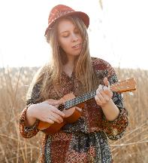
THE HEAVENLY FOOD
“Let the message of Christ dwell among you richly as you teach and admonish one another with all wisdom through psalms, hymns, and songs from the Spirit, singing to God with gratitude in your hearts.” (Colossians 3:16)
Colossians 3:15-17 shows us how to feed our heavenly nature (and it turns out that we cannot feed it in isolation, but we need the fellowship of the church for this):
Letting the peace of God rule us
Remaining unanimous as one body
Being grateful
Studying the Bible extensively
Teaching each other what we have learned
Singing psalms, hymns, and spiritual songs
Doing everything in the name of Jesus
“Song is a weapon that we can always use against discouragement. As we thus open the heart to the sunlight of the Savior’s presence, we shall have health and His blessing” (Ellen G. White, “The Ministry of Healing,” p. 254) .

Slide 11

“Cultivate a kind, tender, sympathetic heart, and never call these attributes weakness, for they are the attributes of Christ. Be careful of your influence. Let it be of so pure and fragrant a character that you will never be ashamed to have it reproduced in others.
As drops of water make the river, so little things make up life. Life is a river, peaceful, calm, and enjoyable, or it is a troubled river, always casting up mire and dirt. In this life you may place yourself under the discipline of the Holy Spirit. Through the sanctification of the Spirit you will thus grow more and more like Christ.
EGW ( That I May Know Him , July 22)

