Slide 1

STANDING IN ALL THE WILL OF GOD
Lesson 13 for March 28, 2026

Slide 2


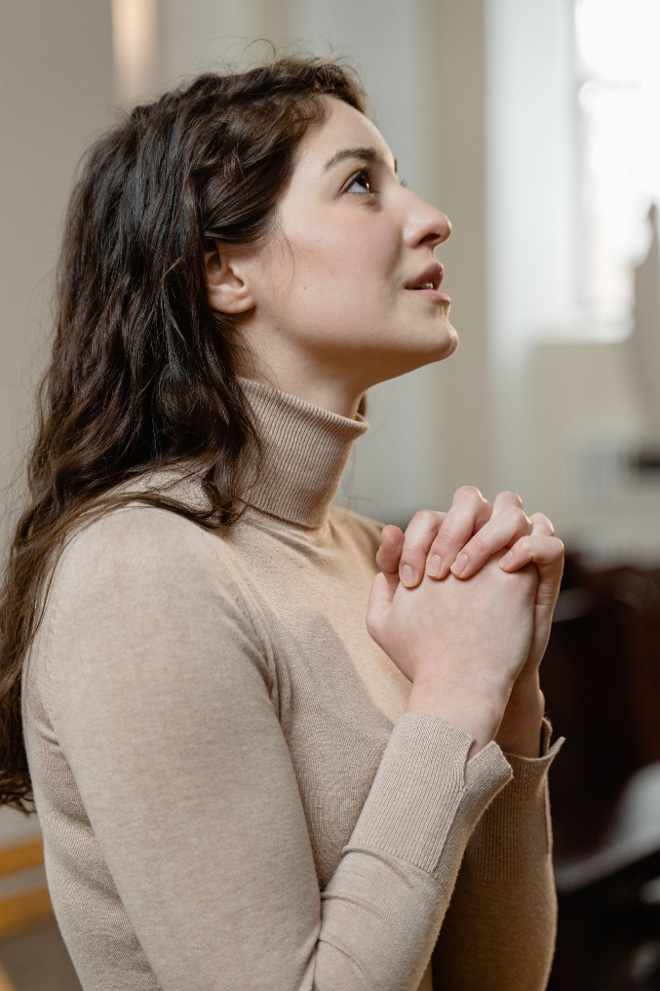

“In everything give thanks; for this is the will of God in Christ Jesus for you”
1 Thessalonians 5:18, NKJV

Slide 3


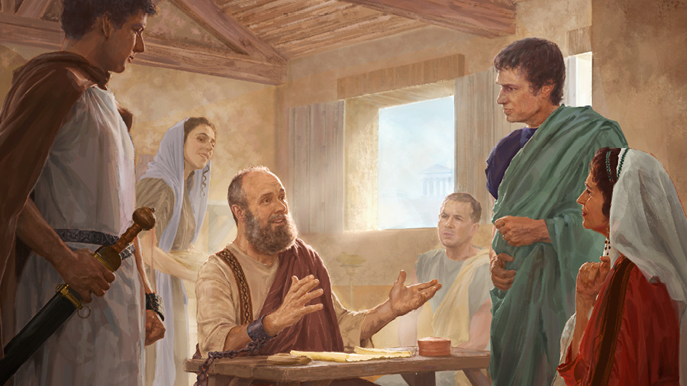
Paul worked with various collaborators, and he recognized the work of those who wholeheartedly dedicated themselves to maintaining and strengthening the churches.
The emissaries
Tychicus and Onesimus (Colossians 4:7-9)
Those of the circumcision
Aristarchus, Mark, and Jesus (Colossians 4:10-11)
The instructor
Epaphras (Colossians 4:12-13)
The beloved and the worldly
Luke and Demas (Colossians 4:14)
Church leaders
Nympha and Archippus (Colossians 4:16-18)
At the end of the letter to the Colossians, Paul sends greetings from his collaborators, and greets the faithful brothers of Colossae.
It also interjects Epaphras's fervent desire: "that you may stand firm in all the will of God, mature and fully assured" (Col. 4:12 NIV).

Slide 4

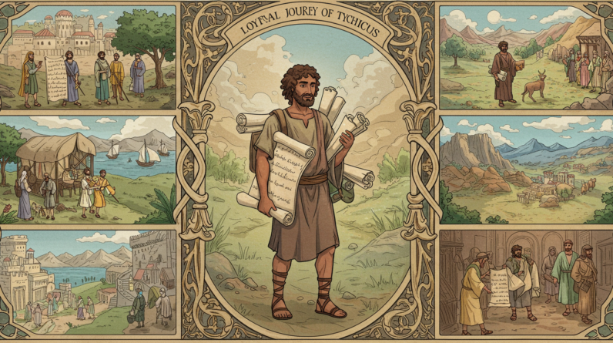
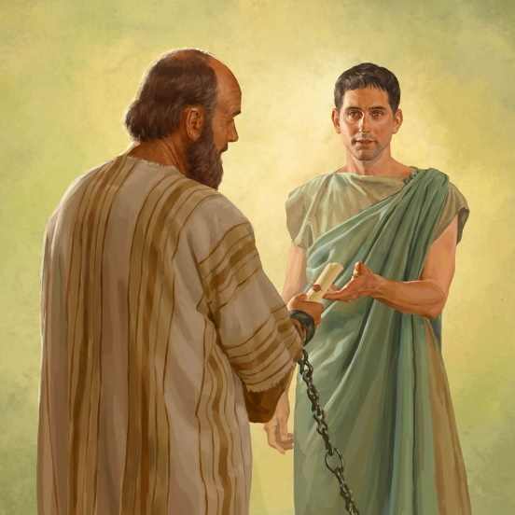


THE EMISSARIES
“Tychicus will tell you all the news about me. He is a dear brother, a faithful minister and fellow servant in the Lord, […] He is coming with Onesimus, our faithful and dear brother, who is one of you. They will tell you everything that is happening here.” (Colossians 4:7, 9)
In addition to evangelizing in the most important cities of the Empire, Paul wrote letters to maintain contact with the churches, or to encourage those he did not know personally.
These letters were sent through beloved and faithful brothers (Col. 4:7-9).
TYCHICUS
On Paul's third missionary journey, he accompanied him to deliver an offering to Jerusalem (Acts 20:4). He assisted Paul in Rome and delivered the letters to the Ephesians and Colossians (Eph. 6:21; Col. 4:7). When Paul was released, he could have replaced Titus in Crete (Titus 3:12). During Paul's final imprisonment, he was sent as pastor to the church in Ephesus (2 Tim. 4:12).
ONESIMUS
A slave who ran away from his master, Philemon. He was converted during Paul's first imprisonment in Rome. Paul sent him back to his master with a heartfelt letter, urging Philemon to treat him with Christian affection (Phlm. 1:10). Together with Tychicus, he delivered the epistle to the Colossians (Col. 4:9).

Slide 5

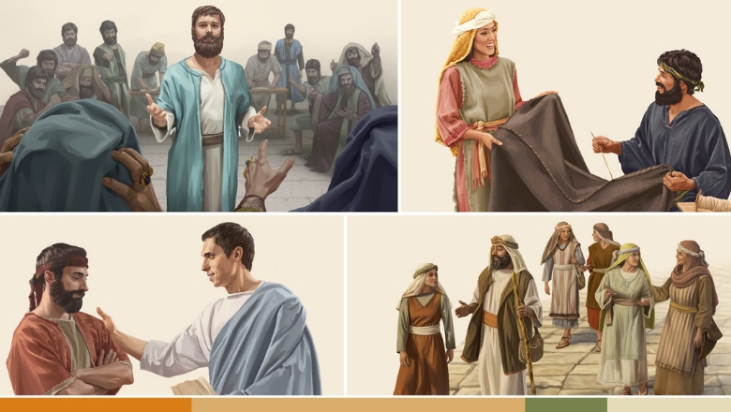
THOSE OF THE CIRCUMCISION
“…These are my only fellow workers for the kingdom of God who are of the circumcision; they have proved to be a comfort to me” (Colossians 4:11)
Paul strove to break down the walls that divided the Church. He surrounded himself with collaborators from all over, and from diverse backgrounds. Jews and Gentiles, Asians and Europeans worked together in harmony.
His vision was to achieve a united church that worked towards a common goal: the preaching of the gospel.
ARISTARCHUS
He was a native of Thessalonica (Acts 27:2). He had trouble during the riot in Ephesus (Acts 19:29 ). He accompanied Paul to deliver the offering in Jerusalem (Acts 20:4). He was imprisoned with Paul in Rome, and sent greetings to the Colossians and Philemon (Col. 4:10; Phlm. 1:24)
MARK
The nephew of Paul's first companion, Barnabas, deserted the mission in Pamphylia, and Paul refused to take him on a second journey (Acts 15:37-38). He accompanied his uncle and became a useful evangelist for Paul (Acts 15:39; 2 Timothy 4:11). Peter treated him like a son (1 Peter 5:13). He was the author of the Gospel of Mark
All we know about him is that he was Jewish, and that he was known by the nickname “Justus” (Col. 4:11)
JESUS

Slide 6

THE INSTRUCTOR
“Epaphras, who is one of you, a bondservant of Christ, greets you, always laboring fervently for you in prayers, that you may stand perfect and complete in all the will of God.” (Colossians 4:12)
Epaphras helped spread the gospel in Colossae, Hierapolis, and Laodicea, churches he deeply loved (Col. 4:13). Along with Epaphras's greeting, Paul includes his wishes for the Colossians (Col. 4:12):
He instructed the church in Colossae, making the gospel widely known to them (Col. 1:7). Paul presents him with three titles: “dear fellow servant”; bondservant of Christ”; and “fellow prisoner”
(Col. 1:7; 4:12; Phlm. 1:23)
EPAPHRAS
Stand firm
They must remain unmoved, especially in the face of the enemy's schemes
(Eph. 6:11)
May you be perfect
This perfection is attained through selfless love
(Mt. 5:44, 48), although one always grows in it (Phlp. 3:12)
May you be complete
To be filled with all that we are capable of receiving from God

Slide 7

THE BELOVED AND THE WORLDLY
“Luke the beloved physician and Demas greet you” (Colossians 4:14)
LUKE
Author of the Gospel of Luke and the Acts of the Apostles, he is considered Paul's biographer (Luke 1:1-4; Acts 1:1). A physician by profession, is called "beloved" by Paul. He remained with Paul until his death (2 Tim. 4:11).
DEMAS
He was Paul's co-worker during his first imprisonment in Rome (Phlm. 1:24). However, during his last imprisonment, he deserted Paul, “loving this world”
(2 Tim. 4:10).
If he were only mentioned in Colossians 4:14, Demas would have remained as a faithful collaborator of Paul.
The contrast between Luke and Demas became clear over time. Luke was loved for his work, while Demas loved the world and abandoned Paul.
Luke remained steadfast in his hope for the Second Coming and the New Earth. Demas loved the glory of this world more than the glory to come.
He stopped loving Jesus and gave his heart to the world
(1 John 2:15).

Slide 8

CHURCH LEADERS
“Give my greetings to the brothers and sisters at Laodicea, and to Nympha and the church in her house” (Colossians 4:15)
All we know about Nympha is that she led a church in the city of Laodicea. We don't even know if she was a man or a woman, since some manuscripts say “his house,” others “their house,” and still others—the majority—“her house.”
Philemon's son, a native of Colossae, was at some point a companion of Paul (Phlm. 1:1-2). Paul asks him to continue working in the ministry (as a deacon, pastor, or elder of the church in Colossae).
NYMPHA
ARCHIPPUS
Paul asks the Colossians to have his letter read to the people of Laodicea, and for them to read the letter he wrote to the Laodiceans (Col. 4:16).
Therefore, he mentions the two main leaders of these churches: Nympha [of Laodicea] and Archippus [of Colossae] (Col. 4:15, 17).
We do not know Paul's message to Laodicean’s, although we do know the message that the apostle John wrote to him 30 years later (Rev. 3:14-22).

Slide 9

“Service for God demands the whole being—heart, mind, soul, and strength. Without reservation we are to give ourselves to God, that we may bear the image of the heavenly instead of the image of the earthly. There must be a quickening of the sensibilities, that the mind may be fully awake to the work to be done for all classes, high and low, rich and poor, learned and ignorant. We are to reveal the tenderness shown by the great Shepherd as He gathers the lambs in His arms and carefully guards His flock from harm, leading it in safe paths. Christ’s followers are to show His tenderness and sympathy, and they must also show His intensity of desire to impart the truths that mean eternal life to the receiver.”
EGW (Christ Triumphant, February 9)

