Slide 1
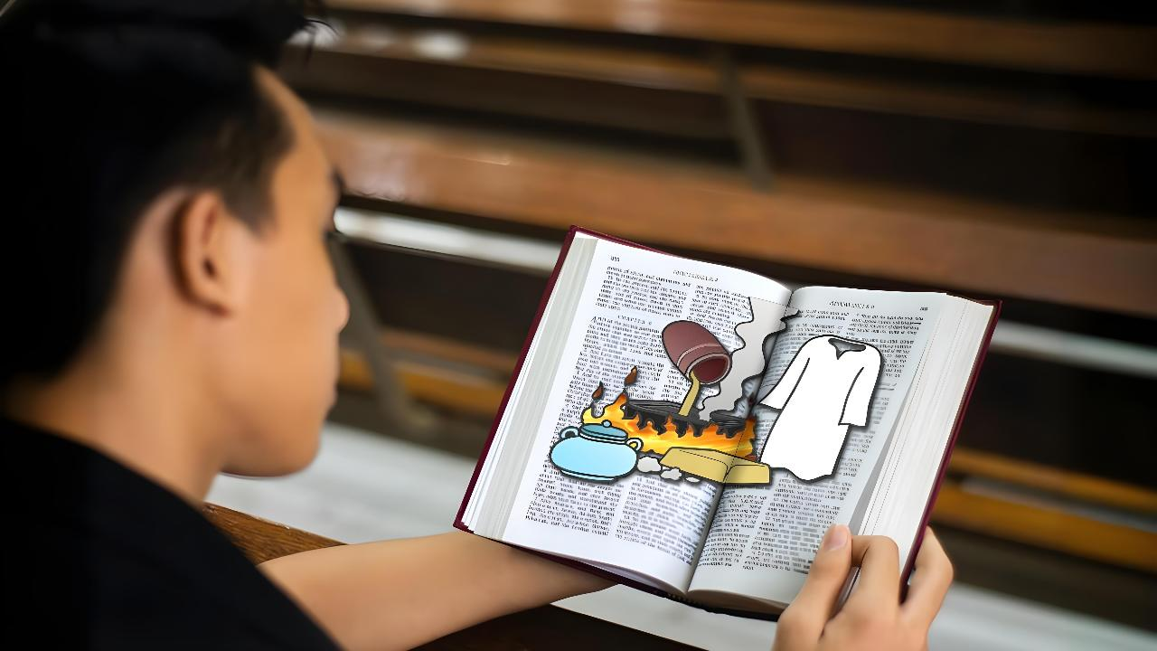
REALITY CHECK
Lesson 1 for April 4, 2026

Slide 2
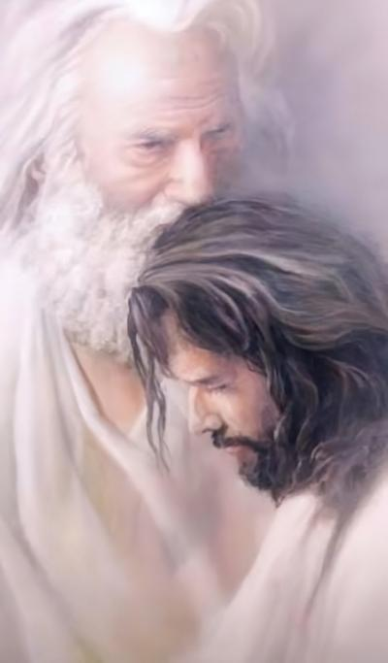
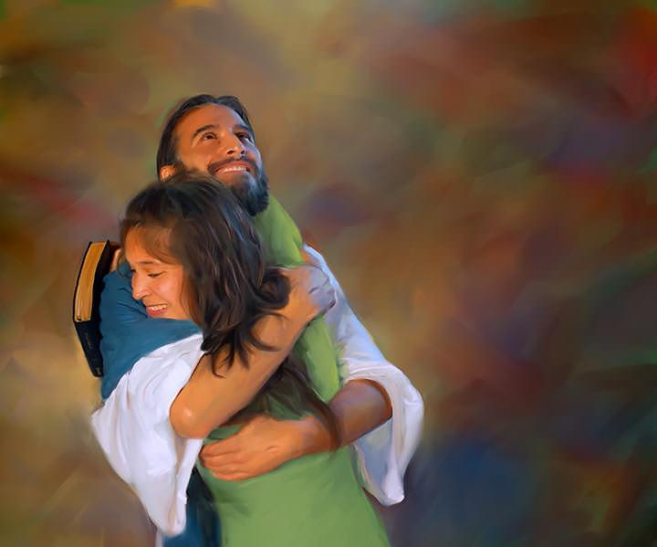
“As the Father loved Me, I also have loved you; abide in My love.”
(John 15:9 NKJV)

Slide 3

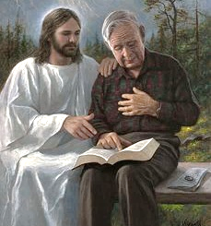



Each of us has developed a different relationship with God. But we all agree on one thing: this relationship can (and should) grow.
The first step we must take in order to grow is to be aware of our current situation.
God has given us a general message about the spiritual state of the church in this final stage of life. Now it is up to us to examine ourselves to see which part of that message applies to us, and how to strengthen and deepen our relationship with God.
The message of God (Revelation 3:14-22):
Evaluation (vv. 14-17)
Solution (v. 18)
Result (vv. 19-20)
Gratification (vv. 21-22)
Reality check (John 15:1-11):
The branch and the vine
The sap

Slide 4

THE MESSAGE OF GOD
(Revelation 3:14-22)

Slide 5


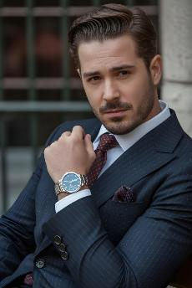

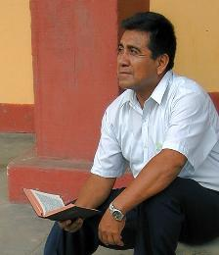
EVALUATION
“Because you say, ‘I am rich, have become wealthy, and have need of nothing’—and do not know that you are wretched, miserable, poor, blind, and naked” (Revelation 3:17)
The message to the seven churches presents the state of the world church from apostolic times to the present day (Rev. 2-3). In presenting the message for our day (Laodicea), Jesus presents himself as “the Amen [the Truth], the faithful and true witness” (Rev. 3:14).
When we look at ourselves we see our Truth : “I am rich, and have become wealthy, and have need of nothing” (Rev. 3:17a).
But Jesus sees the truth , our reality: “You are wretched, miserable, poor, blind and naked” (Rev. 3:17b).
Now it's time to evaluate ourselves. Am I aware of what I truly have, and what I still need? How much have I grown in my relationship with Jesus? Am I changing for the better?

Slide 6

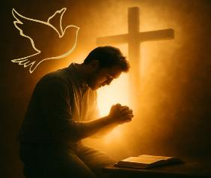
SOLUTION
“I counsel you to buy from Me gold refined in the fire, that you may be rich; and white garments, that you may be clothed, that the shame of your nakedness may not be revealed; and anoint your eyes with eye salve, that you may see.” (Revelation 3:18)
Since feeling comfortable with our situation produces apathy (lukewarmness), Jesus advises us to do three things:
Buy refined gold
We must not settle for half-truths or a superficial study of the Bible. We must discard human doctrines (tinsel) and delve deeper into our study of the Bible to remove all imperfection (dross) from our understanding of it.
Buy white garments
Accepting Jesus' righteousness as the only way to achieve salvation. Trying to present ourselves to God with our own righteous deeds is to show ourselves naked before Him.
Buy eye drops
Receive the Holy Spirit. Only He can give us spiritual discernment and convince us of our true condition (John 16:8).

Slide 7

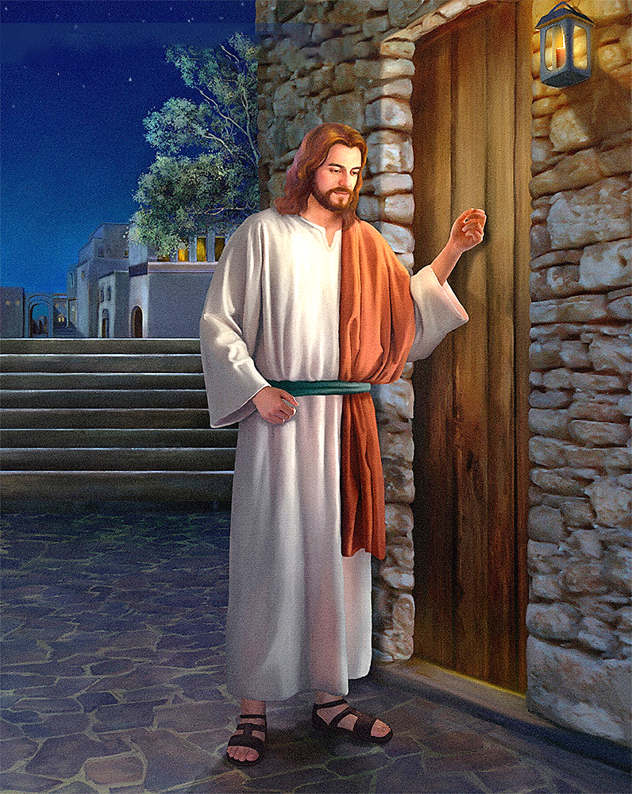
RESULT
“Behold, I stand at the door and knock. If anyone hears My voice and opens the door, I will come in to him and dine with him, and he with Me.” (Revelation 3:20)
There's a problem. I feel fine spiritually, but Jesus wants me to improve. However, if I'm not aware of my need for change, I'll never change. I'll never want to buy what I already think I have.
To solve this, Jesus has his own methods: “As many as I love, I rebuke and chasten”; and he adds: “Repent” (Rev. 3:19).
Jesus' rebuke and punishment are not necessarily negative. He prefers the path of dialogue. He wants to sit quietly with us and talk… “Behold, I stand at the door and knock. If anyone hears My voice and opens the door, I will come in to him and dine with him, and he with Me” (Rev. 3:20).
Jesus knocks on the door of my heart and waits patiently. He doesn't interrupt my life to force me to have a relationship with Him. The decision to open it is mine.

Slide 8


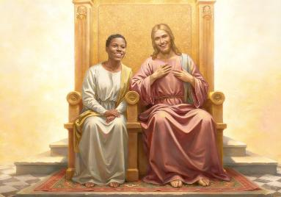
GRATIFICATION
“To him who overcomes I will grant to sit with Me on My throne, as I also overcame and sat down with My Father on His throne.” (Revelation 3:21)
Jesus knows the path is not easy. He knows our efforts to buy the gold, the robe, and the eye salve. He knows our struggles to overcome lukewarmness, open the door, and connect with Him. That is why He tells us: You can overcome, just as I have overcome (Rev. 3:21).
He also knows that we will never take the first step. God has always taken the initiative.
He decided to create us (Gen. 2:7)
He seeks us out when we have sinned (Gen. 3:8-9)
He gave himself to save us (John 3:16)
He wants to give us a reward: to sit with Him, and enjoy eternity in His company (Rev. 3:21)
The key to this divine behavior (which we don't deserve) is love: “I have loved you with an everlasting love” (Jeremiah 31:3). He wants to have a relationship with us. Do I want to have a relationship with Him? Will I open my heart to Him and love Him as He loves me?

Slide 9

REALITY CHECK
(John 15:1-11)

Slide 10

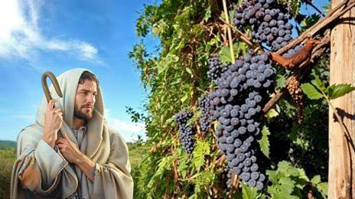
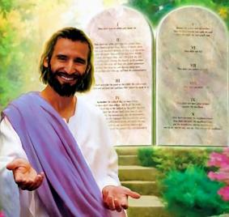
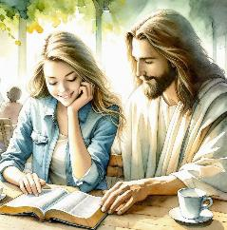
THE BRANCH AND THE VINE
“I am the vine, you are the branches. He who abides in Me, and I in him, bears much fruit; for without Me you can do nothing.” (John 15:5)
Shortly before his death, Jesus declared that he was “the vine,” and that his disciples were “the branches.” What did he mean by this?
A branch can live for a time without being attached to the vine, but eventually it will wither. So that we may not lose eternal life, Jesus makes a plea to us: “Abide in Me” (John 15:4). In the 11 verses in which Jesus tells this parable of the vine and the branches, he uses the verb “abide” 10 times. It must be something truly important.
Abiding in Jesus is an antidote to Laodicean lukewarmness. Moreover, it is a source of joy (John 5:11). But how can we abide in Jesus?
By doing what pleases Him, that is, by keeping His commandments (John 15:10). This is a loving response to the love that God has shown us (1 John 4:19).

Slide 11


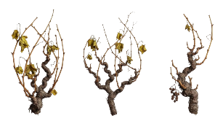

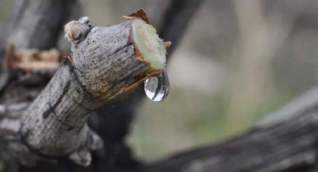
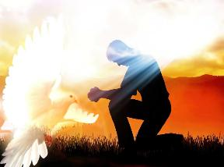
THE SAP
“Abide in Me, and I in you. As the branch cannot bear fruit of itself, unless it abides in the vine, neither can you, unless you abide in Me.” (John 15:4)
In winter, the branches are attached to the vine, but they don't bear fruit. Why? Because they don't receive sap.
Only when spring arrives do these receive the sap from the vine, and then the shoots (tendons) emerge. The Greek word used by John can also refer to branches that have been broken off and grafted back onto the vine.
Whether we are tender shoots or broken branches, one thing is clear: we need the sap of the vine. To what can we compare this sap?
In the same discourse (John 14-17), Jesus gives us the explanation: The Holy Spirit is the one who acts in us to give us life, if we so desire.
He is our Comforter (John 14:16-17)
He reveals Jesus to us (John 15:26)
Convicts us of sin (John 16:8)
He guides us into all truth (John 16:13)

Slide 12

“The gold here recommended as having been tried in the fire is faith and love. It makes the heart rich; for it has been purged until it is pure, and the more it is tested the more brilliant is its luster. The white raiment is purity of character, the righteousness of Christ imparted to the sinner. This is indeed a garment of heavenly texture, that can be bought only of Christ for a life of willing obedience. The eyesalve is that wisdom and grace which enables us to discern between the evil and the good, and to detect sin under any guise. God has given His church eyes which He requires them to anoint with wisdom, that they may see clearly; but many would put out the eyes of the church if they could; for they would not have their deeds come to the light, lest they should be reproved. The divine eyesalve will impart clearness to the understanding. Christ is the depositary of all graces. He says: “Buy of Me” (Revelation 3:18).”
EGW (Testimonies for the Church, vol. 4, p. 88)

