Slide 1

TO KNOW GOD
Lesson 2 for April 11, 2026

Slide 2
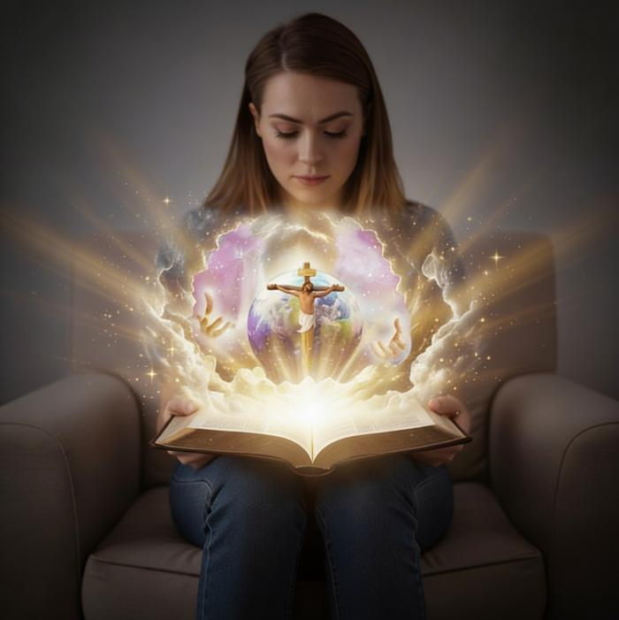
“And this is eternal life, that they may know You, the only true God, and Jesus Christ whom You have sent.”
(John 17:3, NKJV)

Slide 3

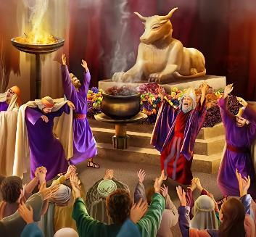

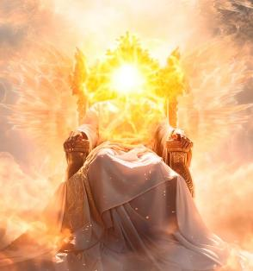
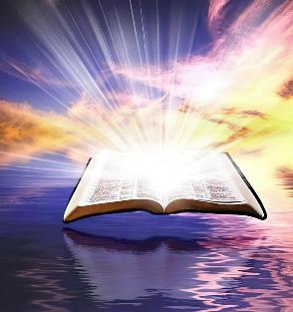
Our understanding of God has been corrupted by sin. We have tried to represent Him in idols shaped like animals or people. He has been portrayed as capricious or tyrannical. Ultimately, humanity has created an image of God in its own likeness.
But what is God really like? Is He so great that understanding Him is beyond our grasp? Certainly, no matter how hard we try, our minds cannot comprehend God. We need help.
But help has arrived. Do you want to know what He is like? In the Bible, we have the true revelation of God's nature.
The attributes of God.
The character of God:
God is holy
God is love
Knowing God:
God revealed in Creation
God revealed in Jesus (Emmanuel)

Slide 4


THE ATTRIBUTES OF GOD

Slide 5


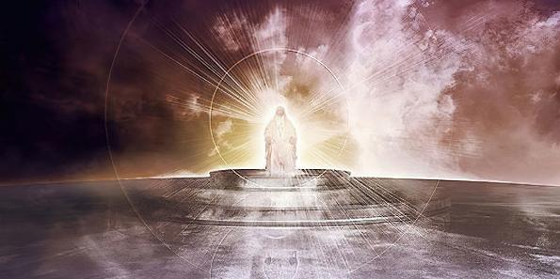

“O Lord God of hosts, who is mighty like You, O Lord?
Your faithfulness also surrounds You” (Psalm 89:8)
THE ATTRIBUTES OF GOD
The Bible offers the most faithful, clear, and consistent image of God. One of the ways it allows us to know Him is through His attributes.
SOME ATTRIBUTES OF GOD
Righteous (Psalm 11:7)
Merciful (Deuteronomy 4:31)
Patient and comforting (Romans 15:5)
Giver of grace (Romans 3:24)
Forgiving One (Psalm 86:5)
Royal (Psalm 47:8)
Eternal (Genesis 21:33)
Almighty (Genesis 17:1)
Omniscient (1 John 3:20)
Knower of the future (Isaiah 46:10)
For his part, Satan has tried from the beginning to distort the character of God, showing him as a selfish God, who only seeks his own good (Gen. 3:4-5).

Slide 6

THE CHARACTER OF GOD

Slide 7

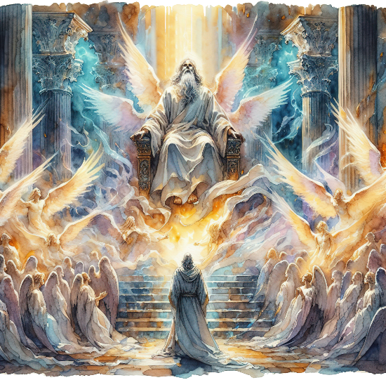
“And they were calling to one another: “Holy, holy, holy is the Lord Almighty; the whole earth is full of his glory.” (Isaiah 6:3 NVI)
GOD IS HOLY
The angels who stand beside God praise Him as “Holy, holy, holy” (Isa. 6:3; Rev. 4:8). This attribute is so intrinsically linked to His character that Isaiah uses it as God’s proper name: “says the Holy One”. (Isa. 40:25; 57:15).
What does it mean to be holy? It means to be consecrated, set apart, clean. We are holy when we turn away from evil and do the work God has entrusted to us. (Num. 15:40; Lev. 11:44; 1 Pet. 2:9).
But how does this apply to God? He is completely separate from evil and has no relationship with sin.
This means that, because He is Holy, His love is holy, pure, and free from selfishness. Because He is Holy, His omnipotence is holy, pure, and free from selfishness. All His attributes are imbued with holiness and purity.

Slide 8


GOD IS LOVE
“And so we know and rely on the love God has for us. God is love. Whoever lives in love lives in God, and God in them.” (1 John 4:16 NIV)
God not only has love or imparts love (although He does both), but “God IS love” (1 John 4:8, 16). Like holiness, love is an intrinsic part of the divine nature.
Out of love, he created humankind male and female, and “commanded” them to love one another (Gen. 2:24)
Out of love, when Adam and Eve sinned, He sought them out and gave them hope (Gen. 3:9, 15)
Out of love, He made a covenant with Abraham and promised blessings for all mankind (Gen. 26:4)
Out of love, he gave his Son –Jesus Christ– to die for our sins (John 3:16)
How can I respond to His love?
“We love Him because he first loved us” (1 John 4:19).
Notes:
SmartArt with large images (the four “for love”)

Slide 9

KNOWING GOD

Slide 10



GOD REVEALED IN CREATION
“The heavens declare the glory of God; and the firmament shows His handiwork.” (Psalm 19:1)
The Bible begins by referring to God as אֱלֹהִ֑ים (elohim). Although the literal translation of this title is “gods,” it is used as a singular word. Something like “In the beginning, Gods created the heavens and the earth” (Gen. 1:1).
It presents us with the Creator who, through the Word [Jesus Christ], and with the intervention of the Spirit, is powerful to bring forth everything that exists (Gen.1:1-3; Jn. 1:1-3).
In Genesis chapter 2, a personal name for God is added: יְהוָ֥ה (Yahweh). Now He doesn't simply say, “Let it be.” He takes man and molds him with His hands. The powerful God reveals Himself as a personal, approachable God.
He touches us, he speaks to us, he teaches us, he assigns us our work… he loves us.

Slide 11

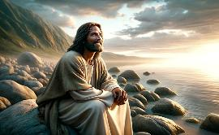
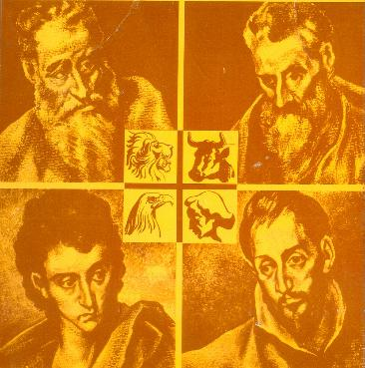
GOD REVEALED IN JESUS (EMMANUEL)
“No one has seen God at any time. The only begotten [h]Son, who is in the bosom of the Father, He has declared Him.” (John 1:18)
If we want to know what God is like, let us get to know Jesus. He is God incarnate (John 1:14), who revealed himself by taking on human nature so that he could be seen and heard by us (John 1:18; 14:9; 1 John 5:20).
He was announced under a prophetic name that indicated the purpose of his life: Emmanuel, God with us (Isaiah 7:14; Matthew 1:23). The four evangelists present him to us in different aspects.
Matthew
From a Jew to the Jews
Mark
From a Jew to the Gentiles
Luke
From a Gentile to the Gentiles
John
From a Jew to Jews and Gentiles
He is the Messiah who fulfills what he promised
Always attentive to serving others
Humane and compassionate
The giver of physical and spiritual life

Slide 12

“Thousands have a false conception of God and His attributes… God is a God of truth. Justice and mercy are the attributes of His throne. He is a God of love, of pity and tender compassion. Thus He is represented in His Son, our Saviour. He is a God of patience and long-suffering. If such is the being whom we adore and to whose character we are seeking to assimilate, we are worshiping the true God.”
EGW (God Cares for Us, August 8)

