Slide 1
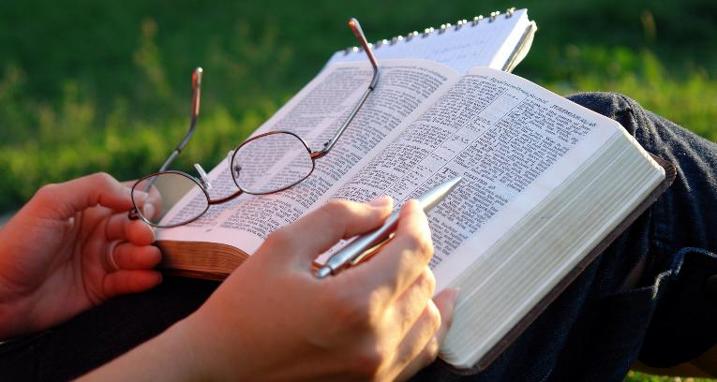
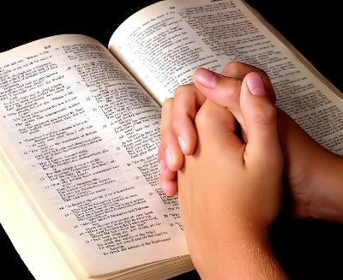
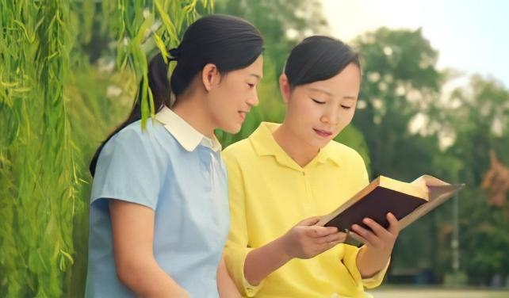
HOW TO STUDY
THE BIBLE
Lesson 5 for May 2, 2026

Slide 2

“So shall My word be that goes forth from My mouth; it shall not return to Me void, but it shall accomplish what I please, and it shall prosper in the thing for which I sent it” (Isaiah 55:11, NKJV)

Slide 3

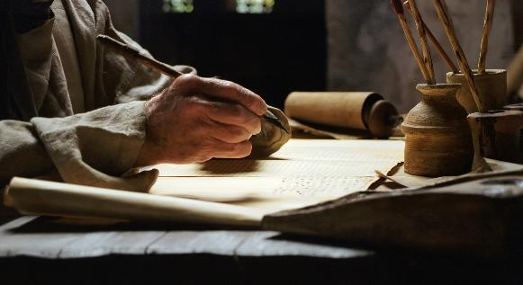

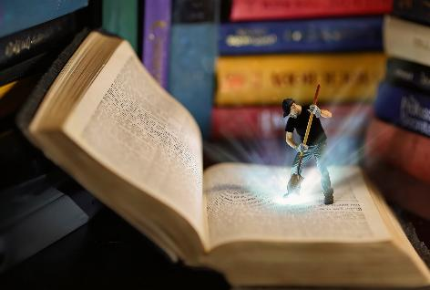
“Holy men of God spoke as they were moved by the Holy Spirit” (2 Peter 1:21), and recorded their message on the pages of the Bible.
In it we find jewels that give life, hope, encouragement, comfort, ... Some are visible at first glance, others must be sought more carefully.
How can we extract these gems that God has prepared for us in the Bible, and what benefits do we gain from studying it?
How to study the Bible:
Time
The place
The technique
Benefits of studying the Bible:
The benefit of sharing it
The benefit of eating it

Slide 4

HOW TO STUDY THE BIBLE

Slide 5

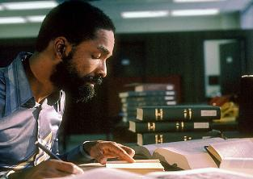
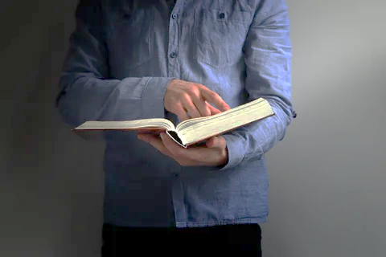

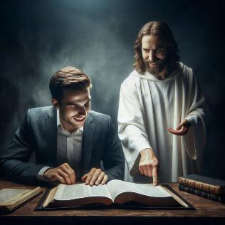
TIME
“You will seek me and find me when you seek me with all your heart.” (Jeremiah 29:13)
What is the best time to study the Bible?
We must analyze our response taking into account two factors: the time factor and the quality factor.
We will obviously get more benefit from setting aside an hour in our schedule for Bible study than from dedicating only five minutes.
However, the time we dedicate to study cannot be limited to superficial reading. This is where our motivation comes into play. Why do I read the Bible? Am I merely seeking knowledge, or do I have a deep desire to know more about God?
We will get the most out of our Bible study when it becomes a time to be with God (Jer. 29:13), and delight in Him (Ps. 37:4); when we look in its pages for God's special message for us.

Slide 6

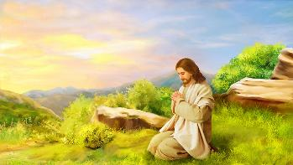


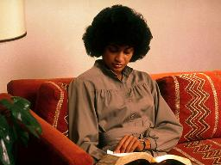
THE PLACE
“Very early in the morning, while it was still dark, Jesus got up, left the house and went off to a solitary place, where he prayed.” (Mark 1:35)
When Jesus wanted a special moment of communion with God, he would get up early and look for a quiet place (Mark 1:35). This can be applied to both prayer and Bible study.
It's difficult to concentrate on studying in a noisy or busy place. It's easier to do so in a comfortable, quiet, and secluded spot.
The first or last hours of the day, when there is more silence, can be times when we can more easily focus our thoughts on God.
Once we have found the right time and place, let's make this a regular activity. Perhaps some special circumstance will cause us to miss that time, but let's not let too much time pass without our daily Bible study.

Slide 7


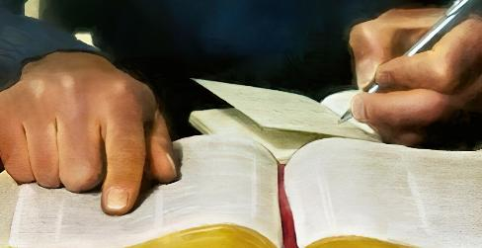
THE TECHNIQUE (1)
“So is my word that goes out from my mouth: It will not return to me empty…” (Isaiah 55:11)
An in-depth study of the Bible consists of four sections
Pray
Reading and understanding [proposed technique]
Pray
Share
Invite the Holy Spirit to be your guide in your studies
Choose a verse or passage from the Bible
He will touch your heart and mind so that you understand what you read
Write it down to help you Engrave it into your mind
Underline the key ideas
Write down the thoughts that inspire those key ideas
Ask God to help you apply the ideas you have learned
Think about who you could share what you've learned with

Slide 8

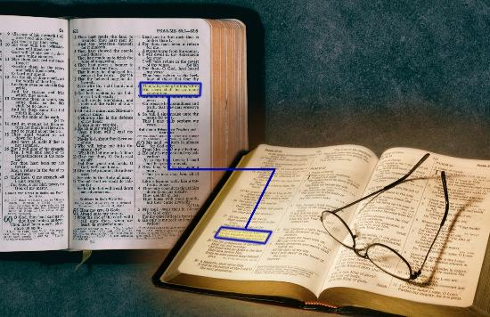
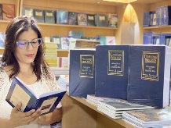

THE TECHNIQUE (2)
“So is my word that goes out from my mouth: It will not return to me empty…” (Isaiah 55:11)
Other Bible study techniques
Compare verse with verse (Isaiah 28:10)
Study chapters or entire books
Studying a topic or word with the help of a concordance
Consult biblical commentaries or dictionaries
Read in parallel with passages from the “Conflict of the Ages” series by Ellen White

Slide 9

BENEFITS OF STUDYING THE BIBLE

Slide 10



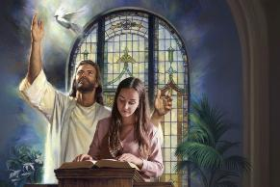
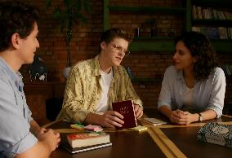
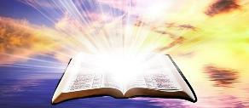
THE BENEFIT OF SHARING IT
“The Sovereign Lord has given me a well-instructed tongue, to know the word that sustains the weary. He wakens me morning by morning, wakens my ear to listen like one being instructed.” (Isaiah 50:4 NIV)
You are asked to prepare a sermon for Saturday's service. You dedicate special time to prayerfully study a topic the Holy Spirit has inspired you to choose. On Saturday, you preach with power. Who stands to benefit most from this sermon?
A Bible study that we share with others – whether in a sermon or on a personal level – has a double benefit.
First, we benefit from what we have learned. Second, the people with whom we share this knowledge benefit and are encouraged to delve deeper into that knowledge.
In both cases, the relationship with God is strengthened and deepened. Such is the power of God's Word, which “will not return to me empty” (Isaiah 55:11).

Slide 11



THE BENEFIT OF EATING IT
“How sweet are your words to my taste, sweeter than honey to my mouth!” (Psalm 119:103)
We must eat the Word of God (Jer. 15:16)!
Although it is sweeter than honey, we should not literally eat it (Psalm 119:103). Reading the Bible is food for the soul, a true refreshment that heals our spirit and transforms our character.
And what's more, this food is free (Isaiah 55:1)!
We simply need to draw near and listen to what God tells us through the Bible (Isaiah 55:3). The more time we spend delving into its pages, the more nourishment we will receive, and the more blessings we will obtain.
"Whatever may be man’s intellectual advancement, let him not for a moment think that there is no need of thorough and continuous searching of the Scriptures for greater light. As a people, we are called individually to be students of prophecy.” Ellen G. White, Counsels to Writers and Editors, p. 41

Slide 12

“The mere reading of the Word will not accomplish the result designed of Heaven; it must be studied, and cherished in the heart. The knowledge of God is not gained without mental effort. We should diligently study the Bible, asking God for the aid of the Holy Spirit, that we may understand His Word. We should take one verse, and concentrate the mind on the task of ascertaining the thought which God has put in that verse for us. […]
The Word of God is the bread of life. Those who eat and digest this Word, making it a part of every action and of every attribute of character, grow strong in the strength of God. It gives immortal vigor to the soul, perfecting the experience and bringing joys that will abide forever.
EGW (Lift Him Up, April 7)

