Slide 1
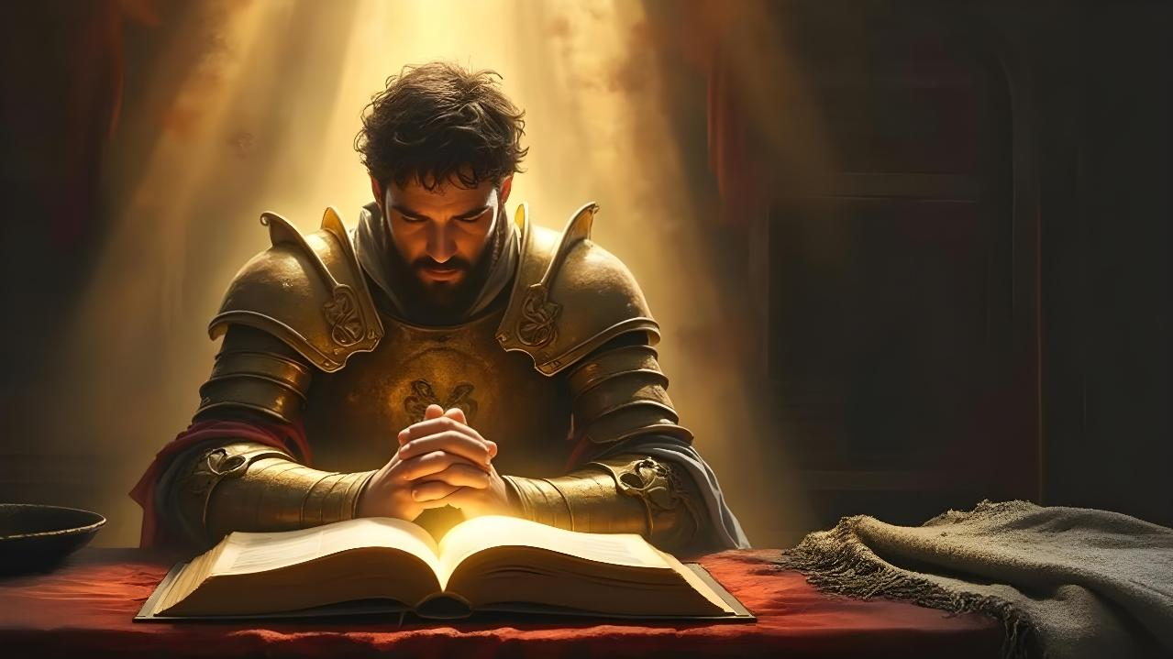
PRAYER
WARRIORS
Lesson 6 for May 9, 2026

Slide 2
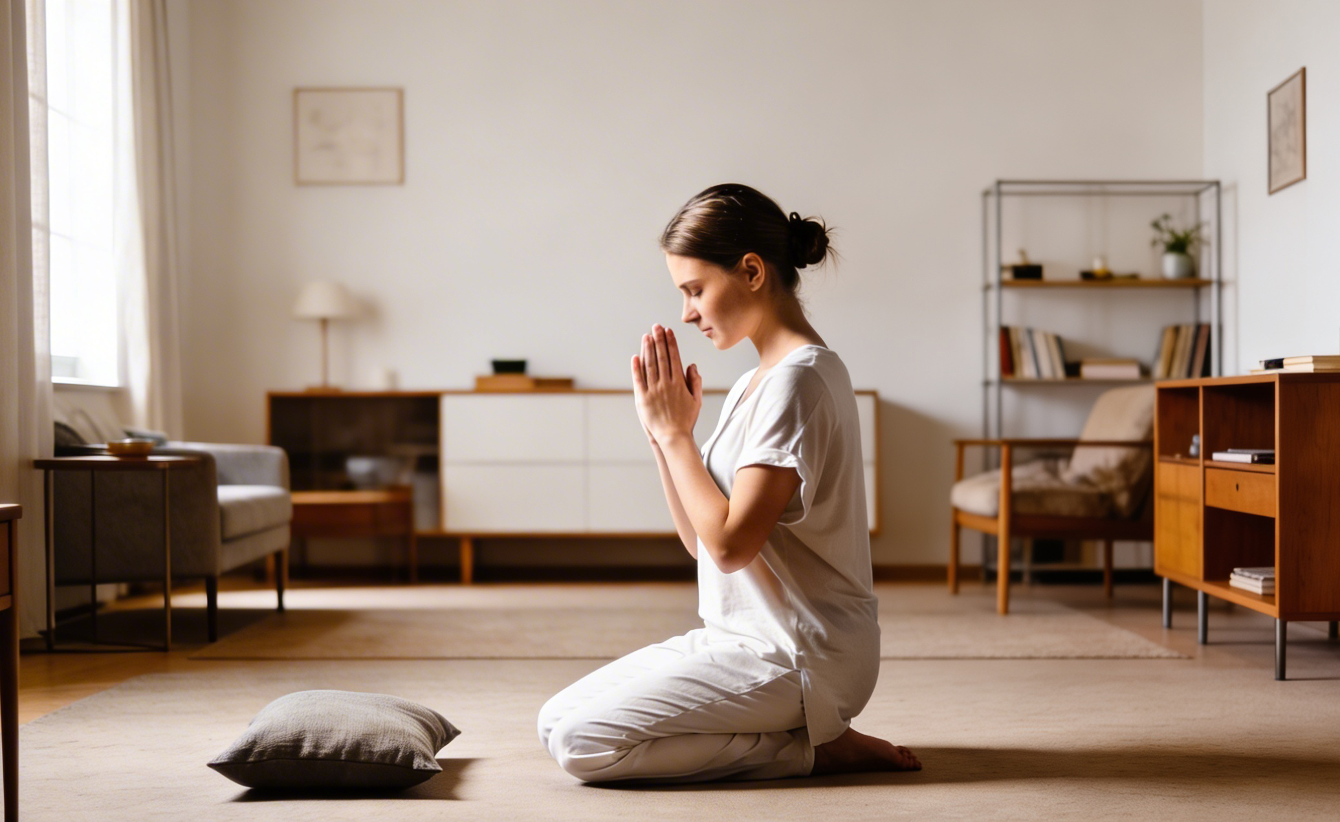
“I love the LORD, because He has heard my voice and my supplications. Because He has inclined His ear to me, therefore I will call upon Him as long as I live” (Psalm 116:1, 2, NKJV)

Slide 3


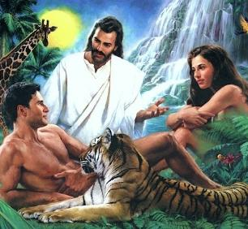

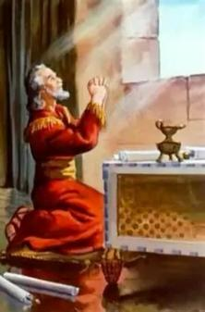
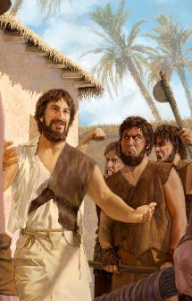
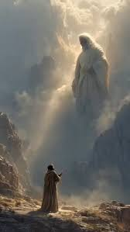


All beings, including humanity, were created by God with the ability to communicate with each other, and with Him.
Unfortunately, human beings lost the ability to communicate directly with God when Adam and Eve sinned.
But God left us a gift. A “telephone” that allows us to continue communicating with Him: prayer.
Daniel, Enoch, and Moses are examples of how we can use this powerful gift.
Daniel:
  Praying in dangerous times
  Pray in the proper posture
Enoch:
  A life of prayer
Moses:
  Talking to God
  Intercessory prayer

Slide 4

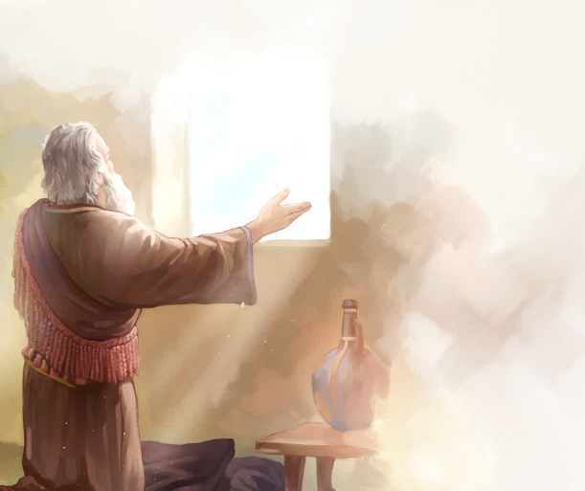
DANIEL

Slide 5

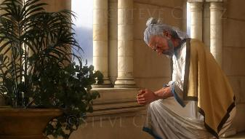
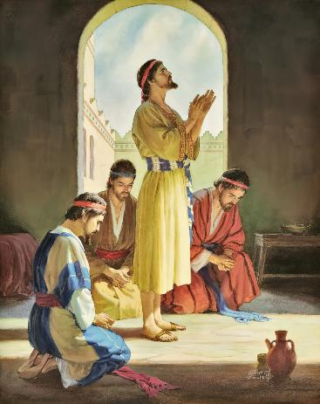
















PRAYING IN DANGEROUS TIMES
“So I turned to the Lord God and pleaded with him in prayer and petition, in fasting, and in sackcloth and ashes” (Daniel 9:3)
Because of his trust in God, Daniel received intelligence, the ability to interpret dreams, and wisdom (Dan. 1:8, 17, 20). When his life and the lives of his friends were in danger, he turned to God in prayer (Dan. 2:17-23).
After a life of prayer, what characteristics had Daniel acquired (Dan. 6:3-5)?
GOOD
ADMINISTRATOR
INTEGRITY
DILIGENT
UNBURNATABLE
RELIABLE
HONORED
FAITHFUL AND LOYAL
WITHOUT ANY
BAD HABITS

Slide 6

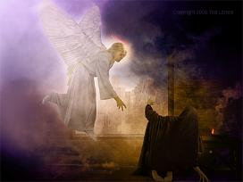
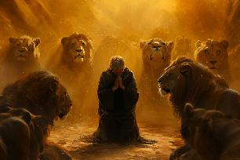
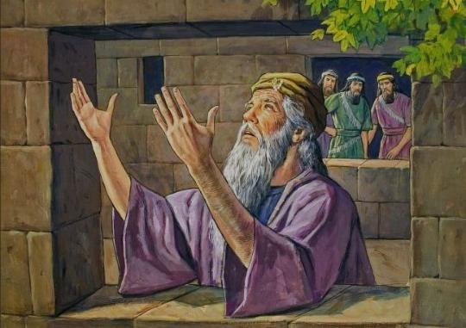
PRAYING IN DANGEROUS TIMES
“So I turned to the Lord God and pleaded with him in prayer and petition, in fasting, and in sackcloth and ashes” (Daniel 9:3)
Heaven was attentive to Daniel's prayer
(Dan. 9:20-23; 10:12). Only by breaking this bond could his enemies harm him (Dan. 6:5-7).
Faced with this new threat of death, Daniel maintained his prayer habits (Dan. 6:10):
He was consistent, praying three times a day
It was predictable, opening its window towards Jerusalem
He had specific habits; he prayed on his knees
It focused on thanksgiving and supplication

Slide 7

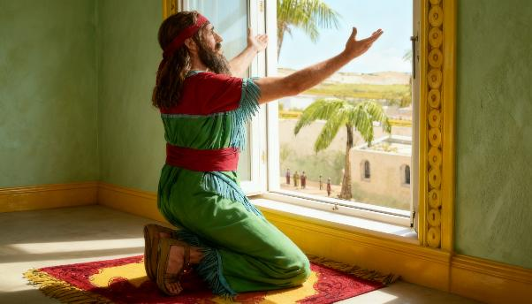
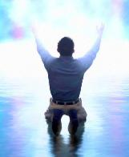
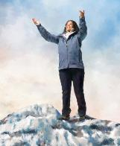
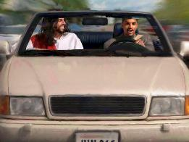
PRAY IN THE PROPER POSTURE
“Now when Daniel learned that the decree had been published, he went home to his upstairs room where the windows opened toward Jerusalem. Three times a day he got down on his knees and prayed, giving thanks to his God, just as he had done before.” (Daniel 6:10)
When we pray, we speak to God as if we were speaking to a friend. However, God is not like us. He is the King of the Universe.
For this reason, Daniel's custom was to kneel before Him to pray, acknowledging Him as his Sovereign.
Since we can pray to God in any circumstance and at any time, it is not always possible or necessary to do so in this way.
Closing our eyes allows us to concentrate more on prayer, but in some circumstances it is not possible (walking, driving, etc.)
The important thing is that our prayers are made with the respect that God deserves.

Slide 8

PRAY IN THE PROPER POSTURE
“Now when Daniel learned that the decree had been published, he went home to his upstairs room where the windows opened toward Jerusalem. Three times a day he got down on his knees and prayed, giving thanks to his God, just as he had done before.” (Daniel 6:10)
In the Bible we find examples of people who prayed in different ways, according to their special circumstances.
Jehoshaphat prayed standing before the people (2Ch. 20:5)
David sat before God to give thanks
(2S. 7:18)
Solomon prayed kneeling, with his hands raised
(1K. 8:54)
The people bowed down to the ground to pray
(Neh. 8:6)
David prayed prostrate on his bed
(1K. 1:47)
Nehemiah stood and prayed silently before the king
(Neh. 2:1-4)
Regardless of our stance, the Bible urges us to pray without ceasing (1 Thess. 5:17), perseveringly (Col. 4:2) and constantly (Rom. 12:12).

Slide 9

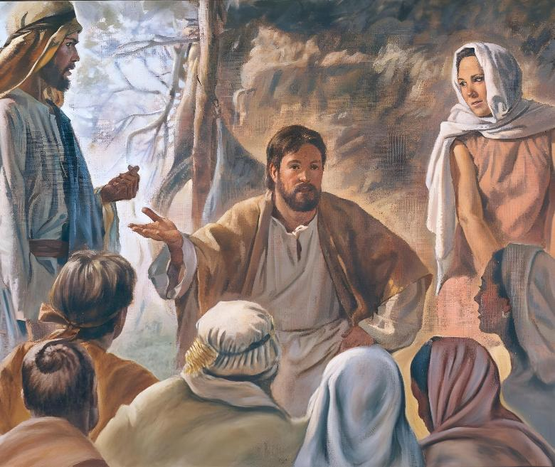
ENOCH

Slide 10

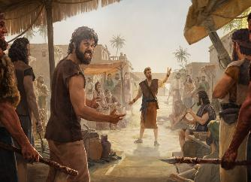
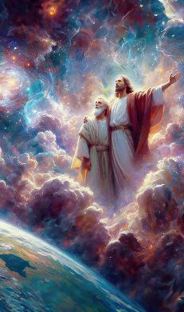
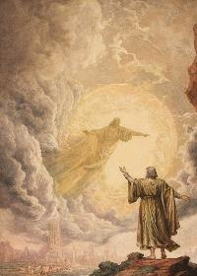
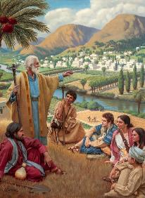
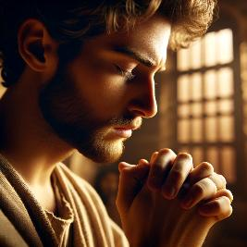
A LIFE OF PRAYER
“Enoch walked faithfully with God; then he was no more, because God took him away.” (Genesis 5:24)
Enoch lived in difficult times, when the wickedness of the antediluvians was increasing. With the birth of his son, his understanding of God expanded, and his communion with Him intensified (Gen. 5:21-24).
Prayer was an important factor in that relationship. The more intense and urgent his work became, the more constant and fervent his prayers were. At times, he would withdraw to secluded places to be more in communion with God. However, he always returned to the people to share his knowledge of God with them.
God hears us both in the hustle and bustle of daily life and in the quiet of retreat. There is no place on Earth where He cannot see and hear us. We can express our prayer with words (which helps us concentrate), or we can do so in silence (which helps us express our thoughts). The important thing is to never stop communicating with God in prayer.

Slide 11

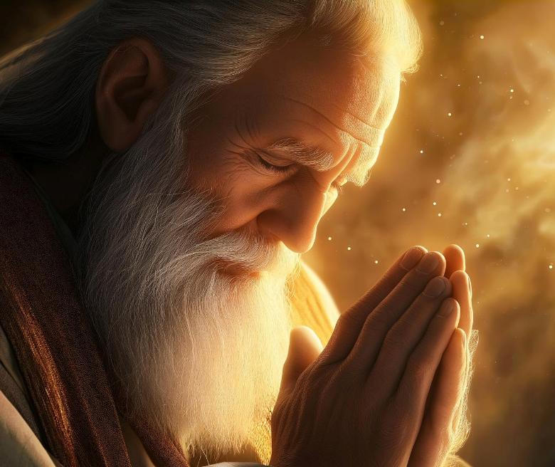
MOSES

Slide 12


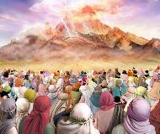
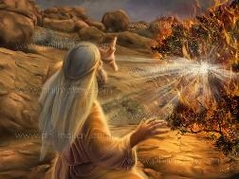
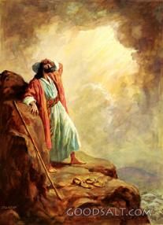
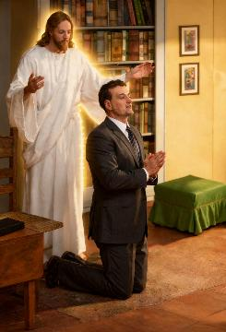
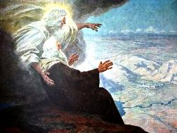
TALKING TO GOD
“Since then, no prophet has risen in Israel like Moses, whom the Lord knew face to face” (Deuteronomy 34:10)
Upon hearing God's voice speaking from Sinai, the people of Israel asked that He not speak to them directly again, because they feared to die because of His voice (Ex. 20:18-19).
This was not the case with Moses, who spoke with God face to face (Deut. 34:10). For 40 years (from the burning bush until his death), Moses and God had regular personal dialogues (Exod. 33:9-11).
The Bible records several forty-day periods during which God gave Moses specific instructions on building the tabernacle and communicated various laws to him. During these dialogues, Moses also interceded for the people.
We do not have the privilege of speaking to God face to face, but prayer fills that gap by allowing us to communicate directly with Him.

Slide 13

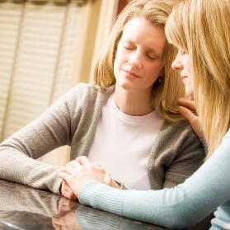

INTERCESSORY PRAYER
“And the Lord was angry enough with Aaron to destroy him, but at that time I prayed for Aaron too.” (Deuteronomy 9:20)
Intercessory prayer is that in which we pray on behalf of other people (James 5:16; Matthew 5:44; 1 Timothy 2:1-4).
Moses interceded with God for others on various occasions and for different reasons:
FOR THEIR FAMILY MEMBERS
⁕ Because of Aaron's sin
(Deut. 9:20)
⁕ Because of the murmuring of Mary
(Nm. 12:10-13)
FOR THE PEOPLE
⁕ When they were thirsty
(Ex. 15:24-25)
⁕ When they were hungry (Nm. 11:11-13)
⁕ When they sinned
(Ex. 32:30-32)
What motivated Moses to pray for others?
The same thing should motivate us: love for those we pray for.

Slide 14

“We should pray in the family circle, and above all we must not neglect secret prayer, for this is the life of the soul. It is impossible for the soul to flourish while prayer is neglected. Family or public prayer alone is not sufficient. In solitude let the soul be laid open to the inspecting eye of God. Secret prayer is to be heard only by the prayer-hearing God. No curious ear is to receive the burden of such petitions. In secret prayer the soul is free from surrounding influences, free from excitement. Calmly, yet fervently, will it reach out after God. Sweet and abiding will be the influence emanating from Him who seeth in secret, whose ear is open to hear the prayer arising from the heart.”
EGW (Steps to Christ, p. 98)

